Slide 1

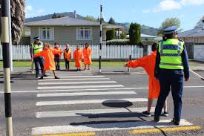



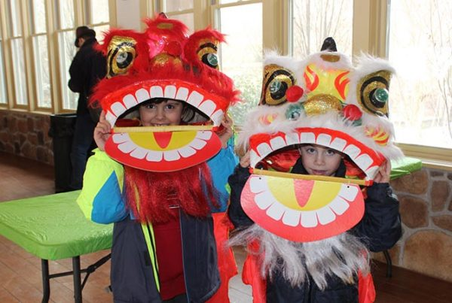

Start at my Feet
How do schools communicate with parents?:
A lot of the communicating happens at the school gate when children are getting drop off/ picked up. This is where parents normally say important messages, they want the teachers to know.
The school uses their school website/ for key information regarding the school. For example, if there's an inset day or own clothes day.
They also hand out term class newsletters which is done through either email or paper copy.
Parents evening - this is where teaches get to meet the parents. They can discuss any concerns on the child. They can also discuss what they will put in place to support the individual. Parents evening is a way to get to know the family and to start forming a relationship with them.
How do schools work with the local community?:
They collect food to donate to their local food Banks. To support their community.
Road safety – people from the local community come in to teach the children road safety.
Member of the local church comes into the school to do an assembly every week on the bible.
The school rent out their football field to local football groups and sport groups.
They also rent out their halls for dance groups and brownies.
School trips – they use local facilities for example local farms, churches, beaches and museums.
The school has after school clubs and breakfast clubs which Is run by people within the community, not the staff in the school.
The school tries to raise a lot of money for local charities, to support their community.
The school bring children to sing to local care home.
The school also has people from the community to come in a teach the children how to ride their bikes safely.
How does the school include the nature of the community?:
The school have themed days designated to children they have in their school who are from different ethnic backgrounds. They would dress up in specific clothes that represent certain cultures. They do this to make them feel included and to teach other children different traditions.
They also do themed topics on different religions, cultures and languages for each year group throughout the year where they do food tasting days, to teach then children what different foods countries and cultures eat. They will also then try including what they have learnt into their school plays. For example, including different languages, songs, clothes.
The displays on the walls are bilingual. There was a lot of Welsh displayed to help encourage children to speak Welsh.
The school also had agencies come into the school to help teach children who could not speak English.
To help parents with low income and are struggling, the school creates trolleys that include all necessary resources such as clothes which parents and people from the local community can come and use.
They also provide potty training within the school which is there to help parents who are struggling or do not have time to potty train their children may be due to workload.
The school will also help parents for example parents in deprived areas by washing the children’s uniform.
Forest schooling – this is where children get the opportunity to learn outdoor and to explore using different skills and materials.
How does the school work with parents?:
Google classroom is used for children to share their work with the teacher and the class. They can also show their careers at home piece of their own work. Which children enjoy doing.
Stay and play in the nursery. This is where children will come in the term before they are about to start with their parents/guardians. The teachers will get to know the parents and discuss any needs of the child. This is to help settle the children and familiarise the area with their parents.
Wellbeing support groups – where parents will come into the school and teachers will give them advice on how to support a children’s wellbeing and give them different strategies if they are struggling.
Open events – teachers show parents how they teach and give them tips for at home with their children. They will also do events where children will show parents/guardians pieces of their work that they have done.
The school set up a twitter page, they post photos and videos of the children. Which is a nice way for parents to see what their children are doing, as most children do not communicate to parents what they have done through the day.
Teachers will work with a career who has a child with additional learning needs helping them to get extra support. Teachers will also help with the process of getting the support that the child needs by refereeing them to different agencies that work with the school.
Health is a big way teachers work with career for example, if the child has diabetes, the teacher may have regular phone calls with the career to ensure that everything’s okay or if they have had a hypo. They will do daily records on how the child’s bloods are throughout the day to report back home. By having regular phone calls will put the parents mind at ease and ensure them that their child is being looked after.
They will record Christmas concerts for parents who are working and cannot attend.
They also ask parents to help on school trips or school fetes.

