Slide 1

Are Digital Skills Important for Study and Work?
Shahana Islam 2209436
Helen Begum 2220165
Danielle Richards 2226749
Digital Skills and Research Methods (LCHS4002_BIRM)
Neale Haddon

Slide 2
Which Digital Tool is Most Used by Students at UWTSD?
Introduction
The purpose of this presentation is to propose a research project on the most used digital tool by UWTSD students.
The presentation will include examples of existing research.
The types of research we may collate and how that information may be used.
The way data collected is sourced ethically and kept confidential.
The expectations of our findings.
Presented by Shahana Islam

Slide 3

Rationale https://www.netscribes.com/wp-content/uploads/2019/06/Technology-Watch.jpg
Before comprehending the most utilised digital tools, it is crucial to comprehend the significance of digital tools in learning.
To be able to use digital tools in education requires competence of managing various digital devices and software (Amhag et al., 2019)
According to Alexander et al.(2019), it was found that there were statistically significant improvements in examination marks compared to a previous cohort who did not have access to the Tecnology Enhanced Learning (TEL) resources. Thus, understanding the most utilised digital tools can provide clarity on these positive results.
It is important to gain an understanding of which digital tools will help students achieve the best outcomes in their studies.
There might be free digital tools with the basic features of expensive technologies that can deepen learning and allow students to meet course expectations (Mucundanyi, Woodley, 2021)
Presented by Danielle Richards

Slide 4
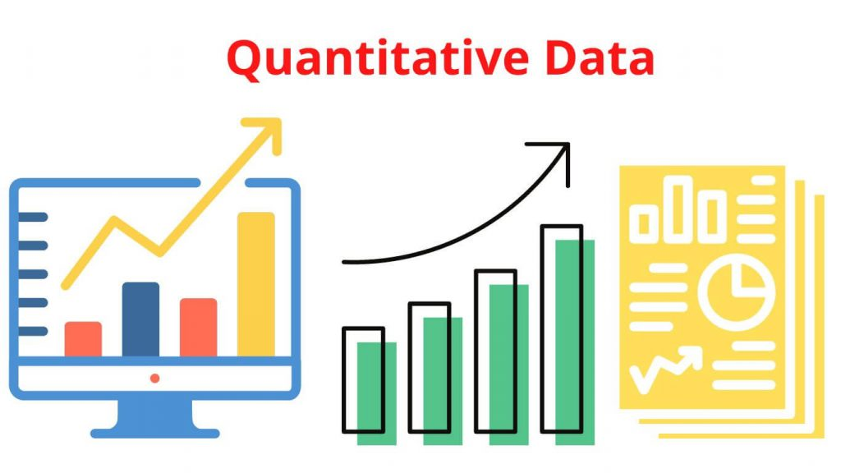
Method https://researchmethod.net/wp-content/uploads/2022/09/Quantitative_Data-1024x576.jpg
There are various methods in which we can collect data to aid in our research, however a quantitative approach would provide the most relevant information.
These will include, closed and Likert scale questions, this can provide easily quantifiable results for analysis. The participants in our study will include UWTSD students who will be emailed questionnaires to complete. We plan to include 100 subjects in our questionnaire. We expect to find variations in the results between age groups, gender and level of study, therefore we will include this as part of the questions asked. We will ask some of the following questions;
Male/Female/Nonbinary etc
Age range: 18-25, 26-35, 36-45, 46+
Do you use one digital tool more than others?
Which is your preferred digital tool for your studies?
Do you use a range of different digital tools to collaborate with your peers?
Presented by Helen Begum

Slide 5

The Four Principles of Ethical Management (mtdtraining.com)
There are many ethical considerations to think of when undertaking any research, first and foremost we consider to be voluntary participation of subjects.
It is rooted in the idea that involvement in research should have no detrimental effects on the participants, honour the individual’s fundamental rights, and respect relationships, bonds, and promises (Bos, 2020).
The need for confidentiality of participants is paramount and adherence to data protection laws apply. We will also provide anonymity to all participants. Presenting an accurate analysis of data curated from our research will be included.
Presented by Danielle Richards

Slide 6
Timeline
Identify a research question 03/02/23
Conduct a review of the relevant existing research
Plan a research method 10/02/23
Consider the ethics of our research, the methods we will use. Submit proposal
Present proposal for approval in our groups 24/02/23
Create a questionnaire 03/03/23
Collect data 10/03/23
Analyse and collate data 17/03/23
Produce report 24/03/23
Write up a full report, discuss and conclude findings individually
Presented by Shahana Islam

Slide 7

https://images.prismic.io/impactio-blog/c13edae1-73b2-4502-9b9e-60c3fc6d1384_Optimizing+an+Approach+to+Publishing+Research+Findings.png?auto=compress,format
Hypothesis
Our hypothesis is that moodle will be the most used digital tool amongst UWTSD students as this is what all students access every day, to see all their assignments, assignment briefs, presentations, etc. It is where work is delivered to us by our lecturers, for us to follow during lessons, it is also where we submit all our assignments and presentations.
We do however feel that there will be other tools that will feature heavily in our research, for instance the library. Multiple digital tools are used by students and people in everyday life, and although there may be one tool used more than others there will be most likely be an overlap where one compliments the other.
Presented by Helen Begum

Slide 8
Reference List
Alexander, P.M., M. Tedesco, L. Koenig, and X. Fettweis, (2019) : Evaluating a Regional climate Model Simulation of Greenland ice sheet Snow and firm Density for Improved Surface mass Balance Estimates. Geophys. Res. Lett., 46, no. 21, 12073-12082, doi:10.1029/2019GL084101.
Amhag, L., Hellström, L. and Stigmar, M., 2019. Teacher educators' use of digital tools and needs for digital competence in higher education. Journal of Digital Learning in Teacher Education, 35(4), pp.203-220.
Bos, J. (2020) Research ethics for students in the social sciences. First edition, 2020. Cham: Springer Nature. Available at: https://doi.org/10.1007/978-3-030-48415-6.
Mucundanyi, G., and Woodley, X., (2021).Exploring Free Digital Tools in Education, International Journal of Education and Development using Information and Communication Technology, Vol. 17 (2), pp. 96 -103

