Slide 1
Personnel of the Legal System
Objectives:
Identify some of the main groups of personnel in the English legal system
Identify the roles that these personnel perform

Slide 2
Personnel of the Legal System
Different institutions and personnel undertake a variety of roles that relate to the two main functions of the legal system:
Making the law
Enforcing and applying the law

Slide 3
Personnel of the Legal System
The Judiciary
Magistrates
Juries
Solicitors
Barristers
Notes:
Legal profession is studied later with a specific worksheet and lecture.

Slide 4
Judges
As a common law legal system, the judges of the ELS are selected from the legal profession (barristers and solicitors)
Only since the Courts Act 1971 have solicitors been able to be appointed as judges
Before the Courts and Legal Services Act 1990 solicitors could not be appointed to the High Court nor sit in the Court of Appeal or House of Lords
In civil law legal systems (e.g. found in France, Germany, Italy and Spain) judges form an entirely separate profession to that of lawyers
They are not recruited from the legal profession
Judges are civil servants and join the judiciary upon graduating from law school

Slide 5
Judges
Lord Judge speaking in 2008 states:
“To do right to all manner of people after the laws and usages of this realm without fear or favour, affection or ill-will”
“He or she must of course know the law, and know how to apply it, but the judge must also be wise to the ways of the world. The judge must have the ability to make decisions.”
Judges must have moral courage to make decisions that will be unpopular with the politicians and the media and the public.
Defend the right to equal treatment before the law”

Slide 6
Constitutional reform Act 2005
Changes to to the role of the Lord Chancellor
No longer head of the judiciary that is now the Lord Chief Justice
Still responsible for the operation of the courts system
Member of the cabinet
Can be appointed from either house.
Independence of the judiciary S23 established the Supreme court

Slide 7
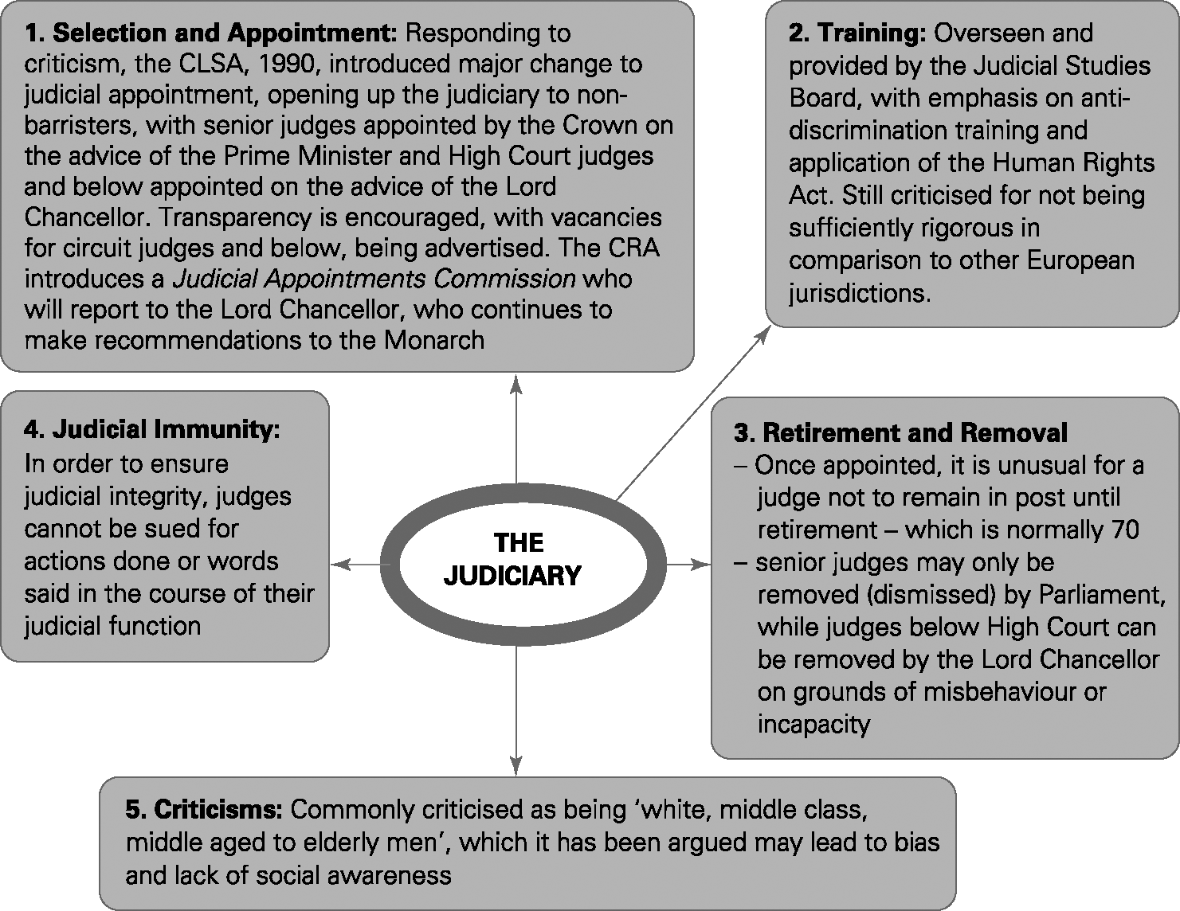
Judges

Slide 8
Lay Decision Makers
Common law legal system is a lay-model
A major role for non-legally qualified (lay) decision makers:
  Juries
  Magistrates
‘Popular’ model of justice
Contrast civil law legal systems found in continental Europe – ‘professional’ model of justice

Slide 9
Magistrates
‘There is no requirement for lay magistrates to have any legal qualifications’
18-65 on appointment, retire at 70
Six key personal qualities
  Good character, understanding and communication, social awareness, maturity and sound temperament, sound judgement and commitment and reliability.
Live within the area
Recruited and selected by a network of 47 local advisory committees
Appointed by the Lord Chief Justice
21,500 lay magistrates

Slide 10
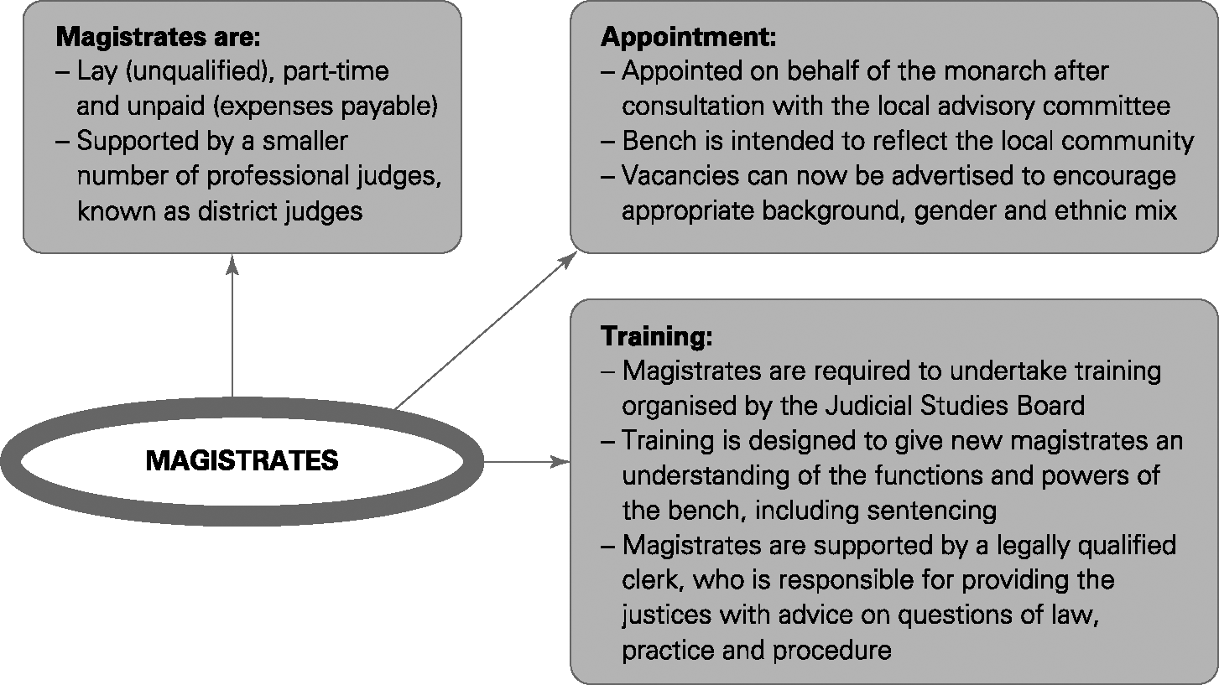
Magistrates

Slide 11
Role and selection of Juries
Role of Jury
Crown Court
Decide guilt or innocence in serious criminal offences
Strict rules about the independence of the jury in reaching its decision – see p.288 S&K
Only 3% of criminal cases go to Crown Court
Only 1/3 of those result in jury trial
Other Courts

Slide 12
Role and selection of Juries
S1 Juries Act 1974
Selection - system of random selection
Jury will be a cross section of society
18-75
Be on the electoral role
Have lived in the UK for at least 5 years
Challenge for cause
‘Stand by for the Crown’
Amendments by the Criminal Justice Act 2003
Discretionary excusal
Vetting for exceptional cases
Trial without Jury S44 CJA2003

Slide 13
Legal Professional
Profession | Presentative Body | Regulatory Body
Solicitors | Law Society | Solicitors Regulation authority (SRA)
Barristers | Bar council | Bar standards Board (BSB)
Legal executives | Chartered Institute of Legal Executives (CILEx) | ILEX Professional standards
Licensed Conveyancers | Council of Licensed Conveyancers
Patent attorneys | Chartered Institute of Patent Attorneys (CIPA) | Intellectual Property Regulations Board (IPReg)
Trade Mark attorneys | Institute of Trade Mark attorneys (ITMA)
Law costs and Draftsmen | Association of Cost Lawyers | Cost Lawyers Standards Board
Notaries | Master of the Faculties

Slide 14
Sentencing
Both judges and magistrates need to decide what the purpose of the sentence is, what is it trying to achieve?
Criminal Justice Act 2003 S 142/ Criminal Justice and Immigration Act 2008 :
  a. Punishment of the offenders
  b. reduction of crime
  c. reform and rehabilitation of offenders
  d. Protection of the public
  e. reparation of the offenders to the persons affected by their offences.

Slide 15
Sentencing Guidelines council has responsibility to produce guidelines for sentencing
https://www.sentencingcouncil.org.uk/
https://www.sentencingcouncil.org.uk/offences/magistrates-court/item/assault-occasioning-actual-bodily-harm-racially-religiously-aggravated-abh/

