Slide 1
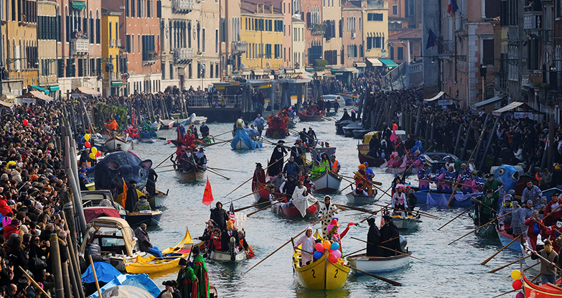
Is this VENICELAND ?!

Slide 2
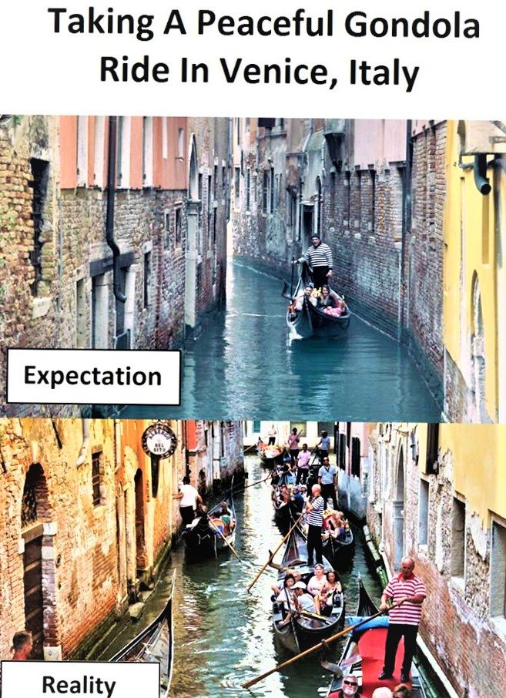
WHAT IS REALLY HAPPENING IN VENICE ?
https://www.youtube.com/watch?v=TGqVG6QUTKQ

Slide 3
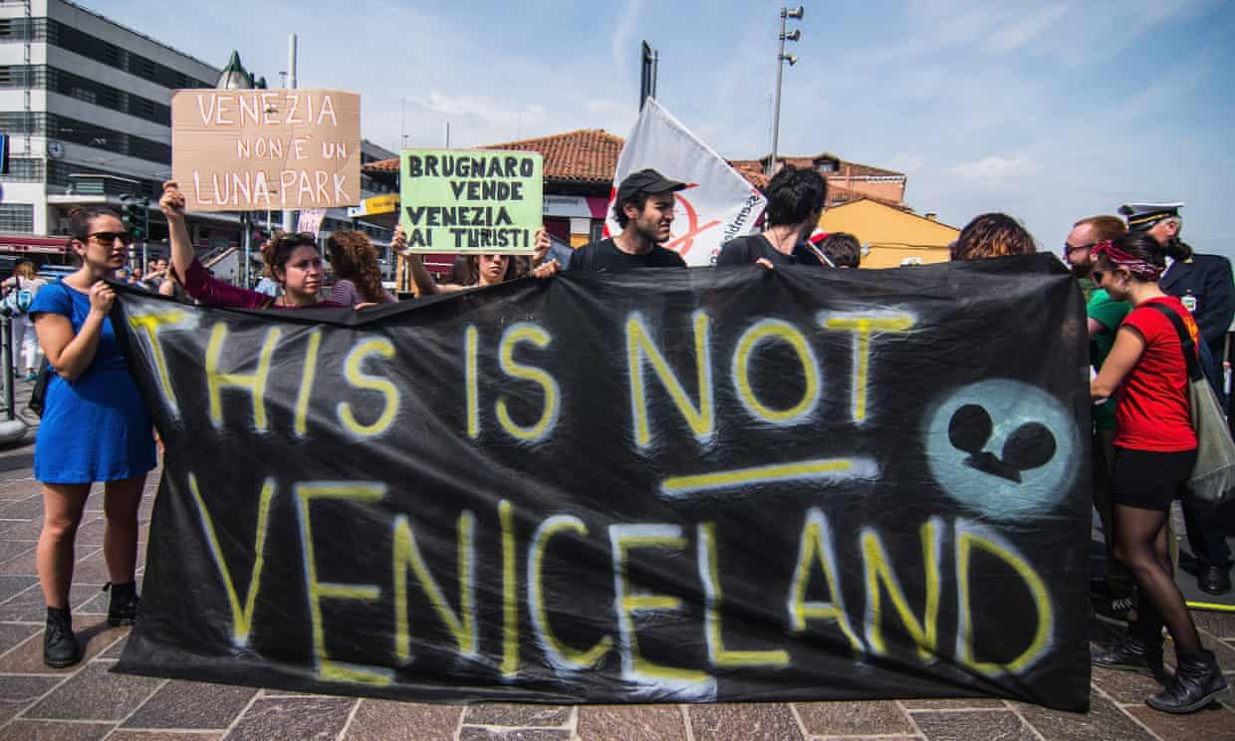
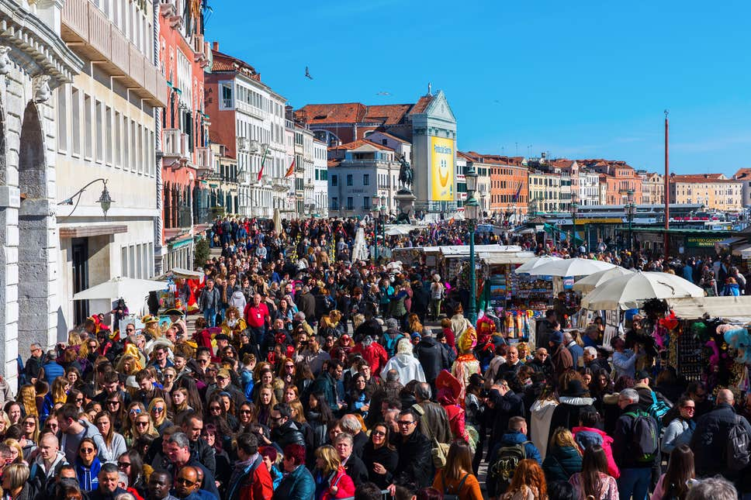
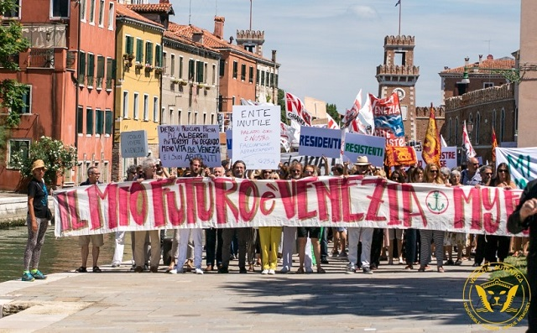
What is the aim of the documentary ?
Raise awareness of the situation in Venice
Flood of tourists, destroying the historic city centre
(Dickinson, 2018).
Community and residents issues, tourists economy
pushes local people out (Dickinson, 2018).
Protests and hazard of cruise ships (BBC, 2019).

Slide 4
statistics
(Peeters et al.,2018,p.233)

Slide 5
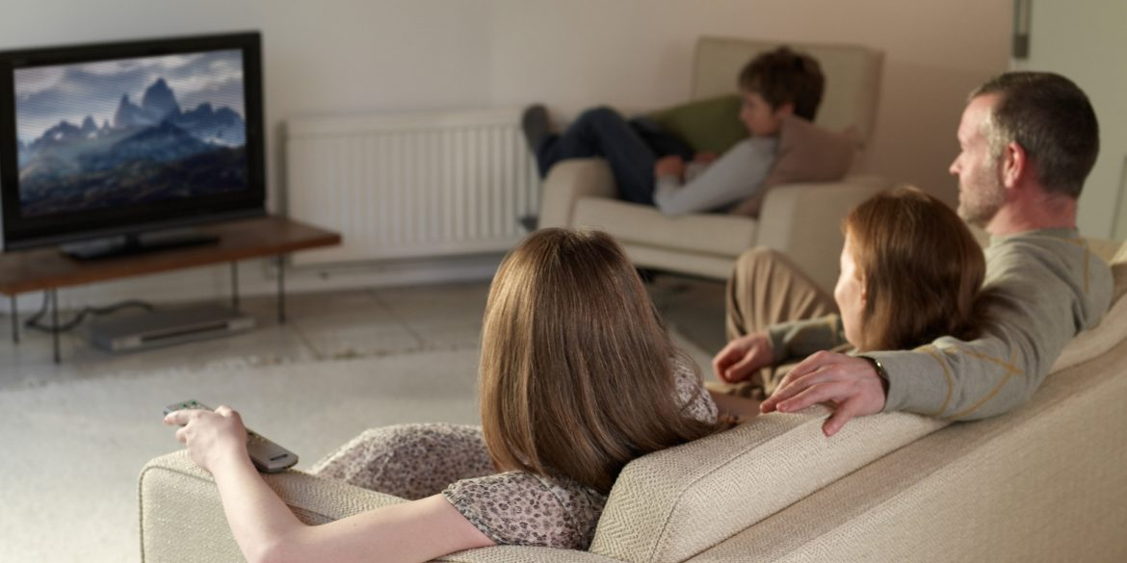

who is the target audience?
Potential tourists to Venice from the UK
Families
Couples
15 million visitors annual visitors (Travel Moments, 2018).
3 million visitors from British in Italy (Government Licence, 2019).

Slide 6

BBC ONE- Panorama , Wednesday night at 8:00 p.m
Plan to show documentary

Slide 7

Research plan
Methodology
Qualitative primary research -Interview, researcher campaigners
Questionnaire –Previous tourists
Secondary – YouTube, new reports on the television, journal articles and internet
Quantitative –Statistics example:- visitor numbers

Slide 8
References
Al Jazeera English (2017) Anti-tourism sentiment grows in overcrowded Venice, Available at: https://www.youtube.com/watch?v=TGqVG6QUTKQ (Accessed: 14th November 2019).
BBC (2019) Panorama, Available at: https://www.bbc.co.uk/programmes/b006t14n (Accessed: 14th November 2019).
BBC (2019) Venice protesters call for ban on large vessels after crash, Available at: https://www.bbc.co.uk/news/world-europe-48568396 (Accessed: 14th November 2019).
Brunton, J. (2018) Venice poised to segregate tourists as city braces itself for May Day 'invasion', Available at: https://www.theguardian.com/travel/2018/may/01/venice-to-segregate-tourists-in-may-day-overcrowding (Accessed: 14th November 2019).
Busy (2019) Expectation vs Reality , Available at: https://busy.org/@alamin0263/expectation-vs-reality-02-venice-italy (Accessed: 14th November 2019).
Coffey, H. (2017) The most overcrowded tourist destinations , Available at: https://www.independent.co.uk/travel/news-and-advice/most-overcrowded-tourist-destinations-amsterdam-rome-venice-warsaw-dubrovnik-a8108096.html (Accessed: 14th November 2019).
Dickinson, G. (2018) Has tourism killed Venice? We visited during the busiest month of the year to find out, Available at: https://www.telegraph.co.uk/travel/destinations/europe/italy/veneto/venice/articles/venice-tourism-crowds/ (Accessed: 14th November 2019).
Edwards, C. (2017) Venice residents protest against tourist influx, Available at: https://www.thelocal.it/20170703/venice-residents-protest-against-tourist-influx-mass-tourism-mi-no-vado-via (Accessed: 14th November 2019).
Hastings, K. (2017) The Benefits of Watching TV as a Family, Available at: https://www.gildshire.com/benefits-watching-tv-family/ (Accessed: 14th November 2019).
Immediate Media Company Ltd (2019) Panorama , Available at: https://www.radiotimes.com/tv-programme/5w4/panorama/ (Accessed: 14th November 2019).
Market research man (2019) An Overview of Market Research Methods, Available at: https://www.mymarketresearchmethods.com/an-overview-of-market-research-methods/ (Accessed: 14th November 2019).
McCaffrey, M. (2018) The Neighboring Islands of Venice, Available at: https://www.bellavitatravels.com/blog/the-neighboring-islands-of-venice (Accessed: 14th November 2019).
Open Goverment Licence (2019) Foreign travel advice Italy , Available at: https://www.gov.uk/foreign-travel-advice/italy (Accessed: 14th November 2019).
Peeters, P., Gössling, S., Klijs, J., Milano, C., Novelli, M., Dijkmans, C., Eijgelaar, E., Hartman, S., Heslinga, J., Isaac, R., Mitas, O., Moretti, S., Nawijn, J., Papp, B. and Postma, A. (2018) Research for TRAN Committee - Overtourism: impact and possible policy responses, Brussels: European Parliament, Policy Department for Structural and Cohesion Policies.
Pike, J. (2019) CINEMA ALTERNATIVE VALENTINES FILMS, Available at: https://www.oxmag.co.uk/articles/cinema-alternative-valentines-films/ (Accessed: 14th November 2019).
Travel Moments (2018) 11 Tips for a Romantic Weekend in Venice, Available at: https://www.opodo.co.uk/blog/romantic-weekend-venice/ (Accessed: 14th November 2019).
Veel, R. (2018) How we avoid the crowds in Venice, Available at: https://academytravel.com.au/blog/avoid-crowdsin-venice/ (Accessed: 14th November 2019).

Slide 9
Thank You for your attention
Presented by Roksana szymanska

