Slide 1
SJS15018 Individuals and Groups – Suzanne Nobile 1703368
‘In the 21st Century, the rise of social media means that one’s sense of ‘self’ is now more unstable than ever’.

Slide 2
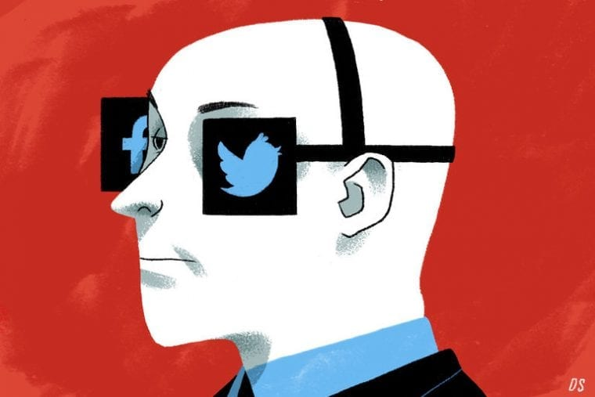
Are we looking through the eyes of Social Media?
(Swaddle, 2017).

Slide 3
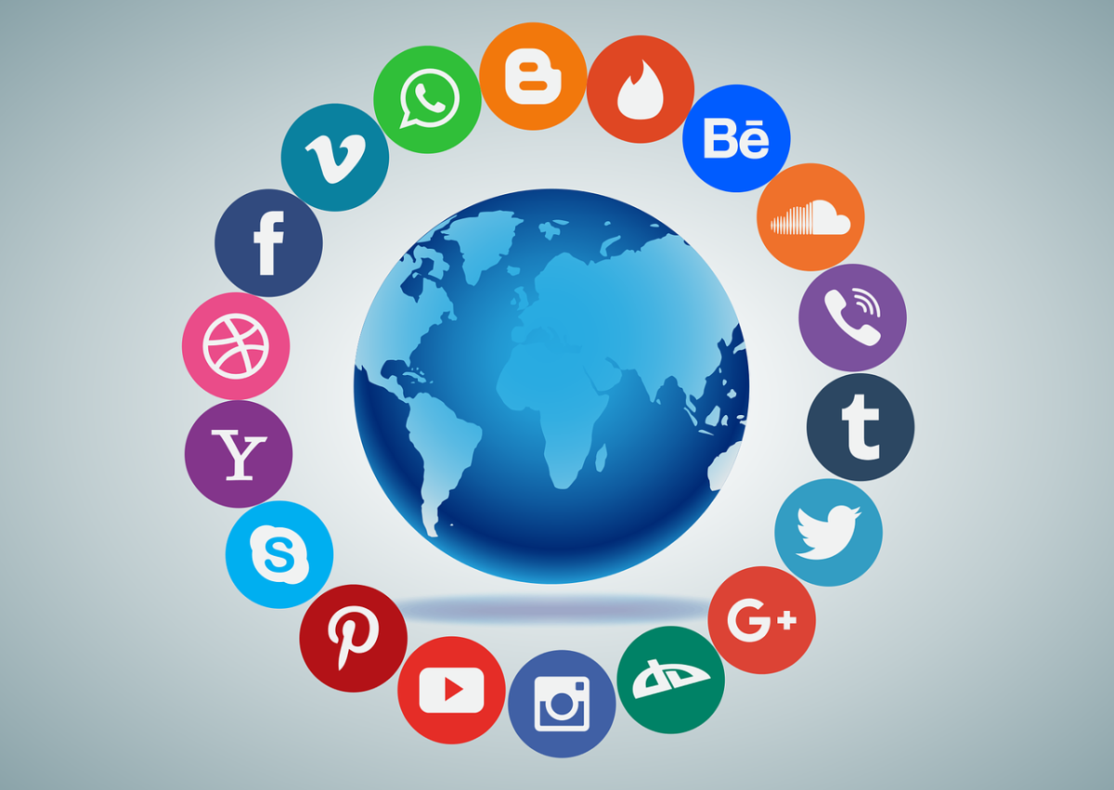
What is Social Media?
Websites and computer programs that allow people to communicate and share information on the internet using a computer or mobile phone.
(Cambridge Business English Dictionary, 2011).
(Phoenix Editorial Board, 2017)

Slide 4
Identity Control Theory – P. Burke 1991
‘Identity control theory explains the nature of identities, and how people develop, maintain, and change the multiple identities. It defines different types of identities, the process of identity verification through which these identities are maintained or changed, as well as the consequences of the verification process for the individual and for society’ (Burke, 2007).
This theory focuses on how you change your ‘self’ according to other peoples perception of your ‘ identity’.
Self verification is associated with positive emotion, therefore, failure to receive that confirmation results in negative emotions.
Seeking self verification from significant others such as friends and family has the biggest impact.
Often there is a discrepancy between ones true identity and ones perceived identity.
(Crawford and Novak, 2018).

Slide 5
The Argument

Slide 6
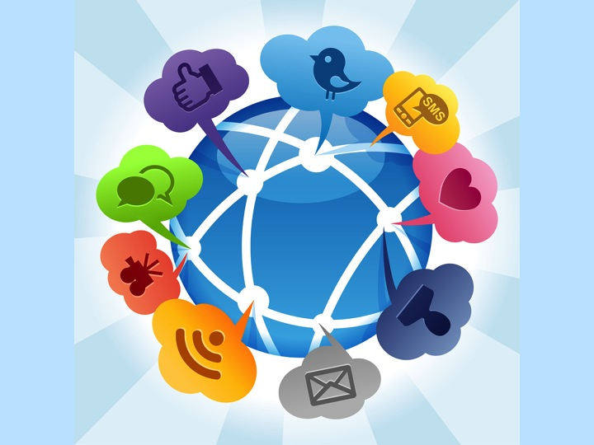

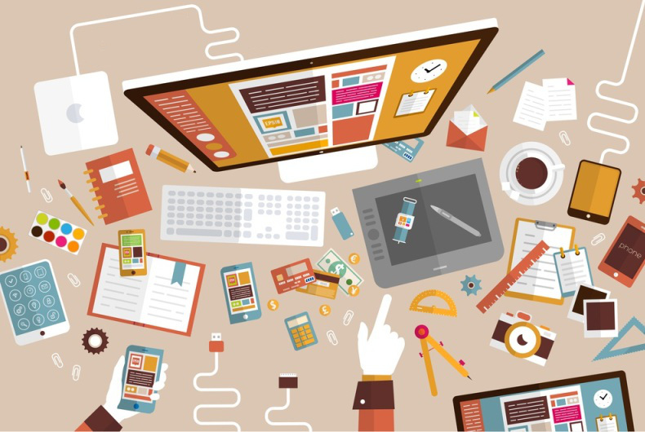
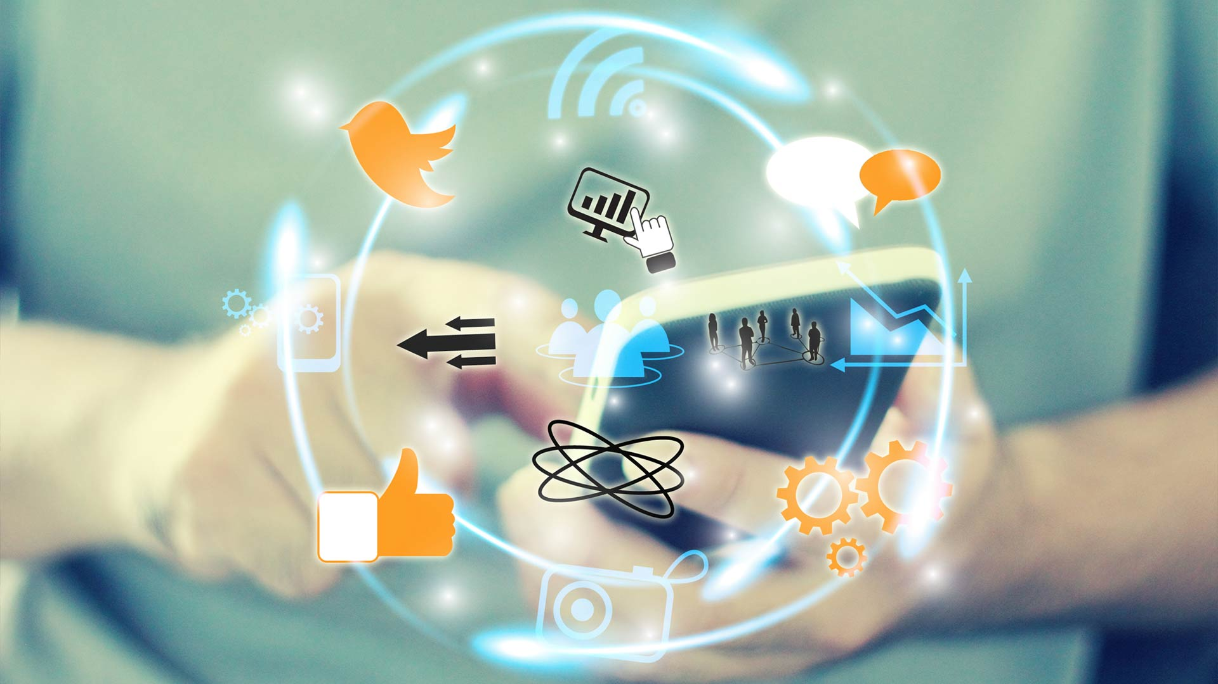
Develops Social Awareness
Teaching and Learning
(United Nations, no date).
POSITIVE INDICATORS
(ShaddowNet, 2018).
Business/Promotional Platform
Efficient Communication
(Business Promotions, no date).
(ShaddowNet, 2018).

Slide 7
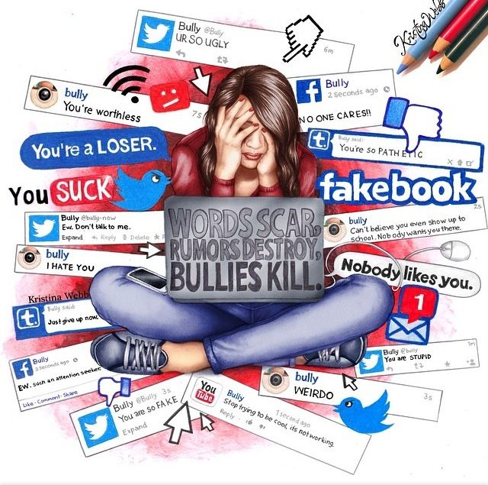
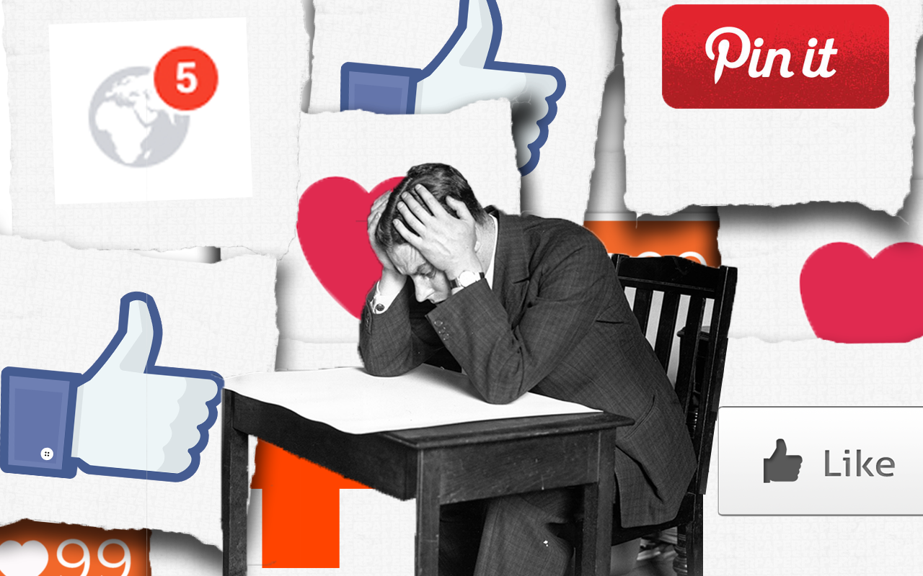
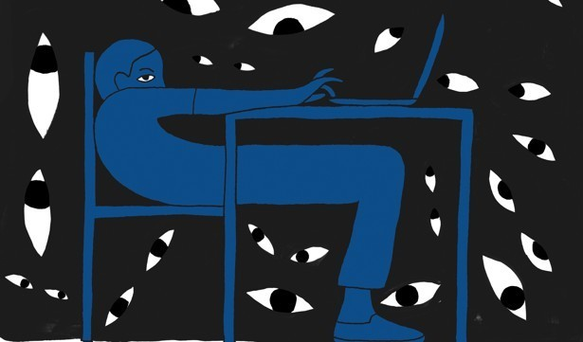
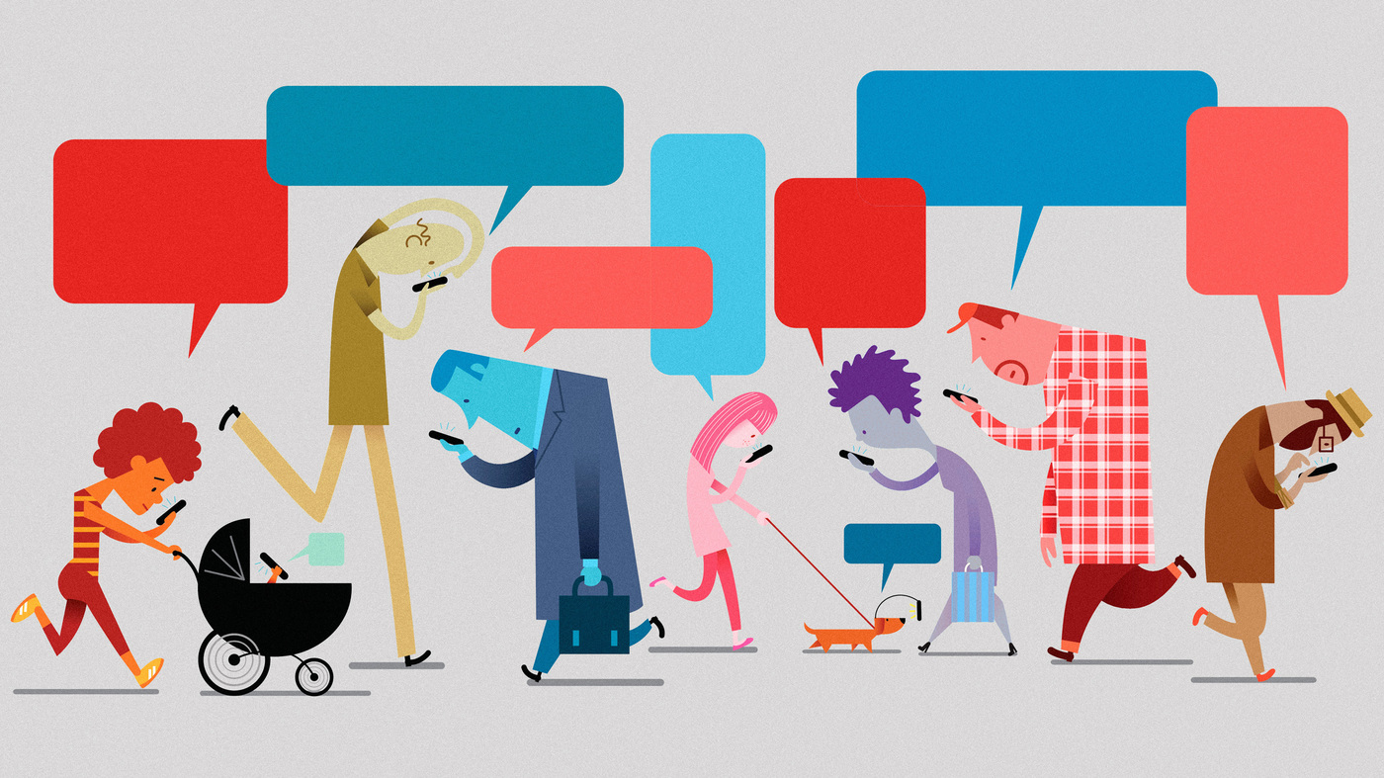
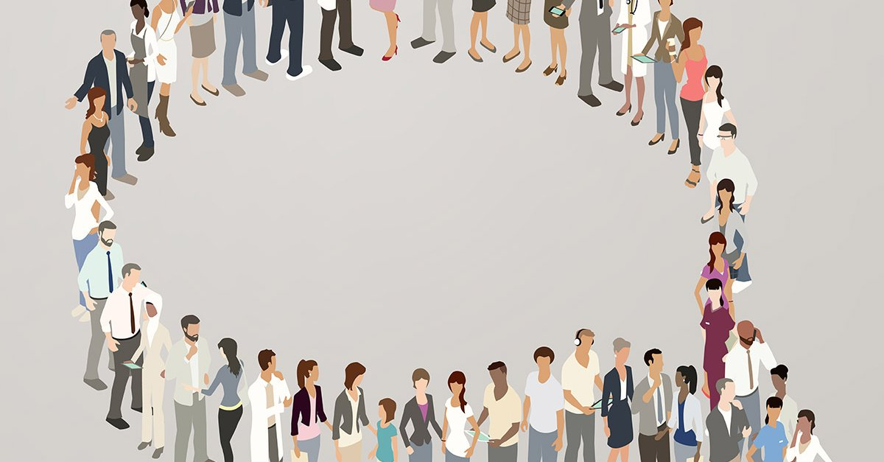
Increases Anxiety and Depression
Cyber Bullying
Prevents Independent Thinking
(ShaddowNet, 2018).
(ShaddowNet, 2018).
Reduces Productivity
(ShaddowNet, 2018).
Lack of Privacy
NEGATIVE INDICATORS
(ShaddowNet, 2018).
(Passionbrand, 2017).

Slide 8
References
Bitchmedia, (2017) Pressure Makes Perfect [Online]. Available at: https://www.bitchmedia.org/article/happiness-effect-review-donna-freitas (Accessed: 22 December 2019).
Cambridge Business English Dictionary, (2011) Social Media. Cambridge: Cambridge University Press, pp. 789.
L.A. Crawford & K.B.Novak (2018) Individuals and Society: Sociological Social Psychology 2nd edn. New York: Routledge, pp.277.
Loyola Phoenix (2017) Social Media Requires Personality, Moderation [Online]. Available at http://loyolaphoenix.com/2017/08/social-media-requires-personality-moderation/ (Accessed: 3 January 2020).
P. Burke, (2007) Identity Control Theory [Online]. Available at: https://onlinelibrary.wiley.com/doi/10.1002/9781405165518.wbeosi002.pub2 (Accessed: 3 January 2020).
Passionbrand, 2017 In the Stars [Online]. Available at: https://www.passionbrand.com/column/in-the-stars/ (Accessed: 3 January 2020). (Threat to Privacy picture).

Slide 9
Practice Promotions (no date) Practice Newsletter Content Strategies [Online]. Available at: https://practicepromotions.net/practice-marketing/practice-newsletter-content-strategies/ (Accessed: 3 January 2020). (Business/Promotion Platform picture).
ShadowNet (2018) 5 Negative and 5 Positive Effects of Social Media on Youth [Online]. Available at: https://shadownetmc.com/5-negative-and-5-positive-effects-of-social-media-on-youth/ (Accessed: 3 January 2020). (Creates Anxiety and Depression picture), (Cyber Bullying Picture), (Reduces productivity picture), (Prevents Independent thinking picture), (Efficiency of Time picture) and (Teaching and Learning Picture).
Slideplayer, (2019) Self Construals https://slideplayer.com/slide/4714959/ [Online]. Available at: (Accessed: 23rd December 2019).
Swaddle, (2017) First World Problems, FWP: Love, or Social Media Censorship [Online]. Available at: https://theswaddle.com/first-world-problems-signs-of-controlling-behaviour/ (Accessed: 22 December 2019).
United Nations (no date) Shaping Our Future Together [Online]. Available at: https://www.un.org/en/sections/news-and-media/index.html (Accessed: 3 January 2020). (Develops Social Awareness picture).

