Slide 1
Module Code ACCC5003
Module Name: Network Operating Systems and Security
Lesson 5-Week-5
Topic DNS and Network Infrastructure

Slide 2
Topic
Content
DNS in Network Infrastructure
Learning Objectives:
Structure of DNS and types
Top level domains and subdomains
Global Distribution and scalability

Slide 3
Importance of Naming
Addresses are used to locate objects
Names are easier to remember than numbers
You would like to get to the address or other objects using a name
DNS provides a mapping from names to resources of several types

Slide 4
Domain Name
Domain name is a way to identify and locate computers connected to internet
No two organizations can have same domain name
A domain name always consists of two or more components separated by
periods called dots (.)
EXAMPLE: www.yahoo.co.in, www.facebook.com etc.
Once a domain has been established subdomains can be created within the domain
EXAMPLE: The domain for the large company could be “Vni.com” and within this domain subdomains can be created for each of the company’s regional office.
Eg: Bombay.vni.com

Slide 5

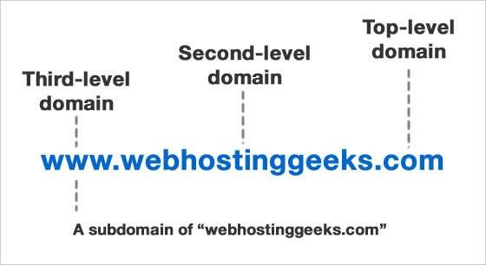
Structure of DNS
Last name. subdomain. second-level domain. top-level domain
EXAMPLE: vijay.Bombay.vni.com

Slide 6
Top level domains
Top level domains are classified into 3 categories:
Organizational or generic domains
Geographical or country domains
Reverse domains

Slide 7
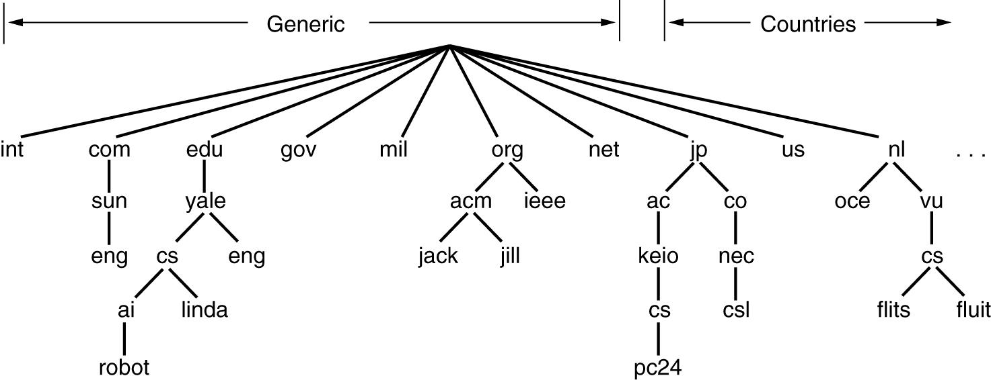
Types of Domains
It consists of three character code which indicates the primary function of the organization or their generic behavior
Most commonly used top level domains are:

Slide 8
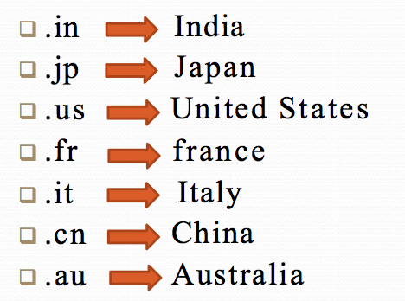
Country Domains
It consists of two characters which represents different countries/regions all around the world
These codes have been standardized by International Standard Organizational (ISO)

Slide 9
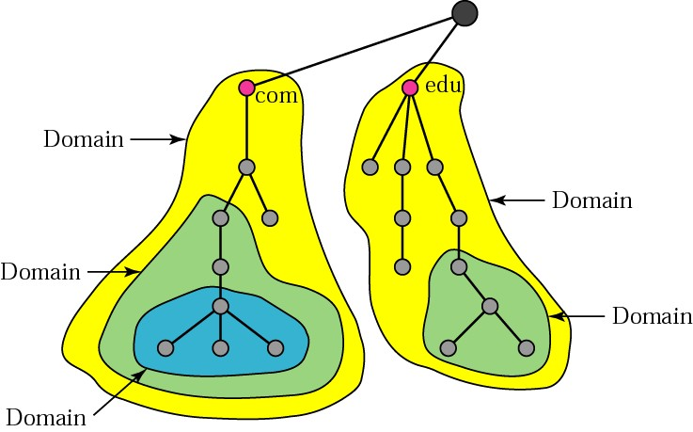
Sub domains
Domain is a sub tree of domain name space
Root node is empty
Domain is divided into sub-domains
Domain name is the domain name of the node at the top of the sub tree

Slide 10
DNS
Each domain name has a corresponding IP address
When the user types the domain name in the address bar, the corresponding IP address is supplied. Such a translation is possible with the help of system called DNS (DOMAIN NAME SYSTEM)
DEFINITION:
“DOMAIN NAME SYSTEM is a collection of the databases that contain information about domain names and their
corresponding IP address.”

Slide 11
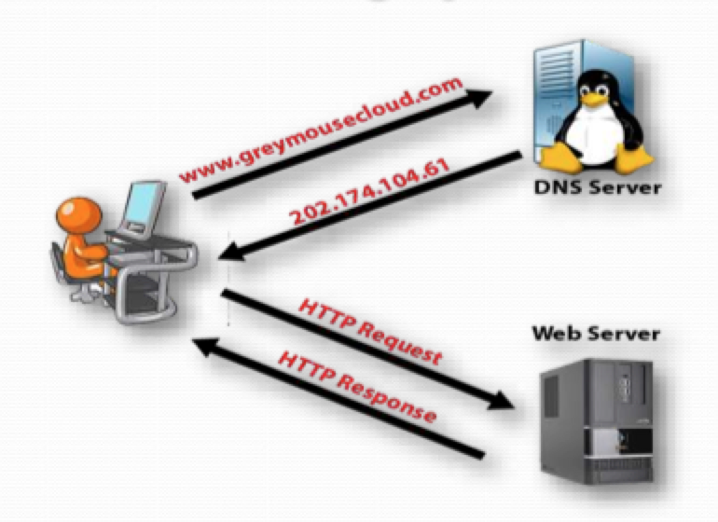
DNS

Slide 12
DNS
When an application program needs to communicate with other computer, it needs to translate the name and the other computer into its IP address. The applications program that requests the service then becomes the client of DNS.
It then sends the request to DNS server. The server looks up the name and then returns correct IP address.
A large number of DNS servers may be involved to get the right IP address. After receiving the correct IP address, the communication between two computers starts.

Slide 13
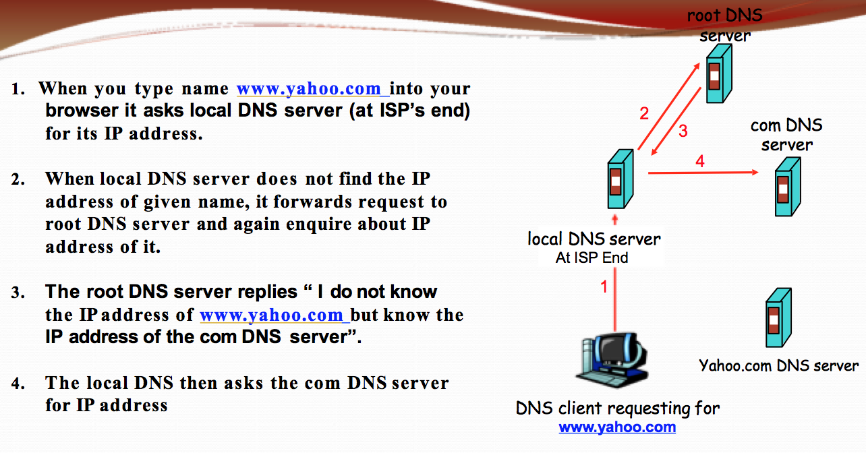
DNS Example

Slide 14
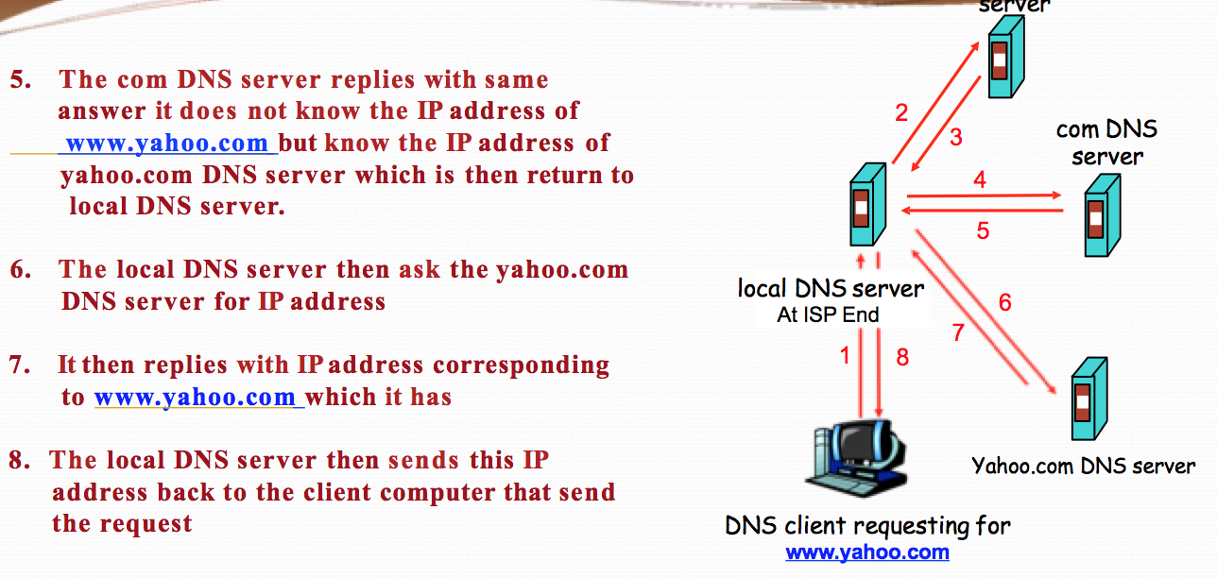
DNS Example

Slide 15
Global Distribution
Data is maintained locally, but retrievable globally
No single computer has all DNS data
DNS lookups can be performed by any device
Remote DNS data is locally catchable to improve performance

Slide 16
Scalability
No limit to the size of the database
One server has over 20,000,000 names
No limit to the number of queries
24,000 queries per second handled easily
Queries distributed among masters, slaves, and caches

Slide 17
Dynamicity
Database can be updated dynamically
  Add/delete/modify of any record
Modification of the master database triggers replication
  Only master can be dynamically updated
Creates a single point of failure

Slide 18
Reliability
Data is replicated
  Data from master is copied to multiple slaves
Clients can query
  Master server
  Any of the copies at slave servers
Clients will typically query local caches
DNS protocols can use either UDP or TCP
  If UDP, DNS protocol handles retransmission, sequencing, etc.

Slide 19
Loose Coherency
The database is always internally consistent
  Each version of a subset of the database (a zone) has a serial number
The serial number is incremented on each database change
Changes to the master copy of the database are replicated according to timing set by the zone administrator
Cached data expires according to timeout set by zone administrator

Slide 20
References
Orin Thomas(2019), Windows Server 2019,Inside Out. Available at https://learning.oreilly.com/home/
Jordan Krause,(2019),Mastering Windows Server 2019: The complete guide for IT professionals to install and manage Windows Server 2019 and deploy new capabilities, 2nd Edition.2019
(E-Book) Paul Cobbaut, Linux Fundamentals
http://linux-training.be/linuxfun.pdf
Andrew S Tanenbaum, David J. Wetherall ( 2013) Computer Networks, Pearson
https://docs.microsoft.com/en-us/windows-server/networking/technologies/dhcp/dhcp-top

