Slide 1
Module Name : Electronics I
Module Code : ACDB5002
Topic : Ultra Sonic Sensor
Lecture : 17
Lecture By,
Mrs. Jenifer Prince Devaraj,
Lecturer - Embedded Electronics,
Faculty of Applied Computing,
UWTSD
Email:j.prince-devaraj@uwtsd.ac.uk

Slide 2
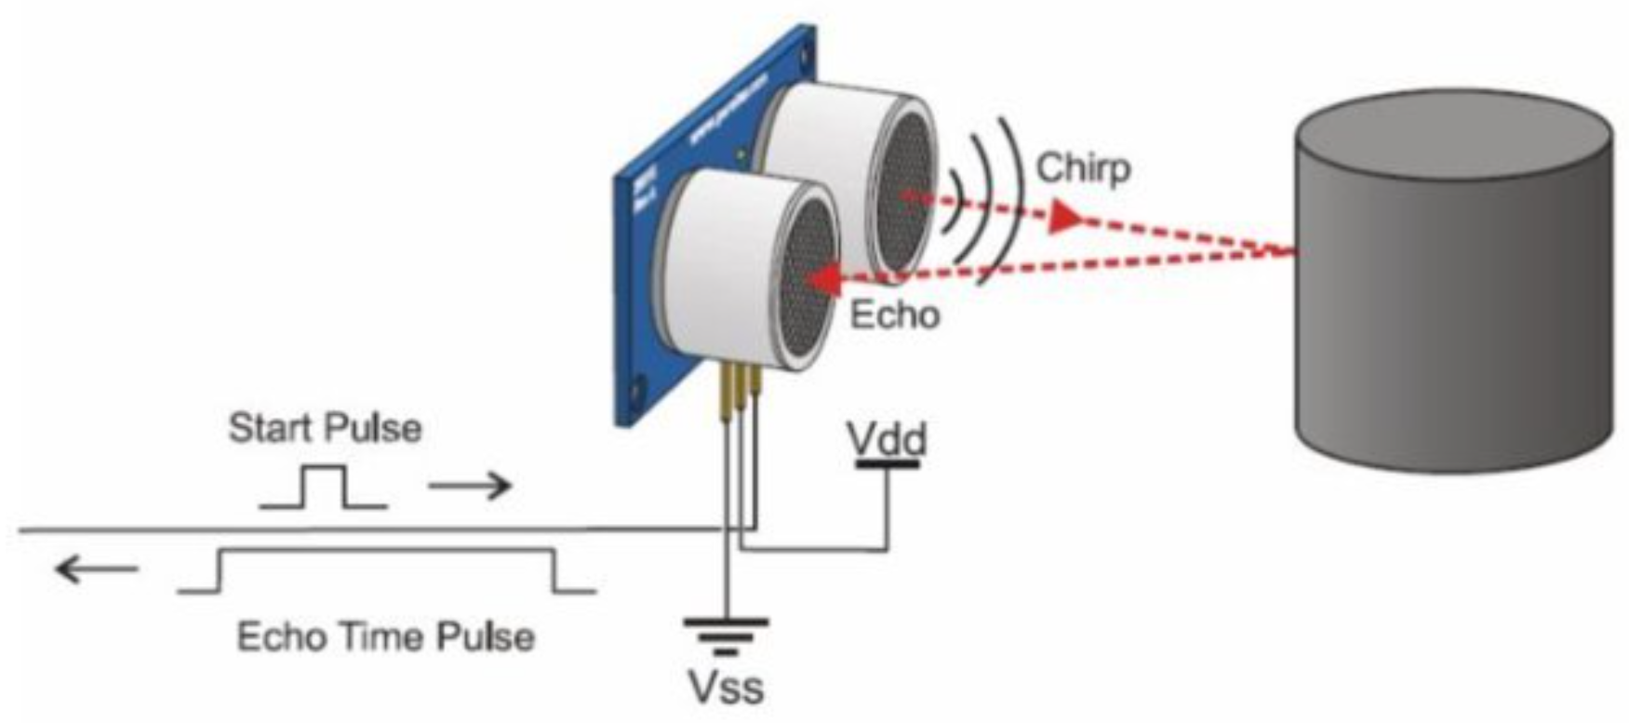
Ultrasonic Sensors
Ultrasonic Sensor
Ultrasonic sensors measure distance using high-frequency sound waves (ultrasound) beyond human hearing.
The sensor emits an ultrasonic pulse and listens for the returning echo.
The time between sending the pulse and receiving the echo is used to calculate the object’s distance.
UWTSD Lectures / ACDB5002 – Electronics 1
Notes:
Ultrasonic sensors measure distance using high-frequency sound waves (ultrasound) beyond human hearing.
They work by emitting an ultrasonic pulse, then waiting for its echo to return. The time taken gives the distance to the object.
Non-contact measurement so that it avoids damage or wear.
Works regardless of object colour, transparency, or ambient light.

Slide 3
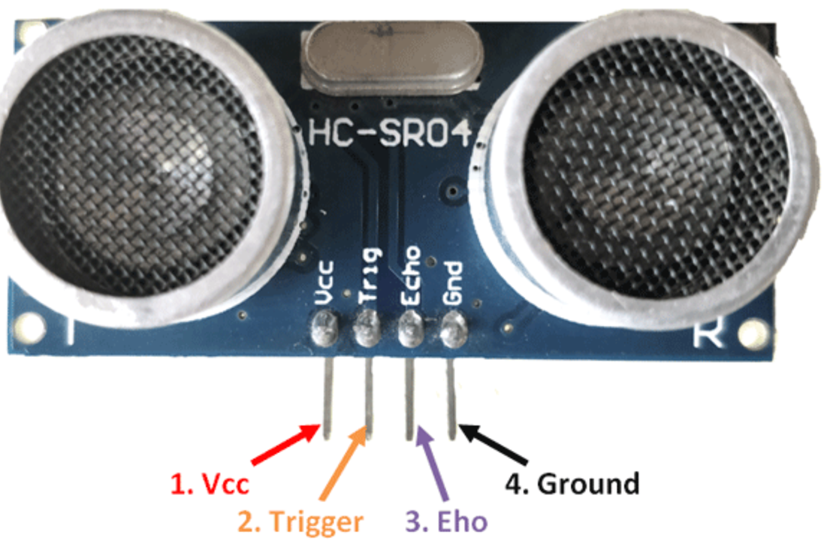
HC-SR04
Ultrasonic Sensor
Commonly used ultrasonic module for industrial projects.
Typical specs: Measuring range from a few cm up to several meters.
Pins / Connectivity:
  VCC — 5V supply
  GND — Ground
  TRIG — Trigger input (to start measurement)
  ECHO — Echo output (returns pulse whose width = time-of-flight)
UWTSD Lectures / ACDB5002 – Electronics 1

Slide 4
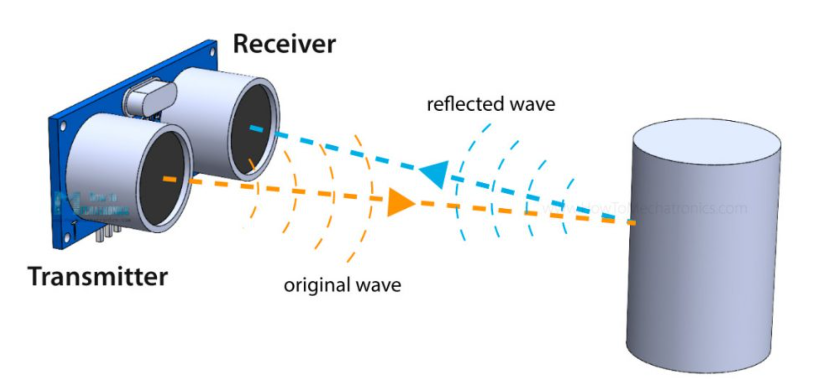
HC-SR04- Working
Ultrasonic Sensor
MCU sends a 10 µs HIGH pulse on TRIG
  → sensor emits an 8-cycle burst of ultrasound at ~ 40 kHz.
Sound travels through air, hits an object, and reflects back.
Sensor sets ECHO pin HIGH immediately after the burst; when echo returns, ECHO goes LOW.
UWTSD Lectures / ACDB5002 – Electronics 1

Slide 5
HC-SR04- Working
Ultrasonic Sensor
The duration ECHO stayed HIGH = round-trip time of sound.
Because the sound travels to the object and back, the /2 divides the round trip.
Distance is calculated using formula:
Distance = (Time of Flight × Speed of Sound) / 2
UWTSD Lectures / ACDB5002 – Electronics 1

Slide 6
HC-SR04- Applications
Ultrasonic Sensor
Widely used in conveyor and automation systems
Common for tank/level measurement applications
Essential in robotics for obstacle sensing
Used in parking systems and distance/obstacle alerts
UWTSD Lectures / ACDB5002 – Electronics 1
Notes:
Works in dark, dusty, smoky, or low-light environments — optical sensors often fail there.
Does not depend on object colour, transparency or material (unless the surface is soft/absorbing).
Reliable for non-contact detection, conveyor systems, level measurement, robotics, parking/obstacle detection, etc.

Slide 7
Advantages of Ultrasonic Sensing
Ultrasonic Sensor
Reliable non-contact distance measurement
Works with a wide range of surfaces and materials
Simple, cost-effective, and easy to integrate
Provides consistent and accurate readings
UWTSD Lectures / ACDB5002 – Electronics 1

Slide 8
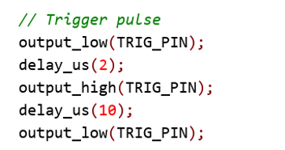
Ultrasonic Trigger Pulse Generation
Ultrasonic Sensor
UWTSD Lectures / ACDB5002 – Electronics 1
Notes:
output_low(TRIG_PIN);
Ensures the TRIG line begins at LOW to stabilize the sensor.
delay_us(2);
Wait 2 µs for clean signal edges.
output_high(TRIG_PIN);
Starts the trigger pulse.
delay_us(10);
Keeps TRIG HIGH for 10 microseconds, which is the required input for HC-SR04 to emit an 8-cycle 40 kHz ultrasonic burst.
output_low(TRIG_PIN);
Ends the trigger pulse.
Sensor now sends sound waves and waits for the echo.

Slide 9
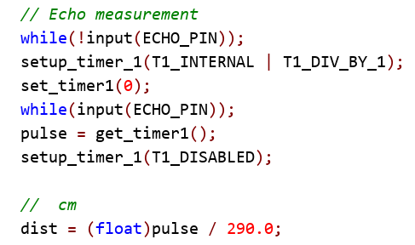
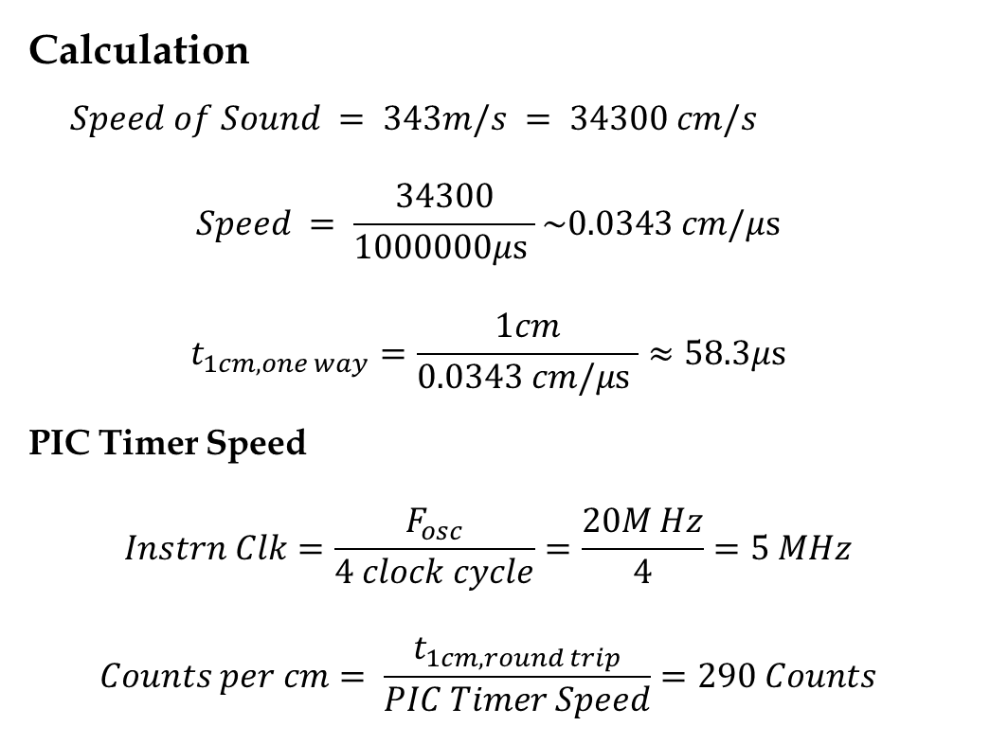
Echo Pulse Measurement Using Timer1
Ultrasonic Sensor
Calculation
$Speed of Sound = 343m/s = 34300 cm/s$
$$Speed = \frac{34300}{1000000μ\text{s} }\sim 0.0343 cm/μ\text{s}$$
$$t_{1cm,one way}=\frac{1cm}{0.0343 cm/μ\text{s} }≈58.3μ\text{s}$$
PIC Timer Speed
$$Instrn Clk=\frac{F_{osc}}{4 clock cycle}=\frac{20M Hz}{4}=5 MHz$$
$$Counts per cm= \frac{t_{1cm,round trip}}{PIC Timer Speed}=290 Counts$$
UWTSD Lectures / ACDB5002 – Electronics 1
Notes:
while(!input(ECHO_PIN));
Waits until the ECHO pin goes HIGH.
This HIGH transition means the ultrasonic burst has been sent and the sensor has started timing the returning echo.
setup_timer_1(T1_INTERNAL | T1_DIV_BY_1);
Enables Timer1 using the internal clock with no prescaler.
Timer resolution = 0.2 microseconds per tick.
set_timer1(0);
Clears Timer1 so counting starts from zero when ECHO becomes HIGH.
while(input(ECHO_PIN));
Keeps looping as long as the ECHO pin stays HIGH.
During this time, ultrasonic sound travels → hits object → returns back.
pulse = get_timer1();
Stores the number of timer ticks measured while ECHO was HIGH.
More ticks = longer sound travel time = object is farther.
setup_timer_1(T1_DISABLED);
Stops Timer1 to prevent unnecessary counting.

Slide 10
Thank you

