Slide 1


Professional Bodies in Construction
R Thomas

Slide 2
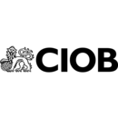
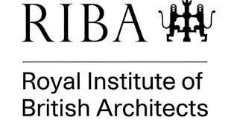
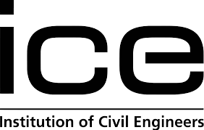
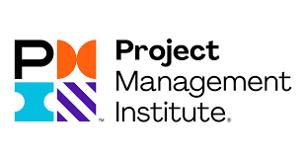
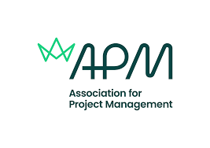
Agenda
CIOB
RIBA
ICE
PMI
APM

Slide 3
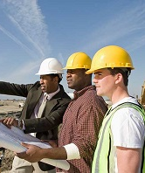
What are they?
Professional bodies are organisations made up of individuals from a specific sector - in this case, the construction sector - who are responsible for ensuring construction professionals maintain adequate standards of training and ethics. They also offer routes to becoming fully chartered.

Slide 4
In this context, the term 'professional' refers to an individual who has achieved certain educational and training standards that provide them with the knowledge, expertise and skills necessary to carry a particular role effectively.
Professional bodies typically seek to further the interests of their profession and members. They may also set standards for ethics, performance, competence, insurance, training, and so on, that must be met to remain within the profession. These are typically set out in a code of conduct.

Slide 5
A chartered institute, or a chartered body, is a professional body which has been granted a Royal Charter and provides members with a route towards becoming qualified as a chartered professional.
It is compulsory for certain professions to be a member of a particular professional body, in order that they have a ‘licence to practice’, or be included on a professional register, for example, architects must be registered with the Architects Registration Board.
It suggests that a professional commitment is a: ‘Commitment to abide by a code of conduct and professional behaviours that normally includes a requirement to practise ethically, and maintaining and acting within limits of competence.’

Slide 6
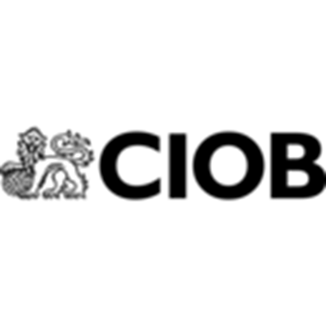
CIOB Home Page | CIOB
The CIOB is the most influential professional body for construction management and leadership, with around 50,000 members in more than 100 countries. Our members work in disciplines that cover the entire lifecycle of a built asset and even in the education and development of the next generation of professionals.
Our Royal Charter commits us to work in the public interest.
This means we campaign on the major issues, which today includes eradicating modern slavery from the industry, improving the quality of the built environment, ensuring the right skills, talent and behaviours are nurtured in construction, and that our environment is protected through more energy-efficient buildings and less-wasteful construction practices.

