Slide 1

WHERE'S MY LOCAL?
Group Project
Richard, Lewis, Sam and Leon

Slide 2
WHERE'S MY LOCAL?
Company Presentation

Slide 3
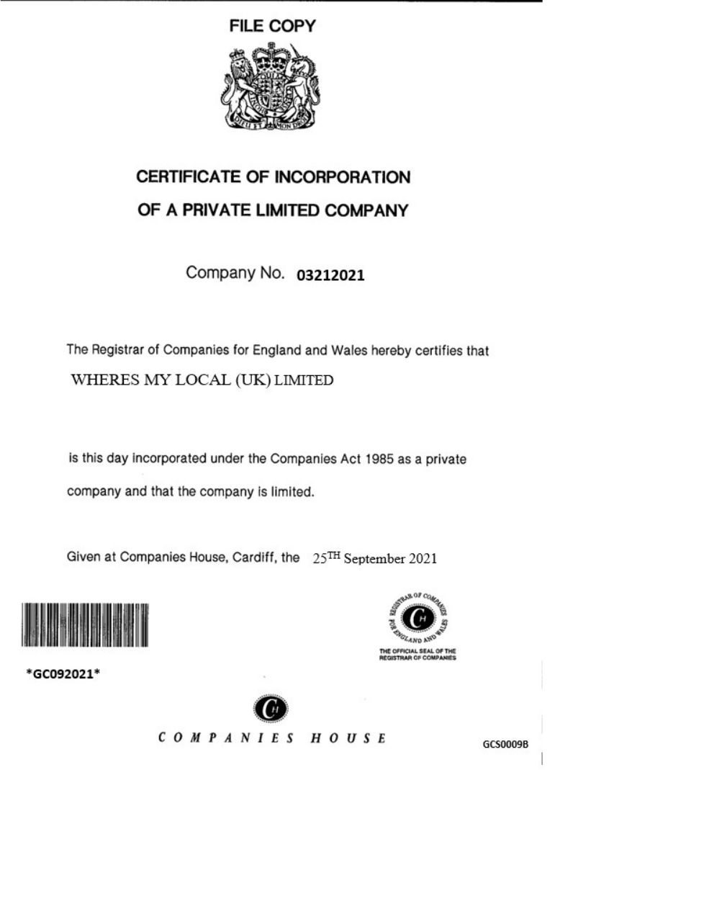
Company Registration
Where’s my Local? Has been
Registered with Companies House under Reg No. 03212021
The company full name is Where’s my Local (UK) Limited T/A Where’s my Local.
A fee of £12 has been paid for online registration.

Slide 4
Why Set up as a Limited Company?
* Ltd Companies are more attractive to Investors.
*Lower Taxes e.g. Income tax higher than Corporation tax. No National Insurance Payable except on wages
* Expenses are VAT tax deductible (within reason).
* If company is sued the company is liable not the owner.

Slide 5


Our Logo

Slide 6
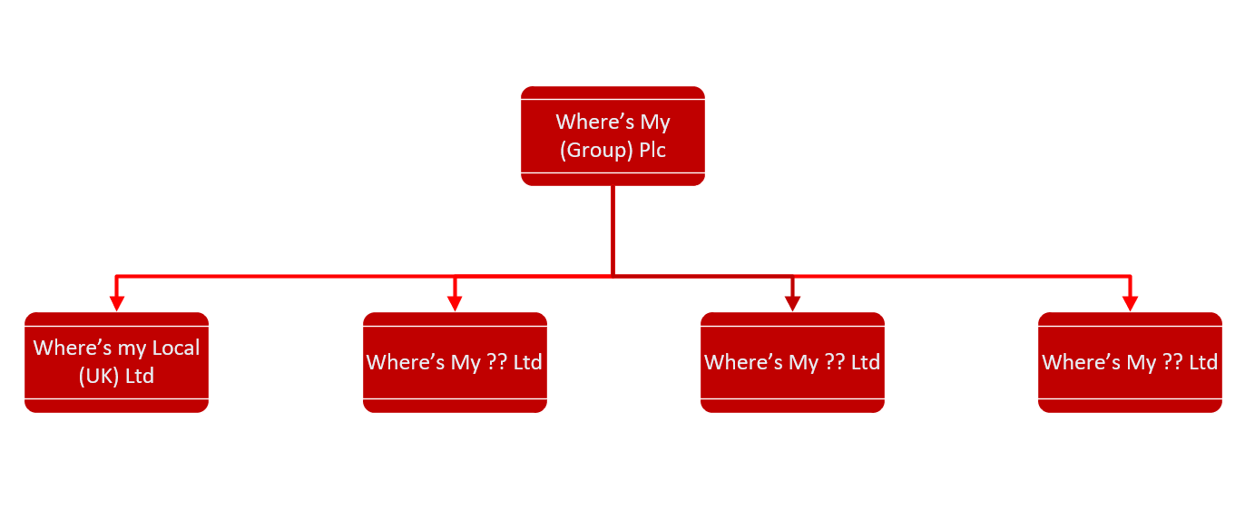
Future
In the event of expansion, a group entity can be created.
The Where’s my (Group) PLC would become the Parent Company.
Where’s my Local (UK) Ltd and other companies would be become part of this group underneath the Parent Company.

Slide 7
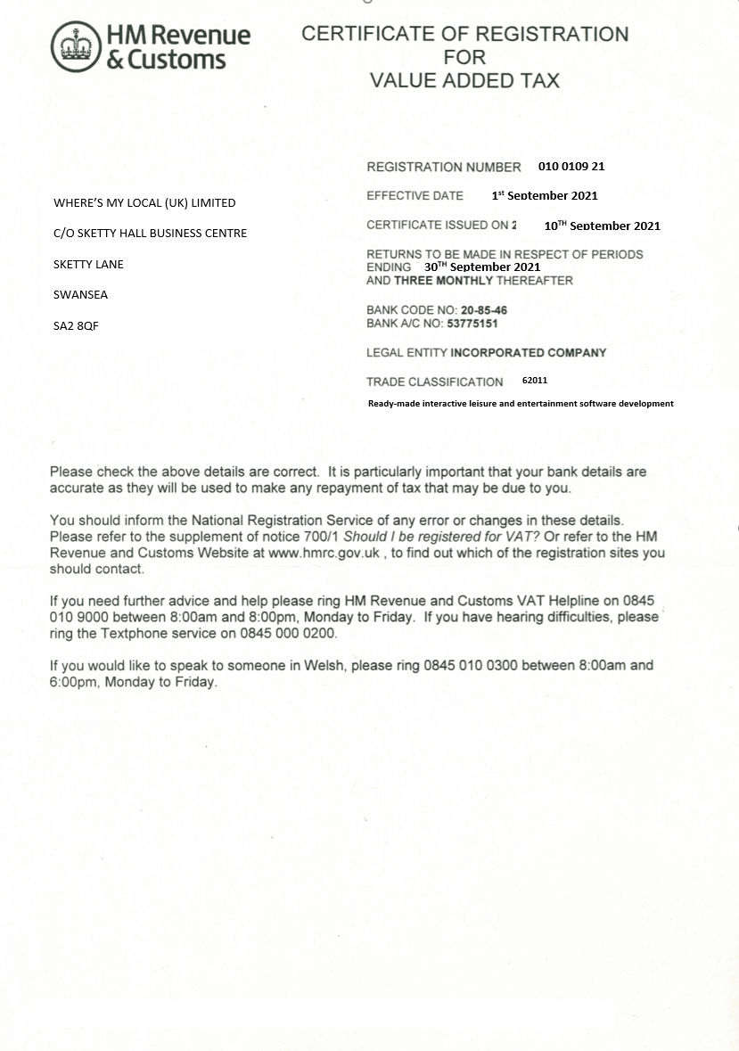
VAT (Value Added Tax) Registration
Where’s my Local (UK) Ltd has been
Registered with the HMRC under Vat Reg No. GB 010 0109 21.
A form has been completed to register for VAT.
Future Companies would be allocated their own VAT Numbers for Accounting Purposes.

Slide 8
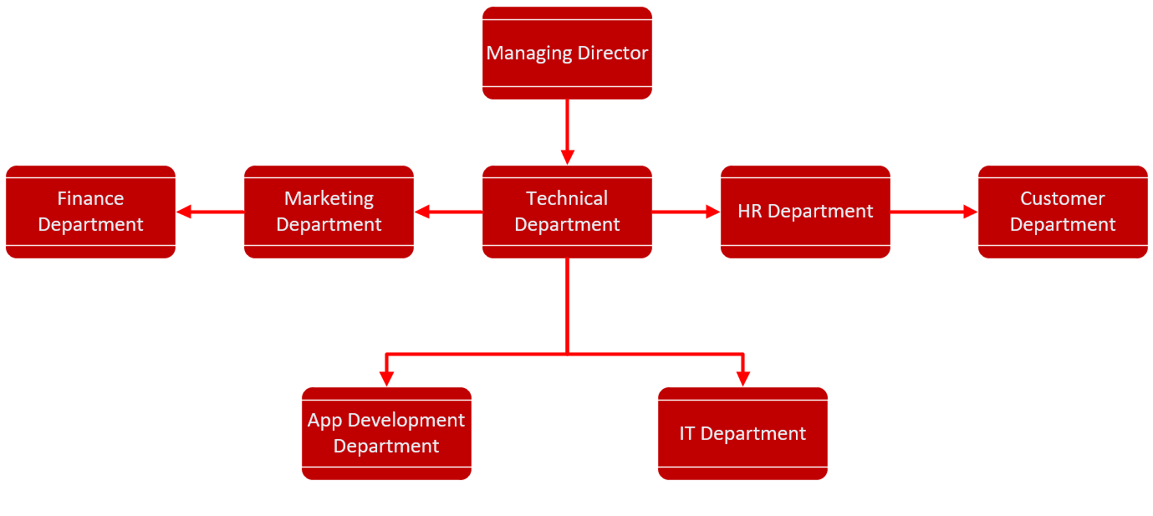
Organisation Structure
The company will organize as above.
There are five directors each managing each aspect of the business.
Each department will have its own Manager to deal with the day to day running of each department answerable to the department Director.

Slide 9
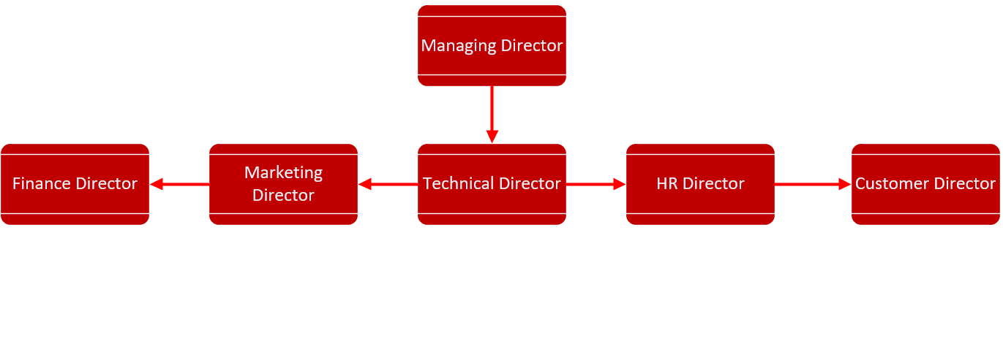
Leadership Structure
The Directors will organize as shown.
Each of the Directors will report to the Managing Director.
The Managing Director will represent the company and provide leadership and be responsible for encouraging growth of the company.

Slide 10
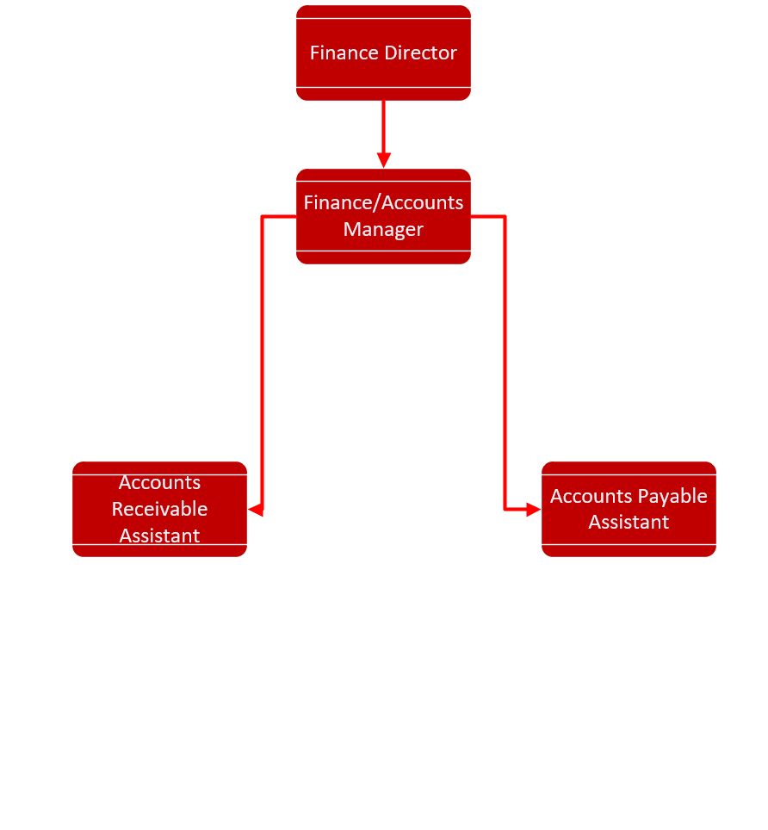
Finance Department Structure
The Finance Account Manager will run the Finance department and report to the Finance Director.
The Accounts Receivable Assistant will process and incoming payments and take appropriate action if late.
The Accounts Payable Assistant will make the payments to suppliers and ensure this is done on time.

Slide 11
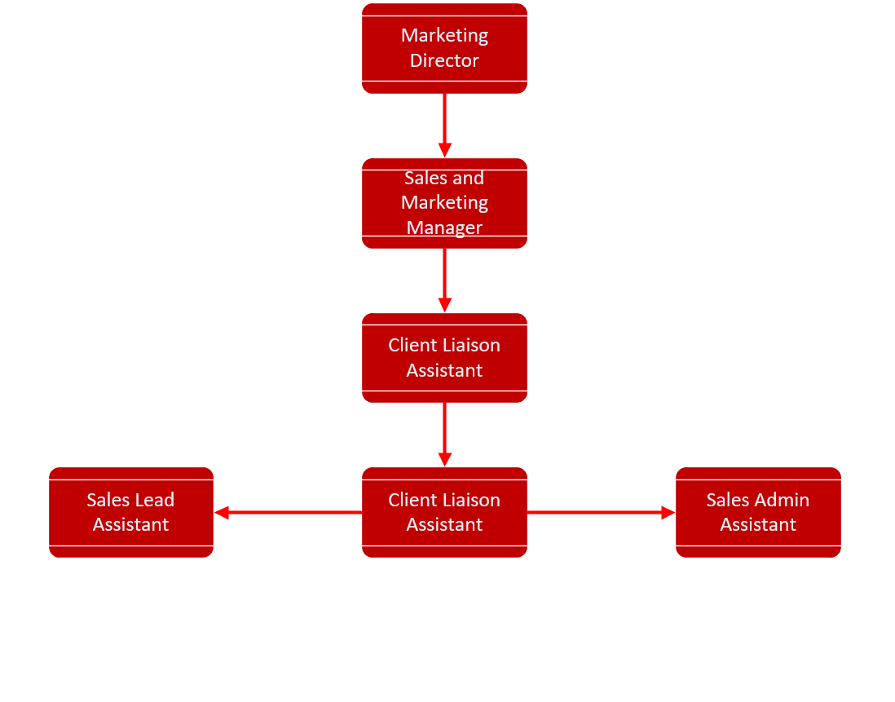
Marketing Department Structure
The Marketing Manager will run the Marketing department and report to the Marketing Director.
The Sales Lead Assistant will work with the Sales Admin Assistant to bring in and process new clients such as large Breweries.
The Client Liaison Assistant will maintain these new relationships.

Slide 12
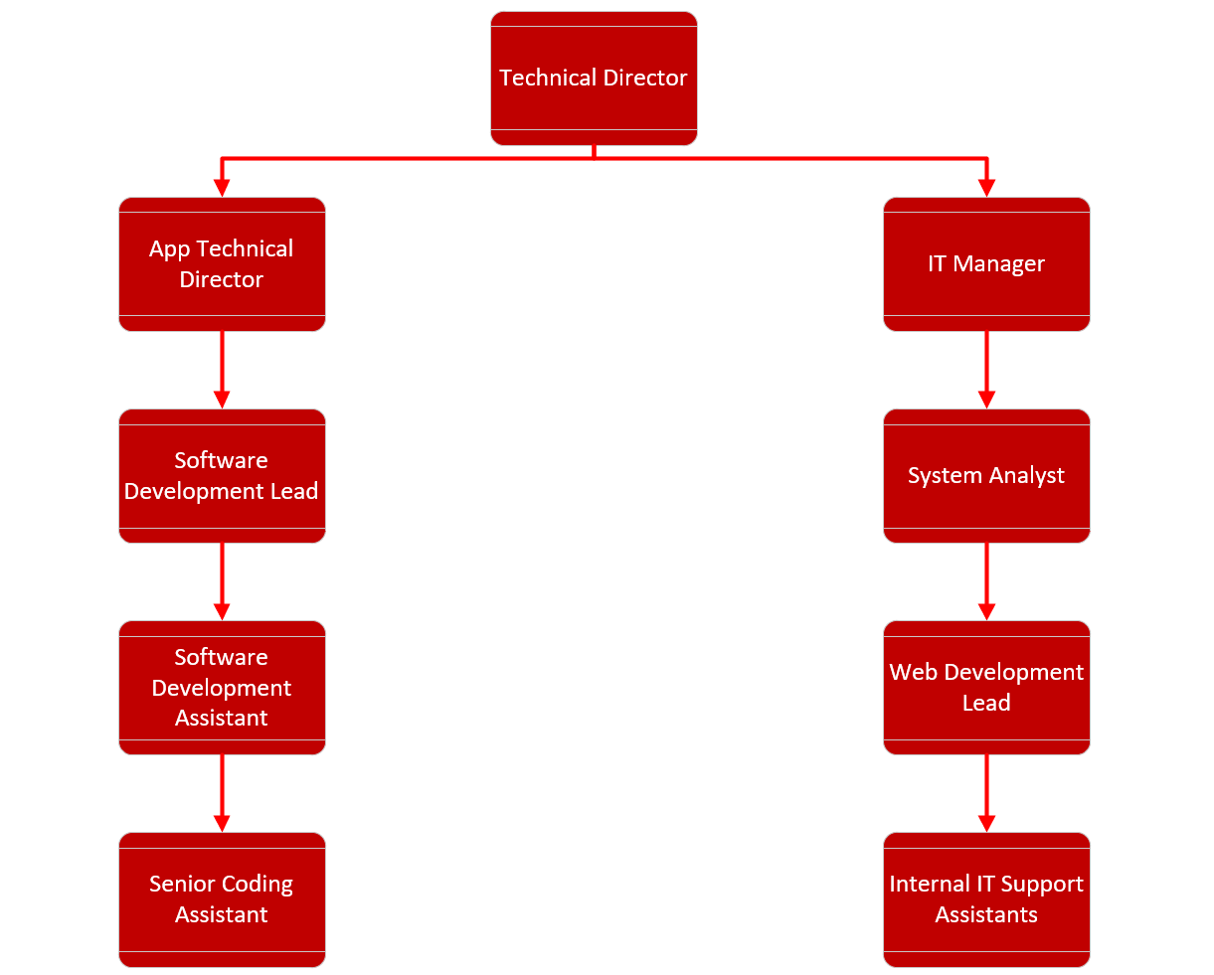
Technical Department Structure
There are two Managers who will report to the Technical Director
App Technical Manager and their team will develop the App(s).
The IT Manager and their Team will manage the Companies IT Systems and provide support to the Users and Clients.

Slide 13
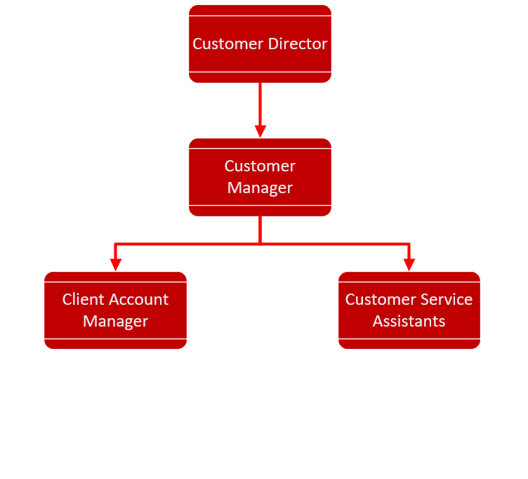
Customer Department Structure
The Customer Manager will report to the Customer Director.
The Client Account Manager will look after Client Accounts and deal with any queries.
The Customer Service Assistants will deal with Users and address any issues or complaints that they have.

Slide 14
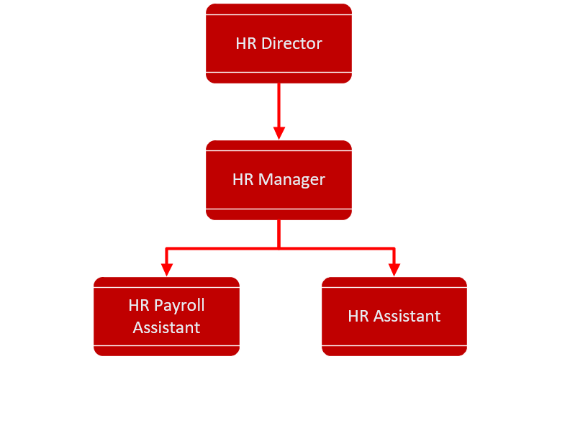
HR Department Structure
The HR Manager will report to the HR Director.
HR Payroll Assistants will deal with payroll and ensure correct taxations details are used.
HR Assistants will deal with employee queries, document disciplinary issues and conduct interviews for staff.

Slide 15
Mission Statement
“Dedicated to helping people plan and enjoy their Evening Out”.

Slide 16
Vision Statement
“Where’s My Local? aims to be your constant company during your search for good food and drink whether your young and on the town or a family looking for a quiet meal”.

Slide 17
Objective
“Our objective is simple. To become the essential, reliable and friendly App for those who are going out on the town or for those who want a quiet meal without sacrificing quality and accuracy”.

Slide 18
Code of Conduct
In this section a summary of the code of conduct will be outlined.

Slide 19
Use of Technology
Mobile phones or other electronic items must be off during working hours.
However, use of the above is allowed during break times only.
Social media will be monitored and any detrimental posts to the company or brand will be investigated, and appropriate action taken.
Any social media posts must be clearly stated to be opinion and not that of the company.
Personal internet usage during working hours is prohibited unless on a break.

Slide 20
Software and IP/Copyright Properties
Staff will be expected to work on and develop software.
Any code/software or properties developed during the contract of employment remains the sole property of the company.
Under the contract of employment the company is entitled to any or all royalties earned from the publication of the software and this remains in place for a period of no less than one year after the termination of employment.
Any staff found to be in breach of the above will be met with legal action and the company reserves the right to exercise this at it’s discretion.

Slide 21
Dress Code
Casual wear such as Jeans, skirts dresses is acceptable however outfits must be appropriate for a working environment.
Clothing with inappropriate use of language or images will not be allowed.
If a client or potential visit is due to take place employees will be notified and requested to wear appropriate business attire.

Slide 22
Employee Breaks.
A 60-minute lunch break is allocated to employees, and they are required to log out for lunch, and they log in on time.
Failure to do so will result in 30 minutes wages to be deducted.
Consistent offences will lead to disciplinary action and possible dismissal.
Lunch breaks will be allocated to you by your manager and break swapping is to be at your managers discretion.

Slide 23
Absenteeism
Please follow the standard practice if you do not believe you will be in work.
Please inform your line manager at least one hour before you are due to start your shift.
Consistent absences will be investigated, and action could be taken.
You must start and end your shift at the designated time or disciplinary action will be taken.

Slide 24
Confidentiality
Employees are reminded that all information that:
Any information acquired during the course of employment
Relating to the business or other persons, IP or bodies with whom the company has dealings
Or has not been made public without our express consent
Is confidential and employees shall not disclose such information or IP at any time before or after the termination of employment and cannot be disclosed to any third party without our express written consent.

Slide 25
Disciplinary Action.
First stage is a verbal warning.
Second stage is a written warning.
Third stage will result in a verbal and written warning.
Fourth stage if a further violation takes place, then summary dismissal will occur.
If the initial offence is severe enough then the employee may be sacked for Gross Misconduct.

Slide 26
WHERE'S MY LOCAL?
Marketing Presentation

Slide 27
Is there an existing market for WHERE’S MY LOCAL?
Other apps of a similar nature to WHERE’S MY LOCAL bring in considerable traffic and downloads. For example –
A direct competitor to WHERE’S MY LOCAL is the Wetherspoon app. Here is a list of some of the functionalities that it has that we wish to incorporate into out app –
The ability to locate the nearest Wetherspoons.
A full range of menus.
The ability to order both food and drinks to your table.
Advertisements for daily offers.

Slide 28
Analysing Our Product
To efficiently market our product it is important that we analyse its strengths and weaknesses. To do this I have used a SWOT analysis.
Strengths
Easy to use
In demand product
Opportunities
Opportunity to branch further than Swansea
Collaborations with different branches

Slide 29
Analysing Our Product (2)
Weaknesses
Limited to Swansea
Finance
Threats
Opposing companies
Licencing
Finance

Slide 30
Analysing Our Product (3)
PEST Analysis –
Political
Contribute to small businesses around Swansea
Economic
This is an eco friendly product being developed with as little carbon footprint as possible
Social
Our product brings people together and helps with socialising
Technological
The development of our app and what we had to consider when designing the app

Slide 31
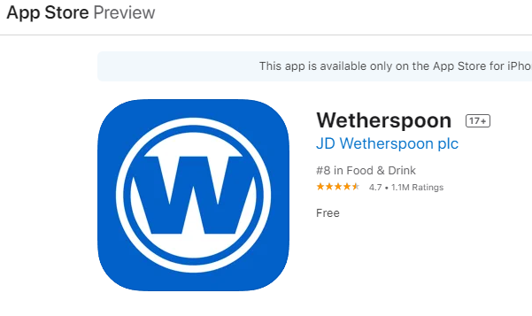
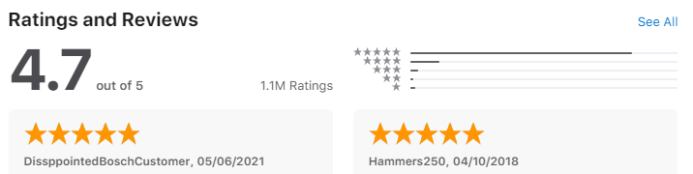
Is there a market?
Looking at competitors apps downloads, such as the Wetherspoons app we believe that there is a market for this kind of app. This is backed up by the figures from the both the Apple App Store and the Google Play Store –
The App Store has Wetherspoon as number 8 in the world for food and drink with 1.1 million ratings.

Slide 32
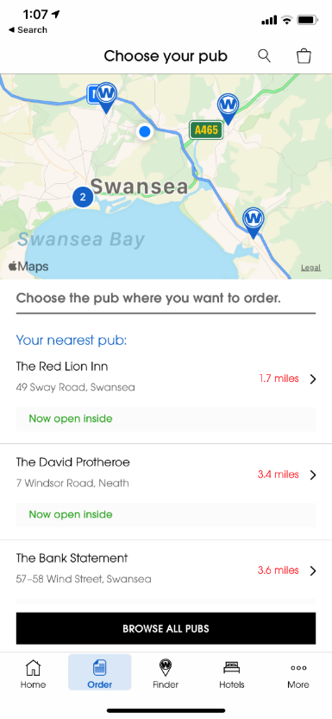
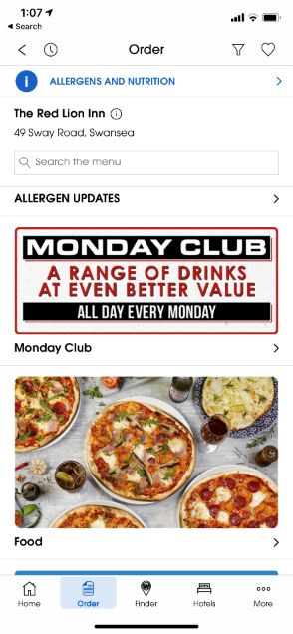
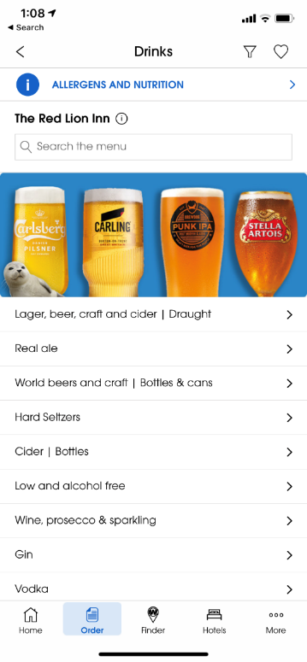
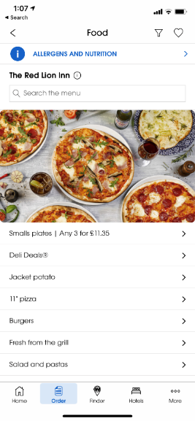
Here are some examples of the competitor's app -
Features including –
Ability to locate nearest branch.
View a range of menus.
Displaying deals for the given day.

Slide 33
How can we differ?
We would like to differ by allowing the user to branch out discover a variety of different restaurants/bars rather than being limited to just the one chain.
This will be to our advantage as it will allow us to –
Cater to a wider variety of audience
Give the customer options that other apps do not
Allow us to collaborate and branch out to more companies

Slide 34
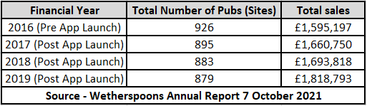
Potential Sales Through App
Here are some sales figures for a competitor (Wetherspoons) since the release of their mobile app in March 2017 -

Slide 35
Our Target Audience
Given that the app primarily advertises bars, out demographic is both male and females ranged from 18 and beyond.
A great target audience for us is Students –
Swansea University currently had 16,315 undergraduate students, many of whom will be new to the city. Our app will –
Help familiarise them with their new surroundings
Make locating the city's nightlife easier
Help them filter their preferences to locate their ideal location

Slide 36




How To Reach Our Target Audience
The most effective way that we are able to reach our target audience is through the use of social media platforms. Some of these platforms include –
Facebook
Instagram
Twitter
Snapchat

Slide 37
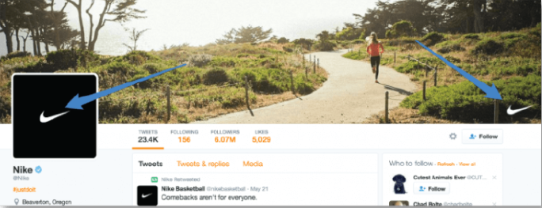
The Benefit of Social Media Marketing
Using social media as a form of advertisement is the perfect way to it out demographic audience. It allows us to –
Create a visual representation of our brand e.g.

Slide 38

The Benefit of Social Media Marketing cont.
Engage with customers
Post regular updates to keep customers informed
Reach as many customers as possible. This can be achieved though paying social media companies to appear as “Recommended” companies on peoples social media pages.

Slide 39
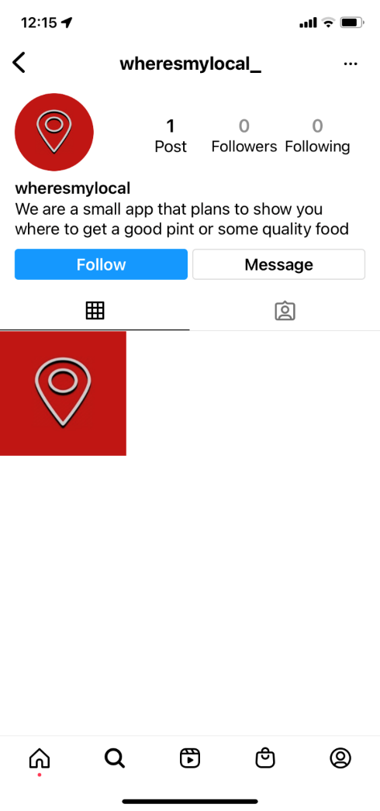
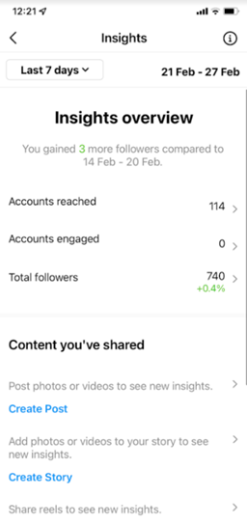
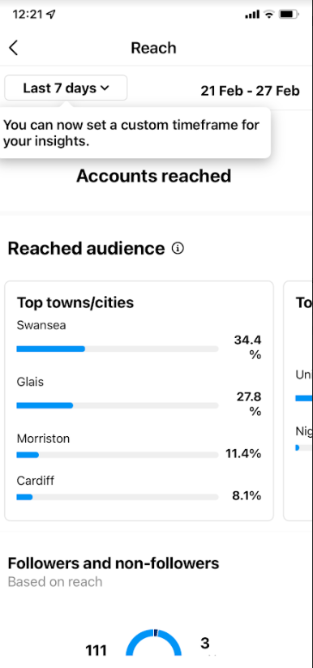
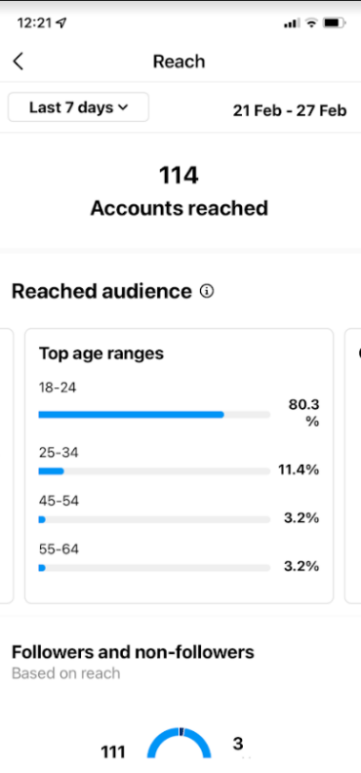
Our Social Media
Here is a screenshot of our Instagram page. We have taken the handle @wheresmylocal_ to make us easy as possible to find.
Here is an example of how beneficial Instagram is to us in order to gain insights into the audience we are reaching and engaging with –

Slide 40
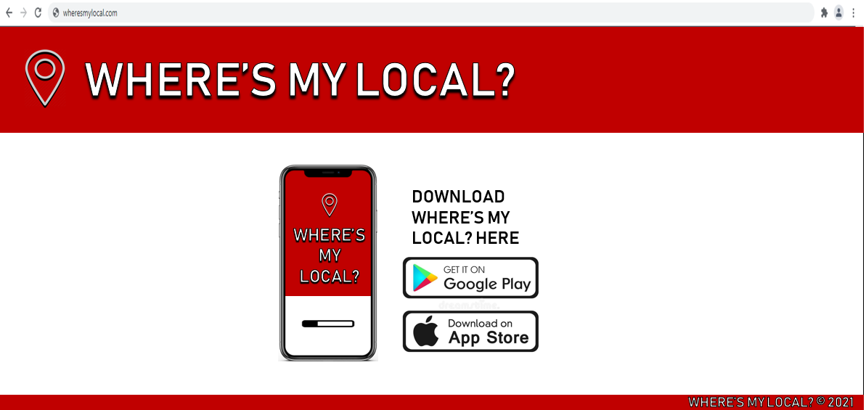
Alternative advertisement methods
Website –
Using participating pubs/restaurants to run advertising campaigns. This can also be used for promotional deals.

Slide 41
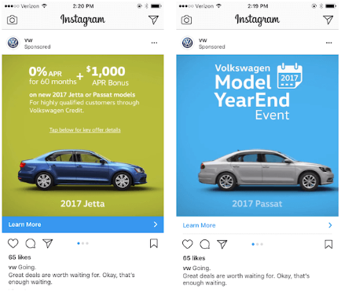
Financing the Marketing Plan
After consulting with the finance team we have devised a marketing budget of £4900. Here are some cost examples of marketing strategies–
Instagram – Average around $0.01 to $0.05 per engagement

Slide 42
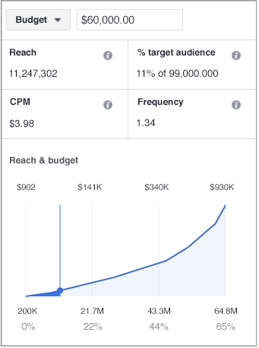
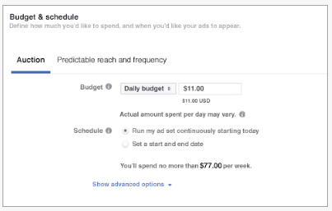
Financing the Marketing Plan (2)
Facebook – Clicks per Minute with defined budget.

Slide 43
Thank you for listening.
Are there any questions?

Slide 44


IDEATION & DESIGN

Slide 45
Requirements
The WheresMyLocal app must include the following:
Ability for users to create an account to access rewards from associated pubs.
In app ordering for food/drinks.
Maps to find pubs in the area.
Must include menu items from pubs that we are associated with.
Must include a checkout system to allow users to order in app.
Ability for customers to review and rate pubs.
Allow pubs to put on various promotions to appeal to customers.
Targeted advertisements to customers.

Slide 46
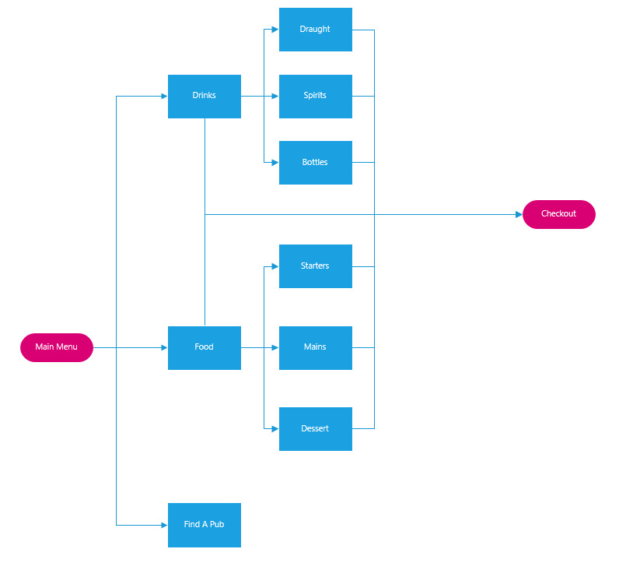
App Navigation Flowchart

Slide 47
USP
Where's My Local differs from other apps on the market such as Weatherspoon’s or Swansea Eats.
Our unique selling point is that we work with local pubs rather than just the chain pubs. We work with these pubs to allow them to sell their products via our app, whilst giving them the ability to reward their customers that have signed up with us. By working with us, pubs can reach a larger target audience, as people will see their pub on the app and decide to visit, whereas they wouldn’t usually think about going there.

Slide 48
Design and Implementation

Slide 49
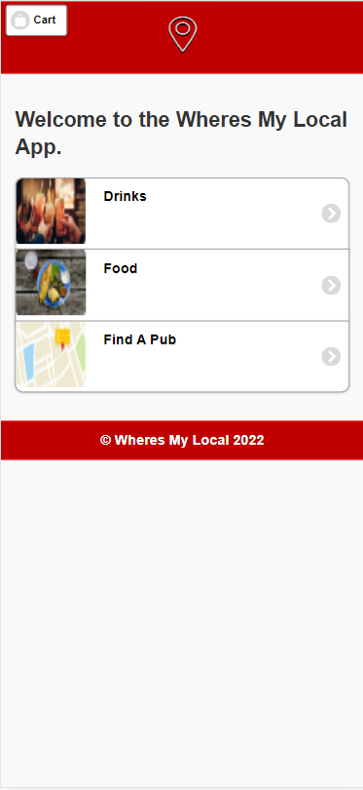
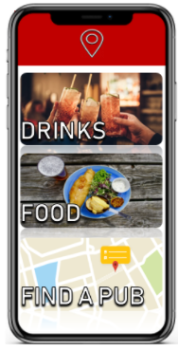
Design & Implementation – Main Menu

Slide 50
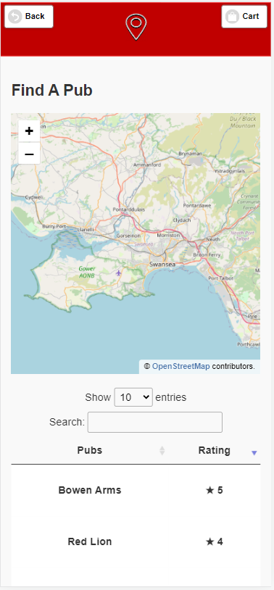
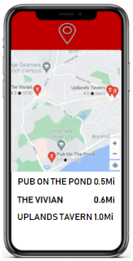
Design & Implementation – Pub Finder

Slide 51
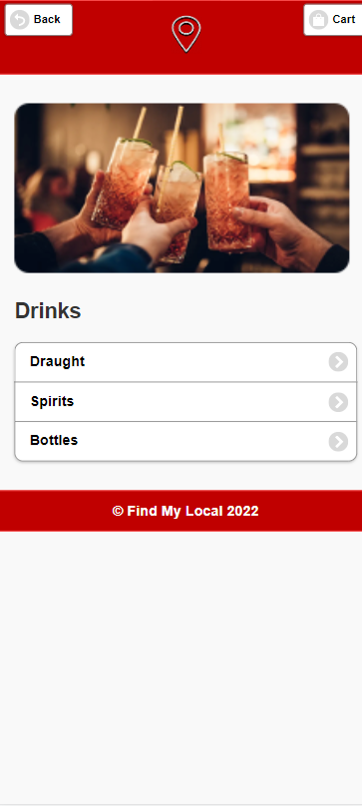
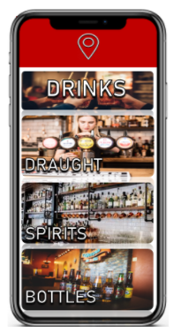
Design & Implementation – Drinks

Slide 52
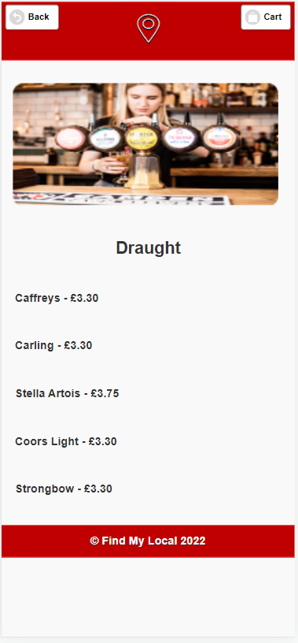
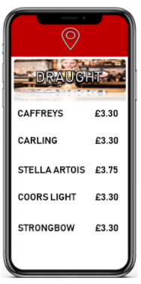
Design & Implementation – Menu Example

Slide 53
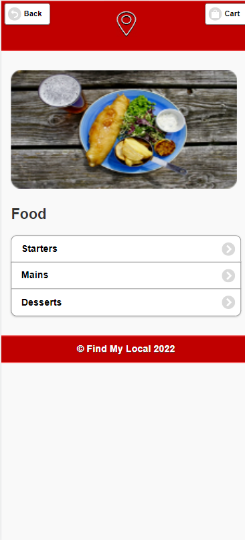
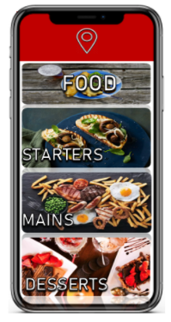
Design & Implementation – Food

Slide 54
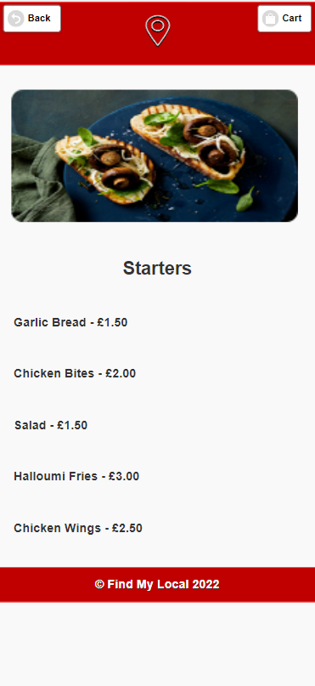
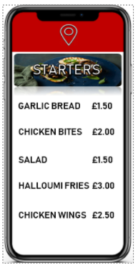
Design & Implementation – Menu Example

Slide 55
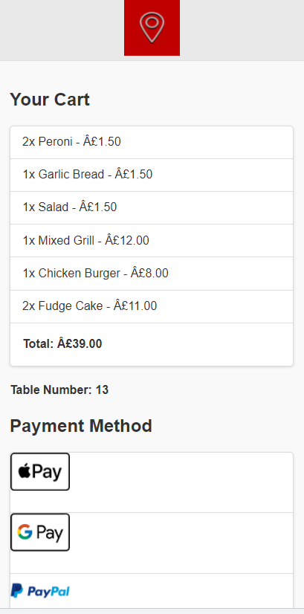
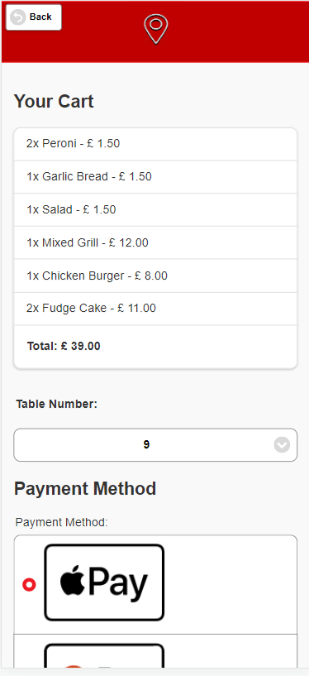
Design & Implementation – Cart

Slide 56
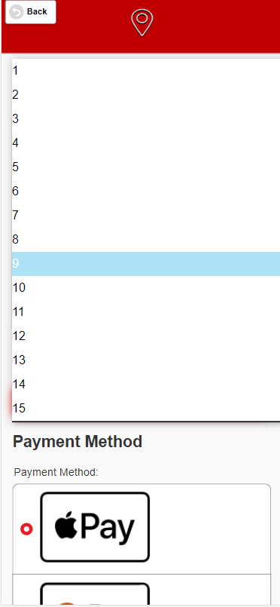
Select Table Number

Slide 57

Finance Presentation

Slide 58
Where the Funding is Coming from
Patreon/Kickstarter
Venture Capitalists
These will help Kickstart our idea
We will need these to fund the more costly of things like staff costs on the first year.

Slide 59
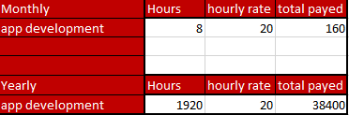
Cost Analysis

Slide 60
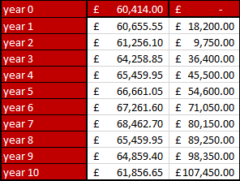
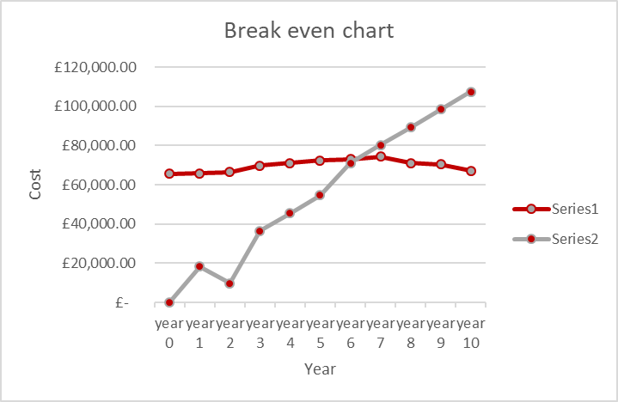
Break Even Analysis

Slide 61
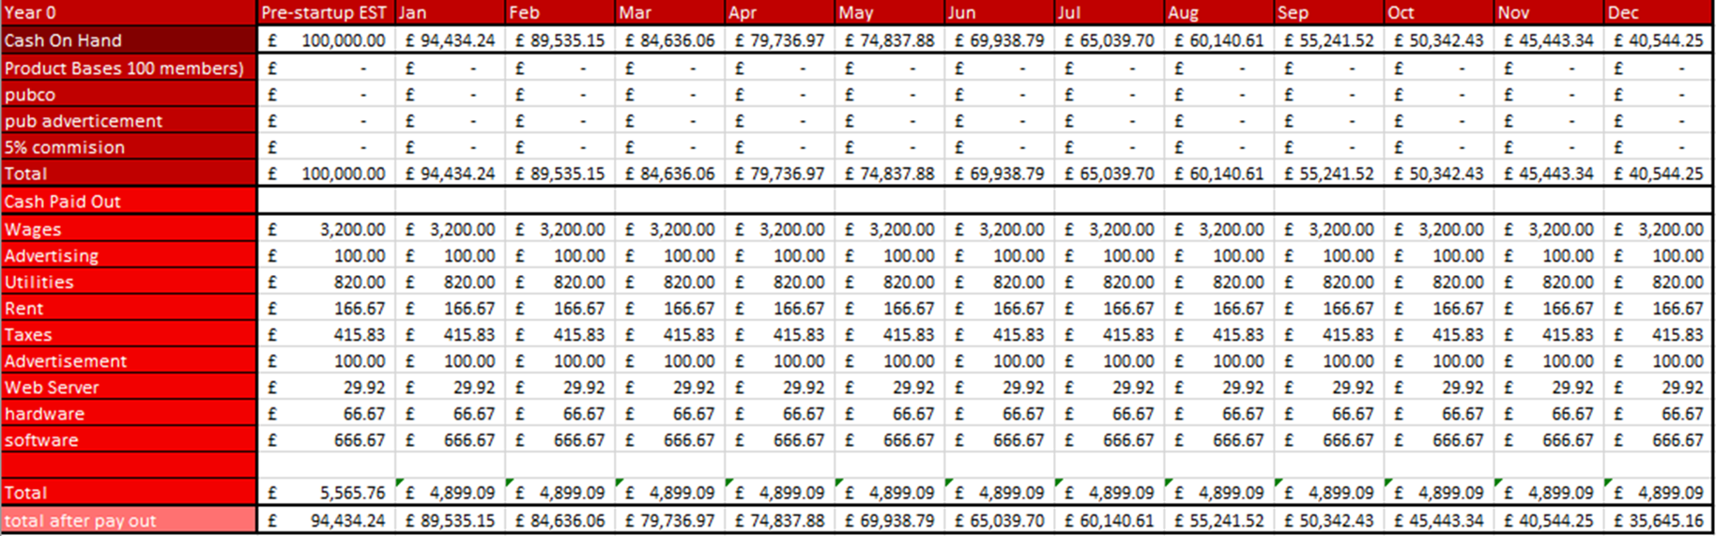
Cash Flow Chart Year 0
Notes:
Here you can see I will start with £100,000 to allow for us to kick start out business

Slide 62
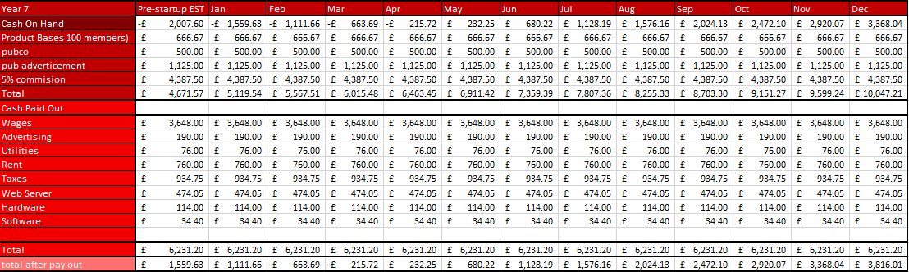
Cash Flow Chart Year 7

Slide 63
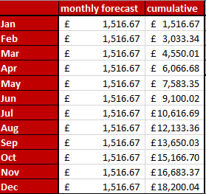
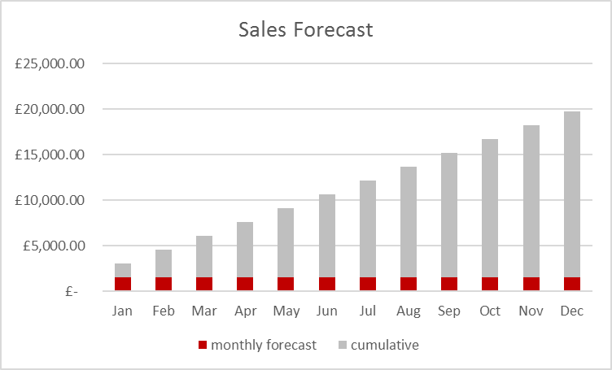
Sales Forecast

Slide 64
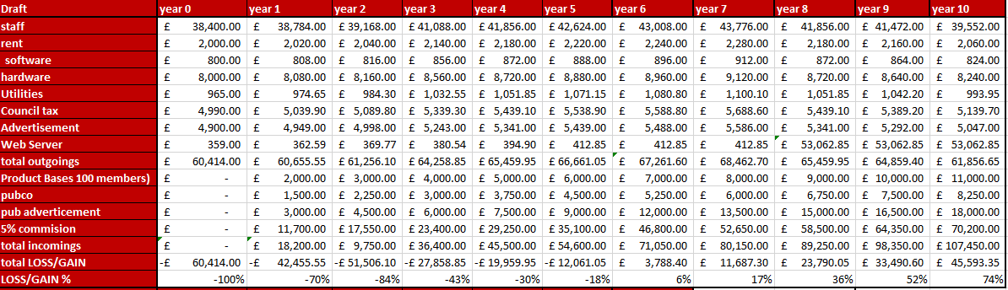
Break Even Workings (Appendix)

Slide 65
Thank you for listening.
Are there any questions?

Slide 66
References
https://www.reed.co.uk/average-salary/average-app-developer-salary
https://startups.co.uk/websites/hosting/website-hosting-cost/
https://www.businessofapps.com/marketplace/app-marketing/research/app-marketing-cost/
https://www.ukpower.co.uk/business-energy/average-business-energy-bills

