Slide 1
Practical:
Individual Presentation name: Mariya Georgieva Malamova
Student number: 2028275
Module: International Business Communication

Slide 2
Table of contents
Introduction
Cultural challenges likely to be experienced by British Company in China
Intercultural communication theories
Recommendations
Conclusion
References

Slide 3

INTRODUCTION
Different countries generally have their own distinct cultures which in turn unique in nature. Organizations, who are seeking to establish their businesses or make partnership with the company of different country, needs to gain proper knowledge about the cultures prevailing in those countries. It is not easy for organizations and their employees to adapt to the culture of other country.
Notes:
The lack of cultural adaptability create various culture various cultural and communication challenges for these organizations. However, there are some intercultural communication theories through the help of which organizations can overcome from these challenges. This presentation is going to be revolved around a scenario in which an UK based organization is planning to make joint venture with a Chinese company. The aim of this presentation is to highlight the cultural challenges that might need to be faced by that UK based company while making partnership with its new Chinese partner. This presentation will also include some recommendations along with intercultural communication theories to avoid these challenges. This situation can also lead to the failure of the business.

Slide 4

Company and Scenario Overview
The main objective of this presentation is to help a British Multinational company TK Maxx come into a successful joint venture with a Chinese company for expanding their business operations. In order to establish a successful company base in China, the company will have to face various challenges pertaining to cultural differences between nations along with establishing proper corporate communication with the Chinese company.

Slide 5

  Cultural challenges likely to be experienced by British Company in China
Difficult to understand consumer's attitude: This is one of the major challenge that may be faced by British company in China because culture put heavy influence over consumer's attitudes
Local business practices: This is an another cultural challenge that British company may suffer in China because the business practices prevailing in the country may be distinct due to differentiation in country's culture.
Notes:
Difficult to understand consumer's attitude: If the British company fails to understand the culture prevailing in China then it will be difficult for the former one to effectively fulfil consumer's needs since customs, habits and preferences of consumers remains significantly influenced by country's culture.
Local business practices: International businesses need to have proper understanding of other country's culture otherwise it will be difficult for them to meet the requirements of their stakeholders.

Slide 6

Continue
Individualism: Staff members of British company may find it challenging to coordinate and collaborate with employees of Chinese company because different culture may have their own way of doing particular work.
Diversity issue: There is no doubt that British company can make its workforce diversified by making joint venture with Chinese company but ineffective diversity management will restrain employees from making effective coordination
Notes:
Individualism: Due to this cultural challenge, British company may face difficulty while carrying out their team related activities.
Diversity issue: This cultural issue may even lead to the failure to the joint venture of both the companies.

Slide 7

Continue
Stakeholder conflict: Stakeholders of British and Chinese company may indulge into conflict due to differences encompassing in the cultures of both the countries.
Understanding local ethical issues: British company may fail to understand local ethical issues of China due to ethical differentiation.
Notes:
Stakeholder conflict: This cultural challenge can create ambiguity and value conflict along with the differences in the decision-making process of the joint venture.
Understanding local ethical issues: It is possible that different cultures may have their distinct ethical values. This differentiation may force the company to indulge itself in local ethical issues.

Slide 8
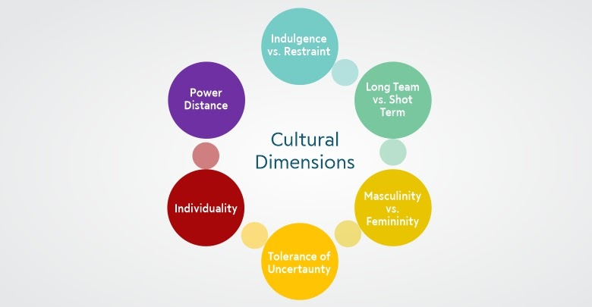
  Intercultural communication theories
There are some intercultural communication theories highlighted below that can be considered by British company to overcome its cultural challenges in China.
Hofstede's Cultural Dimensions Theory
It is regarded as an effective cross-cultural communication theory that was proposed by Geert Hofstede in order to demonstrate the impact of society's culture on the values and behaviour of individuals.
Notes:
Hofstede's Cultural Dimensions Theory
This theory helps in analysing the differences encompassing in the cultures of different countries. It identifies these differences on the basis of four 5 distinct dimensions namely power distance index, uncertainty avoidance index, indulgence vs restraint, long term orientation, individualism and masculinity vs femininity. The distinct dimensions of Hofstede's cultural dimensions’ theory have been highlighted below in context to the cultures of UK and China.
Power distance index: This dimension of the theory displays the degree to which less powerful members of institutions or organizations expect and accept that the power is divided in an unequal manner. It has been identified that China scores 80 in this index which in turn indicates the superior-subordinate relationship in this country is more polarised and superiors don't exercise their authority on subordinates in an adverse manner. While Britain sits lower in this index as it scores only 35 in power distance index.
Uncertainty avoidance index: This index demonstrate the extent to which society can tolerate the situation of ambiguity. This dimension show the way through which society and individuals deals with the fact that future or upcoming event is uncertain. China scores 30 in this uncertainty avoidance index which in turn shows that Chinese individuals are comfortable with ambiguous situation which can also be seen from the fact that there are various ambiguous meanings in Chinese language due to which Western people may find these meanings difficult to understand. UK scores around 35 in this index which is somewhere similar to the former one.
Indulgence vs restraint: This dimension of the theory shows the extent to which individuals have the freedom t fulfil their human desires. In context to countries, it has been identified that China has a score of 24 in this particular dimension which in points out the society's inclined nature towards pessimism and cynicism. On the other, UK has score of 69 in this dimension which shows that British culture is indulgent and stimulate individuals to fulfil their desires.
Individualism vs collectivism: This dimension analyses the degree to which individuals are integrated into groups. China has a score of 20 in this dimension which is regarded as collectivist culture in which individuals work for group's interests where as UK scores 89 which in turn indicates towards individualist culture.
Long term orientation: This particular dimension link the the connection between the past as well as future challenges. The score of China in this dimension is 87 which in turn means that it has a very pragmatic culture while UK scores 51 in this specific dimension.
Masculinity vs femininity: Masculinity defines the society's preference towards heroism, achievement and assertiveness whereas femininity highlights the society's preference towards modesty and cooperation. It has been identified that both China and UK have masculine society since they have a score of 66 in this dimension which in turn shows that both societies are highly success driven and oriented.

Slide 9

Continue
Face negotiation theory
It is also an intercultural communication theory that was proposed by Stella Ting-Toomey with the purpose to define the way through which individuals belonging to distinct cultures communicate since they have to manage sensitive situations and disagreements. This particular theory is based on the assumption that people are generally concerned with saving their faces irrespective of their cultures.
Notes:
This theory facilitates in explaining the reason behind the distinct ways through the help of which individuals of distinct cultures manage conflicts. The face negotiation theory puts significant emphasis on the differences encompassing in the viewpoints of individuals belonging to individualistic and collectivist cultures. In collectivist culture, individuals usually place their importance on collectivism and try to prevent all those things that can bring damages to the group. While people belonging to individualistic cultures often feel that an attempt to avoid the conflict may lead them to losing their faces. It is possible that the culture of UK has some distinct priorities when it comes to saving faces. This indicates that Britain company is firstly required to ensure clarity in its priority to save face.

Slide 10

Recommendations
Cross cultural training: The concerned Britain company is recommended to provide cross cultural training to their employees to overcome cultural challenges
Team working activities: Team working activities can found to be very fruitful for organizations in terms of reducing cultural challenges
Obtain feedback: It is recommended for the Britain company to obtain feedbacks from their employees regarding the issues that they have been facing due to cultural differentiation between UK and China
Notes:
Cross cultural training: This cross-cultural training will facilitate the company in making their employees adaptable to the culture of China. This will not only enhance the coordination and interaction among employees but it will also assist the business in fulfilling their customer's needs in a better manner.
Team working activities: Britain company can consider to push their employees to participate in team oriented activities with staff members of Chinese company in order to make joint venture successful. These activities will allow employees of both the joint venture companies to know more about each other and strengthening their relationship.
Obtain feedback: Through feedbacks, employees will be able to raise their concerns regarding culture and provide their own suggestion in order to reduce those concerns.

Slide 11
CONCLUSION
From this presentation, it can be concluded that culture plays an influential role in the success of an international business. If an organization who is seeking to expand its business in other country may face several number of cultural challenges due to the differences encompassing in the culture of distinct countries. It has been identified that these cultural challenges can be in the form of diversity issue, stakeholder conflict and individualism etc. This presentation has included some recommendations and intercultural communication theories through the utilisation of which organizations can effectively overcome its cultural challenges.

Slide 12
References
Dzhalilova, Z.O., Izomova, S.G. and Ahmedova, G.A., 2021. Intercultural communication and the Latin language. Молодой ученый, (24), pp.398-400.
Minkov, M. and Kaasa, A., 2022. Do dimensions of culture exist objectively? A validation of the revised Minkov-Hofstede model of culture with World Values Survey items and scores for 102 countries. Journal of International Management, 28(4), p.100971.
Mohanty, D.A. and Mukherjee, S., 2018. Face Negotiation and Politeness in" Interpreter of Maladies". IUP Journal of English Studies, 13(4).
Steinfatt, T.M. and Millette, D.M., 2019. Intercultural communication. In An integrated approach to communication theory and research (pp. 307-320). Routledge.
Notes:
Tekeş, B., Üzümcüoğlu, Y., Hoe, C. and Özkan, T., 2019. The relationship between Hofstede’s cultural dimensions, Schwartz’s cultural values, and obesity. Psychological reports, 122(3), pp.968-987.
Zainuddin, M., Yasin, I.M., Arif, I. and Abdul Hamid, A.B., 2018, December. Alternative cross-cultural theories: Why still Hofstede?. In Proceedings of International Conference on

