Slide 1
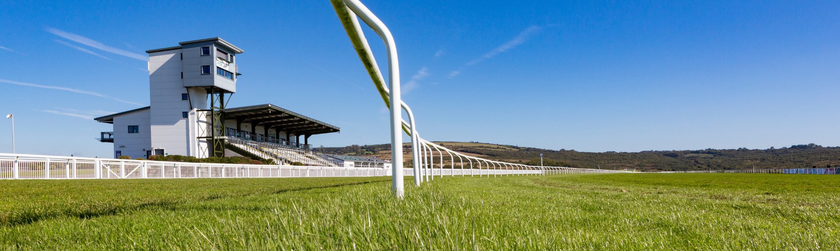

UWTSD Uniting Partnerships with FFOS LAS
#Together Educating Future Generations
Created by Elysia & Steffan

Slide 2
Introduction
Ffos Las
Opened the doors in June 2009
Named after the land it built on
The first racetrack to be built in 80years
Not just a racecourse but a events and functions venue
UWTSD
University was formed in November 2010 and Swansea Met joined in August 2013
UWTSD which also means University of Wales Trinity Saint David is located at 3 different destinations Carmarthen, Lampeter and Swansea.

Slide 3

Aims
To build on the new partnership between UWTSD and Ffos Las
Create new placement opportunities and an option for first year industry experience
Make UWTSD and Ffos Las more recognizable establishments and create a united image
Sharing partnerships/ contacts with one another
More success by working on projects together

Slide 4
Reasons for the project
Create new partnership between Ffos Las & UWTSD.
Creating more successful events for both parties for near and pro long future.
Capitalize on placement opportunities for students to work with Ffos Las.
Promoting both companies for a brighter education purposes.

Slide 5

Why Us?
Steffan:
Experience as a Chef
Excellent customer service
Offer a local's perspective.
Sales experience
Elysia:
Customer service
Event work experience.
Valleys link
Together make good team
As students we get a reach different types platforms.
Get the word out
Add new unique ideas, suggest new twists.

Slide 6
Research
When it comes to finding out what is in demand and what we need to use, we will research the information by:
Using primary and secondary research e.g. websites, surveys and more.
Required information for initial ideas.
Look at the market and clients demands.
Unique ideas that can be brought to the table.

Slide 7
Our Ideas
We aren’t coming empty handed, we got ideas to offer:
18-35 valley day
25-year UWTSD reunion
live sports screenings e.g. rugby, football and more
Fresh fair = UWTSD freshers fair
Each event must be advertised on social media with individual hashtags and more

Slide 8
Project plan
Gant Chart to show time frames to stick to for the project not to run into any difficulty.

Slide 9
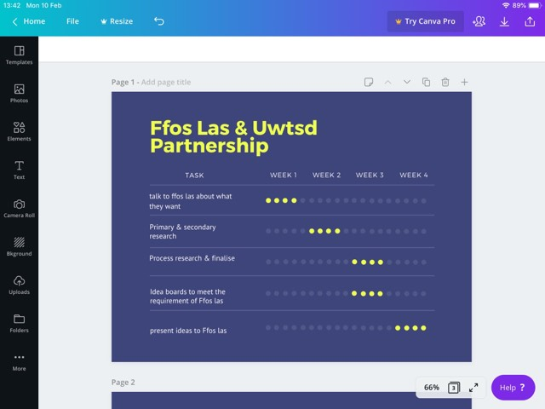


Slide 10


Slide 11
Possible constraints, problems & issues.
One or both companies run into issues.
Communication from the 3 parties involved.
Feedback.
Lack of interest from companies and consumers.
Research does not back up the final 3 ideas.

Slide 12
Questions?

