Slide 1

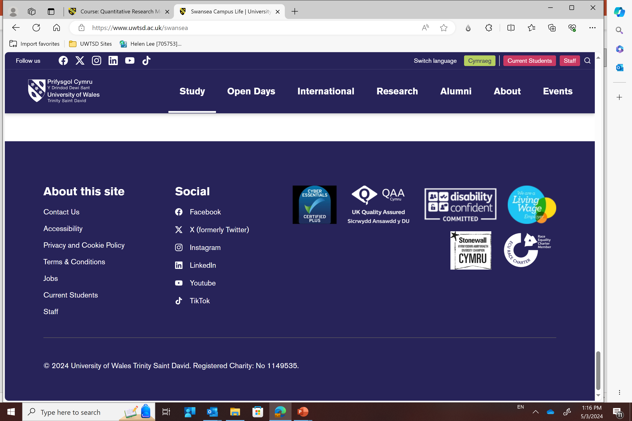
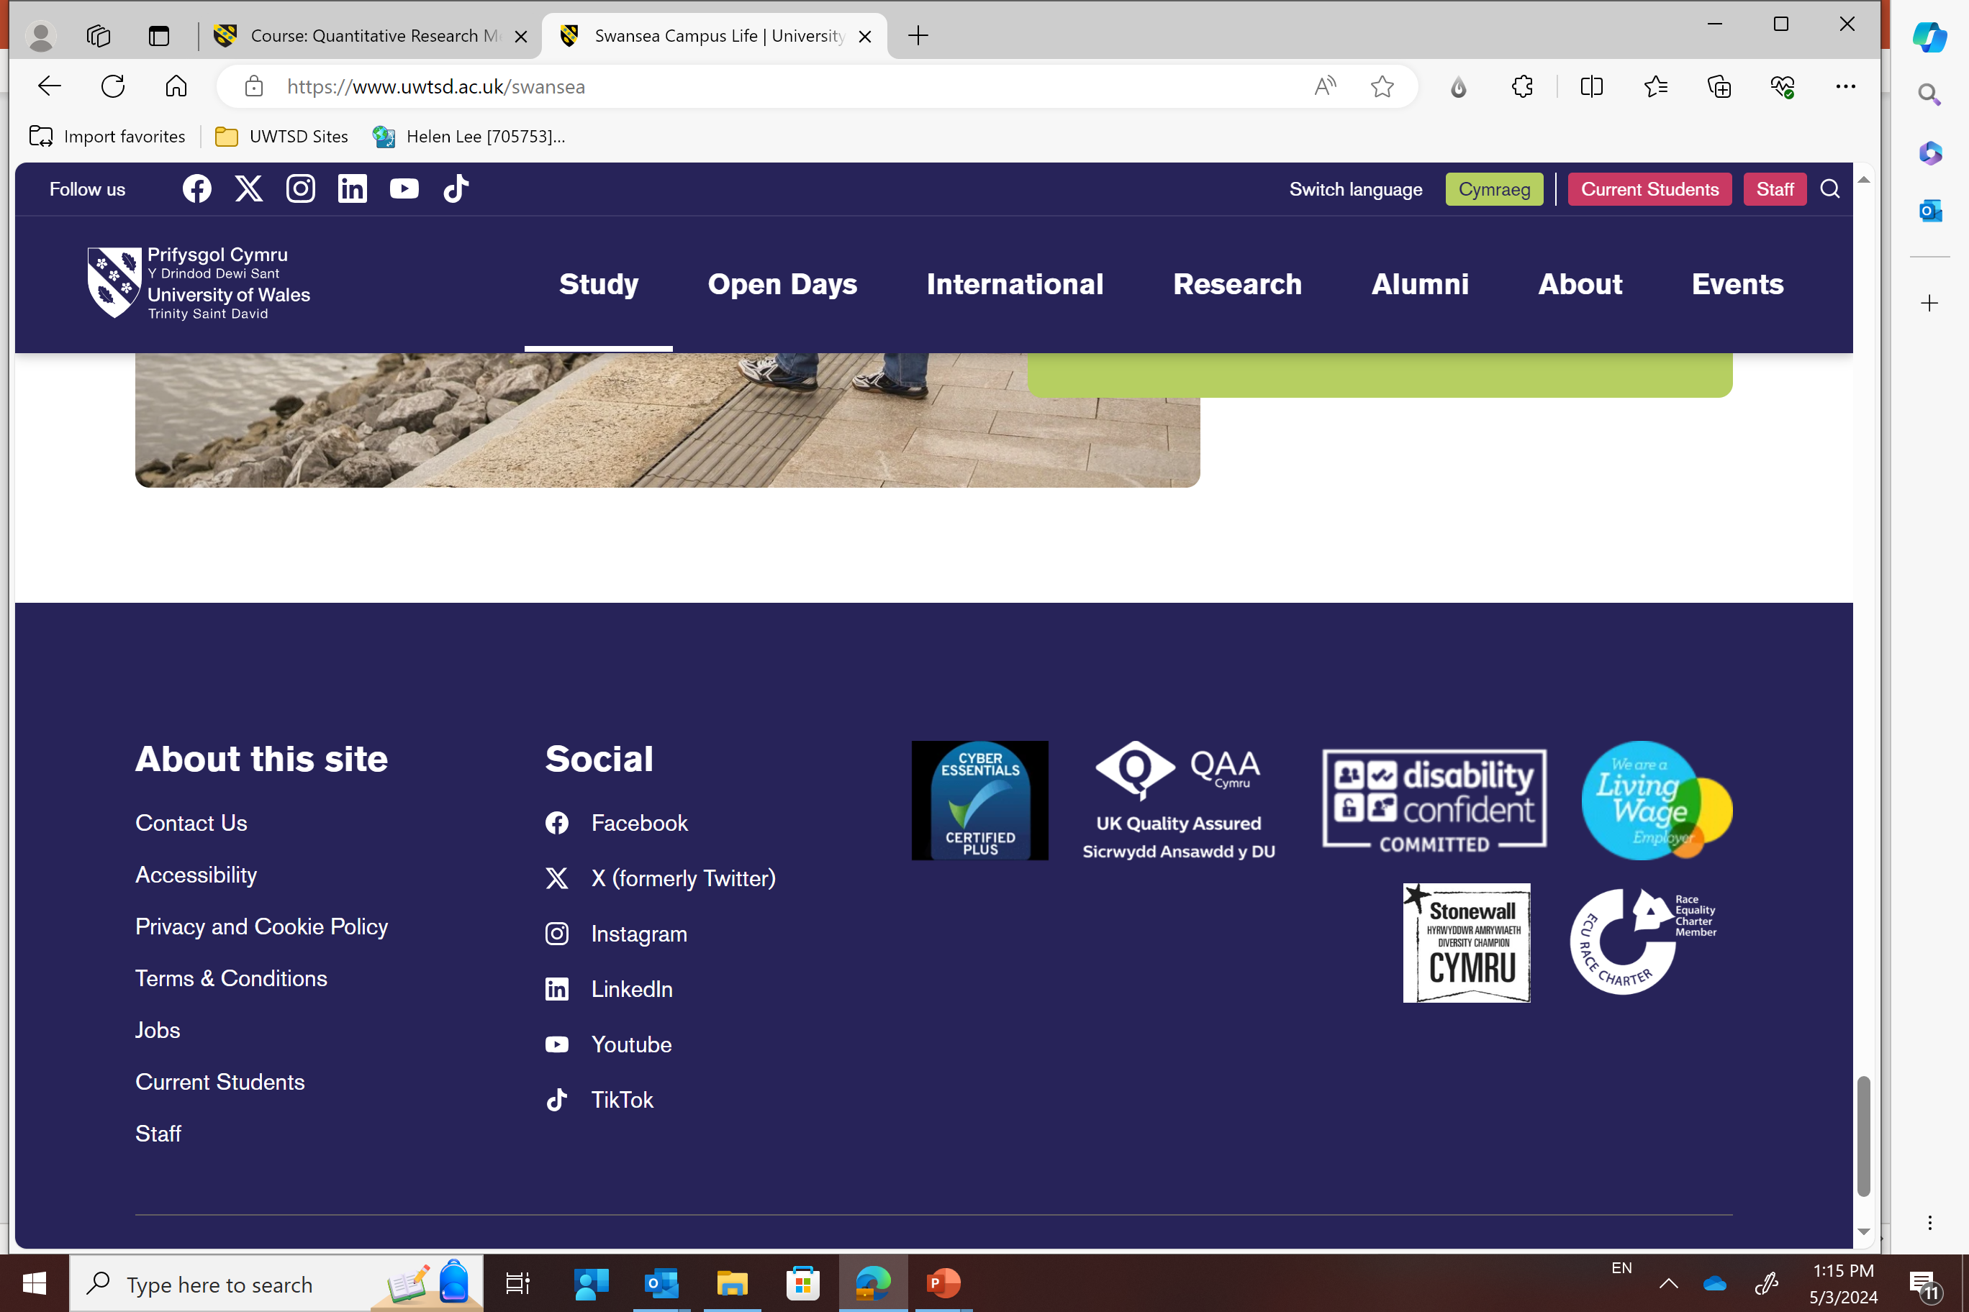
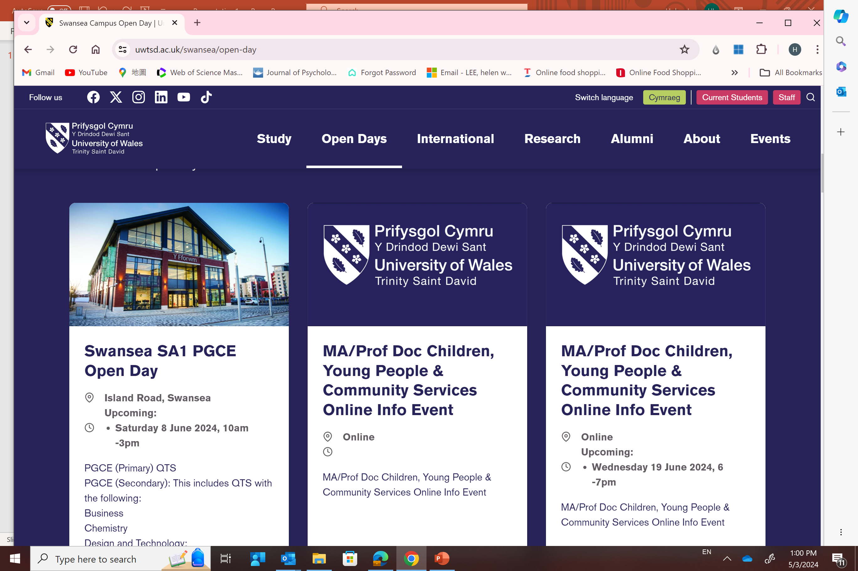
LCDB 7012 -
Advancing to the Doctoral Research Stage
Week 1 – Module Overview

Slide 2
Agenda
Module Overview
In-class activity

Slide 3
LCDB 7012 - Advancing to the Doctoral Research Stage
Items | Description
Schedule | 15/10/2026 – 21/01/2026 (Wednesday) Christmas Break 15th Dec 2026 – 4th Jan 2027
Time | 09:00 - 14:00
Venue | IQ107, IQ Campus

Slide 4
Assessment

Slide 5


Where are you now ?

Slide 6
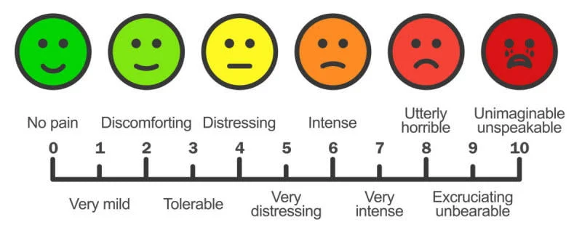
How do you describe your part 1 at this point ?

Slide 7

Last semester of Part 1….

Slide 8
Module Overview
AIM(S)
To present and defend an advanced research proposal incorporating an introduction and justification for the study, critical engagement with current research at the forefront of business and administration / management studies, a clear and advanced research methodology, and clear contributions on how this research will create new knowledge, advance business/ management theory and management/ organisational practices.

Slide 9
Module Overview
LEARNING OUTCOMES
Upon the successful completion of this module, the student should be able to:
Develop the systematic acquisition and understanding of a substantial body of knowledge which is at the forefront of business and management studies and organisational/management practice;
Conceptualise, design and undertake a research project for the generation of new knowledge and understanding at the forefront of business and management studies;
Write and defend a detailed research proposal that will generate original empirical research and new knowledge to advance business and management studies and organisational/management practice;
Frame the creation and interpretation of new knowledge through original research and advanced scholarship; to extend the forefront of business and management studies.

Slide 10
Indicative Content
Writing a research proposal
Skills for a Viva Voce
Research philosophy, method and methodology
Research tools and techniques
Critical thinking
Conceptualising and implementing a qualitative research project
Generation of new knowledge and presenting qualitative empirical evidence
Advanced qualitative and quantitative academic enquiry

Slide 11
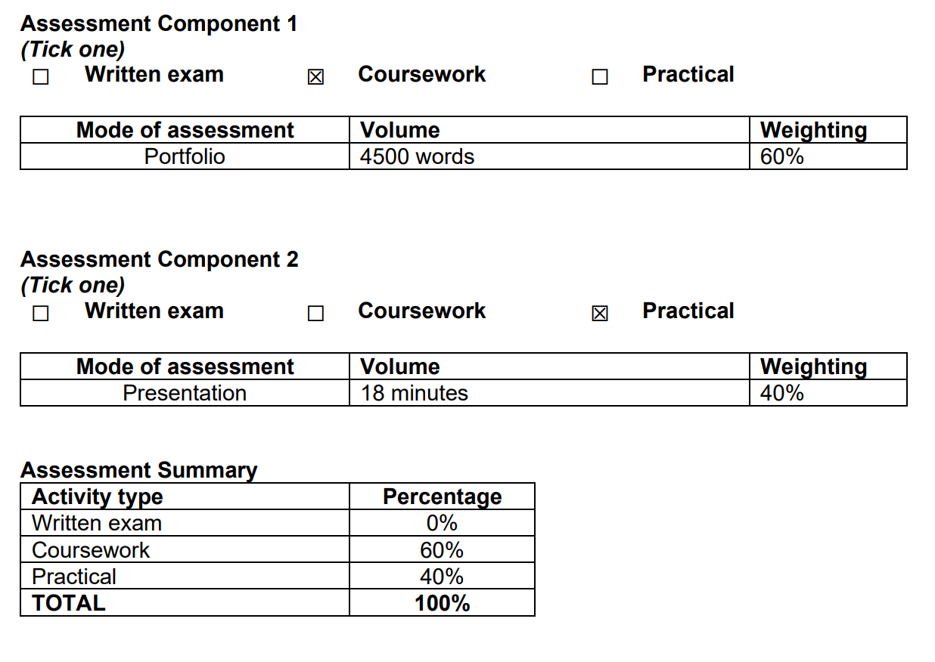
Assessment

Slide 12
Expectation ?

Slide 13

Expectation ?
Engage yourself in the scholarly activities
Completion of this module

