Slide 1

Reflection

Slide 2
Objective
To encourage students to develop an understanding of the power of reflection
To help students with academic challenges like grappling with new concepts or challenging existing perspectives, and writing in a reflective style

Slide 3
Objective
To encourage students to develop an understanding of the power of reflection

Slide 4
What is ‘reflection’?
It is a method of examining your thoughts, feelings and actions in relation to new knowledge and/or experience
Reflection fosters learning
Reflection supports continuing academic and professional practice
We should never stop learning

Slide 5
Donald Schon 1983
He examined how professionals think while practicing
Reflective practitioner
He saw two opposing approaches:
Technical rationality
Reflection in action

Slide 6
Technical rationality (TR)
Scientific theory applied to problem solving: a powerful aspect which shapes professional practice and validates professions
Ivan Illich (1970) saw the dominance of technical expertise, and the control which this brought
Criticism – practical competence in divergent situations: sometimes we see practical competence linked to intuition
Benner – spoke of perceptual abilities (gut feelings)

Slide 7
Reflection in Action
Sometimes we might feel that something is not quite right, something is amiss but are unable to say what or why
‘Tacit’ means being understood without being stated
Think of someone you care for and love, and then try to explain why you feel as you do. Not easy!
Over time, skills and knowledge become internalised
How did you feel during your first driving lesson, and how do you feel now when you get into your car?
Tacit understanding in practice (knowing in action)
Relating theory to practice as performance occurs
Dunlop (1986), ‘Certain understandings that cannot be spelled out in universal rules’
Polani (1967) spoke of tacit knowledge

Slide 8

Reflection
Three intrinsic factors
  Action
  Thought
  Self
We seek reasons for our actions and evaluate the validity of our perception
Learning involves use of the self as a source
Most actions tend to be performed without thinking about them in too much depth

Slide 9

Reflection ON action
Learning from experience
Visualising, recreating the thoughts and experience, evaluating this in conjunction with our feelings
Questioning in relation to:
  Technical Rationality (TR)
  Tacit understanding

Slide 10

Application to learning
Schon – ‘knowledge is generated through reflection in and on action, it is learnt from experience
In your studies:
What, when, where, how?
Listen and take notes
Question as you do this – summarise your ideas
Value the experience
What are your thoughts, feelings and actions?
What do you need to improve?
Not a judgement of the lesson, more a question of how you performed

Slide 11
Borton 1970
So what?
Now what?
What?
What happened - Reflection
Making sense of the experience
Active consideration of options

Slide 12
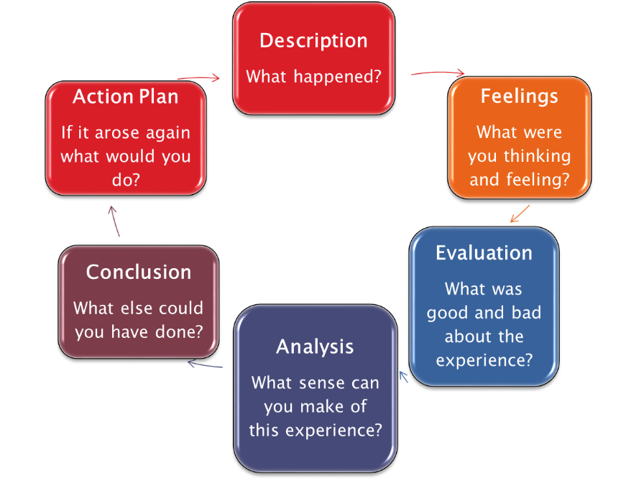
Gibbs
Gibbs' Reflective Cycle (1988)

Slide 13
Why reflect?
Develop an inquisitive mind
Explore options for change
Plan new ways of working

Slide 14
Key steps in reflection
Step back and take a third-party perspective
Consider how you felt at the time of the event
How did your feelings influence your behaviour?
Did your perspective change after the event?
Was the outcome inevitable or did you inlfuence the outcome?
If so, how? Was your impact positive or negative?
If you had a time machine, would you feel, think and act in the same way?
Would changing your behaviour have changed the outcome?
Did the experience change your awareness and understanding?

Slide 15
Reflective excellence entails
A clear account of the event
Interpretation from reflection
Outcomes for next time

Slide 16
Academic v Reflective Writing
Academic | Reflective
3rd person and objective | 1st person and subjective
Not personal | Personal experiences and perceptions
Academic literature | Your perspective plus academic sources
Clear structure | Shaped by reflective models
Defined purpose and specification | Perhaps less well defined purpose
Conclusions are clear | A continual process
After Moon 2008

Slide 17
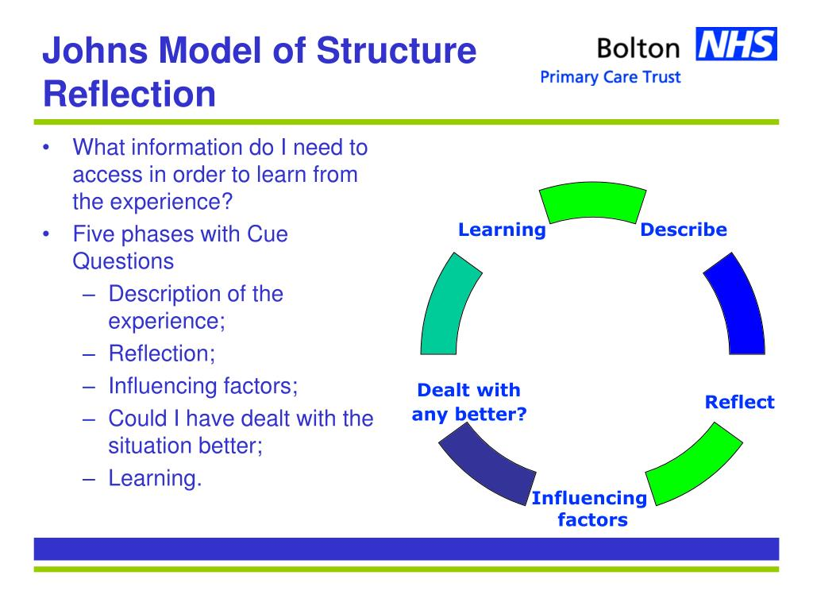

Slide 18
Gibbs G (1988) Learning by Doing: a guide to teaching and learning methods. Oxford: Oxford Polytechnic

