Slide 1
Week 4 – Big O Notation
Dr Tim Bashford

Slide 2
Why Big O?
Big O notation is a mathematical notation that describes the limiting behaviour of a function when the argument tends towards a particular value or infinity
The growth rate of a function is also referred to as the order of the function hence the “O”…. how the run time or space requirements grow as the input size grows
Used to measure the performance of algorithms
  It is a common and good measure of algorithm performance
Often quoted when comparing the performance of algorithms
The maths can be a bit daunting if you are not mathematically inclined…..but we will try to keep it simple

Slide 3
The Big What?
We write a mathematical function with a name with a capital O, like this:
O(n)
… hence, big O.

Slide 4
Big O
Big O stands for Order of growth
How efficient the algorithm is at processing arbitrary inputs
Big O is also a measure of computational complexity
The growth rate of the resources required (usually time)
  Hence you may see it quoted as a measure of complexity

Slide 5
Exercise
Say you have a 100 fields each containing cattle
You have a dragon that likes eating cattle, so you want to hunt the dragon
How do you find which field the dragon is in?

Slide 6
Answer
You have to search each field one at a time because we have no other information that would allow us to eliminate any of the fields

Slide 7
Search
Say we have an array of 100 numbers, sorted from lowest to highest
Say we want to check if a number is in the list
We could perform a linear search (aka simple search)
  Check each value start with the first until we find a match or reach the end of the array
It would take 77 steps find the 77th number
If the value is the 100th number, then you would have to check all 100 numbers
You might describe this a stupid search if you were dealing with 100,000 numbers
1
2
3
4
5
6
97
98
99
100

Slide 8


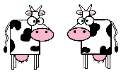
Exercise
Say you have a 100 fields each containing cattle
You have a dragon that likes eating cattle, so you want to hunt the dragon
You know the dragon is smart and greedy, so it will always each the fields with the most cattle first.
Also, you have a nice list telling you how many cattle are in each field.
How do you quickly find which field the dragon is in?
10 cows
9 cows
8 cows
7 cows
6 cows
5 cows
4 cows

Slide 9
Answer
If he has already eaten the cattle in a field then you know that all the fields which have more cattle than this field have already been attacked so the dragon will not be in them
So we could start by choosing the field from the middle of the list and check to see if it is empty
Hence, we can eliminate a number of fields rather than just one every time we check a field
  If the field is empty eliminate all the larger fields than the field we are looking in
  Otherwise, eliminate all the smaller fields since the dragon hasn’t reached this field yet
A smart technique is to try to eliminate as many fields with each check that we make…..binary search
10 cows
9 cows
8 cows
7 cows
6 cows
5 cows
4 cows

Slide 10
Binary Search
The previous approach only eliminated one number at each step
But I know the numbers are sorted in order from lowest to highest, so we can be smarter and eliminate a range of numbers at each step
Start by checking the middle of the numbers i.e. the 50th number in our case. If the value we are looking for is the 63rd number, we know this is higher than the 50th number and we can eliminate all 50 numbers below it in just the first step
1
2
3
4
5
6
Linear search
Check one at a time
Check this next
1
2
3
48
49
50
51
52
99
100
Check here first

Slide 11
Binary Search
We can just keep repeating this process of splitting the remaining numbers of half each time until we find the number
1
2
3
48
49
50
51
52
99
100
mid = 100/2
Eliminate 1-50
STEP 1
Check here first
STEP 2
51
52
53
73
74
75
76
77
99
100
mid = 50+(50/2) = 75
Eliminate 75-100
Check at 75th number
STEP 3
51
52
53
61
62
63
64
65
73
74
mid = 50 + (25/2) = 63
Found it!!
3 checks instead of 63

Slide 12
Binary Search
Comparing the linear search to the binary search to find the 63rd number took 63 steps and 3 steps respectively
How many numbers does a binary search eliminate at each step assuming worst case given 100 numbers to search through?
Worst case it will take 7 steps
50 → 25 → 13 → 7 → 4 → 2 → 1
to find any value
Actually, when you get to the last two values this is clearly a simple decision so in reality this is just 6 steps
Size | 100 | 1000 | 10000 | 100000
Step 1 | 50 | 500 | 5000 | 50000
Step 2 | 25 | 250 | 2500 | 25000
Step 3 | 13 | 125 | 1250 | 12500
Step 4 | 7 | 63 | 625 | 6250
Step 5 | 4 | 32 | 313 | 3125
Step 6 | 2 | 16 | 157 | 1563
Step 7 | 1 | 8 | 79 | 782
Step 8 |  | 4 | 40 | 391
Step 9 |  | 2 | 20 | 196
Step 10 |  | 1 | 10 | 98
Step 11 |  |  | 5 | 49
Step 12 |  |  | 3 | 25
Step 13 |  |  | 2 | 13
Step 14 |  |  | 1 | 7
Step 15 |  |  |  | 4
Step 16 |  |  |  | 2
Step 17 |  |  |  | 1

Slide 13
Exercise
How many steps (worst case) does it take for a binary search to find a word in dictionary containing 365412 words arranged in alphabetical order
Hint: just keep dividing by 2
Use Excel if you want

Slide 14
Answer
Size | 365,412
Step 1 | 182,706
Step 2 | 91,353
Step 3 | 45,677
Step 4 | 22,839
Step 5 | 11,420
Step 6 | 5,710
Step 7 | 2,855
Step 8 | 1,428
Step 9 | 714
Step 10 | 357
Step 11 | 179
Step 12 | 90
Step 13 | 45
Step 14 | 23
Step 15 | 12
Step 16 | 6
Step 17 | 3
Step 18 | 2
Step 19 | 1
19 steps

Slide 15
Divide and Conquer
Divide and conquer is a common technique used in developing algorithms
In a binary search, we divide the numbers by 2 then divide by 2 again and so on.
Remember we said that raising a 2 by a power of k was multiplying 2 by itself k times
2³ = 2 x 2 x 2 = 8
The log of base 2 is equivalent to determining how many times we can divide a value by 2
log₂ (8) = 8/2
= 4/2
= 2/2
= 1
Thus a binary search is running log₂ time (aka log time)
3 times
Once the value goes below 2 we stop…but include it as a step

Slide 16
Exercise
Calculate log₂ of 8
Careful, the “log” button on your calculator is actually base 10 i.e. log₁₀
If your calculator does not provide this, then either use an online calculator or use the following:
For example, log₂ (8) = log₁₀ (8) / log₁₀(2) = 3
Question: Calculate the number of steps (worst case) required for a binary search of:
365,412 items
10,000,000 items
Hint: always round up e.g. 7.1 = 8 steps
log₂ (y) = log₁₀ y / log₁₀ 2

Slide 17
Answer
Size | 365,412 | 10,000,000
Step 1 | 182706 | 5000000
Step 2 | 91353 | 2500000
Step 3 | 45677 | 1250000
Step 4 | 22839 | 625000
Step 5 | 11420 | 312500
Step 6 | 5710 | 156250
Step 7 | 2855 | 78125
Step 8 | 1428 | 39063
Step 9 | 714 | 19532
Step 10 | 357 | 9766
Step 11 | 179 | 4883
Step 12 | 90 | 2442
Step 13 | 45 | 1221
Step 14 | 23 | 611
Step 15 | 12 | 306
Step 16 | 6 | 153
Step 17 | 3 | 77
Step 18 | 2 | 39
Step 19 | 1 | 20
Step 20 |  | 10
Step 21 |  | 5
Step 22 |  | 3
Step 23 |  | 2
Step 24 |  | 1
log₂ (365,412) = 18.48 = 19 rounded up
log₂ (10,000,000) = 23.25 = 24 rounded up

Slide 18
Linear vs Log Time
When comparing how long an algorithm takes to run, the results can be deceiving
For example, let’s say it takes 1ms to complete each search step and we have 100 items
For a linear search O(n), it takes
100 x 1ms = 100ms
For a binary search O(log n) it takes
log₂(100) x 1ms = 10ms (approx.)
So we may conclude (wrongly) that the binary search is 10 times faster than a linear search (10/100 = 10)
Let’s say we now increase the list of numbers to 10 million
A worst case binary search takes 23ms (approx.)
So we might conclude (wrongly) that it will take 10 times as long for a binary search i.e. 23 x 10 = 230ms which is still a very reasonable search time
Question, what is the actual worst case time for the linear search?
1ms is a thousandth of a second i.e.
1/1000 = 0.001 s
1s = 1000ms

Slide 19
Answer
O(n) at 1ms per step where n=10,000,000
= 10,000,000 ms
= 167 mins (approx.)
= 2.8 hours
Linear search O(n) = 2.8 hours
Binary search O(log n) = 23 ms
Try a billion items (1,000,000,000)
Linear search O(n) = 11.6 days
Binary search O(log n) = 30 ms
Using Big O means we can avoid these misconceptions and compare the performance of algorithms in a meaningful way

Slide 20
Another viewpoint
What we are doing is dividing the data we need to process at each stage and consequently halving the processing time at each stage
log₂ tells us how many times we can divide the data by 2
Divide by 2
Divide by 4
Divide by 8

Slide 21
Algorithm Analysis
Best case analysis
Not very useful, many algorithms will perform the same under optimal conditions
For example, the best case for a search would be that the first item we look at is the one we want
Average case analysis
Under specialised circumstances we use the average case e.g. if it is a randomised algorithm such as quicksort. However, this is often not easy to accurately calculate.
Also, what do we mean by “average” anyway?
  … often referred to as the amortised time i.e. the average cost of running a sequence of operations in the worst case i.e. the expected running time
Worst case analysis
Always do the worst case analysis since this tells us how badly the algorithm is likely to perform when we increase the demands we impose on it. Typically, as we give it more data to process. This is the upper bound of performance, it will never perform worse than this.

Slide 22
Comparing Relative Performance
In computing we use it to analyse the number of steps it takes to complete the algorithm
Essentially, Big O values are relative and not meant to be exact i.e. they are a way of comparing relative performance
It is not important that an algorithm takes 20ms to execute just that it always takes 20ms to execute
Very important to remember this!!

Slide 23
Question
Which is quicker?
Do we care?
int x = 5;
int y = 4;
y= x + 5;
int Add(int y)
{
int x;
x= y + 5;
return x;
}

Slide 24
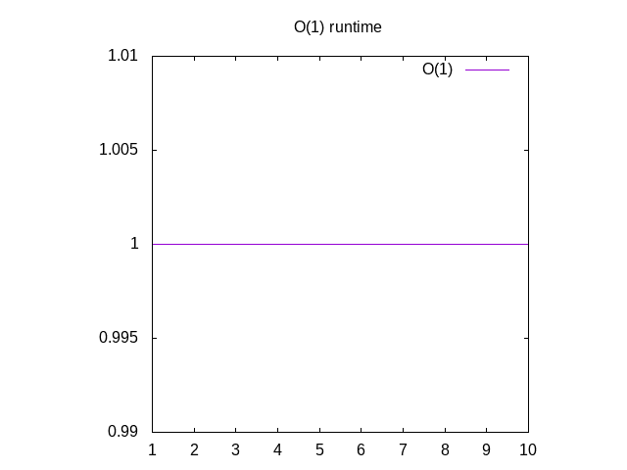
Simple Example
These code examples may take a different amount of time depending on the number of lines of code BUT each individual function will always execute in the same amount of time because the number of instructions (“steps”) to be executed is fixed.
In Big O notation, this is written as O(1)
Remember we are only looking for causes of a big dynamic growth in time (orders of magnitude), so although we could write O(3) because of the 3 instructions we consider this irrelevant and just write 1.
int x = 5;
int y = 4;
y= x + 5;
int Add(int y)
{
int x;
x= y + 5;
return x;
}
Just runs for the same amount of time regardless of the data we give it
https://justin.abrah.ms/computer-science/big-o-notation-explained.html

Slide 25
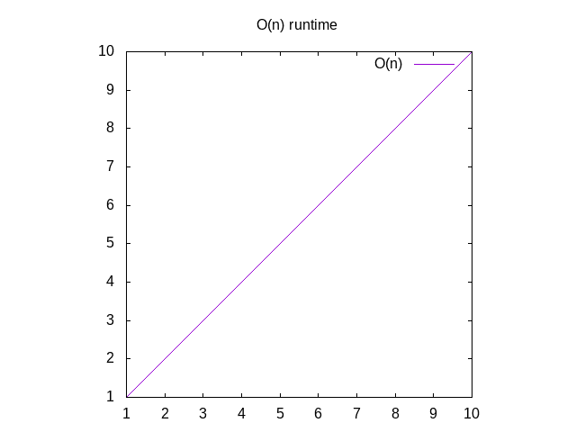
Iteration (e.g. linear search)
A loop causes a linear increase in execution time (growth)
The bigger the “length” value the more iterations the loop performs, the more instructions that are executed and the longer the code takes to execute
In Big O notation, this is written as O(n) aka “Order of n”
bool FindIndex(int numbers[], int length, int value)
{
int index;
for (index = 0; index < length; index++)
{
if (numbers[index] == value) return index;
}
return -1; // Not found
}
For Big O, we ignore these line when compared to the loop execution time
“n” here is the “length” argument.
The code before and after the loop are constant giving O(n) + O(1). However, the O(1) term can be ignored because the loop is the dominate term. e.g. the code inside the loop could run 100,000 times
O(n)
O(n)
The O(1) term becomes swamped by the O(n) as “n” increases
O(1)
O(1)

Slide 26
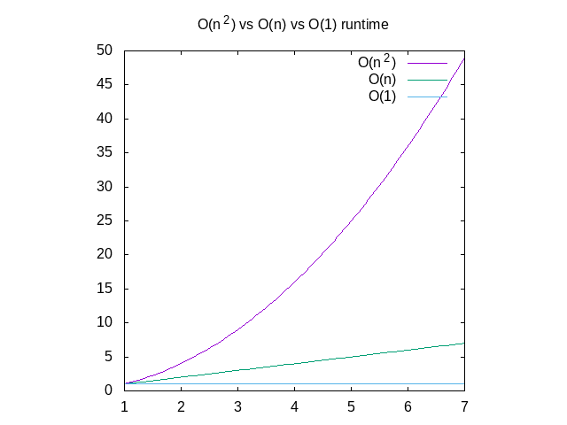
Loops Within Loops
void Multiply(int numbers[], int n, int m)
{
for (int i = 0; i < n; i++)
{
for (int j = 0; j < m; j++)
{
numbers[(i * m) + j] = i * j;
}
}
}
With a loop within a loop, the outer loop executes n inner loops executing n instructions
n * n = n²
In Big O notation, this is written as O(n²) aka “Order of n squared”
Worse than O(n)
O(n²) gets much slower as n increases
O(n²)
Note: we are dealing with relative values so the fact that the inner loop and outer loop are using different limits n and m, is irrelevant
O(n * m) is equivalent to O(n²)
O(n)
O(1)

Slide 27
Exercise
What is the Big O complexity of the code on the right?
Hint: might be a trick question
void Multiply(int numbers[], int n)
{
for (int i = 0; i < n; i++)
{
for (int j = 0; j < 5; j++)
{
numbers[(i * 5) + j] = i * j;
}
}
}

Slide 28
Answer
The inner loop always iterates 5 times, so the time it takes to execute is always constant
Hence, we can ignore the inner loop giving us
O(n)
For this reason, a Big O rule states we can ignore any constants
Given m = 5
O(n x m) = O(n x 5) = O(n)

Slide 29
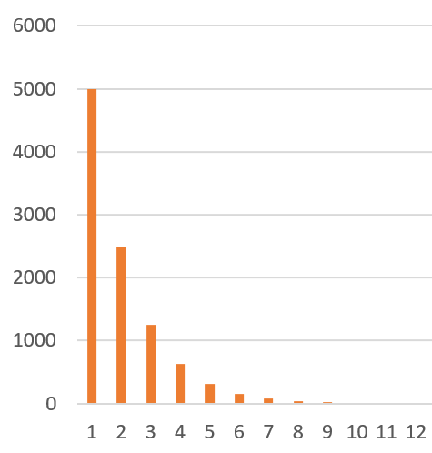
Searching: log time
Halving the values to be searched during each iteration
A classic example, is to search for something in an array or list of “n” values such as a Binary Search
The most efficient approach is to eliminate groups values by chopping down the search space in big chunks instead of reading each value sequentially until you find it (assuming the list is sorted)
Any algorithm that reduces the number of executed steps required, say by ½, produces a logarithmic result
In Big O notation, this is written as O(log(n))
This is very efficient since the time required in each iteration rapidly declines to zero (relatively speaking) as the number of values to be searched is halved each time
Values to be searched
Total elapsed time log(n)
Iteration
For algorithms, when we write log X we imply log X
2

Slide 30
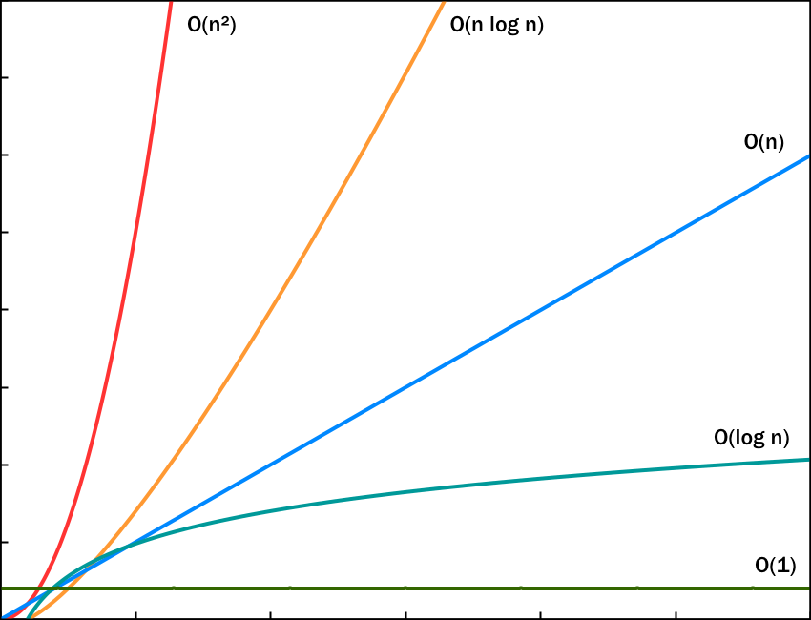
Merge Sort
Sorting is classic example where we have an array or list of “n” values that need to be sorted using a merge-sort
First we have to divide the values into two halves then we sort each half O(log(n))
Next we take the two sorted halves and merge them together using a loop to walk down each half adding them back to the “sorted” array or list O(n)
But we do repeat these two step continually until the list is fully sorted giving O(n log(n))
The result is worse than O(n) but better than O(n²)
O(n²)
O(n log n)
O(n)
O(log n)
O(1)
n times log n

Slide 31
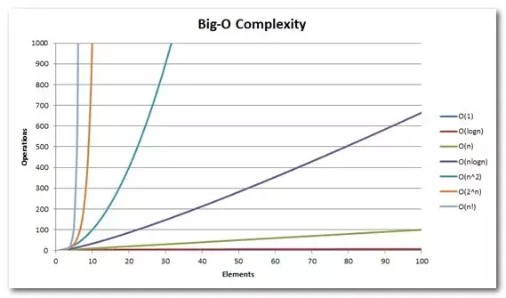
Factorial Time
Some algorithms perform even worse
Remember factorials, for positive integer value x
x! = x(x-1)(x-2)(x-3)….1
We will come across this in the “Travelling Salesman Problem”
n!
2^{n}
n log n
n²
n
log n

Slide 32
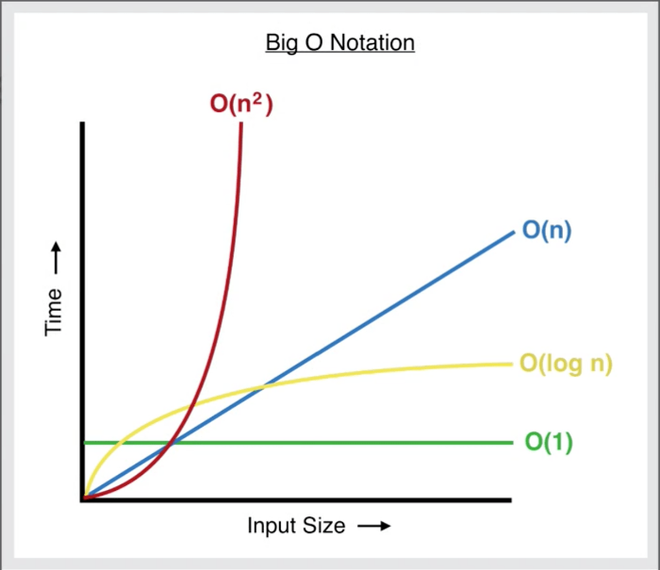
Comparison
Remember, this is all relative and what we are interested in is what happens as the number of item n increases
Ranked from best (smallest) to worst (largest)
O(1) fixed number of executed steps
O(log(n)) an algorithm that reduces the work each iteration, plateaus out at some point
O(n) a loop executing n steps
O(n log(n) an algorithm that reduces the work each iteration, but does additional work on each iteration
O(n²) a loop within a loop each running n steps
O(n!) VERY VERY BAD
O(n²)
O(n log n)
O(n log n)
O(n)
O(log n)
O(1)

Slide 33
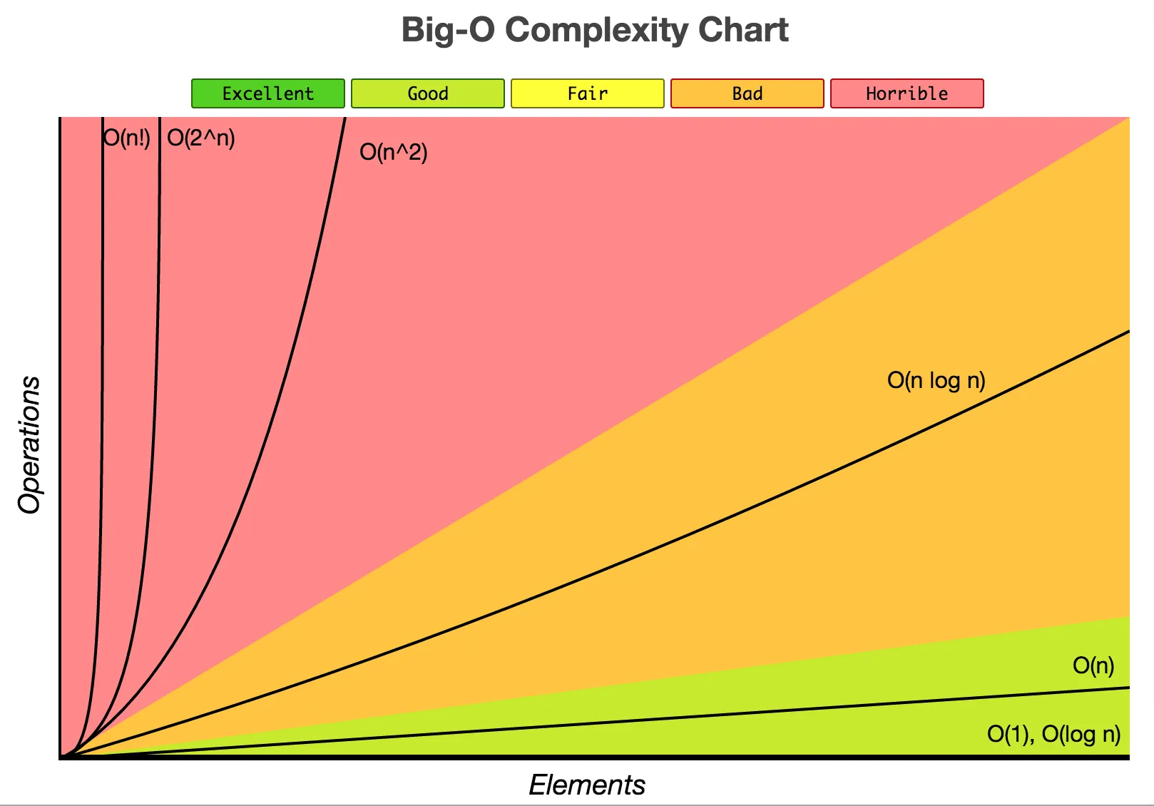

Slide 34
Rules
Given a constant C
O(C) = O(1)
O(C x n) = C x O(n) = O(n)
Addition:
O(n) + O(m) = O(n + m)
We do not care about the number of steps so make m = n
O(n + m) = O(n + n) = O(2n) = O(n)
Multiplication
O(n) x O(m) = O(n x m) ➔ typically written O(nm)
Unless m is known to be significantly smaller than n, we do not care about the number of steps so make m = n
O(n x m) = O(n x n) = O(n²)
THE SIMPLE IDEA:
If you have two sequential loops with n and m counts O(n + m) is equivalent to O(n)
Likewise, for loops within loops
O(n * m) is equivalent to O(n²)
Because this is all relative.

Slide 35

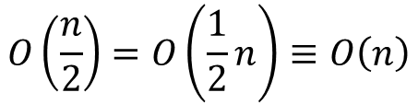


Rules
Big O assumes a large number of steps such that the contribution of the terms that grow "most quickly" will eventually make the other ones irrelevant.
Thus:
When you add terms together, if one of them is the largest then you can ignore the rest e.g.
When you multiply terms together, any constant values can be ignored e.g.
$$O\left(n^{2}\right)+O\left(n\right)≡O\left(n^{2}\right)$$
$≡$ means identical
$$O\left(\frac{n}{2}\right)=O\left(\frac{1}{2}n\right)≡O\left(n\right)$$
$$O\left(2n\right)≡O\left(n\right)$$
$$O\left(n^{2}\right)O(2\log{n)=O(2n^{2}\log{n})}≡O(n^{2}\log{n)}$$

Slide 36

Exercise
O(3n) = ?
O(n + n) = ?
O(n x m) = ?
O(n² + n) = ?
Simplify the Big O value for the insertion sort algorithm given it has the following performance:
Calculate the Big O complexity of adding m square matrices of n x n in terms of n and m.
Hint: you will need m-1 additions.
n² is larger
$$O(\frac{n^{2}}{2}+ \frac{n}{2} −n)$$
Hints:
Discard constants
Set m = n
Discard the smaller terms

Slide 37
Answers
O(3n) = O(n)
O(n) + O(n) = O(n + n) = O(2n) = O(n)
O(n x m) = O(n x n) = O(n²)
O(n² + n) = O(n²)
Notice how the contribution of the “n” term dwindles as value of n increases. Hence, we can discard the O(n) term since it of little comparative relevance
n² + n
Try a value of n = 10
(10)² + 10 = 100 + 10 = 110
Comparing the contribution of both terms we get n² = 100/110 = 91% and n = 10/110 = 9%
n increasing
n | 10 | 100 | 1,000 | 10,000 | 100,000 | 1,000,000
n² | 90.91% | 99.01% | 99.90% | 99.99% | 100.00% | 100.00%
n | 9.09% | 0.99% | 0.10% | 0.01% | 0.00% | 0.00%

Slide 38

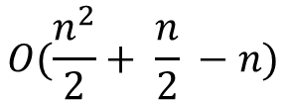


Answers
$$O(\frac{n^{2}}{2}+ \frac{n}{2} −n)$$
5.
Eliminate the ½ constants. n² is the largest term.
6. m-1 additions of n x n matrices.
Eliminate the -1 constant.
The question states the answer can be presented in terms of m and n, so this answer is OK. However, for a large number of matrices, you could argue that m and n are equivalent in terms of impact, meaning
n³ is larger than n².
$O\left(\frac{n^{2}}{2}+ \frac{n}{2} −n\right)=O \left(\frac{n^{2}}{2}\right)=O(n^{2})$
$$O \left(m −1\right)O\left(n^{2}\right)$$
$$O \left(m −1\right)O\left(n^{2}\right)=O\left(m\right)O\left(n^{2}\right)=O(mn^{2})$$
$$O\left(mn^{2}\right)=O\left(nn^{2}\right)=O\left(n^{3}\right)$$

