Slide 1

Global Business Challenges
National and International Strategic Policies

Slide 2
Learning Objectives:
Deliberate the need for national and international strategic policies
Understand the elements of the Paris Agreement and the Wellbeing of Future Generations (Wales) Act
Critically analyse the value of such policies
Reflect on the impact that such policies have on business today

Slide 3
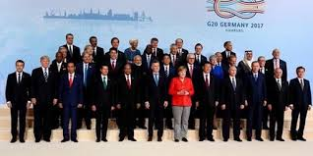
Notes:
What are strategic policies? Why do we need them? What do they do?

Slide 4




Notes:
What Happened?
What are the key treaties and policies?
How effective do you consider these?
(Dismal Failure or Historic Breakthrough? Clemencon, 2016)
How do these affect business?
(Schaffer and Dhooge (2017) suggest that international and national policies affect the decision making process and the strategy of an organisation.
Schaffer, R. and Dhooge, L. (2017) international Business Law and its Environment. Cengage Learning.

Slide 5
https://www.youtube.com/watch?v=Geycac7M32c
Notes:
Following the video; discuss whether students think that the Paris agreement is a good thing in light of Americas withdrawal. What are its weaknesses? Is it still relevant? Fit for purpose?

Slide 6
https://www.youtube.com/watch?v=rFeOYlxJbmw
Notes:
Activity to follow

Slide 7
In groups of ¾, select an organisation and consider the 5 ways that they would have to work differently according to the Wellbeing of Future Generations (wales) Act;
Long Term
Integrate
Involve
Collaborate
Prevent
What changes would you have to make?
What affect would this have on the business?

