Slide 1

Module name
Community Care and Management of Long-term Conditions
Student name: Josephine Osei Amoah
Student ID: 2233505
Module code: (LCHS7003_LON)
Lecturer name: Muhammed Khan
Subject: Chronic Kidney Disease (CKD)
(

Slide 2
I confirm that I have not used any AI tools in the research and creation of this assignment. I confirm that I have not presented any AI-generated materials as my own work. I confirm I have copies of my drafts, notes, and other resources I used, which I may be asked to provide in evidence.

Slide 3

Content Page
Definition… …………………………………………………………………6
Overview of Chronic Kidney Disease …………………………………….7
Symptoms and Aetiology ……………………………………………………9
Prevalence (UK and Global) .……………………………………………..10
Economic and Social Burden ……………………………………………..11
Diagnosis and Initial Assessment ………………………………………...12
Management (NICE Guidelines) ………………………………………….13
Models and Frameworks of Care …………………………………………14
Treatment Options in the UK ………………………………………………15
Comorbidities ………………………………………………………………..16
Prevention Strategies ……………………………………………………….17
Co-productive Care …………………………………………………………18
Skills, Values and Professional Practice ………………………………….19
Personalised Care and Self-Management ……………………………….20
Recommendations ………………………………………………………….21
Conclusion …………………………………………………………………..22
References ………………………………………………………………….24

Slide 4
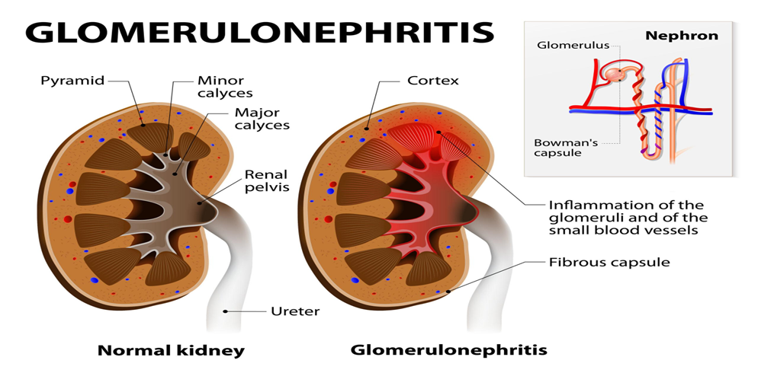
Chronic Kidney Disease (CKD)
According to Kidney Care UK, 2024. Chronic kidney disease (CKD) is a prolonged condition characterised by the kidneys' inability to function optimally. This ailment harms the kidneys, preventing them from effectively filtering blood, which leads to the accumulation of waste in the body.
(Kidney Cares, (n.d.)
Notes:
When diagnosed with chronic kidney disease (CKD), this means that a persons’ kidneys are not functioning optimally. As a result, waste products begin to accumulate in your body because your kidneys are unable to eliminate them effectively. This makes damage to the filtering system of the kidneys allows blood and protein to escape into your urine.

Slide 5
Audience
Community nurses in primary care
Key role in early detection, monitoring and education
Notes:
Community nurses play a key role in early detection, monitoring, patient education, and long-term management of CKD.

Slide 6
Definition
Kidney Care UK, 2024. Chronic kidney disease (CKD) is a prolonged condition characterised by the kidneys' inability to function optimally. This ailment harms the kidneys, preventing them from effectively filtering blood, which leads to the accumulation of waste in the body.
CKD is a growing global public health challenge (WHO, 2021).
Driven by ageing, diabetes and inequalities (Hill et al., 2016).
Significant burden on healthcare systems
Requires integrated and preventative approaches (NHS England, 2019).
Notes:
According to Kidney Care UK, 2024. Chronic kidney disease (CKD) is a prolonged condition characterised by the kidneys' inability to function optimally. This ailment harms the kidneys, preventing them from effectively filtering blood, which leads to the accumulation of waste in the body.

Slide 7
Complexity
eGFR <60 or kidney damage ≥3 months (NICE, 2021).
Often asymptomatic, delayed diagnosis
Highlights need for proactive screening (Levey et al., 2020).
Notes:
CKD is often asymptomatic in early stages, making early detection challenging yet essential.

Slide 8
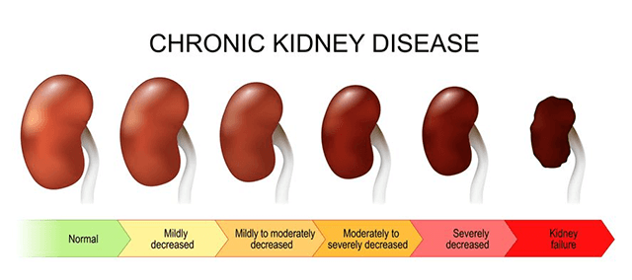
Symptoms
Fatigue
Oedema
Nausea
Reduced urine output (NHS, 2023).
Often asymptomatic early (Webster et al., 2017).
diagram below showing some steps of chronic Disease appears
(UPMC (2025)

Slide 9
Causes of CKD
Diabetes
Heart Disease
smoking
Unhealthy diets
High blood pressure (hypertension)
Inflammation of the kidneys (glomerulonephritis)
Prolonged, consistent use of specific medications, including non-steroidal anti-inflammatory drugs (NSAIDs) like ibuprofen and naproxen
A family history that includes inherited kidney disorders and uncommon diseases, which represent one in ten instances of chronic kidney disease (CKD) in adults and nearly all cases in children.
(Kidney Care UK, 2024)

Slide 10
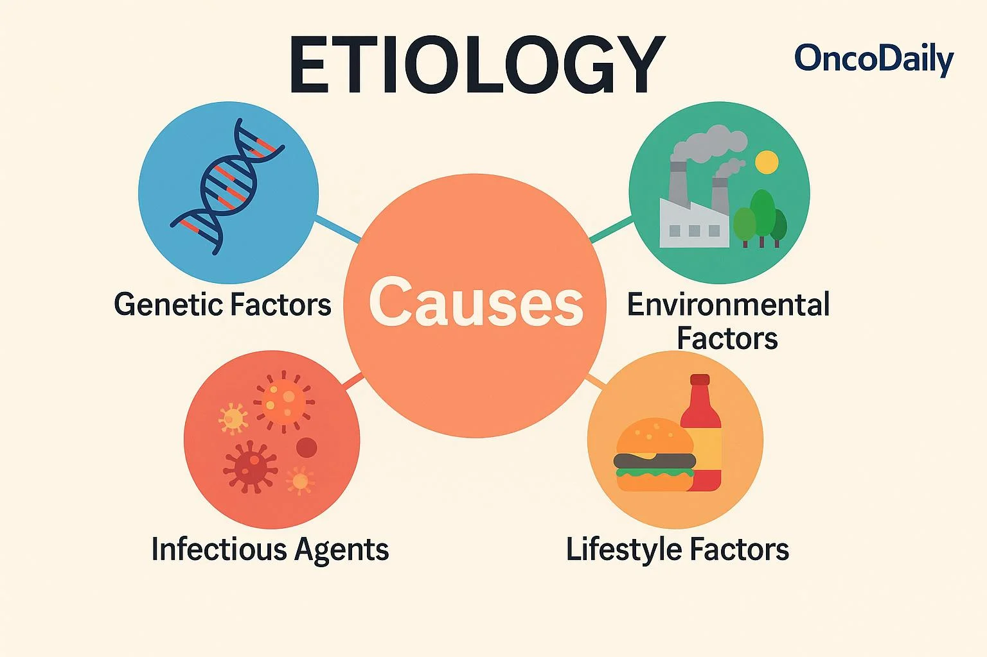
Aetiology and Determinants
Strong link to social determinants of health
Health inequalities significantly influence outcomes (Marmot, 2020).
Diagram show some determinants of Kidney disease
(OncoDaily, 2025)
Notes:
CKD is multifactorial, strongly linked to social determinants such as deprivation and access to care.

Slide 11
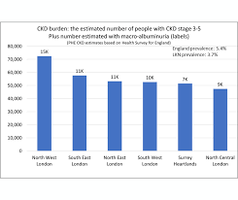
Prevalence & Inequalities of UK and worldwide
Accor7.2 million people are affected by CKD in the United Kingdom (Public Health England, 2021).
Higher in deprived and ethnic minority groups
Indicates systemic inequities in healthcare access (NHS Digital, 2022)
The NHS in England spends about £1.45 billion per year on CKD, which is around 1.3% of total NHS spending (Kerr, M. et al. (2012)
All kidney disease (including CKD and kidney failure) costs the UK about: £6.4 billion per year to the NHS, £7 billion total to the UK economy (including wider costs like lost productivity) (Kidney Research UK , 2023)
Table shows CKD Burdens in UK
(London Kidney Network, 2023).
Notes:
Prevalence is increasing globally, driven by chronic disease patterns. Inequalities highlight the need for targeted interventions.

Slide 12
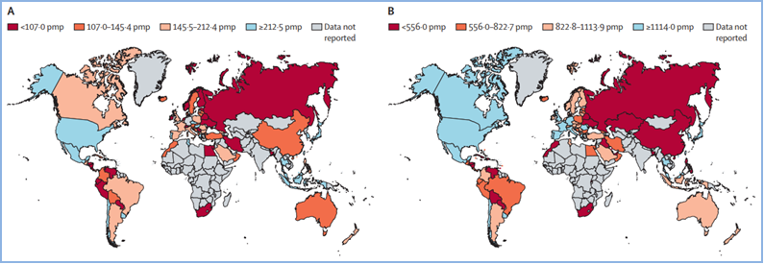
Worldwide
According to Bikbov et al., 2020; Kovesdy, 2022. CKD affects around 10–13% of the global population (over 700 million people), making it a major worldwide health issue.
The financial implications of CKD are substantial, with treatment costs varying from several thousand dollars in the initial stages to exceeding $50,000 annually per patient for dialysis (Vanholder et al., 2017).
Table showing global Kidney Health Atlas
(NephJC, 2024).

Slide 13
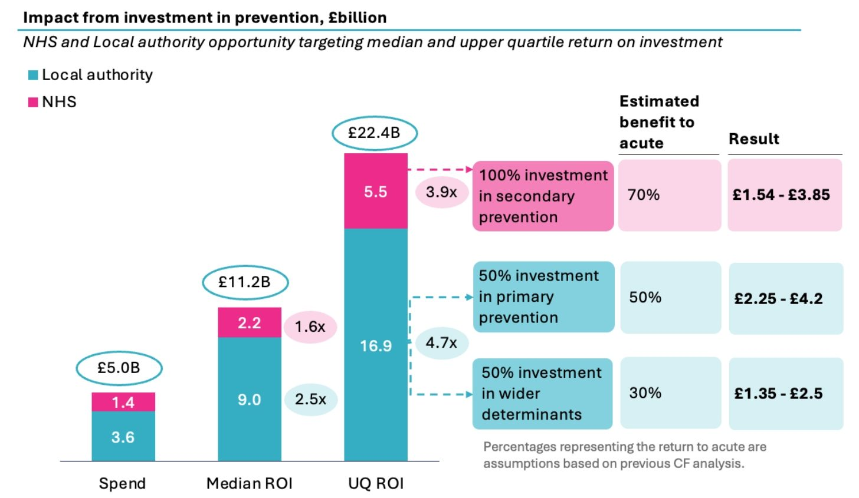
Economic and Social Burden
High direct healthcare costs: CKD significantly impacts NHS spending, especially on dialysis and managing complications, highlighting a reactive treatment approach (NHS England, 2019).
Inefficiency in resource allocation: Excessive funding for advanced disease indicates a lack of investment in early detection and prevention, which hampers cost-effectiveness.
Productivity losses: CKD leads to decreased workforce participation due to fatigue, comorbidities, and lengthy treatments, resulting in broader economic losses (CF Analysis, CF and NHS Confed, 2024).
Health inequalities: The burden of CKD is disproportionately felt in deprived populations, leading to greater prevalence and poorer outcomes, which intensifies social and economic inequalities.
Quality of life impact: Dependence on long-term treatments like dialysis severely affects physical, psychological, and social wellbeing.
Critical insight: The existing system is both financially and socially unsustainable, necessitating a transition from expensive end-stage care to preventative, community-focused strategies.
(Kidney Care UK, 2023).
Notes:
Late-stage CKD significantly increases healthcare costs. Preventative strategies are more cost-effective.

Slide 14

Diagnosis
eGFR and ACR testing Underdiagnosis common in early stages. Urine albumin-creatinine ratio, and blood tests and fasting glucose (NICE, 2021)
Inconsistent screening uptake in practice
Early detection reduces complications (Stevens and Levin, 2018)
Chronic Kidney Disease (CKD) is categorized into five stages according to eGFR values, indicating the extent of kidney damage.
GFR is determined by various factors including age, sex, ethnicity, and creatinine concentrations (and occasionally height and weight)
Notes:
Early diagnosis relies on routine screening in high-risk populations, yet uptake remains inconsistent.

Slide 15

Initial Assessment
Blood pressure
Cardiovascular risk (Di Angelantonio et al., 2016).
Medication review ( RCN, 2021)
Lifestyle assessment
Holistic care approach
(Stevens and Levin, 2018).
Notes:
A comprehensive assessment is crucial because of the significant comorbidity associated with cardiovascular disease. Consequently, the initial evaluation includes monitoring blood pressure, assessing lifestyle factors, and reviewing medications to adopt a holistic approach (Stevens and Levin, 2018).

Slide 16

Management (Critical View)
Focus on slowing progression, not cure
Relies heavily on patient adherence
Lifestyle modification is essential (WHO, 2021).
Resource limitations impact effectiveness, for example, BP and glycaemic control (NICE, 2021).
Notes:
NICE guidelines emphasise risk reduction rather than cure, highlighting chronic care management which is important for the regulation of blood pressure, enhancement of glycaemic control, and encouragement of lifestyle modifications to decelerate the progression of the disease (NICE, 2021).

Slide 17
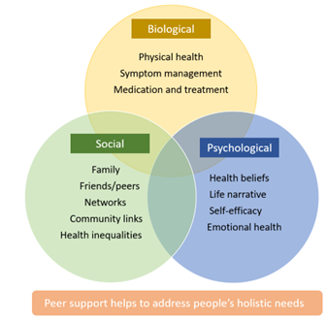
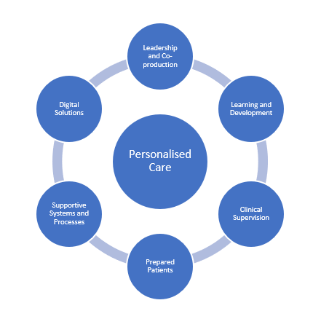
Models and Frameworks
Biopsychosocial Model diagram
The Chronic Care Model promotes proactive and structured care, leading to enhanced outcomes (WHO, 2021).
The Biopsychosocial Model focuses on addressing the comprehensive biological, psychological, and social needs of individuals (Marmot, 2020).
The Comprehensive Model of Personalised Care, which consists of six components, improves patient-centred management (NHS England, 2019):
Shared decision-making
Personalised care planning
Social prescribing
Supported self-management
Personal health budgets
Choice
Integrated Care Systems facilitate better coordination among services (NHS England, 2022).
NICE guidelines establish a standard for evidence-based management of Chronic Kidney Disease (CKD) (NICE, 2021).
6 comprehensive model diagram
(NHS England, 2023)
(Personalised Care Institute, 2023)
Notes:
Nevertheless, there remain implementation gaps and health inequalities throughout the UK.. These frameworks establish a solid basis for CKD management, their effectiveness relies on proper implementation, sufficient resources, and active patient involvement.

Slide 18

Treatment Options
Dialysis and transplantation for advanced CKD
Access to treatment may vary regionally (Webster et al., 2017)
ACE inhibitors, SGLT2 inhibitors recommendation (United Kingdom Kidney Association, 2022)
Kidney Care UK (2025)
Notes:
While pharmacological treatments slow progression, advanced CKD requires costly interventions like dialysis.

Slide 19
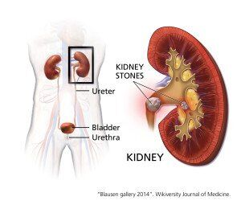
Comorbidities
Cardiovascular disease, which is the leading cause of mortality (Tonelli et al., 2017)
Diabetes mellitus, recognized as a major cause and comorbidity (NICE, 2021)
Hypertension, identified as both a cause and a consequence (NICE, 2021)
Anaemia, resulting from reduced erythropoietin production (UK Kidney Association, 2022)
Bone and mineral disorders, referred to as CKD-MBD (NICE, 2021)
Depression and anxiety, representing a significant psychological burden (Marmot, 2020)
Fluid overload and electrolyte imbalance (Stevens and Levin, 2018)
Diagram showing how when the kidney is strong and when it is inffected
(Gout Education Society, 2025)
Notes:
Multimorbidity complicates care, requiring integrated service delivery.

Slide 20
Prevention
Primary Prevention (Prevent onset)
A nutritious diet (low salt, balanced nutrition)
Consistent physical activity (World Health Organization, 2021).
Weight control
Quitting smoking
Limiting alcohol consumption (Public Health England, 2020).
Secondary Prevention (Early detection)
Screening for high-risk populations (diabetes, hypertension)
eGFR and urine ACR assessments (National Institute for Health and Care Excellence, 2021)
NHS Health Checks (NHS England, 2019).
Tertiary Prevention (Prevent progression)
Managing blood pressure
Controlling glycaemia (National Institute for Health and Care Excellence, 2021).
Medications (ACE inhibitors) (UK Kidney Association, 2022).
Lifestyle modification (NHS England, 2019).
Public Health & Policy
NHS England prevention initiatives (NHS England, 2019).
Addressing health disparities (Marmot, 2020).
Patient education and self-management strategies (Kidney Care UK, 2023).
Notes:
The prevention of Chronic Kidney Disease (CKD) encompasses primary, secondary, and tertiary levels, underpinned by both global and UK policy frameworks. Nevertheless, in spite of the existence of explicit guidance, the efficacy of these strategies is frequently constrained by disparities in access to care, health literacy, and inconsistencies in service delivery.

Slide 21
Co-productive Care
Shared decision-making improves outcomes (NHS England, 2019).
Requires patient empowerment and trust
Barriers include health literacy and time constraints (House of Commons, 2018).
Notes:
Effective CKD management requires collaboration between patients and professionals, though barriers include health literacy.

Slide 22
Skills and Professional Practice
Advanced communication and empathy required (RCN, 2021).
Cultural competence essential
Supports personalised, ethical care (Marmot, 2020).
Notes:
Community nurses must adapt communication styles to support diverse populations.

Slide 23

Personalised Care Model
Patient education and self-management strategies (Kidney Care UK, 2023).
The NHS England personalised care model comprises six key components: shared decision-making, personalised care planning, social prescribing, supported self-management, personal health budgets, and patient choice (NHS England, 2019)
It enhances patient self-management by empowering individuals to actively participate in managing chronic kidney disease (CKD), which includes making lifestyle changes and adhering to treatment plans.
This model promotes holistic, patient-centred care that is tailored to meet individual needs, preferences, and comorbidities.
Nevertheless, successful implementation necessitates system-wide support, workforce training, and integration across various services (NHS England, 2023).
Challenges include health literacy, resource limitations, and inconsistencies in service delivery across different regions.
(NHS England, 2018)
Notes:
These components empower patients but require system-level support for full implementation.

Slide 24
Recommendations
Strengthen
Strengthen early detection strategies
Improve
Improve community-based intervention (NICE, 2021)
Address
Address health inequalities (Marmot, 2020)
Notes:
Policy and practice must align to reduce disparities and improve outcomes.

Slide 25
Conclusion
Conclusion
Chronic Kidney Disease (CKD) represents a major and escalating public health issue both in the United Kingdom and worldwide.
Timely diagnosis and preventive measures are crucial for minimizing progression and associated complications.
Successful management necessitates the incorporation of NICE guidelines, tailored care, and collaborative multidisciplinary strategies.
The presence of comorbidities and health disparities adds to the complexity of care delivery.
Future advancements hinge on early intervention, active patient participation, and the comprehensive implementation of care models across the healthcare system.
Notes:
A shift towards prevention and integrated care is essential for sustainable management.

Slide 26
REFERENCES
Bello, A.K. et al. (2017) Global kidney disease. The Lancet, 390(10105), pp. 197–213.
Bikbov, B. et al. (2020) Global, regional, and national burden of chronic kidney disease, 1990–2017. The Lancet, 395(10225), pp. 709–733. https://doi.org/10.1016/S0140-6736(20)30045-3 (Accessed: 14 April 2026).
British Medical Association (BMA) (2022) Chronic kidney disease statistics. London: BMA.
Centers for Disease Control and Prevention (CDC) (2022) Chronic kidney disease in the United States. Atlanta: CDC. https://www.cdc.gov/kidneydisease (Accessed: 5 April 2026).
Couser, W.G. et al. (2011) The contribution of chronic kidney disease to the global burden of major noncommunicable diseases. Kidney International, 80(12), pp. 1258–1270.
Diabetes UK (2023) Diabetes and kidney disease. London: Diabetes UK. https://www.diabetes.org.uk (Accessed: 5 April 2026).
Di Angelantonio, E. et al. (2016) Chronic kidney disease and risk of major cardiovascular disease and non-vascular mortality. BMJ, 354, i4481.
Fraser, S.D.S. and Roderick, P.J. (2019) Kidney disease in the UK: a view from primary care. BMJ, 364, l135.
Gout Education Society (2025) Comorbidities. https://gouteducation.org/medical-professionals/treating-gout/comorbidities/ (Accessed: 27 March 2026).
Hill, N.R. et al. (2016) Global prevalence of chronic kidney disease. PLOS ONE, 11(7), e0158765.

Slide 27
House of Commons Health Committee (2018) Prevention in health and social care. London: HMSO.
Kerr, M. et al. (2012) Estimating the financial cost of CKD to the NHS in England. Nephrology Dialysis Transplantation, 27(suppl_3), iii73–iii80. https://doi.org/10.1093/ndt/gfs269 (Accessed: 14 April 2026).
Kidney Care UK (2023) Living with kidney disease. https://www.kidneycareuk.org (Accessed: 6 April 2026).
Kidney Care UK (2024) Chronic kidney disease (CKD). https://kidneycareuk.org/get-support/free-resources/patient-information-booklets/chronic-kidney-disease/ (Accessed: 11 April 2026).
Kidney Care UK (2025) SGLT2 inhibitors information. https://kidneycareuk.org/get-support/free-resources/patient-information-booklets/sglt2-inhibitors/ (Accessed: 24 March 2026).
Kidney Cares (n.d.) Chronic kidney disease (CKD). https://kidneycares.com/chronic-kidney-disease-ckd/ (Accessed: 17 March 2026).
Kidney Research UK (2023) The economic impact of kidney disease in the UK. https://www.kidneyresearchuk.org (Accessed: 11 April 2026).
Kovesdy, C.P. (2022) Epidemiology of chronic kidney disease: an update 2022. Kidney International Supplements, 12(1), pp. 7–11. https://doi.org/10.1016/j.kisu.2021.11.003 (Accessed: 12 April 2026).
Levey, A.S. et al. (2020) Nomenclature for kidney function and disease. Kidney International, 97(6), pp. 1117–1129.
London Kidney Network (2023) Kidney facts and figures. https://www.londonkidneynetwork.nhs.uk (Accessed: 24 March 2026).
Marmot, M. (2020) Health equity in England: The Marmot Review 10 years on. London: Institute of Health Equity.
NICE (2021) Chronic kidney disease: assessment and management (NG203). https://www.nice.org.uk/guidance/ng203 (Accessed: 1 April 2026).
National Kidney Foundation (2022) Clinical practice guidelines for chronic kidney disease. New York: NKF.
NHS Digital (2022) Health Survey for England. Leeds: NHS Digital.

Slide 28
NHS England (2018) Personalised Care Model Video. https://www.youtube.com/watch?v=jkzLP1_Y6Mw (Accessed: 17 March 2026).
NHS England (2019) The NHS Long Term Plan. London: NHS England.
NHS England (2022) Health inequalities improvement framework. London: NHS England.
NHS England (2023a) Chronic kidney disease pathway. London: NHS England.
NHS England (2023b) Personalised care model. London: NHS England.
NephJC (2024) Global Kidney Health Atlas. https://www.nephjc.com/news/global-kidney-atlas (Accessed: 11 April 2026).
OncoDaily (2025) Etiology. https://oncodaily.com/oncolibrary/etiology (Accessed: 21 March 2026).
Personalised Care Institute (2023) Embedding personalised care. https://www.personalisedcareinstitute.org.uk/2023/09/25/embedding-personalised-care-an-organisational-journey/ (Accessed: 7 April 2026).
Public Health England (2020) Health matters: preventing cardiovascular disease. London: PHE.
Public Health England (2021) Chronic kidney disease prevalence model. London: PHE.

Slide 29
Royal College of Nursing (2021) Advanced nursing practice framework. London: RCN.
Stevens, P.E. and Levin, A. (2018) Evaluation and management of chronic kidney disease. Kidney International Supplements, 8(1), pp. 1–150.
Tonelli, M. et al. (2017) Chronic kidney disease and mortality risk. The Lancet, 380(9844), pp. 807–814.
UPMC (2025) Chronic kidney disease. https://www.upmc.com/services/kidney-disease/conditions/chronic-kidney-disease/ (Accessed: 28 March 2026).
UK Kidney Association (2022) Clinical practice guidelines for chronic kidney disease. London: UKKA.
United Nations (2021) Non-communicable diseases progress monitor. New York: UN.
Vanholder, R. et al. (2017) The cost of kidney disease and CKD burden. Nature Reviews Nephrology, 13(4), pp. 193–205. https://doi.org/10.1038/nrneph.2017.17 (Accessed: 14 April 2026).
Webster, A.C. et al. (2017) Chronic kidney disease. The Lancet, 389(10075), pp. 1238–1252.
World Health Organization (2021) Global burden of disease. Geneva: WHO.
World Health Organization (2022) Noncommunicable diseases country profiles. Geneva: WHO.
Zoccali, C. et al. (2017) CKD-related cardiovascular risk. Nephrology Dialysis Transplantation, 32(2), ii1–ii9.

