Slide 1
Social and Ethical Marketing –
Assignment 2
Callum Cresser

Slide 2
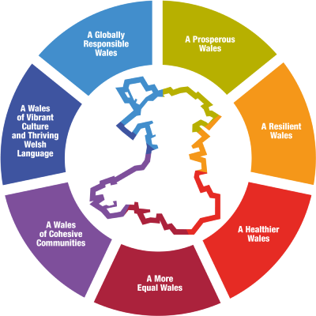

Introduction to ‘Cymuned Caerfyrddin’
Shopping in the current day
Health and Wellbeing Act Wales

Slide 3
Idea One
Carmarthen Town Open Evening
Later Opening Hours For Local Businesses 2 Nights A Year
Local Foods And Crafts On The Streets
Benefits The Local And Organic Selling Businesses
Attempting To Brings More People Into The Town Centre

Slide 4
Digital Marketing
Social Media Marketing
Use Of Social Media To Promote The Event
Frequently Shared Online
Content Marketing
Creating And Distributing Leaflets For Promotion
Aimed At Attracting Target Market

Slide 5
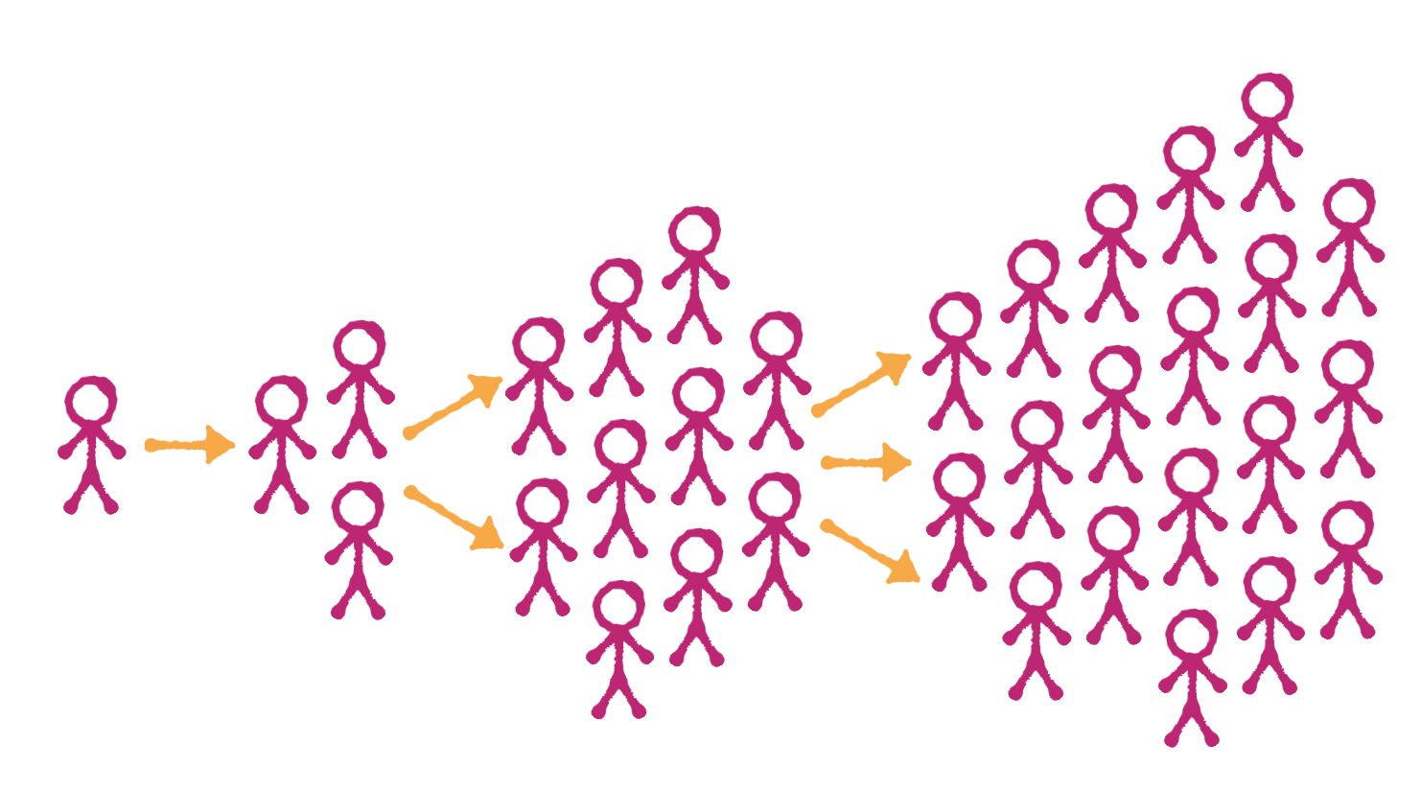
Evangelism
Vital in promoting local businesses

Slide 6
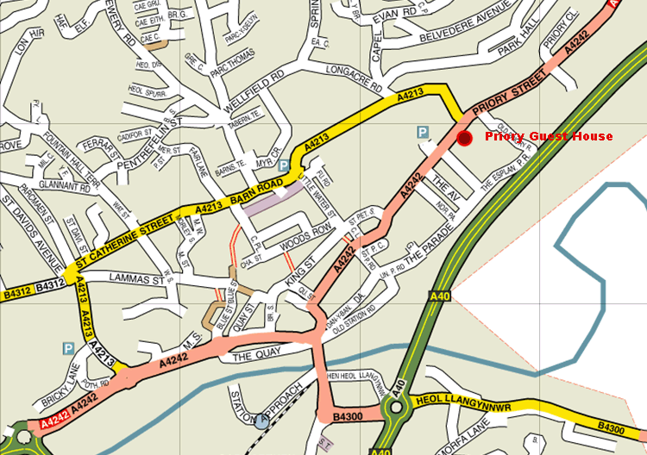
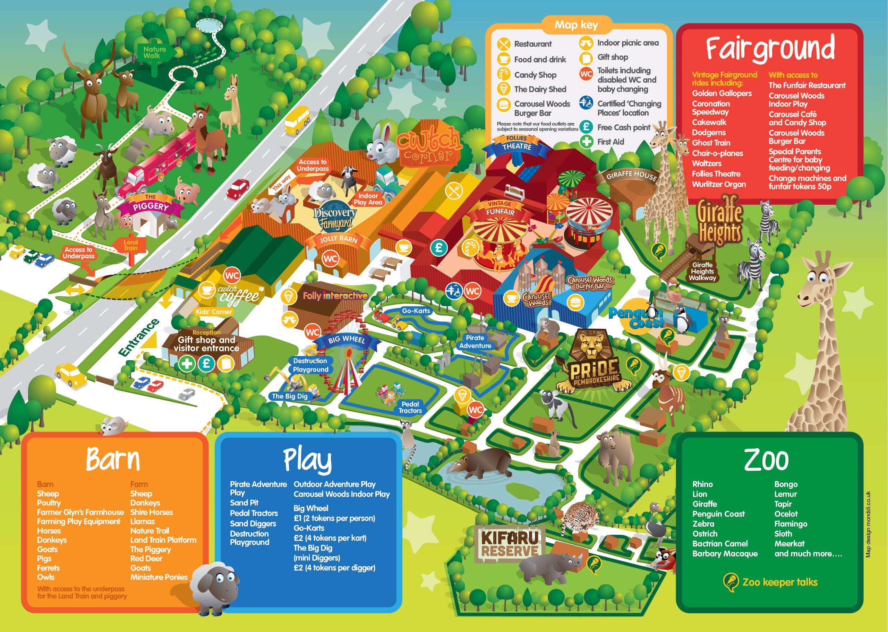
Idea Two
New Information Boards For Local, Organic And Vegan Shops In Carmarthen

Slide 7
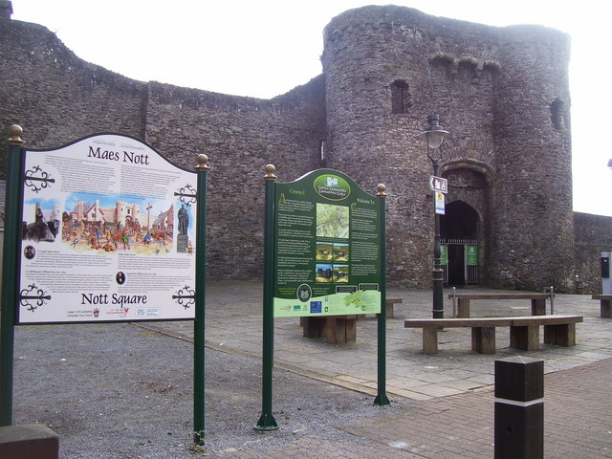
Marketing Idea Two
Produce New Leaflets That Can Be Distributed Through The Town
Campaigns On Social Media, Newspaper And Radio To Promote The New Information Boards, Leaflets

Slide 8

Idea Three
Introduce A New ‘Local Day’ Into Schools In Carmarthen To Celebrate Local Foods, Crafts And Culture
Aims To Improve Young People’s Understanding Of The Local Economy
The Next Generations Learns The Importance Of Organic And Local Produce

Slide 9
Benefits
Raise Awareness in Young People
Helps to support the local businesses
Next generation will be inspired to purchase local and organic goods
Learn about the important local culture

Slide 10
Marketing Idea Three
Experiential Marketing
Marketing Local Produce By Getting Young Engaging Young People
As Well As
Advertising Within The School System By Printing In Newsletters And Sending Posters Home To Parents

Slide 11
Conclusion
Local Businesses Need Our Support
Easier To Access Local Businesses In The Town
Potential To Grow The Customer Base For Local And Organic Business In Carmarthen
The Different Marketing Strategies Are Vital

Slide 12
References
https://gov.wales/well-being-of-future-generations-wales - Health and Wellbeing Act
https://medium.com/the-megacool-blog/how-to-generate-word-of-mouth-buzz-for-your-mobile-game-50408e209df0 - Word of mouth
http://www.dyfeddiners.freeuk.com/prioryguesthouse.htm - Map of Carmarthen
https://www.geograph.org.uk/photo/4866187 - Carmarthen Town Information Boards
https://www.folly-farm.co.uk/plan-your-day/map/ - Folly Farm Leaflet

