Slide 1

Assignment 1 – The role of Nursing
Amy Leyshon - 2125305

Slide 2

Introduction
This presentation is going to talk about the rules and regulations of Nursing within Wales and the United Kingdom. It will underpin what qualifications are needed to practice within the health and social care sector and demonstrate what makes a good nurse and how to deliver safe effective care and understand the responsibility that comes with the role. It will discuss service users and their different needs.

Slide 3
Objectives
The organisation type?
The different type of service users and needs?
The Training and Qualifications needed in HE, Job role and ongoing requirements?
The roles and responsibilities of the worker(s)?
How health and social care values are applied?
Multi and inter disciplinary working ?
Communication?
Factors which impact on service delivery?

Slide 4
The organisation type/role?
A nurse looks after individuals of all ages and in all settings such as in hospitals, community and care settings. They promote good health, prevent illness, look after the ill, disabled and dying people which also includes treatment and rehabilitation (WHO, 2022).
The aim is to be effective, safe and kind and improve society's health and wellbeing (NMC, 2021).
The core role -Regulate, support, influence (NMC ,2021).

Slide 5
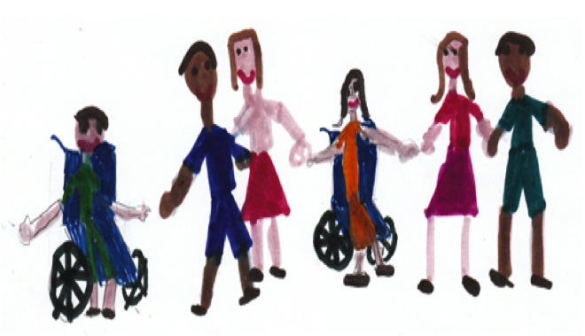
The type of service users and different needs.
Care should be reflective on the service user's current needs.
Person-centred care.
Treated and constantly communicated with as equals.
Responding positively to behaviours.
Building personal relationships and social networks.
maximise independence and choice.
(HIQA, 2018).

Slide 6

Training and Qualifications
Degree
Two sometime three A-levels or equivalent at Level 3
GCSES – Maths, English, Biology, or Human Biology
Practical hands-on experience
Access to health course
CPD - Continued Professional Development
(The NHS, 2015)

Slide 7
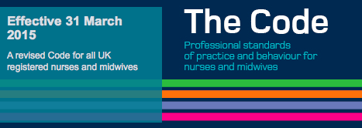
The roles and responsibilities of the worker(s)
The code (NMC 2015a) ‘4PS’
Prioritise people,
Practice effectively,
Promote professionalism
Trust.
When the code (NMC 2015a) was updated, Several areas were added such as the
fundamentals of care, conscientious objection, end of life care, duty of candour,
social media, medicines managements and prescribing.

Slide 8

How health and care values are applied
7 Care Values
Respect for the individual
Maintaining confidentiality
Empowering and promoting independence
Preserving the dignity of individuals
Effective communication that displays empathy and warmth
Safeguarding and a duty of care
Promoting anti-discriminatory practice
(Castleford Academy, 2020)

Slide 9

Multi and inter disciplinary working
Gps
Specialist doctors
Occupational therapists
Pharmacists
Physiotherapists
Social workers
Housing and voluntary sectors
Multidisciplinary teams (MDTs) are the coil for organising and coordinating health and care services to meet the needs of every individual with complex care needs. The team brings together the knowledge and skills of different professionals to assess, plan and manage the care jointly.
(Intergrated research and practice, 2018)

Slide 10
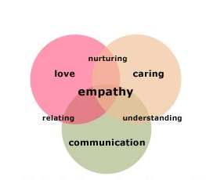
Communication
Nurses should be able to adapt when they are communicating to a professional or a service user.
Understanding
Person centred care
Empathetic
Respect
Professional
Body language
Confidence
Honesty and courtesy
Flexablity
Awareness (Eastern Ilinois University, 2022)

Slide 11
Factors which can impact on service delivery
Some nurses and trainee staff can lack in basic calculation skills which could be very dangerous when looking after a patient when administering medication and to monitor the doses, patients' fluid intake and stock management (Braddell & Cripps ,2009)
Poor staffing levels increase mortality by 26% compared to better staffed wards. (The RCN, 2021)

Slide 12
Refrences
World Health Organisations (2022) nursing and midwifery available at: https://www.who.int/health-topics/nursing#tab=tab_1
Royal College of Nursing (2018) Investing in a Safe and Effective Workforce: Continuing Professional Development for Nurses in the UK www.rcn.org.uk/professional-development/publications/pdf-007028
Nursing & Midwifery Council. (2018). The code: Professional standards of practice and behaviour for nurses, midwives and nursing associates. https://www.nmc.org.uk/about-us/our-role/
Castlefordacademy.com available at: http://www.castlefordacademy.com/wp-content/uploads/2020/11/introduction-Care-Values-definitions-FAH.pdf
McMullan, M., Jones, R. and Lea, S. (2010). Patient safety: numerical skills and drug calculation abilities of nursing students and Registered Nurses. Journal of Advanced Nursing, 66(4), pp.891–899.
Braddell C, Cripps J. 2009. Maths in the Care Worplace: Workplace audit r1eport. Oxford: Oxfordshire County Council Adult Learning Service.
Understanding and applying Individual righths of the service users in a Disability service (2018) available at: https://www.healthcareinformed.com/understanding-and-applying-individual-rights-of-the-service-user-in-a-disability-service/
Intergrated research and practice (2018) available at: https://www.scie.org.uk/integrated-care/research-practice/activities/multidisciplinary-teams
NHS (2015). How to Become a Nurse. [online] Health Careers. Available at: https://www.healthcareers.nhs.uk/explore-roles/nursing/how-become-nurse/how-become-nurse.
Eastern Ilinois University (2022) available at: https://learnonline.eiu.edu/programs/rn-to-bsn/teamwork-communication-critical-in-healthcare/

