Slide 1
Developing Innovation and
Creativity for Business Advantage
Week 2 (Lecture 2)
Concepts & techniques of innovation & creativity

Slide 2
Objectives
At the end of this session you will be able to understand:
Various platforms for Innovation
Open market Innovation
Innovation Do’s & Don'ts
Types of Service Innovations
SCAMPER
Six Hats Thinking

Slide 3
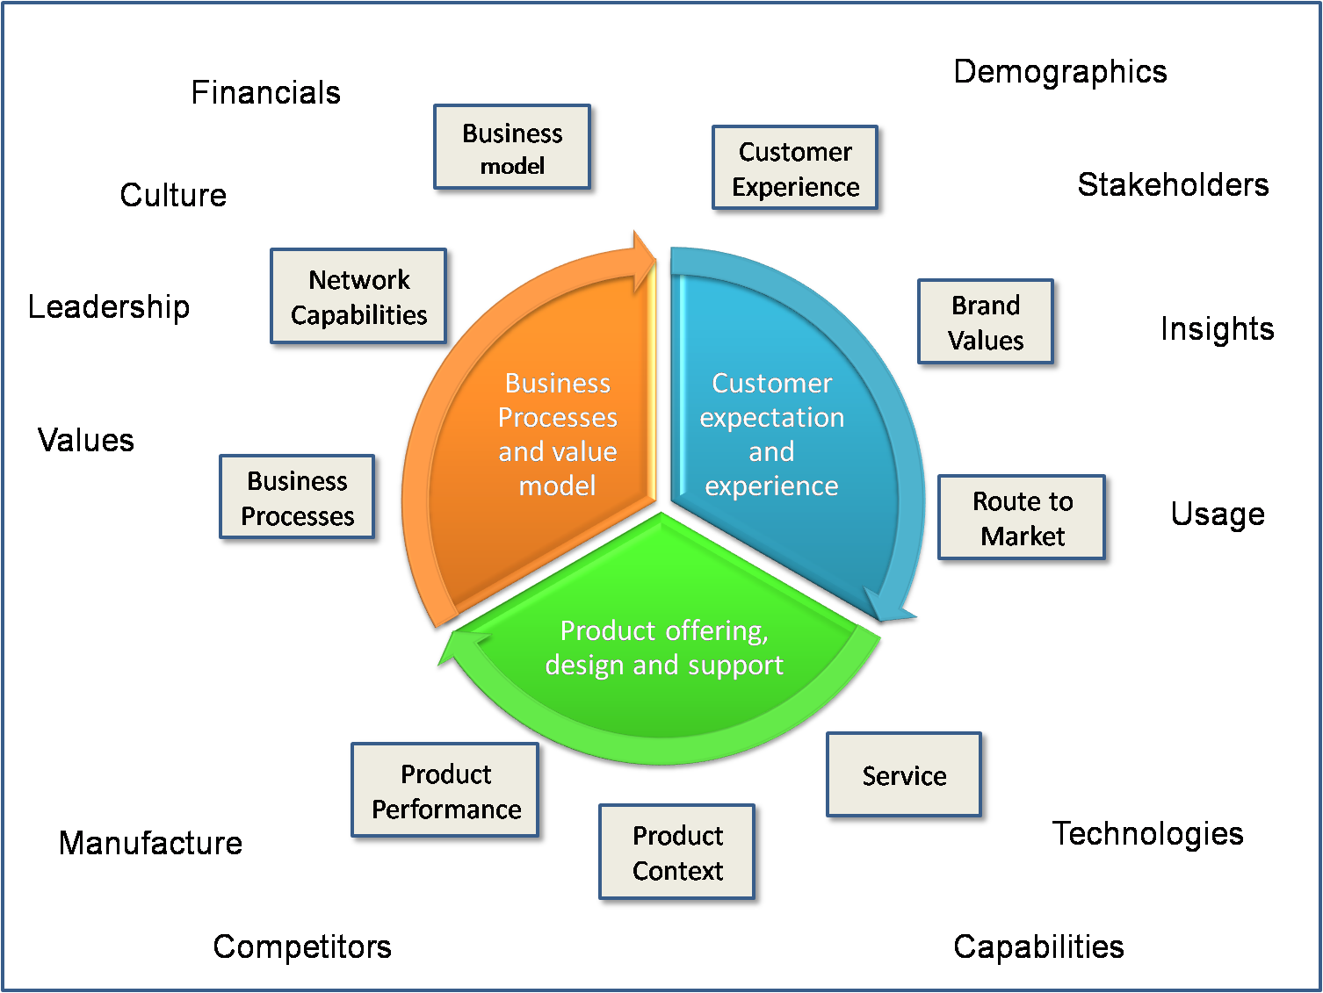
Platform for Innovation
Notes:
http://www.cocatalyst.com/blog/index.php/category/innovation-tools/ accesses 11 Non 11

Slide 4
Platform for Innovation the building blocks
Values, Culture and Leadership
Business Processes, Financials, Business Model and Network
Market structure
Category and brand values
Technologies, performance, value and context
The competition
Notes:
Values, Culture and Leadership:
■What principles form the basis for behaviours within the organisation and, more specifically, what are the key criteria which provide the basis for prioritisation decisions? I will probe this area by referring to specific examples from the organisation’s innovation history.
■Where does the key drive for innovation come from within the organisation? For example, is innovation initiated most commonly in sales, manufacturing or R&D?
■What is the attitude to risk? Is decision making based on gaining consensus or through personal accountability?
■How engaged is senior management in innovation activity?
■What type of innovation mindset does senior management have? E.g. when they say they want a “break-though” do they really mean it?
■How does the business Mission Statement relate to this innovation challenge
Business Processes, Financials, Business Model and Network:
■What product /service development process does the organisation operate?
■What processes does the organisation follow to build its capabilities? E.g. recruitment, research, manufacturing, commercial, marketing and sales.
■What processes does the organisation follow to generate revenues?
■What other partners operate in the value chain and what are their financial investment and rewards?
■Who are the key partners and suppliers?
■How is the organisation funded?
■What is the attitude to capital spending and valuation of assets? Probe around tangible assets and intangible assets (e.g. IP)
Market structure:
■Who does the organisation sell their product or service to?
■Who uses the service/product?
■What does the market landscape look like? How does the organisation segment their market?
■What is the geographic scope of the current market?
■Who are the other stakeholders in the success of the product or service
Category and brand values:
■How does the organisation define their market category?
■What does the organisation think the key considerations are for this category?
■What does the organisation’s brand mean to consumers or customers in the category?
■Given the current brand and category, how open to new products or services might the current consumer base be?
■How are consumers and customers using the organisation’s product or service? What are the key consumer or customer problems that the product solves?
■What are the underlying consumer or customer insights that form the basis for the product or service?
Technologies, performance, value and context:
■What technologies and capabilities are key to the organisation’s current competitive position?
■Which areas of product or service performance are currently most important to consumers and customers?
■What is the current pricing structure?
■Are there critical considerations which might limit innovation such as surrounding infrastructure and large capital investments either by the client or their partners?
The competition:
■Who is the main competitor?
■Which competitor has the best-in-class performance?
■Is there a key limitation which all products in the category suffer from?
■Is there any competitor IP or other prior art which might limit future innovation?

Slide 5
Open market innovation
Harnessing creativity: sharing and generating ideas
  Incubation
  Illumination
  Translation
Notes:
Open market innovation
It about not solely relying on the company’s research and development department for the latest innovations the company reaches out to the market using such techniques as licensing, joint ventures, and strategic alliances or innovation partnerships to bring ideas in or to put ideas out.
Harnessing creativity: sharing and generating ideas
Creativity in the organisation
Looking outside the organisation for creative ideas
Supportive and obstructive features for harnessing creativity
Work processes
Assessing creativity ‘wealth’
Harnessing innovation: options for implementation
Innovation in the organisation
Strategic partnerships or outsourcing
Take over of another company for their product/service
Source Corporate Partners Research Programme, “Harnessing creativity and innovation” Kelly Drewery (2003

Slide 6
Innovation - Do’s & Don'ts
Barriers
Promoters'
Excessive financial constraints
Lack of Time
Lack of resources
Risk aversion & fear of failure
Organisational hierarchy
Unclear leadership
Insufficient incentives
Insufficient training
Insufficient talent
Lack of autonomy
Management support & openness
Leaders’ modelling behaviours
Setting up the right team
Autonomy and freedom
Tolerance of failure
Networking opportunities
Dedicated resources
Incentives and rewards
Notes:
British research conducted by NESTA (the National Endowment for Science, Technology, and the Arts) surveyed over 850 managers found that the following are barriers to innovation, listed in order of importance:
The same research found the following to assist in overcoming barriers to innovation also listed in order of importance:

Slide 7
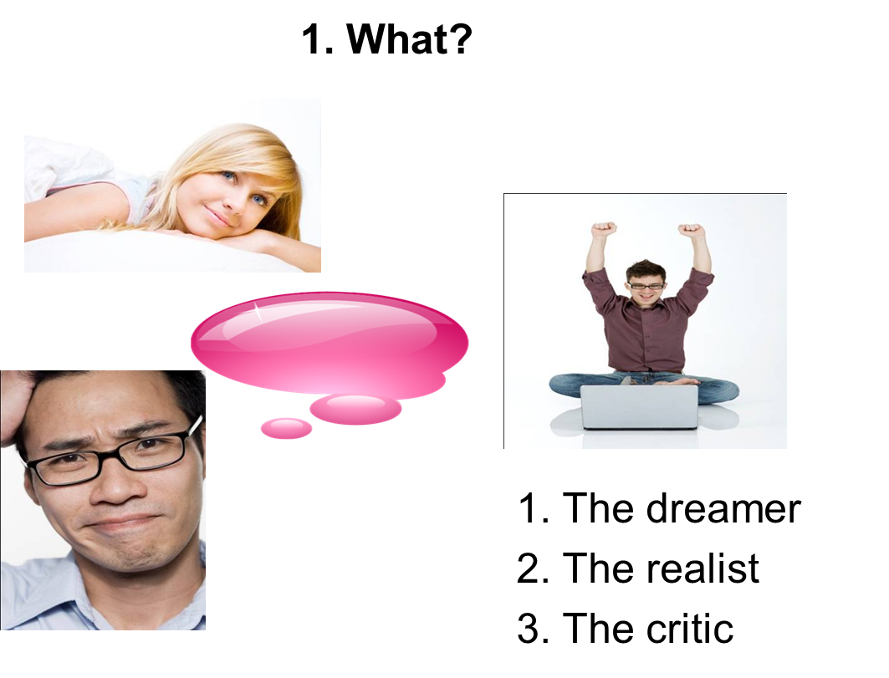
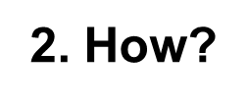
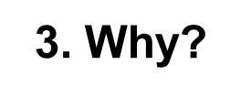
Creativity

Slide 8
Types of Innovation
Product Innovation
Process Innovation
Service Innovation
Notes:
Product Innovation Design of new products
Process Innovation Innovations of this nature often use such techniques as business process reengineering or lean based tools to analyze a process and reduce the number of steps by removing any redundant, repetitive or simply wasteful process steps. An innovative process often needs to precede an innovative product in order for a product to be manufactured at a price that the market will accept.

Slide 9
Service Innovations
Total innovations
Existing services
Evolutionary innovations
Notes:
1.Total innovations: These provide new services to new users
2.Existing services: Provided to a new user group and therefore expanding the reach of the service
3.Evolutionary innovations: Delivering a new service to an existing set of users
References:
Katz R (2009) The Innovators Toolkit – 10 Practical Strategies to Help You Develop and Implement Innovation, Boston, Harvard Business School Publishing
Walker, Richard M (2008) An Empirical Evaluation of Innovation Types and Organizational and Environmental Characteristics: Towards a Configuration Framework, Journal of Public Administration Research & Theory, Vol. 18 Issue 4, p591-615

Slide 10

Where good ideas come from:
YouTube video:

Slide 11
SCAMPER
S – Substitute
C – Combine
A – Adapt
M – Modify
P – Put to another use
E – Eliminate
R – Reverse
Source: https://www.cleverism.com
Notes:
Bring together the individuals who will participate in the SCAMPER exercise. Describe the goal of the exercise and inform participants that they will be using several specific techniques to aid in the brainstorming process.
Substitute. Brainstorm ways to substitute for existing materials, process steps, people, or locations. Think of any aspects of your current process or product, especially those that are considered mandatory, and determine if there is any way to substitute something different.
Combine. Develop a list of ways you can combine multiple objects, ideas, materials, or functions into one. Figure out which parts of your process are currently done independently and brainstorm means of integrating them.
Adapt. Think of ways to adapt existing products or techniques to serve a different purpose or function in a different environment. Consider what objects might serve a new function, which groups in your organization can take on different roles, and which existing products or processes can be altered to meet your needs.
Modify. Establish options for modifying various elements of your process or product. Discuss ways you could change sizes, remove parts, delete process steps, add functionality, and enhance attractiveness.
Put to other use. List ways that you can put an item to different uses. What other functions could it serve, and who else might find it useful?
Eliminate. Identify opportunities to eliminate parts, process steps, excess inventory, or unpopular features. Determine how doing so opens up opportunities for other improvements.
Rearrange. Discuss ideas for rearranging elements in your product or process. Could any steps be transposed, or parts moved around?
Evaluate the ideas that came out of your brainstorming sessions including your SCAMPER session. Using criteria appropriate for your goals, decide which you will test or fully implemen
Read more: How to Use SCAMPER | eHow.com http://www.ehow.com/how_5328899_use-scamper.html#ixzz1dsSmRSBa

Slide 12
Step 1: “S” Substitute
Take away a part of the selected thing, concept or situation and replace it with something else. Substitution is a technique of trial and error, of replacing one object with another till you are able to determine the correct idea.
Some questions you can ask:
What resources/materials can you swap / substitute to enhance the product?
What process or product could you utilize?
Can you utilize other materials or ingredients?
Can you change its colour, sound, smell or roughness?
Can you modify its shape?
Which rules can you substitute or change?
Is it possible to replace someone involved?
Can you utilize the idea in another place?
What would happen if you modified your attitude or feelings towards the product?
Notes:
Bring together the individuals who will participate in the SCAMPER exercise. Describe the goal of the exercise and inform participants that they will be using several specific techniques to aid in the brainstorming process.
Substitute. Brainstorm ways to substitute for existing materials, process steps, people, or locations. Think of any aspects of your current process or product, especially those that are considered mandatory, and determine if there is any way to substitute something different.
Combine. Develop a list of ways you can combine multiple objects, ideas, materials, or functions into one. Figure out which parts of your process are currently done independently and brainstorm means of integrating them.
Adapt. Think of ways to adapt existing products or techniques to serve a different purpose or function in a different environment. Consider what objects might serve a new function, which groups in your organization can take on different roles, and which existing products or processes can be altered to meet your needs.
Modify. Establish options for modifying various elements of your process or product. Discuss ways you could change sizes, remove parts, delete process steps, add functionality, and enhance attractiveness.
Put to other use. List ways that you can put an item to different uses. What other functions could it serve, and who else might find it useful?
Eliminate. Identify opportunities to eliminate parts, process steps, excess inventory, or unpopular features. Determine how doing so opens up opportunities for other improvements.
Rearrange. Discuss ideas for rearranging elements in your product or process. Could any steps be transposed, or parts moved around?
Evaluate the ideas that came out of your brainstorming sessions including your SCAMPER session. Using criteria appropriate for your goals, decide which you will test or fully implemen
Read more: How to Use SCAMPER | eHow.com http://www.ehow.com/how_5328899_use-scamper.html#ixzz1dsSmRSBa

Slide 13
Step 2: “C” for Combine
The next step is to contemplate combining elements of the situation or problem you’re facing so as think up something new. This is in line with the view of many creativity experts that creativity has to do with combining already existing things in a fresh way.
So join, force together or affiliate two or more elements pertaining to your subject matter and contemplate routes by which such a combination could possibly take you to a solution.
Some questions you can ask:
What parts, ideas or materials could be possibly combined?
What could they be combined with to optimize uses?
What could be the result of combining the product in question with another, to develop something new?
What could be the result of combining objectives or purposes?
How to combine resources and talent to develop a new way of thinking directed at the product?
Can different elements be combined to enhance it?
Notes:
Bring together the individuals who will participate in the SCAMPER exercise. Describe the goal of the exercise and inform participants that they will be using several specific techniques to aid in the brainstorming process.
Substitute. Brainstorm ways to substitute for existing materials, process steps, people, or locations. Think of any aspects of your current process or product, especially those that are considered mandatory, and determine if there is any way to substitute something different.
Combine. Develop a list of ways you can combine multiple objects, ideas, materials, or functions into one. Figure out which parts of your process are currently done independently and brainstorm means of integrating them.
Adapt. Think of ways to adapt existing products or techniques to serve a different purpose or function in a different environment. Consider what objects might serve a new function, which groups in your organization can take on different roles, and which existing products or processes can be altered to meet your needs.
Modify. Establish options for modifying various elements of your process or product. Discuss ways you could change sizes, remove parts, delete process steps, add functionality, and enhance attractiveness.
Put to other use. List ways that you can put an item to different uses. What other functions could it serve, and who else might find it useful?
Eliminate. Identify opportunities to eliminate parts, process steps, excess inventory, or unpopular features. Determine how doing so opens up opportunities for other improvements.
Rearrange. Discuss ideas for rearranging elements in your product or process. Could any steps be transposed, or parts moved around?
Evaluate the ideas that came out of your brainstorming sessions including your SCAMPER session. Using criteria appropriate for your goals, decide which you will test or fully implemen
Read more: How to Use SCAMPER | eHow.com http://www.ehow.com/how_5328899_use-scamper.html#ixzz1dsSmRSBa

Slide 14
Step 3: “A” for Adapt
Think if there’s a solution for another problem that you may mold to suit your situation.
Some questions you can ask:
Is there a solution you can take from somewhere else and mold it to suit this one?
Is there a similarity between the current situation and something else?
Is there another context you can position your product in?
What or who could you imitate to adapt this product to fulfill another use or purpose?
What else does the product resemble?
What other ideas or products can you utilize for inspiration?
Are there any ideas outside your field that you can incorporate?
Notes:
Bring together the individuals who will participate in the SCAMPER exercise. Describe the goal of the exercise and inform participants that they will be using several specific techniques to aid in the brainstorming process.
Substitute. Brainstorm ways to substitute for existing materials, process steps, people, or locations. Think of any aspects of your current process or product, especially those that are considered mandatory, and determine if there is any way to substitute something different.
Combine. Develop a list of ways you can combine multiple objects, ideas, materials, or functions into one. Figure out which parts of your process are currently done independently and brainstorm means of integrating them.
Adapt. Think of ways to adapt existing products or techniques to serve a different purpose or function in a different environment. Consider what objects might serve a new function, which groups in your organization can take on different roles, and which existing products or processes can be altered to meet your needs.
Modify. Establish options for modifying various elements of your process or product. Discuss ways you could change sizes, remove parts, delete process steps, add functionality, and enhance attractiveness.
Put to other use. List ways that you can put an item to different uses. What other functions could it serve, and who else might find it useful?
Eliminate. Identify opportunities to eliminate parts, process steps, excess inventory, or unpopular features. Determine how doing so opens up opportunities for other improvements.
Rearrange. Discuss ideas for rearranging elements in your product or process. Could any steps be transposed, or parts moved around?
Evaluate the ideas that came out of your brainstorming sessions including your SCAMPER session. Using criteria appropriate for your goals, decide which you will test or fully implemen
Read more: How to Use SCAMPER | eHow.com http://www.ehow.com/how_5328899_use-scamper.html#ixzz1dsSmRSBa

Slide 15
Step 4: “M” for Modify/Magnify
Pose a question to yourself about which ideas you can produce if you magnify or modify your situation or problem. Magnifying parts of or the whole of your idea may enhance its perceived worth or furnish fresh insight pertaining to which components are most significant.
Modify questions:
Can you change an aspect of your process or product to enhance it?
Can you think of any ways to modify the shape, feel, appearance, color or form of your product?
What can you add to change this product?
What can you highlight or emphasize to produce more value?
What aspect of the product can you make stronger to develop something new?
What would happen if you modified the process in some way?
Is there a fresh twist?
Magnify questions:
Is there anything you can make bigger, higher or larger?
What can you overstate or exaggerate?
Can you increase the frequency?
What can you duplicate? Is it possible to create multiple copies?
Is it possible to include additional features or otherwise add extra value?
What would be the outcome of exaggerating a component?
Is it possible to raise the price by increasing value?
Notes:
Bring together the individuals who will participate in the SCAMPER exercise. Describe the goal of the exercise and inform participants that they will be using several specific techniques to aid in the brainstorming process.
Substitute. Brainstorm ways to substitute for existing materials, process steps, people, or locations. Think of any aspects of your current process or product, especially those that are considered mandatory, and determine if there is any way to substitute something different.
Combine. Develop a list of ways you can combine multiple objects, ideas, materials, or functions into one. Figure out which parts of your process are currently done independently and brainstorm means of integrating them.
Adapt. Think of ways to adapt existing products or techniques to serve a different purpose or function in a different environment. Consider what objects might serve a new function, which groups in your organization can take on different roles, and which existing products or processes can be altered to meet your needs.
Modify. Establish options for modifying various elements of your process or product. Discuss ways you could change sizes, remove parts, delete process steps, add functionality, and enhance attractiveness.
Put to other use. List ways that you can put an item to different uses. What other functions could it serve, and who else might find it useful?
Eliminate. Identify opportunities to eliminate parts, process steps, excess inventory, or unpopular features. Determine how doing so opens up opportunities for other improvements.
Rearrange. Discuss ideas for rearranging elements in your product or process. Could any steps be transposed, or parts moved around?
Evaluate the ideas that came out of your brainstorming sessions including your SCAMPER session. Using criteria appropriate for your goals, decide which you will test or fully implemen
Read more: How to Use SCAMPER | eHow.com http://www.ehow.com/how_5328899_use-scamper.html#ixzz1dsSmRSBa

Slide 16
Step 5: “P” for Put to another use (Contd….)
Contemplate how you can put your current idea to different uses or what could be reused from
elsewhere so as to fix your own problem. Frequently, an idea only turns out to be great when applied in a different manner than first imagined.
Therefore
Modify the goal of the subject.
Contemplate why it exists, its purpose of use and what it is assumed to do.
Confront all of these suppositions and propose new and strange purposes.
A classical manifestation of this step is to discover a substitute market for a manufactured good when a specific market dries up, or to find a new buyer following the termination of the agreement with one buyer.
Some questions you can ask:
Is it possible to utilize this product elsewhere, maybe in another industry?
Who else can utilize this product?
Would this product function differently in a different setting?
Is it possible to recycle the product’s waste to create something new?
What else could it be utilized for?
How could a child or older person utilize it?
Notes:
Bring together the individuals who will participate in the SCAMPER exercise. Describe the goal of the exercise and inform participants that they will be using several specific techniques to aid in the brainstorming process.
Substitute. Brainstorm ways to substitute for existing materials, process steps, people, or locations. Think of any aspects of your current process or product, especially those that are considered mandatory, and determine if there is any way to substitute something different.
Combine. Develop a list of ways you can combine multiple objects, ideas, materials, or functions into one. Figure out which parts of your process are currently done independently and brainstorm means of integrating them.
Adapt. Think of ways to adapt existing products or techniques to serve a different purpose or function in a different environment. Consider what objects might serve a new function, which groups in your organization can take on different roles, and which existing products or processes can be altered to meet your needs.
Modify. Establish options for modifying various elements of your process or product. Discuss ways you could change sizes, remove parts, delete process steps, add functionality, and enhance attractiveness.
Put to other use. List ways that you can put an item to different uses. What other functions could it serve, and who else might find it useful?
Eliminate. Identify opportunities to eliminate parts, process steps, excess inventory, or unpopular features. Determine how doing so opens up opportunities for other improvements.
Rearrange. Discuss ideas for rearranging elements in your product or process. Could any steps be transposed, or parts moved around?
Evaluate the ideas that came out of your brainstorming sessions including your SCAMPER session. Using criteria appropriate for your goals, decide which you will test or fully implemen
Read more: How to Use SCAMPER | eHow.com http://www.ehow.com/how_5328899_use-scamper.html#ixzz1dsSmRSBa

Slide 17
Step 5: “P” for Put to another use
Further questions you can ask:
Is it possible for people other than the intended target market to be able to use it?
Can you utilize this idea in an alternative place?
Can people with various disabilities utilize it?
Are there other ways to utilize it in its present form and shape?
Could it be utilized in another context?
Can you utilize this idea in other industries or markets?
Would the manufactured good work in different places?
If you didn’t know anything about it, would you be able to comprehend the objective of this idea/product?
Is there some other problem that your product may be a solution for?
What are the many diverse ways that the product finds use?
Notes:
Bring together the individuals who will participate in the SCAMPER exercise. Describe the goal of the exercise and inform participants that they will be using several specific techniques to aid in the brainstorming process.
Substitute. Brainstorm ways to substitute for existing materials, process steps, people, or locations. Think of any aspects of your current process or product, especially those that are considered mandatory, and determine if there is any way to substitute something different.
Combine. Develop a list of ways you can combine multiple objects, ideas, materials, or functions into one. Figure out which parts of your process are currently done independently and brainstorm means of integrating them.
Adapt. Think of ways to adapt existing products or techniques to serve a different purpose or function in a different environment. Consider what objects might serve a new function, which groups in your organization can take on different roles, and which existing products or processes can be altered to meet your needs.
Modify. Establish options for modifying various elements of your process or product. Discuss ways you could change sizes, remove parts, delete process steps, add functionality, and enhance attractiveness.
Put to other use. List ways that you can put an item to different uses. What other functions could it serve, and who else might find it useful?
Eliminate. Identify opportunities to eliminate parts, process steps, excess inventory, or unpopular features. Determine how doing so opens up opportunities for other improvements.
Rearrange. Discuss ideas for rearranging elements in your product or process. Could any steps be transposed, or parts moved around?
Evaluate the ideas that came out of your brainstorming sessions including your SCAMPER session. Using criteria appropriate for your goals, decide which you will test or fully implemen
Read more: How to Use SCAMPER | eHow.com http://www.ehow.com/how_5328899_use-scamper.html#ixzz1dsSmRSBa

Slide 18
Step 6: “E” for Eliminate (or Minify)
Contemplate what would happen if you eliminated components or elements of your idea or if you minimized, reduced or simplified aspects of it. By way of repeated elimination or trimming of ideas, processes and objects, it is possible to steadily constrict your challenge to that function or part of the most significance.
Some questions you can ask:
How can you simplify or streamline this product?
What can you tone down or understate?
What components can be taken out without changing function?
What would be the outcome should you take away a component of the product? What would replace the component/part?
Is it possible to eliminate the rules?
What features, rules or parts can you eliminate? Or can you remove extraneous details?
How can you minimize cost, effort or time?
How can you make it lighter, faster, smaller or more fun?
What is unnecessary or non-essential?
Should you break it into different parts?
Notes:
Bring together the individuals who will participate in the SCAMPER exercise. Describe the goal of the exercise and inform participants that they will be using several specific techniques to aid in the brainstorming process.
Substitute. Brainstorm ways to substitute for existing materials, process steps, people, or locations. Think of any aspects of your current process or product, especially those that are considered mandatory, and determine if there is any way to substitute something different.
Combine. Develop a list of ways you can combine multiple objects, ideas, materials, or functions into one. Figure out which parts of your process are currently done independently and brainstorm means of integrating them.
Adapt. Think of ways to adapt existing products or techniques to serve a different purpose or function in a different environment. Consider what objects might serve a new function, which groups in your organization can take on different roles, and which existing products or processes can be altered to meet your needs.
Modify. Establish options for modifying various elements of your process or product. Discuss ways you could change sizes, remove parts, delete process steps, add functionality, and enhance attractiveness.
Put to other use. List ways that you can put an item to different uses. What other functions could it serve, and who else might find it useful?
Eliminate. Identify opportunities to eliminate parts, process steps, excess inventory, or unpopular features. Determine how doing so opens up opportunities for other improvements.
Rearrange. Discuss ideas for rearranging elements in your product or process. Could any steps be transposed, or parts moved around?
Evaluate the ideas that came out of your brainstorming sessions including your SCAMPER session. Using criteria appropriate for your goals, decide which you will test or fully implemen
Read more: How to Use SCAMPER | eHow.com http://www.ehow.com/how_5328899_use-scamper.html#ixzz1dsSmRSBa

Slide 19
Step 7: “R” for Rearrange or Reverse
Rearrange – Contemplate whether you can do some kind of rearranging whether changing the sequence, pattern or layout; interchanging components; changing schedule; changing pace; or interchanging cause and effect.
Reverse – Contemplate what you would do if a portion of your process/product was done or worked in another order, or in reverse. Turn it inside-out, upside-down, or backwards – just make it go against the direction it was meant to be used or to proceed.
Some questions you can ask:
Can you interchange components?
Can you transpose cause and effect?
Can you transpose negatives and positives?
Can you interchange the patterns or layout?
What is the best way to interchange the patterns or layout?
What other sequence, layout or patterns can you use? Can you think of any?
Can you modify the schedule of delivery or pace?
Notes:
Bring together the individuals who will participate in the SCAMPER exercise. Describe the goal of the exercise and inform participants that they will be using several specific techniques to aid in the brainstorming process.
Substitute. Brainstorm ways to substitute for existing materials, process steps, people, or locations. Think of any aspects of your current process or product, especially those that are considered mandatory, and determine if there is any way to substitute something different.
Combine. Develop a list of ways you can combine multiple objects, ideas, materials, or functions into one. Figure out which parts of your process are currently done independently and brainstorm means of integrating them.
Adapt. Think of ways to adapt existing products or techniques to serve a different purpose or function in a different environment. Consider what objects might serve a new function, which groups in your organization can take on different roles, and which existing products or processes can be altered to meet your needs.
Modify. Establish options for modifying various elements of your process or product. Discuss ways you could change sizes, remove parts, delete process steps, add functionality, and enhance attractiveness.
Put to other use. List ways that you can put an item to different uses. What other functions could it serve, and who else might find it useful?
Eliminate. Identify opportunities to eliminate parts, process steps, excess inventory, or unpopular features. Determine how doing so opens up opportunities for other improvements.
Rearrange. Discuss ideas for rearranging elements in your product or process. Could any steps be transposed, or parts moved around?
Evaluate the ideas that came out of your brainstorming sessions including your SCAMPER session. Using criteria appropriate for your goals, decide which you will test or fully implemen
Read more: How to Use SCAMPER | eHow.com http://www.ehow.com/how_5328899_use-scamper.html#ixzz1dsSmRSBa

Slide 20
Step 7: “R” for Rearrange or Reverse
(Contd….)
Further questions:
What other arrangement may be better?
What would be the outcome of process reversal?
What if you turned it upside down?
How can you reverse roles?
Can you rearrange or reverse the concept you already have?
What if you engaged in the exact opposite of what you originally intended?
How could you accomplish the opposite effect?
Notes:
Bring together the individuals who will participate in the SCAMPER exercise. Describe the goal of the exercise and inform participants that they will be using several specific techniques to aid in the brainstorming process.
Substitute. Brainstorm ways to substitute for existing materials, process steps, people, or locations. Think of any aspects of your current process or product, especially those that are considered mandatory, and determine if there is any way to substitute something different.
Combine. Develop a list of ways you can combine multiple objects, ideas, materials, or functions into one. Figure out which parts of your process are currently done independently and brainstorm means of integrating them.
Adapt. Think of ways to adapt existing products or techniques to serve a different purpose or function in a different environment. Consider what objects might serve a new function, which groups in your organization can take on different roles, and which existing products or processes can be altered to meet your needs.
Modify. Establish options for modifying various elements of your process or product. Discuss ways you could change sizes, remove parts, delete process steps, add functionality, and enhance attractiveness.
Put to other use. List ways that you can put an item to different uses. What other functions could it serve, and who else might find it useful?
Eliminate. Identify opportunities to eliminate parts, process steps, excess inventory, or unpopular features. Determine how doing so opens up opportunities for other improvements.
Rearrange. Discuss ideas for rearranging elements in your product or process. Could any steps be transposed, or parts moved around?
Evaluate the ideas that came out of your brainstorming sessions including your SCAMPER session. Using criteria appropriate for your goals, decide which you will test or fully implemen
Read more: How to Use SCAMPER | eHow.com http://www.ehow.com/how_5328899_use-scamper.html#ixzz1dsSmRSBa

Slide 21






Six Hats Thinking (De Bono 1985)
Notes:
White hat: Information approach - white as in paper, printout, faxes; white paper is neutral and merely conveys information.
Red hat: Feelings approach - red as in fire, red for warmth; the red hat covers feelings, emotions and intuition; helps keep people warm.
Black hat: Logical Negative approach - black robes of a judge; assessing matters with stern caution and no nonsense.
Yellow hat: Logical Positive approach - sunshine and optimism; look on the bright side; feel positive in the sunshine.
Green hat: Creating thinking approaches - green for nature and creation; green for growth, new shoots, energy; new ideas springing up.
Blue hat: Control of Thinking approaches - blue for sky and the overview; looking down on the thinking; helicoptering; blue for cool and detached but all knowing and wise

Slide 22




Six Hats Thinking (White, Red & Yellow)
White Hat: Information focuses on the data available and what you can learn from it, in particular examining the gaps in the knowledge you have and either trying to fill them or taking account of them.
Red Hat: Feelings looks at problems using intuition, gut reaction, and emotion as well as getting you to think about how others will react emotionally to the issue and how to understand the responses of people who may not follow your reasoning.
Yellow Hat: Benefits . At this stage, you begin to think positively and view all the benefits in an optimistic light, particularly in terms of the value of the decision. It is designed to keep your thinking positive.
Notes:
Six Thinking Hats - Looking at a Decision From All Points of View
'Six Thinking Hats' is an important and powerful technique. It is used to look at decisions from a number of important perspectives. This forces you to move outside your habitual thinking style, and helps you to get a more rounded view of a situation.
This tool was created by Edward de Bono in his book '6 Thinking Hats'.
Many successful people think from a very rational, positive viewpoint. This is part of the reason that they are successful. Often, though, they may fail to look at a problem from an emotional, intuitive, creative or negative viewpoint. This can mean that they underestimate resistance to plans, fail to make creative leaps and do not make essential contingency plans.
Similarly, pessimists may be excessively defensive. Emotional people may fail to look at decisions calmly and rationally.
If you look at a problem with the 'Six Thinking Hats' technique, then you will solve it using all approaches. Your decisions and plans will mix ambition, skill in execution, public sensitivity, creativity and good contingency planning.
How to Use the Tool:
You can use Six Thinking Hats in meetings or on your own. In meetings it has the benefit of blocking the confrontations that happen when people with different thinking styles discuss the same problem.
Each 'Thinking Hat' is a different style of thinking. These are explained below:
White Hat:
With this thinking hat you focus on the data available. Look at the information you have, and see what you can learn from it. Look for gaps in your knowledge, and either try to fill them or take account of them.
This is where you analyze past trends, and try to extrapolate from historical data.
Red Hat:
'Wearing' the red hat, you look at problems using intuition, gut reaction, and emotion. Also try to think how other people will react emotionally. Try to understand the responses of people who do not fully know your reasoning.
Black Hat:
Using black hat thinking, look at all the bad points of the decision. Look at it cautiously and defensively. Try to see why it might not work. This is important because it highlights the weak points in a plan. It allows you to eliminate them, alter them, or prepare contingency plans to counter them.
Black Hat thinking helps to make your plans 'tougher' and more resilient. It can also help you to spot fatal flaws and risks before you embark on a course of action. Black Hat thinking is one of the real benefits of this technique, as many successful people get so used to thinking positively that often they cannot see problems in advance. This leaves them under-prepared for difficulties.
Yellow Hat:
The yellow hat helps you to think positively. It is the optimistic viewpoint that helps you to see all the benefits of the decision and the value in it. Yellow Hat thinking helps you to keep going when everything looks gloomy and difficult.
Green Hat:
The Green Hat stands for creativity. This is where you can develop creative solutions to a problem. It is a freewheeling way of thinking, in which there is little criticism of ideas. A whole range of creativity tools can help you here.
Blue Hat:
The Blue Hat stands for process control. This is the hat worn by people chairing meetings. When running into difficulties because ideas are running dry, they may direct activity into Green Hat thinking. When contingency plans are needed, they will ask for Black Hat thinking, etc.
A variant of this technique is to look at problems from the point of view of different professionals (e.g. doctors, architects, sales directors, etc.) or different customers.
Example:
The directors of a property company are looking at whether they should construct a new office building. The economy is doing well, and the amount of vacant office space is reducing sharply. As part of their decision they decide to use the 6 Thinking Hats technique during a planning meeting.
Looking at the problem with the White Hat, they analyze the data they have. They examine the trend in vacant office space, which shows a sharp reduction. They anticipate that by the time the office block would be completed, that there will be a severe shortage of office space. Current government projections show steady economic growth for at least the construction period.
With Red Hat thinking, some of the directors think the proposed building looks quite ugly. While it would be highly cost-effective, they worry that people would not like to work in it.
When they think with the Black Hat, they worry that government projections may be wrong. The economy may be about to enter a 'cyclical downturn', in which case the office building may be empty for a long time. If the building is not attractive, then companies will choose to work in another better-looking building at the same rent.
With the Yellow Hat, however, if the economy holds up and their projections are correct, the company stands to make a great deal of money. If they are lucky, maybe they could sell the building before the next downturn, or rent to tenants on long-term leases that will last through any recession.
With Green Hat thinking they consider whether they should change the design to make the building more pleasant. Perhaps they could build prestige offices that people would want to rent in any economic climate. Alternatively, maybe they should invest the money in the short term to buy up property at a low cost when a recession comes.
The Blue Hat has been used by the meeting's Chair to move between the different thinking styles. He or she may have needed to keep other members of the team from switching styles, or from criticizing other peoples' points.
It is well worth reading Edward de Bono's book 6 Thinking Hats for more information on this technique.
Key points:
Six Thinking Hats is a good technique for looking at the effects of a decision from a number of different points of view.
It allows necessary emotion and scepticism to be brought into what would otherwise be purely rational decisions. It opens up the opportunity for creativity within Decision Making. The technique also helps, for example, persistently pessimistic people to be positive and creative.
Plans developed using the '6 Thinking Hats' technique will be sounder and more resilient than would otherwise be the case. It may also help you to avoid public relations mistakes, and spot good reasons not to follow a course of action before you have committed to it.

Slide 23



Six Hats Thinking (Black, Green & Blu)
Black Hat: Caution. Using 'Black Hat' thinking, you are encouraged to look at all the bad points of the decision both cautiously and defensively to understand why it might not work. This highlights any weak points in a plan and allows you to adjust, eliminate or prepare contingency plans to counteract them.
Green Hat: Creativity. This is where you can develop creative solutions to a problem through a unrestrictive way of thinking. This means very little criticism of ideas and is the point at which a number of creativity tools can be implemented.
Blue Hat: Managing the Thinking. The final hat stands for process control and is generally worn by those chairing meetings. It comes into its own when ideas are drying up or thinking becomes stagnated in which case the 'wearer' may direct things towards 'Green Hat' thinking to generate creativity or 'Black Hat' thinking when a contingency plan is called for
Notes:
Six Thinking Hats - Looking at a Decision From All Points of View
'Six Thinking Hats' is an important and powerful technique. It is used to look at decisions from a number of important perspectives. This forces you to move outside your habitual thinking style, and helps you to get a more rounded view of a situation.
This tool was created by Edward de Bono in his book '6 Thinking Hats'.
Many successful people think from a very rational, positive viewpoint. This is part of the reason that they are successful. Often, though, they may fail to look at a problem from an emotional, intuitive, creative or negative viewpoint. This can mean that they underestimate resistance to plans, fail to make creative leaps and do not make essential contingency plans.
Similarly, pessimists may be excessively defensive. Emotional people may fail to look at decisions calmly and rationally.
If you look at a problem with the 'Six Thinking Hats' technique, then you will solve it using all approaches. Your decisions and plans will mix ambition, skill in execution, public sensitivity, creativity and good contingency planning.
How to Use the Tool:
You can use Six Thinking Hats in meetings or on your own. In meetings it has the benefit of blocking the confrontations that happen when people with different thinking styles discuss the same problem.
Each 'Thinking Hat' is a different style of thinking. These are explained below:
White Hat:
With this thinking hat you focus on the data available. Look at the information you have, and see what you can learn from it. Look for gaps in your knowledge, and either try to fill them or take account of them.
This is where you analyze past trends, and try to extrapolate from historical data.
Red Hat:
'Wearing' the red hat, you look at problems using intuition, gut reaction, and emotion. Also try to think how other people will react emotionally. Try to understand the responses of people who do not fully know your reasoning.
Black Hat:
Using black hat thinking, look at all the bad points of the decision. Look at it cautiously and defensively. Try to see why it might not work. This is important because it highlights the weak points in a plan. It allows you to eliminate them, alter them, or prepare contingency plans to counter them.
Black Hat thinking helps to make your plans 'tougher' and more resilient. It can also help you to spot fatal flaws and risks before you embark on a course of action. Black Hat thinking is one of the real benefits of this technique, as many successful people get so used to thinking positively that often they cannot see problems in advance. This leaves them under-prepared for difficulties.
Yellow Hat:
The yellow hat helps you to think positively. It is the optimistic viewpoint that helps you to see all the benefits of the decision and the value in it. Yellow Hat thinking helps you to keep going when everything looks gloomy and difficult.
Green Hat:
The Green Hat stands for creativity. This is where you can develop creative solutions to a problem. It is a freewheeling way of thinking, in which there is little criticism of ideas. A whole range of creativity tools can help you here.
Blue Hat:
The Blue Hat stands for process control. This is the hat worn by people chairing meetings. When running into difficulties because ideas are running dry, they may direct activity into Green Hat thinking. When contingency plans are needed, they will ask for Black Hat thinking, etc.
A variant of this technique is to look at problems from the point of view of different professionals (e.g. doctors, architects, sales directors, etc.) or different customers.
Example:
The directors of a property company are looking at whether they should construct a new office building. The economy is doing well, and the amount of vacant office space is reducing sharply. As part of their decision they decide to use the 6 Thinking Hats technique during a planning meeting.
Looking at the problem with the White Hat, they analyze the data they have. They examine the trend in vacant office space, which shows a sharp reduction. They anticipate that by the time the office block would be completed, that there will be a severe shortage of office space. Current government projections show steady economic growth for at least the construction period.
With Red Hat thinking, some of the directors think the proposed building looks quite ugly. While it would be highly cost-effective, they worry that people would not like to work in it.
When they think with the Black Hat, they worry that government projections may be wrong. The economy may be about to enter a 'cyclical downturn', in which case the office building may be empty for a long time. If the building is not attractive, then companies will choose to work in another better-looking building at the same rent.
With the Yellow Hat, however, if the economy holds up and their projections are correct, the company stands to make a great deal of money. If they are lucky, maybe they could sell the building before the next downturn, or rent to tenants on long-term leases that will last through any recession.
With Green Hat thinking they consider whether they should change the design to make the building more pleasant. Perhaps they could build prestige offices that people would want to rent in any economic climate. Alternatively, maybe they should invest the money in the short term to buy up property at a low cost when a recession comes.
The Blue Hat has been used by the meeting's Chair to move between the different thinking styles. He or she may have needed to keep other members of the team from switching styles, or from criticizing other peoples' points.
It is well worth reading Edward de Bono's book 6 Thinking Hats for more information on this technique.
Key points:
Six Thinking Hats is a good technique for looking at the effects of a decision from a number of different points of view.
It allows necessary emotion and scepticism to be brought into what would otherwise be purely rational decisions. It opens up the opportunity for creativity within Decision Making. The technique also helps, for example, persistently pessimistic people to be positive and creative.
Plans developed using the '6 Thinking Hats' technique will be sounder and more resilient than would otherwise be the case. It may also help you to avoid public relations mistakes, and spot good reasons not to follow a course of action before you have committed to it.

Slide 24
Discussion & action
Which hat would like to wear?
and
Why?
What can each (colour thinking) contribute for innovation?

