Slide 1
BMPL5017
Preparing for Research Within Policing
2024/25

Slide 2
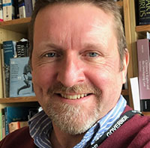
Welcome
Mike Durke
Senior Lecturer
Postgraduate: MA (Child Welfare), MBA, PGCE (PCET)
Undergraduate: BA (Hons)
CMgr, FCMI, FHEA
See also, ’56+ years in 2 minutes’
https://youtu.be/h8OJ3X_k5AQ

Slide 3
Contents
2. Assessments
  Deadline Dates
  Referencing
  Reading List
3. What success looks like
  You Will Need …
  VLE - Moodle
  Your Next Steps …
1. Overview
  Welcome
  Level of Study
  Aims of Module
  Learning Outcomes
  Lesson Content

Slide 4
Contact
Face-to-face is always best.
Before and after class a quick question eases pressure
Email - Mike.durke@uwtsd.ac.uk
Student-facing focus on innovation and change
Website - www.mikedurke.co.uk

Slide 5

Swansea Councillor
The Swansea Council website contains a huge amount of information relating to a very wide range of public service provision.
Lists of councillors
Lists of meetings
Agenda packs and reports
Videos of public meetings
‘Scrutiny’ of what the council does and why it does it
We are accountable to the 245,000 people who live here!
Power of arrest has a limited function
Multi-Agency Partnership is critical to solve major problems
What are the major issues and where might the solutions lay?
https://democracy.swansea.gov.uk/mgUserInfo.aspx?UID=392&LLL=-1

Slide 6

How can I help you?
Teaching, guiding, mentoring, coaching so you secure pass marks for assignment
Identify and help to reach potential
Experience means I have failed a lot and learned from the experience!
If I had a time machine, I could help the young me, avoid falling into so many potholes in the road!
References and career support

Slide 7
Timetables & Teaching
On the Hwb
Always access there
Download the app
Ensure your uwtsd email is working correctly

Slide 8
Weekly Classes
Swansea students: Weds 9-1pm in AS502
Cardiff students: Thurs 11am-1pm UW Registry Room 26

Slide 9

Level 7
Postgraduate studies (masters)
Third Year
Level 6 - Graduation
Second Year
Level 5 – Consolidate & build
First Year
Level 4 – Foundation & skills

Slide 10

Overview
Timetables
Attend, take notes, be proactive
Participation is everything
What aspects of modern policing really spark your interest?

Slide 11
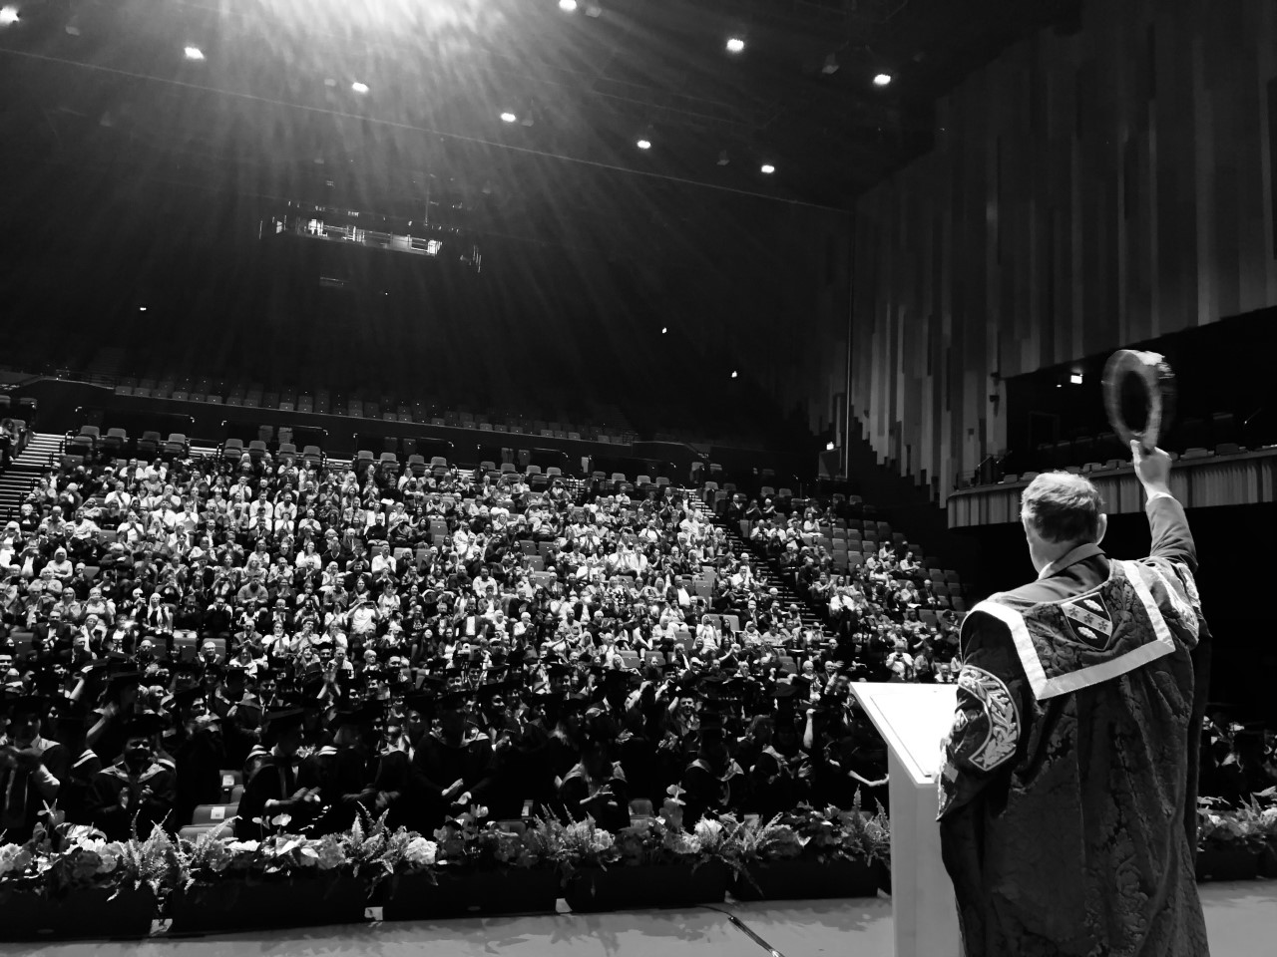
From preparing for research at Level 5 to the 40-credit research module at Level 6
This years sets a foundation for the final year. You will begin Level 6 with your Level 5 Research Proposal

Slide 12
Weeks 1 – 6 (w/b)
27th January – 3rd March 2025
Only one assignment due after Easter
10th March – Progression week
20 Credits
Weeks 7 - 9 (w/b)
17th March – 31st March
Easter Break – 7th April – 25th April
Assignment – 11.59pm Friday 2nd May 25

Slide 13
Level of Study
Level 5 reflects the ability to identify and use relevant understanding, methods and skills to address broadly-defined, complex problems.
Taking responsibility for planning and developing courses of action as well as exercising autonomy and judgement within broad parameters.
Reflects understanding of different perspectives, approaches or schools of thought and the reasoning behind them.

Slide 14
Aim of Module
AIM
To equip the student with the appropriate research skills in order to understand how to put evidence-based policing initiatives into practice, through planning and preparing for an individual policing research project in level 6.

Slide 15
Learning Outcomes
Upon the successful completion of this module, the student should be able to demonstrate the ability to:
Identify effective ways of choosing a research topic and methodology.
Demonstrate skills in the use of resources and primary/ secondary literature sources relevant to the degree programme.

Slide 16
Indicative Content
Effective planning and preparation skills to start research.
Writing a research proposal form.
Identifying ethical considerations.
Structure of dissertation/research project.
Strengths and Weaknesses of research methodologies and approaches.

Slide 17
Indicative Content
Researching, analysing, and evaluating research publications.
Qualitative and quantitative data.
Effective referencing skills of a wide range of materials
Problem solving.

Slide 18
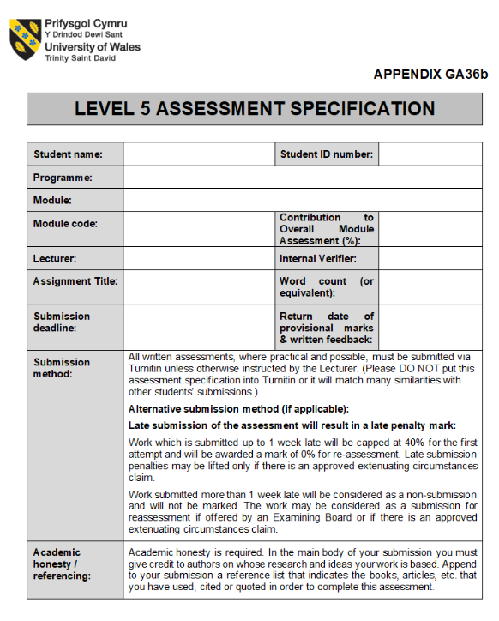
Level of Study: 5
Standard assessment specifications for each level
All tailored to the module in question
It is of critical importance to understand assessment specs as soon as they are released

Slide 19
Assessment
100% - Coursework
Porfolio equivalent to 4000 words
The aim is to prepare you for the 40-credit major project at Level 6
Focus on why research is so important and write a Research Proposal

Slide 20

Referencing
Becoming a black belt in Harvard referencing
Author’s surname, initial, (year), title, place of publication: publisher
Developing research skills (UWTSD library and information)
A foundation for your studies at all academic levels and for research in the professional context

Slide 21
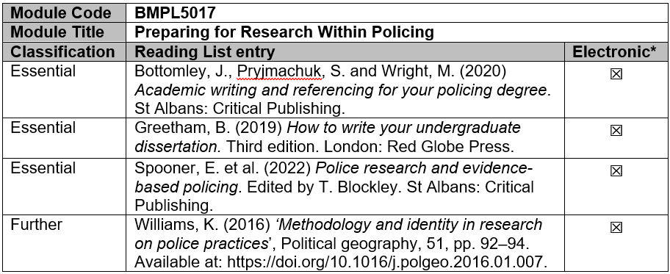
Reading List

