Slide 1


Case Study of HUAWEI’s
Change Management
HUAWEI’s dilemma after US sanction

Slide 2

Introduction
What is change in an organisation?
According to lecture slides, Change is a constant factor in any business or organisation, whether it’s driven by shifts in technology, digital transformation or changing market pressures.
Organisational change is a constant in many organisations, driven by a number of different forces including customers, markets and technology. (CIPD, 2021).
Change is constant or maybe the only constant in an organisation.
Of HUAWEI’s Case Study

Slide 3
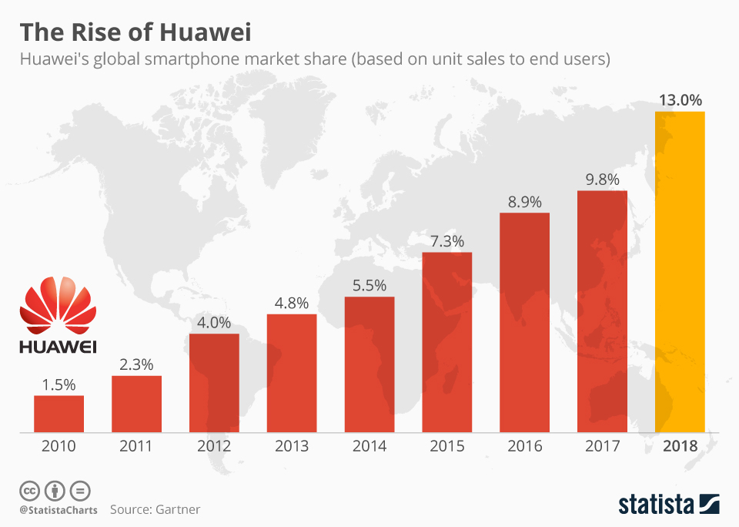
Background of HUAWEI
World’s leading Information and communications technology (ICT) infrastructure and smart device provider
HUAWEI’s Glories
10% reinvestment of sales revenues back into R&D annually; owns one of biggest patent portfolios globally; highly praised on qualities and values on patents in hand (Huawei, 2023)
smartphone business had peaked at 13% market share globally in 2018 (Statista, 2019), closely after Samsung and Apple.
Source: Statista (2019)

Slide 4
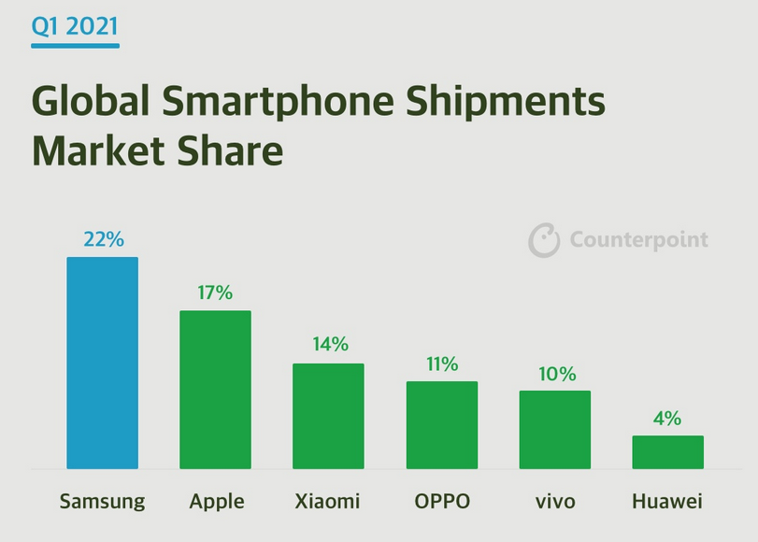
Background of HUAWEI
World’s leading Information and communications technology (ICT) infrastructure and smart device provider
HUAWEI’s Dilemma
Huawei’s business quickly shrinks after US sanction, smartphone sales had dropped 32% in the first 9 months of Year 2021 (McDonald, 2021), with only 4% market share in Q1 2021 (Sean, 2021).
Source: Counterpoint (2023)

Slide 5

Key factors and drivers
of changes
Market pressure caused by Politics (Sino – US trade war)
International and domestic competition
Forecast of global economic downturn
Technology sanction
Endogenous organisational culture

Slide 6
SWOT analysis of HUAWEI
 | INTERNAL | EXTERNAL
 | STRENGTHS | OPPORTUNITIES
POSITIVE | Heavy R&D expenditure on hardware and operating system (OS) development Rules and standards maker of 5G technology (Kharpal, 2022). One of major owners of biggest patent portfolio globally (Huawei, 2023) | Strong brand recall especially in domestic market (Kharpal, 2020). Rapidly recovered Chinese economy from COVID-19
 | WEAKNESSES | THREATS
NEGATIVE | Relied on silicon chip providers such as Qualcomm Inc. Relied on OS service provider such as Google’s Android OS | Tough rivals even within domestic market in China. Consequences of US sanction over supply chains and brand credibility
Source: Created by author

Slide 7

CHANGE IN PROCESS
of HUAWEI

Slide 8
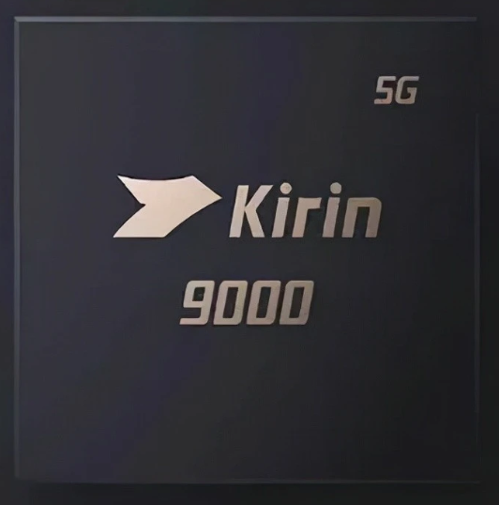

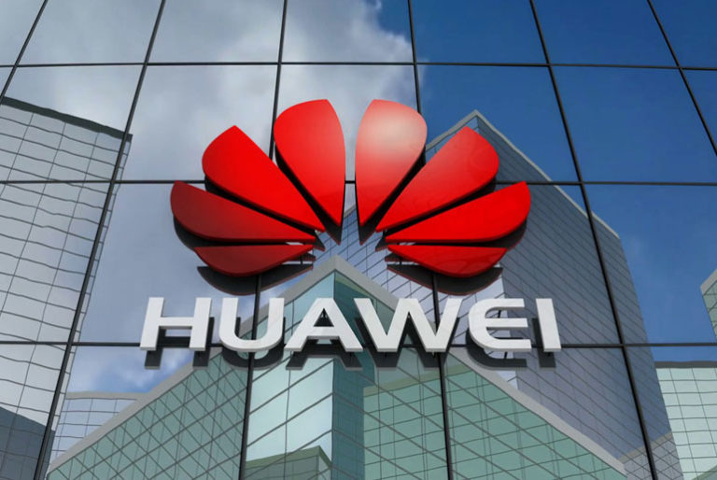
CHANGE IN PROCESS
HUAWEI’S efforts
Reform supply chains by replacing crucial parts with self-developed and local manufactures. (Machine)
Invest heavily on self-developed OS – Harmony OS in order to create new ecosystem. (Machine)
Reconstruct business portfolios to confront challenging environment (Organism)

Slide 9
Lewin Model analysis for HUAWEI
Lewin’s force field analysis
Total | Driving Forces the change | The status quo | Restraining forces resisting the change | Total
5 | Management decides to move on localization and self-sufficiency | Regaining market share and competitiveness | Increased R&D expenditure reduces profitability | 4
5 | US sanction force Huawei to alternate its R&D direction and priorities |  | Too much pressure on R&D department and personnel | 3
4 | Showing ambitions to retake the market position |  | Slower technology iteration reduces brand attractiveness | 4
14 |  |  |  | 11
Source: Created by author

Slide 10

Beneficial or Hindered?
Through the change management Huawei had executed, the localization rate of parts in Huawei’s production has obviously increased to withstand supply chain pressure after the sanction took place, which “its localization substitution had made great progress”. (AmpleChip,2023).
And more thinking

Slide 11
Conclusion
What is going to be?
To Huawei, the change management in place is expected to benefit the entire organisation in future growth, but it might hinder the performance of the organisation in the short term. A Chinese proverb “守得云开见月明” is suitable to conclude Huawei’s case study which means “every cloud has a silver lining”.
Of HUAWEI’s Case Study

Slide 12



References
AmpleChip (2023) Where is the progress of Huawei's localization in China? Available at: https://www.ample-chip.com/NewsDetail/where-is-the-progress-of-huawei-s-localization-in-china.html (Accessed: 25 Feb 2023)
Cameron, E. and Green, M. (2015). Making sense of change management : a complete guide to the models, tools and techniques of organizational change. 5th Edn. Kogan Page.
CIPD (2021) Change management | Introduction. Available at: https://www.cipd.co.uk/knowledge/strategy/change/management-factsheet (Accessed: 25 Feb 2023)
Counterpoint (2023) Global Smartphone Shipments Market Data (Q1 2021 – Q4 2022). Available at: https://www.counterpointresearch.com/global-smartphone-share/ (Accessed: 25 Feb 2023)
Huawei (2021) Huawei: Optimizing portfolio to boost business resilience and navigate a challenging environment. Available at: https://www.huawei.com/en/news/2021/4/huawei-has-strategy (Accessed: 25 Feb 2023)
Huawei (2023) About Huawei. Available at: https://www.huawei.com/uk/corporate-information/research-development (Accessed: 25 Feb 2023)
Lei Liu
2216376@student.uwtsd.ac.uk

Slide 13
References
Kharpal, A. (2020) Huawei overtakes Samsung to be No. 1 smartphone player in the world thanks to China as overseas sales drop. Available at: https://www.cnbc.com/2020/07/30/huawei-overtakes-samsung-to-be-no-1-smartphone-maker-thanks-to-china.html (Accessed: 25 Feb 2023)
Kharpal, A. (2022) Huawei licenses 5G patents to rival as U.S. sanctions force the Chinese giant to seek new revenue. Available at: https://www.cnbc.com/2022/12/09/huawei-licenses-5g-patents-to-rival-as-us-sanctions-bite.html (Accessed: 25 Feb 2023)
McDonald, J. (2021) Huawei sales off 32% after US sanctions, smartphone sale. Available at: https://apnews.com/article/technology-business-china-858b395d1a554f57518ef055af6336a8 (Accessed: 25 Feb 2023)
Sean (2021) Huawei only held 4% smartphone market share in Q1 2021. Available at: https://www.gizmochina.com/2021/06/11/huawei-held-4-smartphone-market-share-q1-2021/ (Accessed: 25 Feb 2023)
Statista (2019) The Rise of Huawei. Available at: https://www.statista.com/chart/18063/worldwide-smartphone-market-share-of-huawei/ (Accessed: 25 Feb 2023)
Lei Liu
2216376@student.uwtsd.ac.uk

