Slide 1
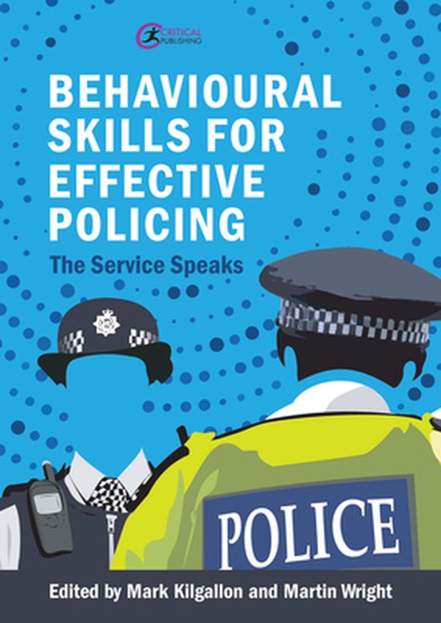
Inclusive Policing

Slide 2
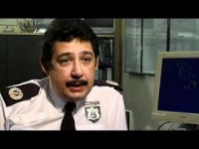
Breaking the Cycle
A personal perspective
Brian Langston
Retired Assistant Chief Constable
Thames Valley Police

Slide 3
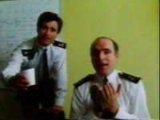
Futile quest
Should policing aspire to represent the communities it serves?
With reference to ethnicity, this has been a central challenge for 50 years
At the time of the Macpherson Report (1999) 2% of the service was BAME v. 6.5%% of the population
Currently, we have 7.3% compared with 14% of the population
Not a “particularly impressive return on investment.”
Langston 2022

Slide 4
Emotional connections
British policing must focus on regaining the trust and confidence of the whole society and not descend into a purely reactive enforcement role
The police do not have to mirror the community they serve at least not in terms of identity diversity
A rainbow police service reflecting the community is unrealistic and misguided
The simplistic approach to co-opt minorities into organisations failed to recognise the power of underlying cultures
Langston 2022

Slide 5
The diversity cosh
Head down
Nose clean
Do not mention the D-word
… hopefully avoid making a career-limiting gaffe
Away from command and control and towards creative problem solving and cognitive diversity
‘Wicked thinkers’ who operate beyond the bounds of standard operating procedures, think laterally, creatively and flexibly
Even at senior levels, officers are weary of being under the diversity cosh
Langston 2022

Slide 6
Policing with authority
A radical approach to equality diversity and inclusivity is needed - less about counting heads and more about making heads count
Appearance might help, but attitude makes all the difference
It is about character not the colour of one's skin
This is how we capitalise on opportunities to build rapport, change perceptions and dislodge prejudice
Emotional intelligence, self-awareness and empathy, enable officers to transcend the suspicion with which they might initially be viewed
Emotional intelligence, surprisingly, has never being an explicit prerequisite for the police officer
Langston 2022

Slide 7
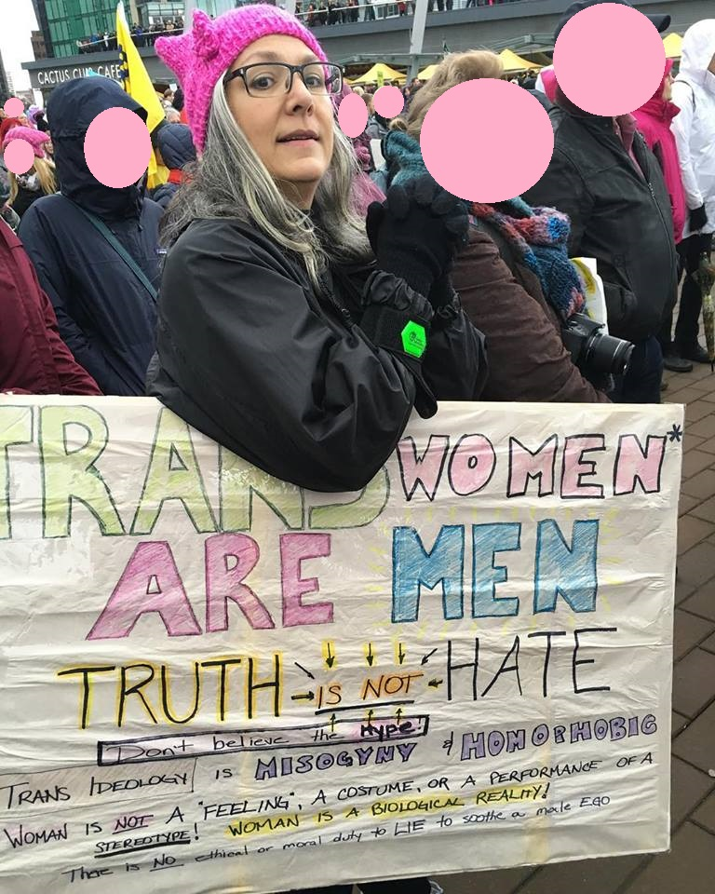
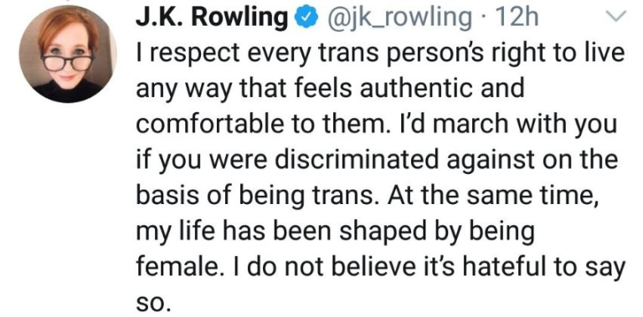
Open discussion
Equality, diversity and inclusion should be openly discussed everywhere
Not driven underground
Who feels confident to offer a perspective on the transgender debate?
Langston 2022

Slide 8
Uniqueness and belonging (Langston’s experience 1980 – 2010)
Not treated as an organisational insider. Difference seen as valuable for organisational success but not truly embraced
“You’re not like us!”
DIFFERENTIATION
The individual is valued for the difference they bring to the organisation and encouraged to retain their uniqueness within the team.
“You are valued for who you are”
INCLUSION
Sense of uniqueness
Not considered ‘one of us’. Not perceived as bringing value to the team
Not one of the in-crowd. Difference seen as a burden
“Go away!”
EXCLUSION
Only accepted as ‘one of us’ provided they conform to the dominant culture and play down differences
Differences are encouraged
“We’re supposed to be the same!”
ASSIMILATION
Feeling of belonging

Slide 9
Operation Comfort
Local Commander in Slough
Put the community in the driving seat to shape policing style
Terrorist incident backlash, with far-right groups targeting Slough
Appearance of racist graffiti and skinheads, tensions build
Radical Islamists pitch stalls in the High Street. Conflict ahead
Inflammatory behaviour of radical Muslims
Retail footfall declines
Media – Slough is a no-go area at weekends
Langston 2022

Slide 10
Operation Comfort
I remember saying:
“I want you to smile, joke, shake hands, kiss babies and pat dogs if necessary to show the community that we are there to reassure them. Don’t wear your uniform on your face!” (Langston 2022: 21)
Rather than a high-profile police response, and likely increase in fear of crime and likelihood of violence
Deter and reassure instead, through active engagement
‘Critical incident’ on the cards: pigs heads to be thrown into the mosque
Briefing: take every opportunity to reassure the community and allay fears
Smile and be approachable

Slide 11
Operation Comfort
Local community leaders and politicians were invited to sit in on the briefing, and to go on patrol with officers
They were given a direct dial number to the Silver Control Room to report any inconsistent interactions
BAME Sergeant and 6 officers engaged with ethnic minorities using their cultural awareness and language skills (Urdu, Punjabi, Jamaican patois)
Younger officers said they would not normally talk to people unless they had a reason or power to do so
Langston 2022

Slide 12
Operation Comfort
Police recruitment stand set up next to the Islamic radicals
Lots of interest and questions e.g. about levels of racism in the police
Retailers appreciated the approach and the butcher said someone had rather oddly ordered two pigs heads
Media had to report the positive environment
One call claimed a petrol bomb was thrown at the mosque. Officer on the scene reported this was a hoax call
Community observers were glowing in their praise
BAME officers felt valued
Langston 2022

Slide 13
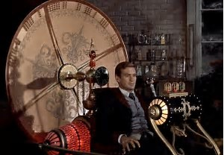
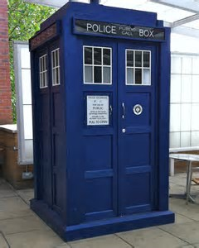
Time machine policy-making
If we could nip into the Tardis and go back in time, could we go and alter mistakes that were made in the past?
Was there a specific time when Britain was a homogenous, united whole?
Was the population ever one thing, one family, sharing a single culture, language, set of beliefs?
Was life ‘better’ years ago and if so how?
Is it natural for us to look back with fondness at times gone by?

Slide 14
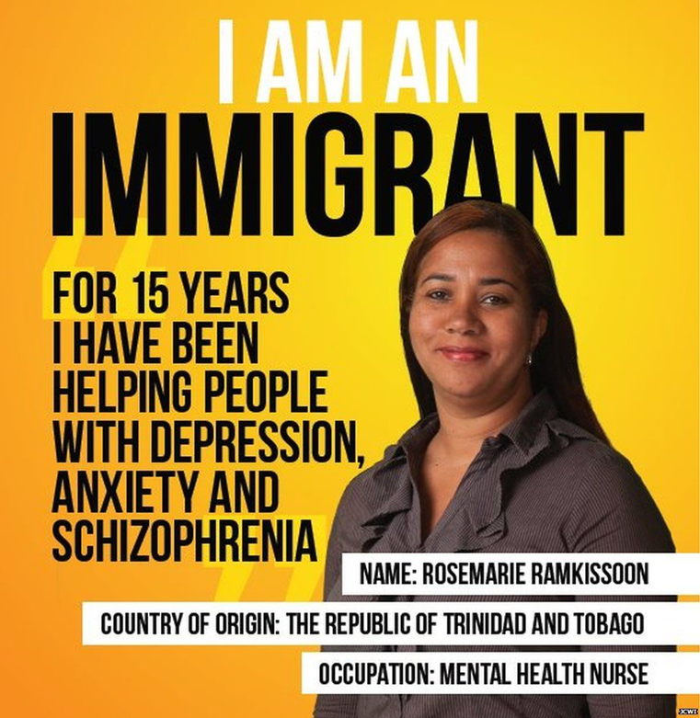
Mud-bloods or pure-bloods?
Where were you born, your parents, grandparents, great-grandparents …?
Does it make sense to think of ourselves as of a particular nationality?
What will your children and grandchildren look like?
Where will they live?
What language will they speak?

Slide 15
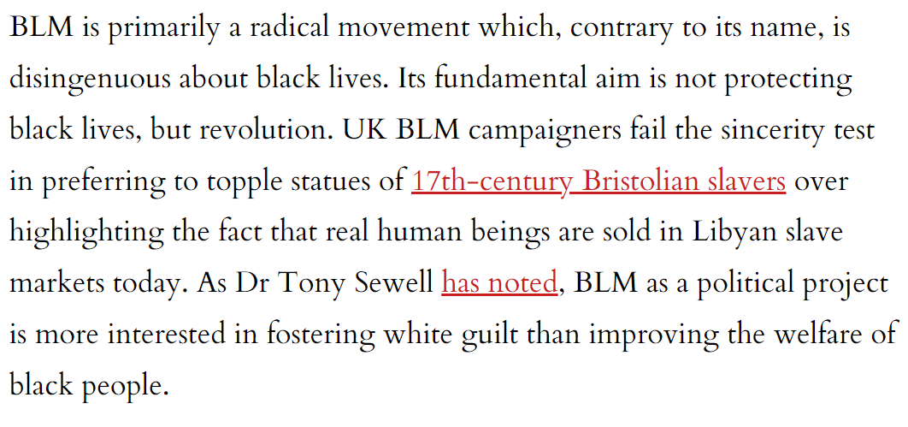
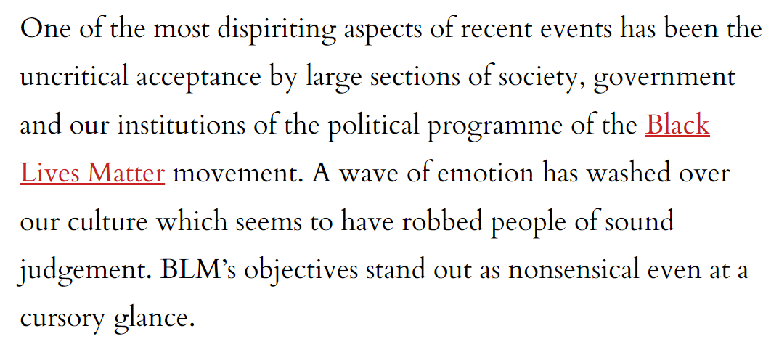
The BLM movement could not be more wrong
Clouston 2020

Slide 16
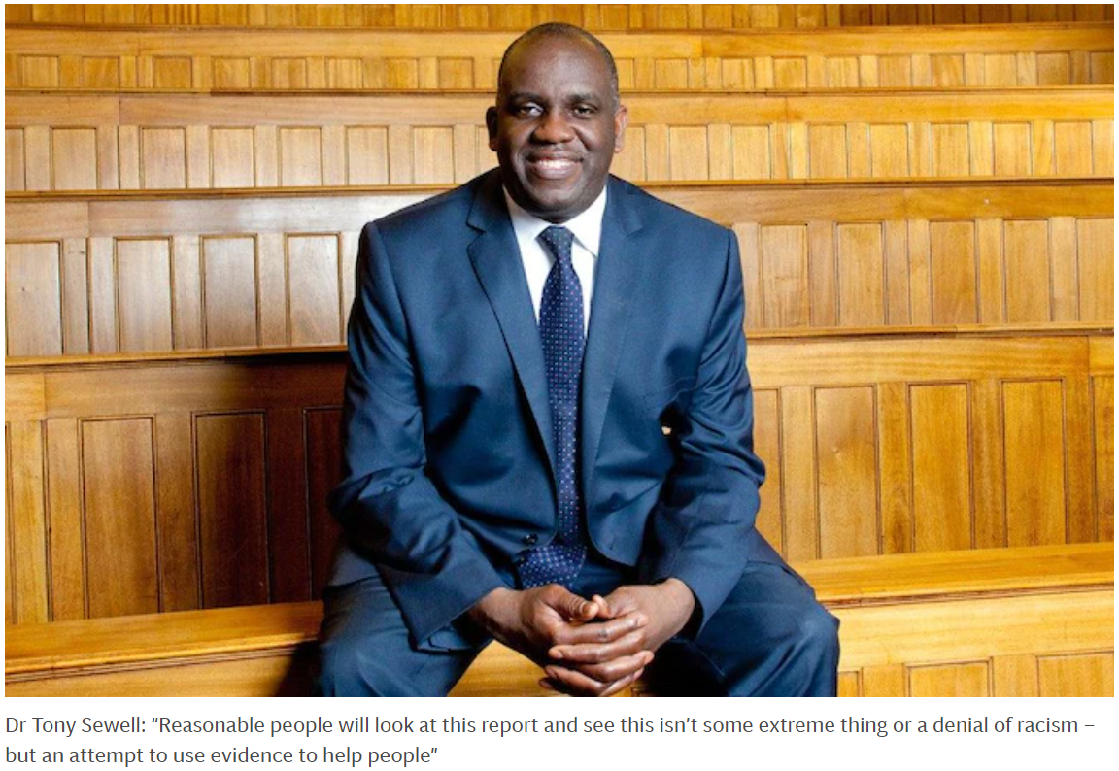
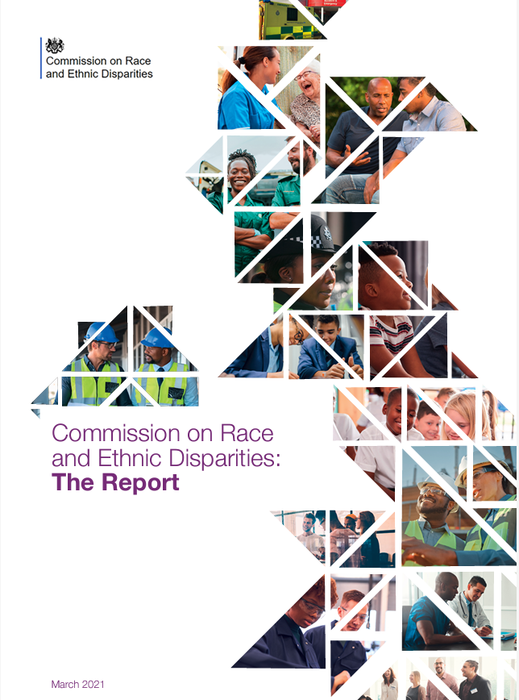
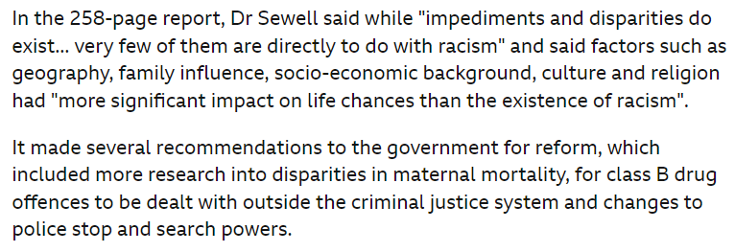

Slide 17
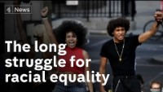

Slide 18
References
Casey L (2016) The Casey Review: A review into opportunity and integration, London: Department for Communities and Local Government
Clouston, W (2020) The BLM movement could not be more wrong, available at https://www.spiked-online.com/2020/06/17/the-blm-movement-could-not-be-more-wrong/
Dorling D (2011) Injustice: why social inequality persists, Bristol: The Policy Press
Fanshawe, S and Sriskandarajah, D (2010) ‘You can’t put me in a box!’ Super-diversity and the end of identity politics in Britain. Institute for Public Policy Research (IPPR).
Winder R (2006) Bloody Foreigners: the story of immigration to Britain, London: Abacus

