Slide 1

Effective Team Working and Communication
(BMSW4002)
DR: Muhammad Islam
2022
Certificate of Higher Education Skills For The Workplace
Group presentation - 3
Full name | Student ID number
Samir Mhanna | 2119514
Mohammed Adam | 2121738
Evdokiya Stefanova | 2018698
Mohammed Salim | 1807323
Communication (Theories, Channels, Barriers, and The Impact)

Slide 2
Content
Introduction
Theories of communication
Channels of communication
Barriers of communication
The impact of communication
Conclusions
References

Slide 3
1st presenter
Student’s Full Name | Samir Mhanna ( Group leader)
Student’s ID Number: | 2119415

Slide 4
Introduction
There are several communication models and theories accessible with the goal of understanding and improving communication.
In our presentation will discuss the classical theories.
Theories of communication
Classical Theories
Open system theory
Human Relations Theories

Slide 5
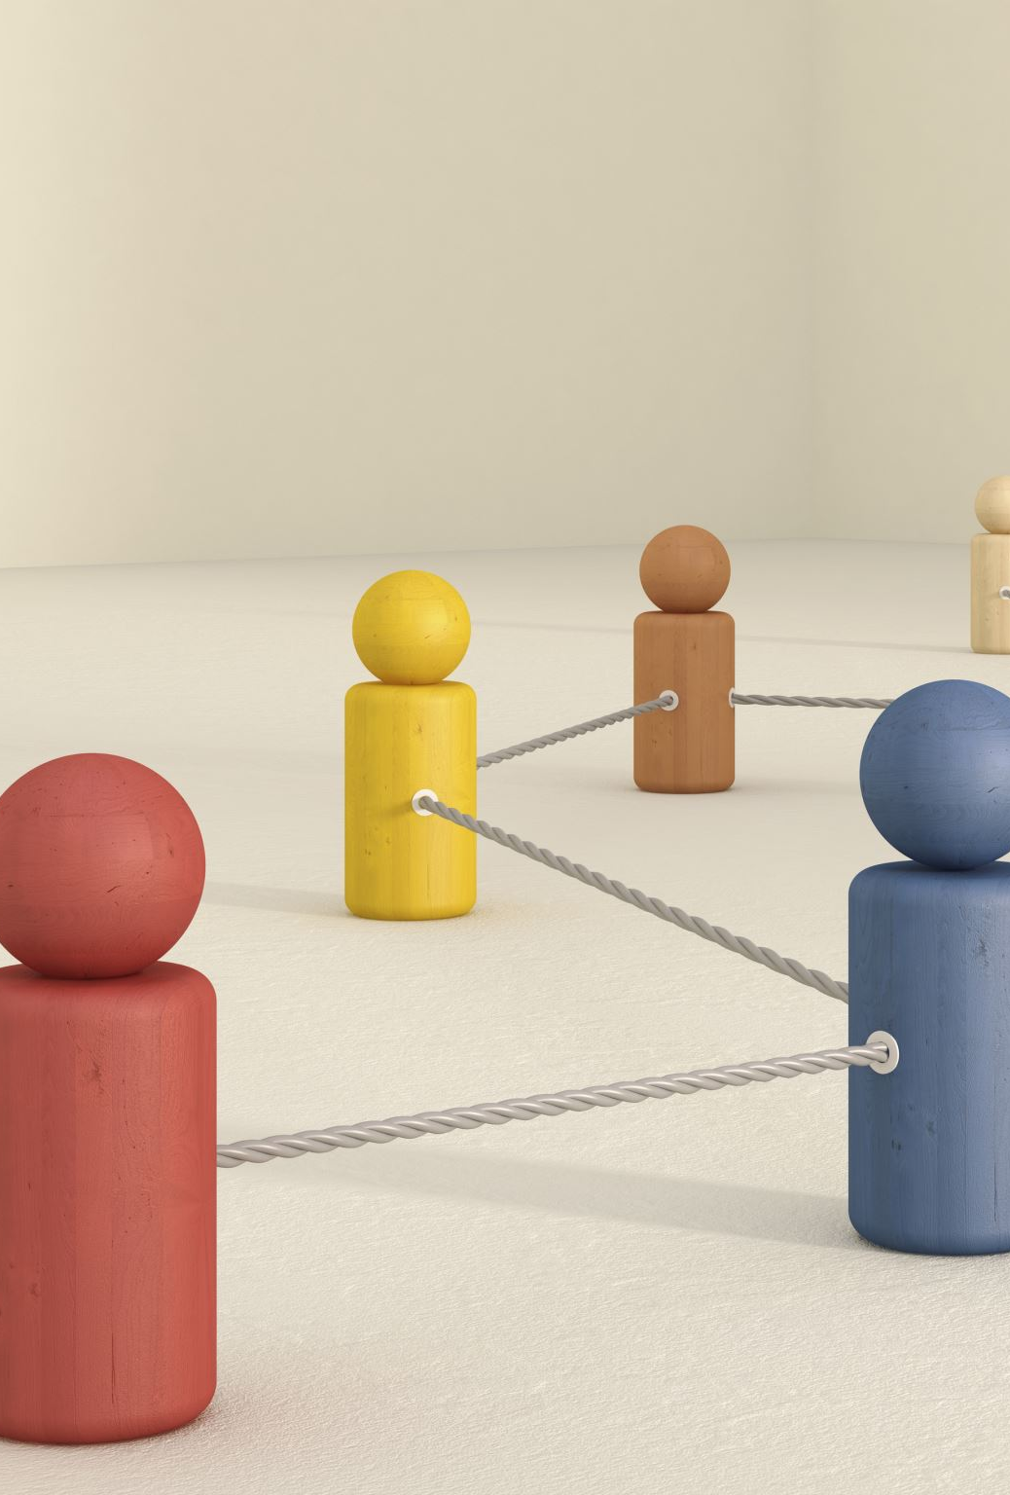
Classical Theories
These theories describe how the communication process works. Such as Lasswell's model, Shannon and Weaver's communication model, and the SMCR model and many others.
Communication exists to enable the manager's control and management the organization via vertical, official channels.

Slide 6
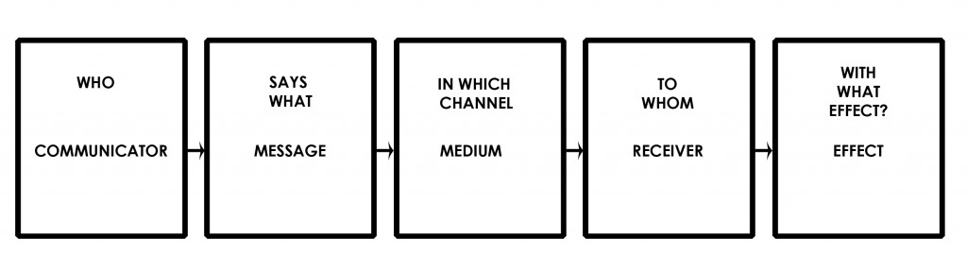
Lasswell’s Model
Lasswell's (1948) communication model: "Who says what, to whom, how, and with what effect?" — was initially published in a Rockefeller Foundation Communication Seminars report (November 1, 1940). (Rogers, 1994)

Slide 7

Function of communication- Lasswell
Correlation of societal components
Cultural transfer from generation to generation
Environmental surveillance

Slide 8
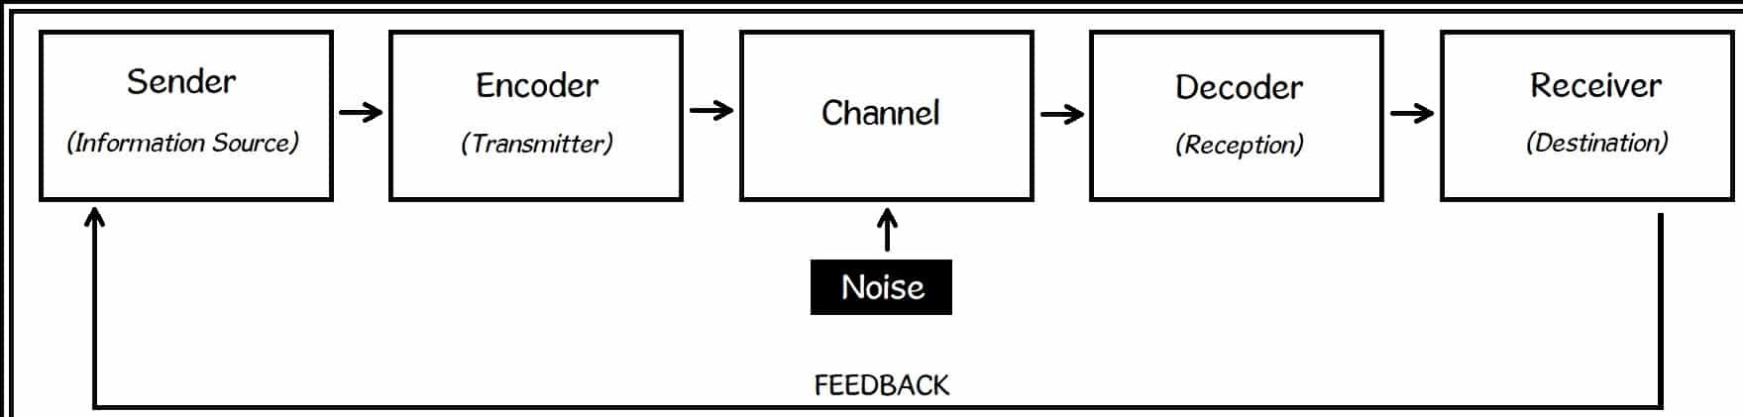
Shannon- Weaver Model
This approach was developed expressly to promote effective communication between sender and recipient.(Al-Fedaghi, 2012).
They also find "Noise" characteristics that influence the communication process. Initially, the method was developed to improve technical communication.

Slide 9
2nd presenter
Student’s Full Name | Mohammed Adam
Student’s ID Number: | 2121738

Slide 10
Introduction
Communication is a vital part of our life activity. Communication mainly takes place to convey to the audience any messages. Besides, this communication mainly required channels to communicate, which are the medium of exchanging any information. To decode the messages these channels are used (Wang and Wang, 2013).

Slide 11
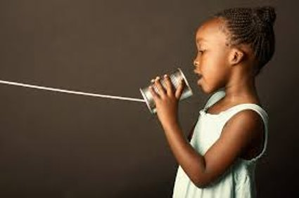
Process of Channels​
In order to send any information from the sender to the receiver, channels are used, and using these channels will help the receiver to understand the data that is sent and works like information. Receiving information will help to determine the skills of communication, knowledge, attributes, culture, and social system for the method and information itself (Wa ng and Wang, 2013).

Slide 12


Channels
Hearing
Hearing is the process of listening to something with the power of perceiving any sound and function accordingly and using this sense to improve the communication level that is created from the tones, noises, or listening to the other tone of voice to understand the situation by hearing the level of seriousness of information.
Seeing
Seeing any piece of information is like using the power of sight to see any object where the body actioning and functioning itself to determine the information presented and seeing any information can help to gather knowledge about the color, structure, and design of certain information to differentiate things.

Slide 13

Smelling
Besides, smelling is something by which people can determine the odor or aroma of any things to determine the objective. Smelling helps to determine the freshness of liveliness of any things with this media people can make sure of absorbing any knowledge or information about any creating thing with the help of organs with the Olfactory communication process.
Touching
With the help of touching any object that tried to provide information basically reflects information with the help of our brain. The brain helps us to know and clarify things and objects by touch. Where the brain gets the input through the skin from mechanoreceptors.
Tasting
Using the tools like tasting can determine the flavor of the product that included information to ensure consistency. Also tasting is needed to provide information when any new innovation of any product is developed (Graham, 2009).

Slide 14
3rd presenter
Student’s Full Name | Evdokiya Stefanova
Student’s ID Number: | 2018698

Slide 15
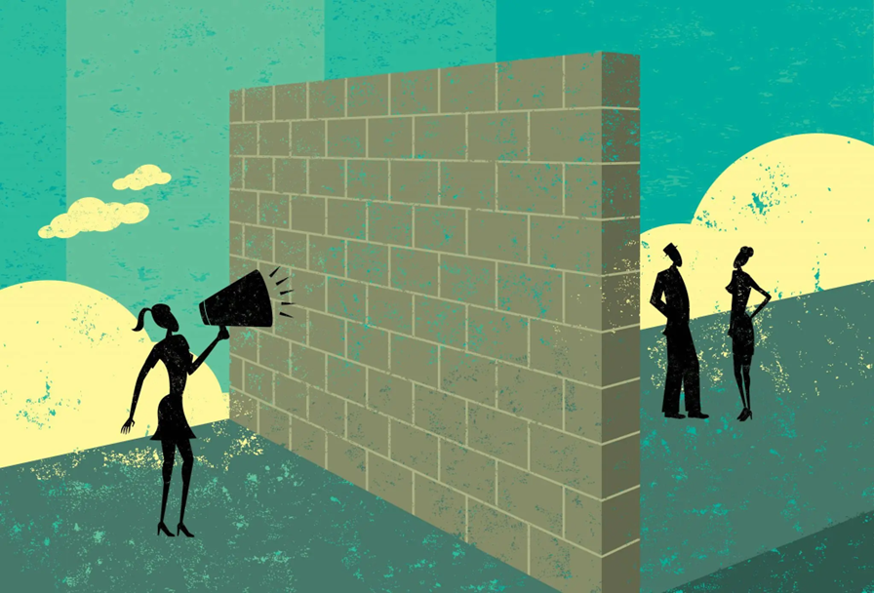

Barriers to effective communication
Communication has many forms, and each of these forms has its individual obstacles. They can be majorly categorized in a few ways such as psychological ,physical, language and systematic barriers.

Slide 16
Psychological barriers
Filtering is a common psychological barrier in which the sender of the information is deliberately manipulating the message so it is better received by the listener, this can be a self-defense mechanism to avoid backlash, for example employees might be hesitant to bring up issues if their boss tends to react aggressively or dismisses their worries.

Slide 17
Physical barriers
Writing through e-mail or talking through a telephone can lead to misunderstandings as people cannot pick-up on the non verbal cues used in language, and lead to the wrong conclusions.
‘These are social factors that can undermine veridicality when absent’ says Depaulo and Friedman (1998)

Slide 18

Language barrier
Language barriers exist when persons do not communicate or have equal proficiency in a language.(Rani, 2016).
As businesses cater to all types of people, they are bound to encounter people with varying language skills. For this reason it is important that language is inclusive, using easy to understand and follow phrasing, as well as providing local translation if necessary.

Slide 19
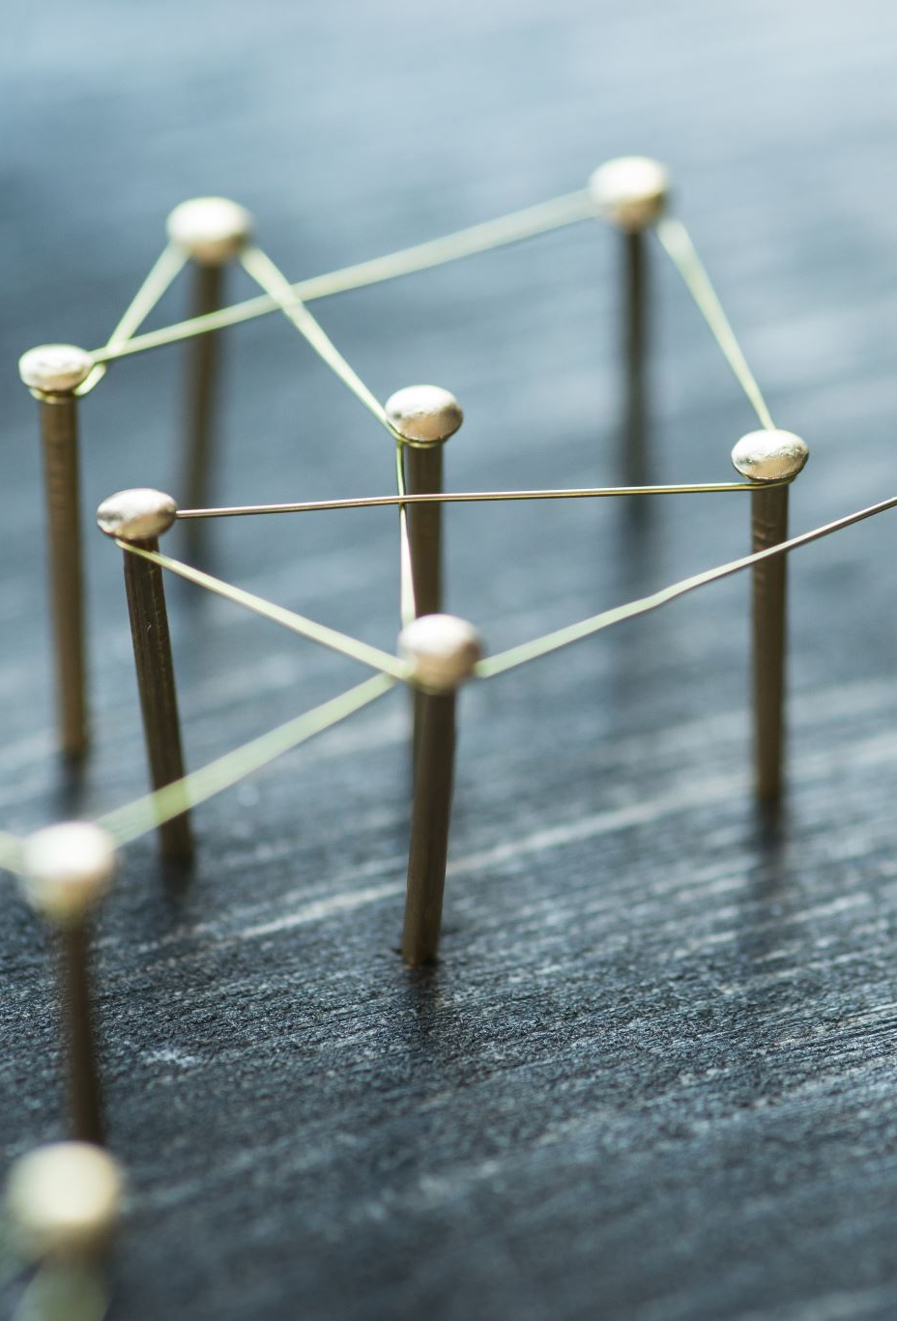
Systematic barriers
Systematic barriers are tricky because their effect on hindering communication is hard to examine properly. They are usually inefficient communication structures.

Slide 20
4th presenter
Student’s Full Name | Mohammed Salim
Student’s ID Number: | 1807323

Slide 21
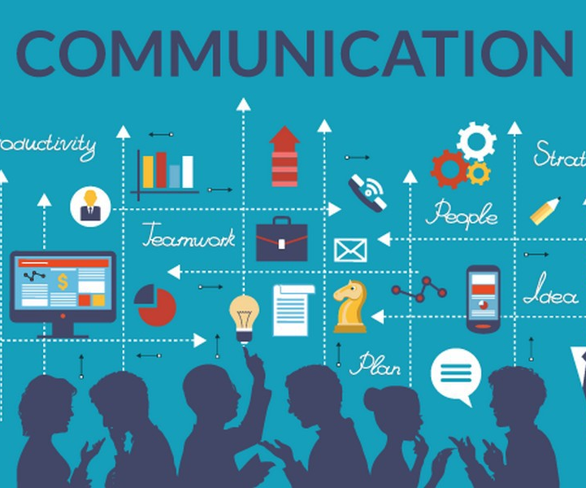
The Impacts Of Communication​
Making a pleasant work atmosphere where employees feel appreciated, respected, and supported.
Communication helps foster two-way trust cultures. Employees must believe they can rely on their leaders, supervisors, and the system..(West A.M. & F.J. Dawson , 2012)​

Slide 22
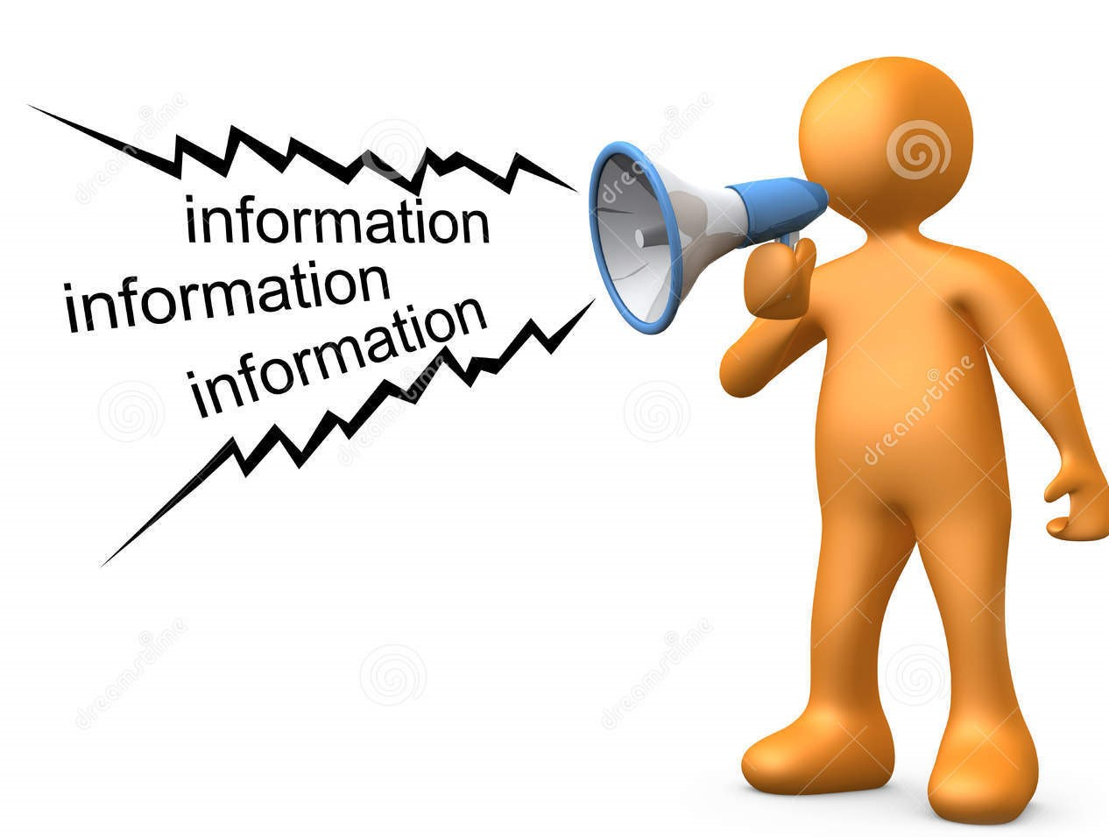
Giving Information
Giving employees the knowledge they need to do their jobs properly, learning opportunities, feedback to boost their confidence, support, and safety in order to innovate and develop new and better methods of providing patient care.(West A.M. & F.J. Dawson , 2012)​

Slide 23

Motivation and Effective Teamworking
Engagement is increased when rituals and rites are widely used to recognise contributions and achievement, and when accomplishment and creativity are consistently celebrated (West A.M. & F.J. Dawson , 2012)
​Communication impacts employees through positively affecting interpersonal relationships within the organisation and giving a positive outcome as employees feel listened to. (D'Aprix 1996)​

Slide 24
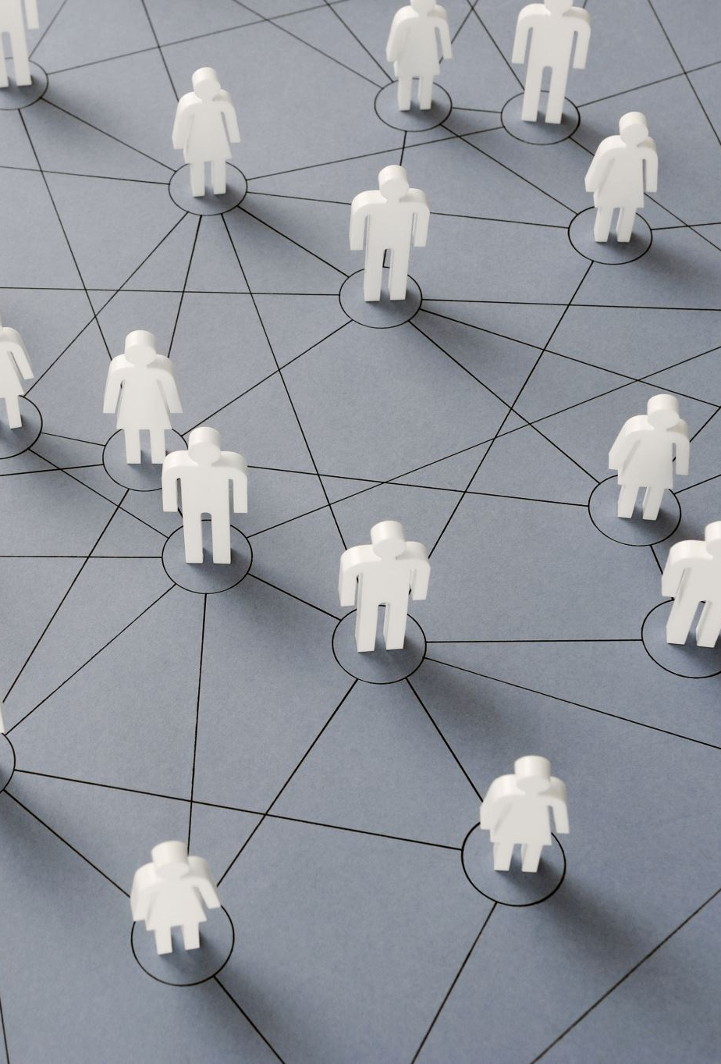
Benefits of Communication
Communication is beneficial in the flow of more formal communication among employees at the same level, such as human resources.​ Diagonal communication are helpful in providing a fast flow of communication that needs to be delivered quickly as it uses less structured pathways. (Plez, D. 1952)​

Slide 25
Conclusions
There are several communication models and theories available to aid in understanding and enhancing communication.
create effective communication channels and systems, particularly with consumers and workers
Any organisation can fail due to a lack of communication.
Every employee and management should endeavour to overcome certain barriers to successful communication.

Slide 26
References
Al-Fedaghi, S. (2012) A conceptual foundation for the Shannon-Weaver model of communication. International journal of soft computing, 7(1), pp.12-19.
Dainton, M. & Zelley, E.D. (2005) Applying communication theory for professional life: A practical introduction. Thousand Oaks, California: SAGE.
D’Aprix, R. (1996). Communicating for Change – Connecting the Workplace with the Marketplace. San Francisco: Jossey- Bass Publishers, 1996​.
Depaulo, B. M., & Friedman, H. S. (1998). Nonverbal communication. In D. T. Gilbert, S. T. Fiske, & G
Graham, I., 2009. Communication. Mankato, Minn.: QEB Pub.​
Lindzey (Eds.), The handbook of social psychology (pp. 3–40). McGraw-Hill. Available at: The handbook of social psychology (Book, 1998) [WorldCat.org] Accessed on: 12th July 2022

Slide 27
Rani, K.U., (2016) Communication barriers. Journal of english language and literature, 3(2), pp.74-76.
Rogers, E.M. (1994) History of communication study. New York: Free Press.
Pelz, Donald C. (1952). Influence: A Key to Effective Leadership in the First Line Supervisor.
Personnel, 29, 209#17.​
West Michael A. & Dawson , F. (2012) - Employee engagement and NHS performance University of Sheffield, Lancaster University.
Wang, J. and Wang, Q., 2013. Body area communications. Singapore: J. Wiley & Sons Singapore.

Slide 28
Thank you
Any questions

