Slide 1
Ufo GROUPS
TRRS4011

Slide 2
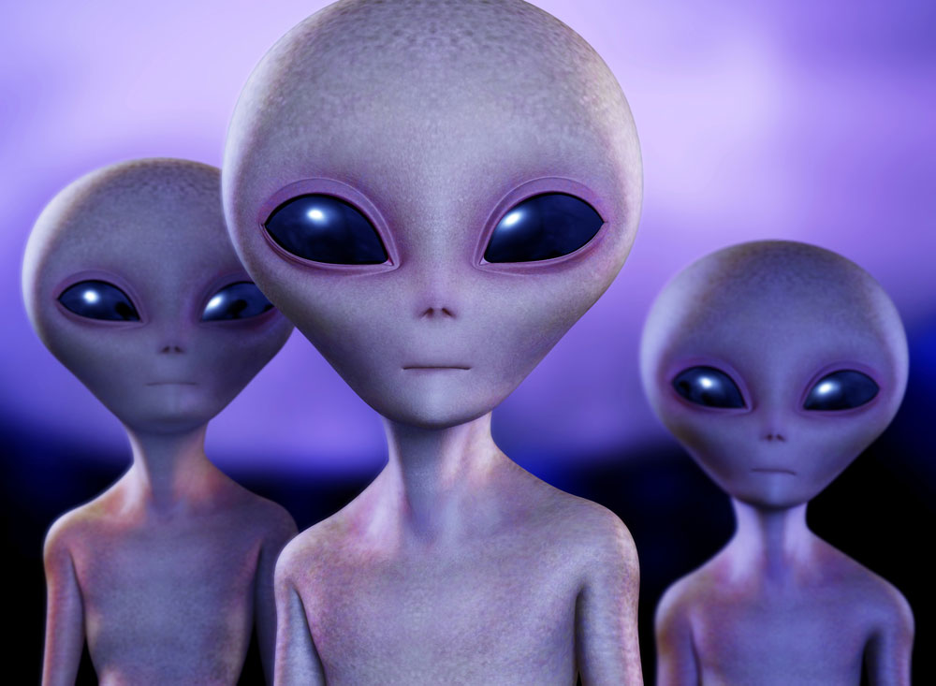
Paul Heelas (2000, 238) notes “Today, there is a much greater awareness of what lies beyond church and chapel: namely, those beliefs which are religious, spiritual, supernatural, paranormal or supra-empirical in that they transgress what the secular form of reference takes to be ‘obviously’ factual, rational, reasonable, sensible, and convincing, and which are not readily demonstrable to the public in general”.
Heelas (1996, 74) 'Faith might be placed in solar bodies, the assumption being that utopia will dawn when a particular (Aquarian) configuration becomes established. Or faith might be placed in the role played by highly evolved spiritual beings'.

Slide 3

Virgil Armstrong (1993, 93-4) states that there are 3 types of UFOs: first, the ‘Guardian Forces’ who have our best interests at heart. Second, the ‘bad guys’ who want to exploit us, violate us, and regain their humanity from us (against idea of contact for good reasons!). Third, the neutral beings who just want to observe ‘and heaven only knows what other purposes in the future’.
Waya (1993, 71) ‘…each person…has a chief guide or spirit guide. I had always likened my spirit guide to the Christian idea of a guardian angel who is always there to help us, counsel us, and in general keep us out of hot water, providing we listen to the voice of our spirit guide or our intuition, our knowing…’.

Slide 4

‘When I was six years old, I first met what I then thought was my guardian angel. In reality, he was my alien guide, and he has been with me for over fifty years. I trust him completely. He has fair skin, blue eyes and white-blond flowing hair and he wears a glittery white jumpsuit. He is over six feet tall and has a strong masculine voice. His messages and unfailing guidance have shown me there is more to our existence than the information fed to us by the schools, the pulpits and the media’ (Morrow, 86).
‘…people have…to overcome criticism of their beliefs and the conditioning of centuries by churches, parents and peers’ (Morrow, 1993, 86).
‘…you may have to simply think as a child’ (Morrow, 1993, 85)

Slide 5
Partridge (2004, 79) says that much of how we feel about such things will depend on our background (depends on class, religion geography, gender, age, race). Partridge says that faeries and ghosts are a huge part of our childhood, then we are taught to reject them.

Slide 6
UFO GROUPS
Aetherius Society

Slide 7
1955 Sir George King
King claimed to be a psychic and in touch with cosmic masters’. Can reincarnate in a spiritual body, remain on earth to guide humanity as one of the Great White Brotherhood or be reincarnated on another planet. ‘The eventual goal is merging with all life forms, including the celestial bodies’ (Chryssides, 1999, 370).

Slide 8
Ufo groups
HEAVEN’S GATE

Slide 9

http://web.archive.org/web/20110721182919/http://www.heavensgate.com/

Slide 10
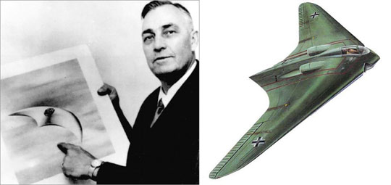
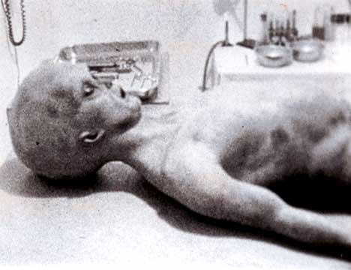
Bonnie Nettles (1927-1985) Marshall Herff Applewhite (1931-1997)
Kenneth Arnold 1947 (pilot) sights ‘flying saucers’. First widely reported sighting.
1947 – Roswell incident, New Mexico, USA (crash. Spaceship. 1970s conspiracy theories.

Slide 11

1966 – Applewhite appointed Assistant Professor of Music, Texas
1968 – Chariots of the Gods (Erich von Daniken b1935) – higher beings created things we’ve found that are advanced, eg pyramids, Stonehenge. Artwork shows ETs. Humans not ready to hear all this.
1972 –Heart attack, Nursing and Astrology.
1973 – Claim to be ‘The Two’ (Revelation 11:3 – “And I will give power unto my two witnesses…”
1975 – First Public Meetings. Toured US & Canada.
1976 – Summer Camp in Wyoming. Organisation matures with uniforms and teachings codified.
Ti (Nettles) died in 1985 and the appearance of the comet was believed to be a sign from her that the time had come to abandon bodily ‘containers’.

Slide 12

1991 – Total Overcomers Anonymous formed; promotes celibacy and asceticism.
1996 – Group rents San Diego property with money from computer consultancy
1996 – Halle Boppe appears
26th March 1997 – 39 suicides. (San Diego). They had taken a combination of alcohol, painkillers and tranquillisers. The Medical examiner of San Diego termed it ‘an immaculately carried out group decision’.

Slide 13
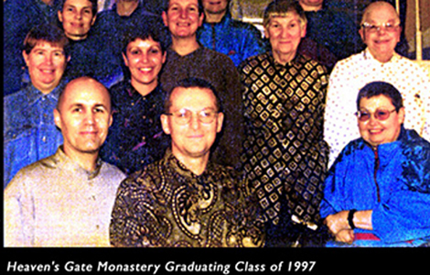
Kingdom of God as physical evolutionary level, not ‘merely’ spiritual
Asceticism, celibacy (inc. castration of 7 male members), no smoking, alcohol, etc.
Use Biblical apocalypse and Ufology to create coherent cosmology. Claim links to Jesus – Appelwhite direct relation. View body as ‘vehicle’.
Understood ‘older members’ minds to be attuned to Extra Terrestrial messages (early in movement all members could do this)
Sought ‘beyond-human’ existence; ‘Human Individual Metamorphosis’ achieved when all wordly attachments left behind.
‘Next level above human’ or the ‘evolutionary level above human’.
‘Spaded under’ (body is vehicle for soul).
‘Return home’

Slide 14
Hale-Bopp comet (ice and dust and a ‘tail’ of gas appears when near the sun) discovered in 1995 by Alan Hale and Thomas Bopp (astronomers). Chuck Shramek (amateur astronomer) noticed an attachment to Hale-Bopp and said it was an alien spaceship.
‘It was only a matter of time before someone hit on the notion of taking a spaceship to heaven’, (Sunday Times 30.3.97).
Internet was the main method of communication.
‘Owes more to Star Trek than the Bible’ (Sunday Times 30.3.97)
Also ‘Suicide cult had rendezvous with spacecraft behind comet’ (The Times 28.3.97).
Method: phenobarbital, sleeping pills, vodka and suffocation. 15, 15, then 9 on three days.
Attire – new tracksuits, trainers and ID documents.
Those who died had recorded video messages to be left behind.
“Human parents do not possess the offspring that they have. Breaking away from the world is not easy, but we must become another human being and abort the human mind…a new creature is born. We came from distant space and are about to return”. (Applewhite, Inside Story documentary, BBC, 1997).

Slide 15
UFO GROUPS
THE RAELIANS

Slide 16
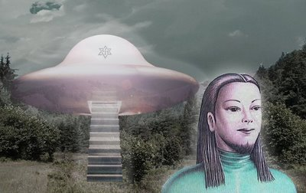
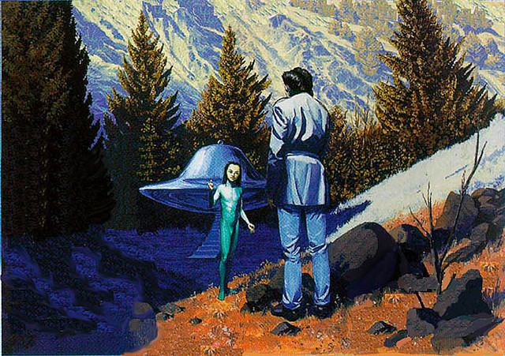
Claude Vorilhon (b. 1946) – Vichy, France
13th December 1973 – Clermont-Ferrand - Flying Saucer: 7m x 2.5m
4’ (1.2m) ‘Man’ mistaken for child.
Alien was leader of Council of Elohim – Hebrew plural Gods.
Explained Rael (‘Messenger of Elohim’) had been watched since birth.
Human-like creatures who have attained great scientific knowledge.
Genetic-engineering on own planet
Found earth to carry out experiments.
Sent messengers to right wrongs (e.g. Jesus, Mohammed, etc). Rael is final prophet.

Slide 17
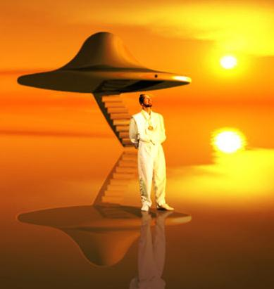
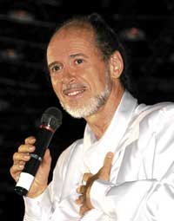
Rael to build embassy to welcome Elohim when they come to earth (by 2035)
Israel first choice, as Jews chosen people of Elohim
Israel refused permission to date – may now be placed in nearby territory (e.g. Egypt)
Over $7,000,000 raised already to build embassy

Slide 18
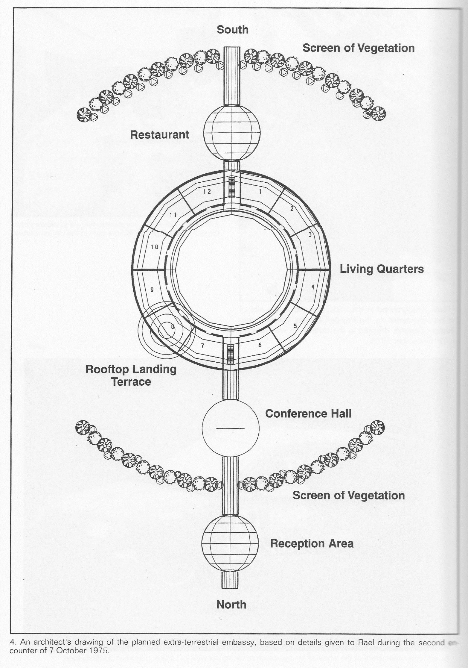
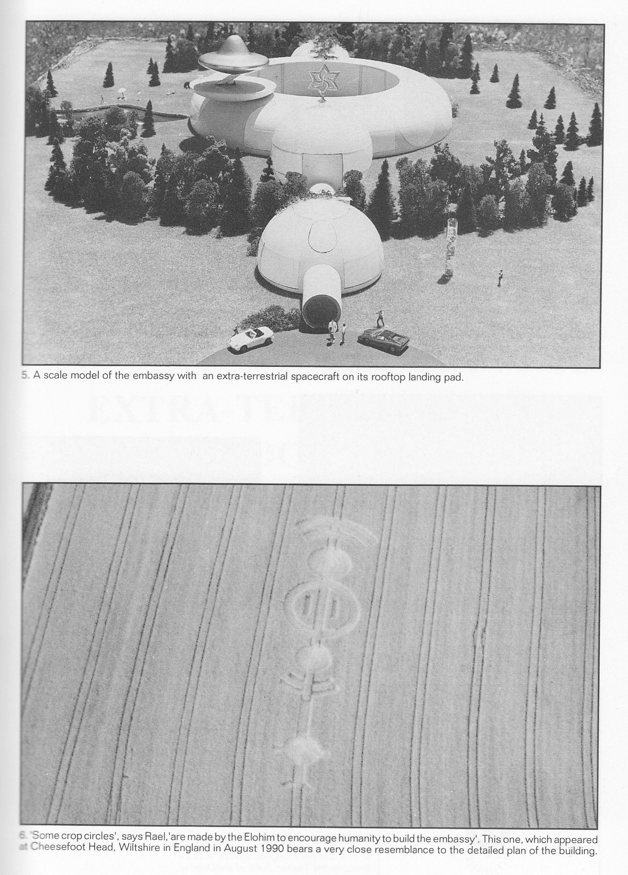
Plans for Embassy

Slide 19
Sexuality is expression of humanity and to be enjoyed
Bisexuality and Homosexuality accepted without question
Sex workers and exotic dancers are not judged
Summer camps welcome freedom of sexual expression – but only with consent from all concerned
“When I asked a guide to give me an estimate of the number of homosexuals in the movement, he replied rather coldly: ‘We don’t think in such narrow categories. Some of us are unisexual, some are bisexual, some are trisexual – and a few of us are even quadrasexual.’ When I timidly asked what the last category might represent, he leaned forward and whispered, ‘With the Elohim!’” (Palmer, 2004, 105)

Slide 20

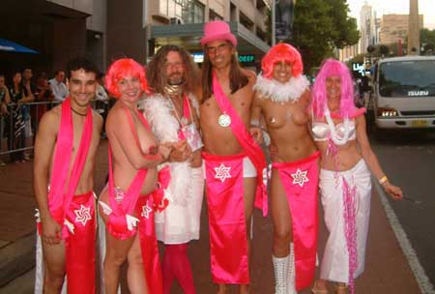


Raeliangay.org

Slide 21
Ufo groups
POPE ALICE

Slide 22



Popealice.org

Slide 23
Pope Alice Her Divine Holiness
The alter-ego of Luke Roberts – Australian ‘a masked extraterrestrial-type pink spiritual leader of the muthical lost planet Mu…’ Burns & Monro, 2014, 89)
The ‘Pink Pope’ (Burns & Monro, 2014, 91) Anti-Roman Catholic. A ‘Kiss-in’ a ‘protest designed to heighten awareness of the legitimacy of public displays of affection between people of the same gender’ (Burns & Monro, 2014, 89).

Slide 24
Ufo groups
THE URANTIA BOOK

Slide 25
The Urantia Papers were published in 1955 as The Urantia Book. The book is 2,097 pages in length, and contains 196 chapters, divided into four sections. It is said to contain the earth”s fifth revelation from God and is seen as the most complete revelation so far available to humanity. It outlines the nature of God, creation and humanity and aims to dispel any conflict that might be perceived to exist between science and religion.

Slide 26
“…I am utterly convinced that, circa 1906-1955, non-material beings of super-human intelligence and maturity interfaced regularly with a group of (eventually) six mortals for the purpose of providing a religious revelation of epochal significance” (Mullins, 2000, 4-5).
The ‘sleeping subject’ and the ‘peculiar sleep’.
Mullins (2000, 149): “…the subject was moistening his lips…’Perhaps we should ask a question’…’How are you feeling?’…To the great astonishment of everyone, the subject spoke! But the voice was peculiar, not his normal voice. The voice identified itself as a student visitor on an observation mission from another planet”.

Slide 27
Celestial Beings and Copyright Law??
Urantia Foundation v. Maaherra, 895 F.Supp. 1337 (D. Ariz. 1995). Summary judgment was granted to the plaintiff on the defendant's assertion that the Urantia Book copyright is invalid because the copyright claimant is not the author. The book, the defendant claims, is a work of divine revelation. Its authors are spiritual beings. But the court found sufficient human creativity in the book to support a copyright and declined to rule whether the book is a divine revelation.
http://library.findlaw.com/1999/Aug/1/128064.html 05/02/06
“The celestial origin of the Urantia Book is a matter of faith, and freedom of religion would be damned” and
“Both sides in the lawsuit agree[d] that these ‘celestial beings’ exist, and in a lawsuit the court must do by what both parties agree…”
http://www.kicon.com/law/cases_e/copyright.html 26/7/05

Slide 28
Channelling

Slide 29
Channeling = interdimensional communication.
Channelling is when someone claims to be in contact with a supernatural source of information from which teachings are received (Melton, 1992, 18).
Suzanne Riordan (1992, 105) '...the pendulum is swinging from a worldview in which there was no place for gnomes, goblins, and angels to one teeming with nature spirits, extraterrestrials, and ascended masters. If the former is dry and sterile in its relentlessly materialistic focus, the latter is wildly imaginative and infinitely suggestible. As traditional peoples have always known, humanity is not alone in the cosmos, and the subtle realms which science and monotheism have ignored are a source of great fascination to these post-modern seekers’.

Slide 30
Hanegraaff (1996, 30-31) divides channelling into several groups. First, trance channelling, although the depth of trance varies. Like shamanic spirit-possession? Although says that many channels think more in terms of blending than possession. Second, various kinds of automatisms, such as the ouija board and automatic writing. Third, those examples of clairaudient and/or clairvoyant communication. Fourth, open channelling. But modes can change Ibid., 33.
Three of the best-known channellers are Jane Roberts, and Seth, JZ Knight and Ramtha, and Jach Pursel and Lazaris.

Slide 32
Bowman notes the “growing hunger for ‘hidden knowledge’ of various sorts”, noting that channelled wisdom “…both imparts knowledge about the past, and advice for the present and future from diverse disembodied sources including historical figures, religious teachers, eliens, angels and ascended masters” . Channelling also, she argues, links with the “importance in contemporary spirituality…[of]…the idea of interconnectedness between all life-forms, between huanity and nature, between the empirical world and unseen realms, between past, present and future” (2000, 90).

Slide 33
Satanic nrms

Slide 34
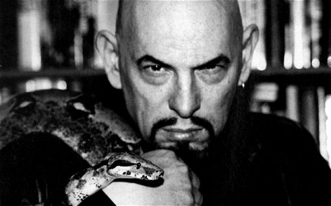
Satanism is not what we think!
Satan is a deity (esoteric Satanism)or a life principle (rational Satanism – self religion or self spirituality).
It’s not about worshipping what Christianity deems evil, but it is a form of “humanistic atheism” (Lewis, 2002, 214), with Satan symbolising “rebellion against unjust and corrupt authority”. Differs from other forms of atheism as it believes in forces and in magick (Lewis, 2002, 214).

Slide 35
The Church of Satan
1960s counterculture (1966)
California
Charismatic leader - Anton Szandor LaVey (1930-1999)
The Satanic Bible
Upper-middle class converts
Routinization, rebellion, tension, schisms, controversy, anti-cult movement
World rejecting but not as Roy Wallis meant it – world affirming / world-embracing
Atheistic, humanistic, self religion
Schisms – Church of Satanic Brotherhood and the Temple of Set

Slide 36
Bibliography
Armstrong, Virgil, ‘UFOs: A Case in Point’, in The New Age Primer, (Light Technology Publishing, 1993)
Bowman, Marion “Nature, the Natural and Pagan Identity”, DISKUS Vol 6 (2000) http://www.uni-marburg.de/religionswissenschaft/journal/diskus
Chidester, D. (2005) Authentic fakes: Religion and American popular culture. Berkeley, Calif: University of California Press.
Burns, Stephen and Anita Monro eds (2014) Public Theology and the Challenge of Feminism, London: Routledge.
Chryssides, George (1999) Exploring New Religions, London: Cassell.
Crowley, Vivianne (1994) Phoenix from the Flame, Pagan Spirituality in the Western World, London, Thorsons.
Cusack, Carole M (2010) Invented Religion, London: Ashgate.
Daschke, Dereck and W Michael Ashcraft (2005) New Religious Movements, A Documentary Reader, New York: University Press.
Gardner, M., Urantia, Buffalo, Prometheus Books, 1995.
Glasziou, K, Science, Anthropology and Archaeology in The Urantia Book, part 3, “Who Wrote the Urantia Papers?”, no date, available at http://www.urantiabook.org/archive/readers/doc183.htm 04/02/06.

Slide 37
Harvey, Graham (1997) Listening People, Speaking Earth, Hurst and Co Ltd.
Heelas, Paul (1996) The New Age Movement, Oxford: Blackwell.
Hunt, Stephen (2002) Religion in Western Society, Basingstoke, Palgrave.
LaVey, Anton Szandor The Satanic Bible, (New York: Avon, 1969).
Lewis, James R ed, Encyclopedia of Cults, Sects, and New Religions, (New York: Prometheus Books, 2002)
Lewis, James R., Legitimating New Religions (New Jersey: Rutgers University Press, 2003).
Lewis, Sarah (2008) "The Peculiar Sleep: Receiving The Urantia Book" in The Invention of Sacred Tradition, Lewis, James R and Olav Hammer eds, Cambridge, Cambridge University Press, 199-212.
Melton, Gordon J , 'New Thought and the New Age', in JR Lewis & J Gordon Melton eds., Perspectives on the New Age, (New York Press, Albany, 1992),
Morrow, Helga, ‘Walk with the Angels: aliens and ETs’, in The New Age Primer, (Light Technology Publishing, 1993)
Moyer, E.P., Our Celestial Visitors, Hanover, Moyer Publishing, 2000.
Moyer, E.P., The Birth of a Divine Revelation, Hanover, Moyer Publishing, 2000.
Moyer, E.P., Spirit Entry into Human Mind, Hanover, Moyer Publishing, 2000.

Slide 38
Mullins, L., A History of the Urantia Papers, Boulder, Penumbra Press, 2000.
Palmer, Susan J “The Secte Response to Religious Discrimination” in in Lucas, PC & Robbins, T eds (2004) New Religious Movements in the 21st century, London: Routledge
Palmer, Susan J “ Women in Controversial New Religions: Slaves, Priestnesses, or Pioneers?” in Davis, DH & Hankins, B eds (2003) New Religious Movements and Religious Liberty in America, Texas: Baylor University Press
Palmer, Susan J (2004) Aliens Adored: Rael's UFO Religion, New Brunswick, NJ: Rutgers University Press.
Partridge, Christopher ‘Paganism’ in Partridge, C ed, (2002) Dictionary of Contemporary Religion in the Western World, Leicester, Intervarsity Press. Partridge, Christopher (2004) The Re-Enchantment of the West, vol 1, London, T&T Clark.
Pearson, J (1998) “Assumed Affinity: Wicca and the New Age”, in Nature Religion Prince, R and Riches, D (2000) The New Age in Glastonbury, Oxford, Berghahn Books.

Slide 39
Pearson, Joanne et al, eds, Nature Religions Today, Edinburgh, Edinburgh University Press.
Petersen, Jesper Aagaard, “Modern Satanism: Dark Doctrines and Black Flames”, in Lewis, James R and Jesper Aagaard Petersen eds, Controversial New Religions, (New York: Oxford University Press, 2005)
Petersen, J.A., (ed) , Contemporary Religious Satanism: A Critical Anthology (Controversial New Religions Series. London: Ashgate, 2009)
Puttick, Elizabeth “Women in New Religions” in Wilson, B & J Cresswell (1999) New Religious Movements, Challenge and Response, London, Routledge.
Riordan, Suzanne 'Channeling: A New Revelation?', in JR Lewis & J Gordon Melton eds., Perspectives on the New Age, (New York Press, Albany, 1992)
Sherman, H., How to Know What to Believe, New York, Fawcett, 1976.
Sutcliffe, S (2003) Children of the New Age, London, Routledge.
Urban, Hugh B (2015) New Age, Neopagan, and New Religious Movements: Alternative Spirituality in Contemporary America: California: University of California Press.
Waya, Ai Gvhdi, ‘Spirit Guides’, in The New Age Primer, (Light Technology Publishing, 1993).
Zablocki, Benjamin & J Anna Looney “Research on New Religious Movements in the post-9/11 World”, in Lucas, PC & Robbins, T eds (2004) New Religious Movements in the 21st century, London: Routledge.

