Slide 1


SKILLS FOR A SUSTAINABLE SCREEN INDUSTRY: Part 4 – Climate Storytelling
BAFTA albert Education Partnership:
Skills for a Sustainable Screen Industry
Notes:
[title card]
[PLEASE NOTE: the notes section of these decks have been filled with additional information to the onscreen text and imagery. It is intended to support your delivery, rather than be a mandatory script to use. Allow the additional information to inspire and guide your journey through the module, and focus on what you and your students find more engaging and useful! If you have any specific questions, you can reach out to the BAFTA albert education team at alberteducation@bafta.org]

Slide 2
SKILLS FOR A SUSTAINABLE SCREEN INDUSTRY: Part 4 – Climate Storytelling
PART 4
01
Storytelling power
Sustainable Production
02
Influencing behaviours
03
Storytelling in action
04
Assessment 4
05
Module conclusion
Notes:
[title + agenda card]

Slide 3

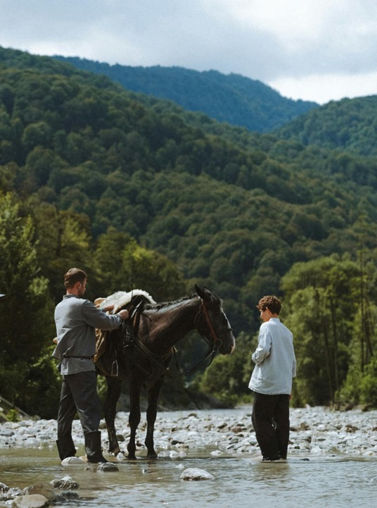
SKILLS FOR A SUSTAINABLE SCREEN INDUSTRY: Part 4 – Climate Storytelling
01
Storytelling power
02
Influencing behaviour
03
Storytelling in action
04
Assessment 4
05
Module conclusion
Notes:
[agenda card]

Slide 4
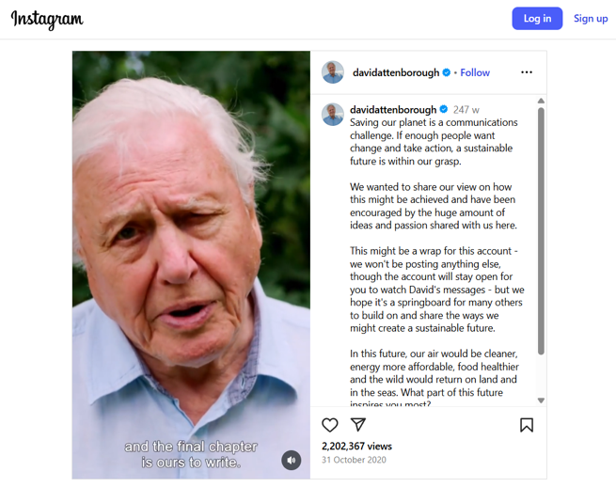
SKILLS FOR A SUSTAINABLE SCREEN INDUSTRY: Part 4 – Climate Storytelling
Communications challenge
“
Saving our planet is now a communications challenge. If enough people want change and take action, a sustainable future is within our grasp "
Broadcaster, biologist, natural historian and author Sir David Attenborough
Notes:
Tackling climate change is as much a communications challenge – of the dangers, solutions and opportunities for positive change – as it is a scientific one
Stories play an enormous part of communication in modern society - and have since the dawn of civilisation
When we refer to ‘climate content’ we don’t just mean climate-specific stories. We have responsibility to consider climate in ever story we tell

Slide 5
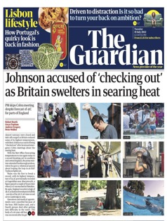
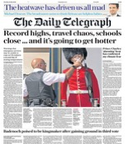
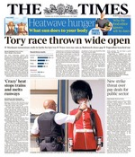


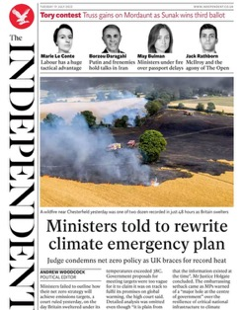
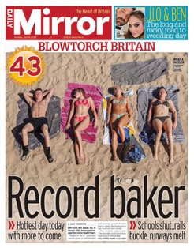
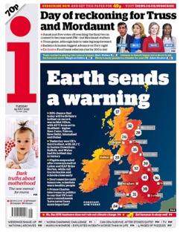


SKILLS FOR A SUSTAINABLE SCREEN INDUSTRY: Part 4 – Climate Storytelling
UK Heatwave, Jul 2022
Did the British Newspapers communicate climate change effectively?
Think about the most recent heatwaves – have the media changed their approach and learned anything?
Notes:
Look at the different ways the UK heatwave was portrayed in the media
What does the imagery say about the story being told (i.e. burning forests and fainting guards vs. Sunbathing on the beach)
What do you think is effective at acknowledging the climate crisis? What isn't – and what story is it choosing to tell instead?

Slide 6
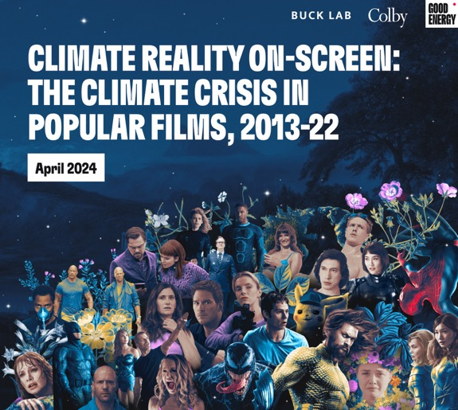
SKILLS FOR A SUSTAINABLE SCREEN INDUSTRY: Part 4 – Climate Storytelling
An era of
abundance?
Watching the majority of films and TV today, you’d have no idea that Earth is in crisis.
The world depicted is no longer the world we live in.
APRIL 2024
“
If climate isn’t in your story, it’s science fiction.”
Screenwriter and producer Dorothy Fortenberry
Notes:
Think about everything you've learned so far: climate change is an everyday part of our lives now (whether it be personal lifestyle choices or big news headlines)
GoodEnergy created the Climate Reality Check report in 2024, and broke down blockbusters from 2013-22 to see if and how they referenced the environment and the climate crisis

Slide 7
What is the Climate Reality Check?
SKILLS FOR A SUSTAINABLE SCREEN INDUSTRY: Part 4 – Climate Storytelling
A Bechdel-Wallace Test for a World on Fire
It provides studios, screenwriters, filmmakers, audiences, and researchers with a straightforward way to assess any narrative for climate representation.
From: “Climate Reality onscreen: The Climate Crisis in Popular Films, 2013–22.” The Buck Lab for Climate and Environment at Colby College and Good Energy (2024)
It asks, in any given story, whether…
Climate change exists?
And does a character know it?
Notes:
The Climate Reality Check is a tool that will allow writers and industry professionals to interrogate their own stories, and for audiences to see whether Hollywood is representing their reality onscreen
Researchers to measure whether climate change is included in any group of stories or if representation is increasing over time

Slide 8
Climate Reality Check Conclusion
SKILLS FOR A SUSTAINABLE SCREEN INDUSTRY: Part 4 – Climate Storytelling
250 Popular Films from 2013—2022 were analysed
Only 9.6% of 250 films passed
Climate change existed in the story world of only 12.8%
Climate change was mentioned in two or more scenes in only 3.6%
However, climate inclusion is becoming more common
Climate change was present in twice as many films released in the second half of the period examined (2018 to 2022) compared to the first half (2013 to 2017)
From: “Climate Reality onscreen: The Climate Crisis in Popular Films, 2013–22.” The Buck Lab for Climate and Environment at Colby College and Good Energy (2024)
Notes:
A research team at the Buck Lab for Climate and Environment at Colby College used the Climate Reality Check to conduct a systematic content analysis of 250 of the most popular fictional films released between 2013 and 2022
The results show that climate representation is on the rise but we still have a long way to go
Filling that gap presents a unique creative opportunity

Slide 9





As storytellers, can we make…
SKILLS FOR A SUSTAINABLE SCREEN INDUSTRY: Part 4 – Climate Storytelling
Responsible editorial decisions without affecting our story?
Creative choices that normalise positive behaviour and encourage critical thinking?
Climate references while maintaining an authentic voice?
Impactful decisions across genres, forms and subjects, not just climate stories?
Notes:
As storytellers, we have the agency to provoke thoughts, represent reality, and make real change in society
Responsible editorial decisions = not portraying behaviour that makes harmful actions appear glamourous, aspirational, or even normal; not scare-mongering; being positive
Creative choices that normalise positive behaviour and encourage critical thinking = showing climate-friendly behaviour as part of our daily lives, encouraging audiences to think about what they do or can do but not dictating their actions
Climate references while maintaining an authentic voice? = it’s not about turning every story into a climate action movie, or even changing storylines; it’s about how we portray the world our story is set in
Decisions across genres, forms and subjects = many stories, including some period stories, can include climate content on some level

Slide 10
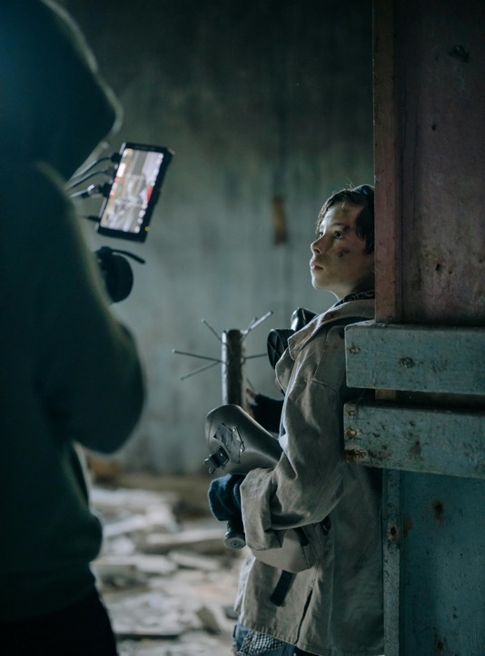
SKILLS FOR A SUSTAINABLE SCREEN INDUSTRY: Part 4 – Climate Storytelling
01
Storytelling power
02
Influencing behaviour
03
Storytelling in action
04
Assessment 4
05
Module conclusion
Notes:
[agenda slide]

Slide 11
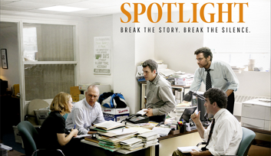

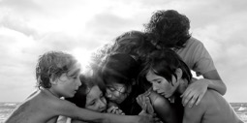

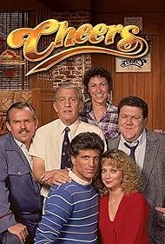

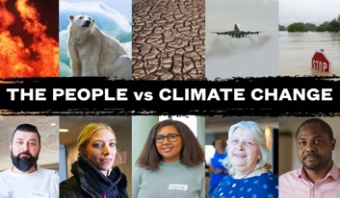
Storytellers have form
SKILLS FOR A SUSTAINABLE SCREEN INDUSTRY: Part 4 – Climate Storytelling
How have these films and series influenced positive behaviour?
Which films or series have influenced your thinking &/or behaviour?
Notes:
Jungle Book = surge in awareness and support of endangered pangolin species attributed to the film
It’s a Sin = rise in HIV testing following broadcast of the C4 series
Cheers = made drink-driving less socially acceptable through use of the “designated driver” term in story dialogue, using the context of community & friends
The People vs Climate Change = 68% of viewers convinced "ordinary people should have a role in responding to climate change"
Spotlight = created Spotlight Fellowship, £500k for investigative journalism
Roma = Mexico worker's righters legislation for 2.4m domestic workers
[opportunity to ask your students if you can think of any other examples of screen storytelling affecting real change]

Slide 12
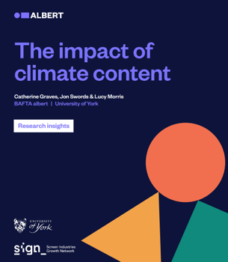
The impact of climate content
SKILLS FOR A SUSTAINABLE SCREEN INDUSTRY: Part 4 – Climate Storytelling
1
2
3
Climate content raises audiences’ interest and concern for climate change
considerably.
Positive changes can be short-lived and dependent on audiences’ pre-existing values.
Incidental and intrinsic climate content elicit positive behavioural responses, with content impacting wider array of specific pro-environmental behaviours.
Graves, C., Swords, J. and L. Morris (2023) ‘The impact of climate content’, albert: London.
Notes:
There is demand for climate content across a range of genres, especially that which intersect with social and environmental issues (e.g. inequality, health, nature and biodiversity loss)
Climate content is proven to raise audiences’ interest and concern for climate change and environmental issues considerably. The effect on audience behaviour is complex, with positive changes often short-lived and dependent on audiences’ pre-existing values
UK audiences are most interested in climate content which shows the impacts of climate change in the UK, portrays achievable solutions and provides information on climate science
The likelihood of positive audience impact was increased through the use of post-viewing support, collaboration with a range of experts, integrating climate content authentically, and through working from a values-first approach by aligning content with the anticipated audiences’ pre-existing values
Incidental (where climate is mentioned in passing) and intrinsic (main focus) climate content elicited similar positive behavioural responses, with intrinsic content impacting a slightly wider array of specific pro-environmental behaviours. Both intrinsic and incidental climate content significantly increased audience concern for global issues and climate change
[Source: Graves, C., Swords, J. and L. Morris (2023) ‘The impact of climate content’, albert: London https://wearealbert.org/2024/02/04/the-impact-of-climate-content-report/]

Slide 13
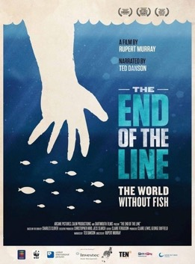
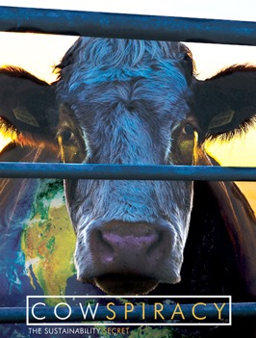
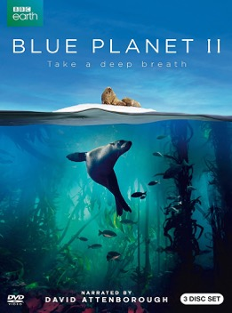
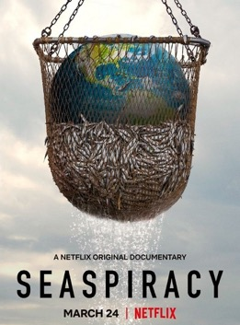
SKILLS FOR A SUSTAINABLE SCREEN INDUSTRY: Part 4 – Climate Storytelling
Climate ‘brainprint’
Notes:
These programmes/ films actively seek to shape public debate, change behaviours and promote sustainable lifestyles
End of the Line - Prêt a Manager and Whiskas switched to sustainable sources of fish, attributing the film directly for this change in policy
2015 - Cowspiracy investigates the environmental impacts of cattle farming and produce, and its enormous strain on land use, food consumption and consumerism
2017 - Blue Panet 2 explored the effect of plastic pollution on marine life and inspired people across the UK to ditch single-use plastic
2021 Seaspiracy (same company as cowspiracy) caused major controversy - pours doubt on the concept of sustainable fishing (MSC blue tick), shines a light on the aquaculture industry and introduces the notion of “blood shrimp”, seafood tainted with slave and human rights abuses. (was Trending in Netflix”s Top 10 Most Watched films & programmes for weeks)

Slide 14
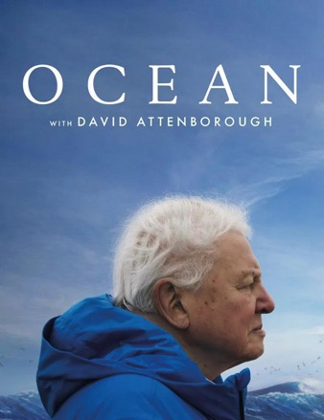

SKILLS FOR A SUSTAINABLE SCREEN INDUSTRY: Part 4 – Climate Storytelling
Ocean with David Attenborough
Context
Feature length nature documentary narrated by David Attenborough with a clear call to action: protect our oceans.
The campaign was executed by Impact Producers at
Impact
International negotiations: Released to coincide with the 2025 UN Ocean Conference with 60+ countries. Here countries made formal commitments to the High Seas Treaty (protecting 30% of the seas by 2030)
Political access: 10 Downing Street screening with 50+ MPs (incl. Prime Minister)
Awareness of harmful practices: Groundbreaking footage exposed bottom trawling, raising awareness and advocacy to ban or regulate
Engagement: Released on Attenborough’s 99th birthday, highest-grossing nature doc of decade (580+ cinemas and NatGeo, Disney+ and Hulu)
Notes:
Here's a recent case study that takes this idea of a brainprint for impact and puts it into practice for change

Slide 15
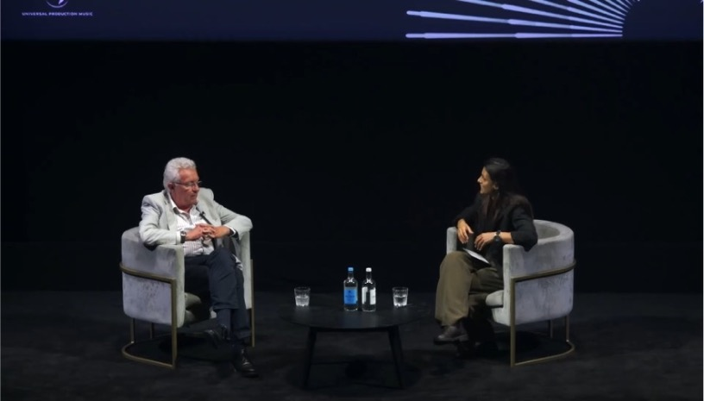
SKILLS FOR A SUSTAINABLE SCREEN INDUSTRY: Part 4 – Climate Storytelling
Ocean with David Attenborough
Notes:
Here's a recent case study that takes this idea of a brainprint for impact and puts it into practice for change

Slide 16
SKILLS FOR A SUSTAINABLE SCREEN INDUSTRY: Part 4 – Climate Storytelling
What is an Impact Producer?
What?
How?
Impact Producers bridge the gap between stories on screen and their real-world outcomes.
They create measurable strategies that work alongside issue-driven productions to engage communities best positioned to drive a desired social, political, or cultural change.
There are four key principles: changing behaviours, communities, minds, and structures. Activities may include:
Education
Community
Lobbying
Media
Events
Notes:
Resources are available for Impact Producers:
https://globalimpactproducers.org/
https://climatestoryunit.org/labs/
https://goodpitch.org/about/#labs

Slide 17




SKILLS FOR A SUSTAINABLE SCREEN INDUSTRY: Part 4 – Climate Storytelling
Climate change and audience
what we know
Even at the current level of warming, there will be major changes to lifestyles and economies*
The majority of people (83%) are concerned about climate change
TV and films are trusted sources of information
Behaviour is already changing – people are saving energy and flying less*
*From research conducted by Ipsos
Notes:
We know that climate change is going to have a significant impact on everyone’s lifestyles and everyday experiences – sooner rather than later
We also know that audiences – almost everyone – engages with film and television to some degree, and that their behaviour can be affected by the stories they watch

Slide 18




SKILLS FOR A SUSTAINABLE SCREEN INDUSTRY: Part 4 – Climate Storytelling
Climate change and audience
what we know
High-carbon lifestyles are currently seen as aspirational
The scale of climate change can induce fear and withdrawal rather than positive action
Other issues, like the cost of living, are viewed as competing with the climate crisis
Understanding of the impact of climate action is low, e.g. recycling is ranked above car use
Notes:
But the way these stories are shown is also key
Currently the climate crisis is portrayed as a scary subject
And what is shown as aspirational lifestyles are often unsustainable (e.g. private jets, big cars, consumerism)

Slide 19
SKILLS FOR A SUSTAINABLE SCREEN INDUSTRY: Part 4 – Climate Storytelling
How do we raise the issues?
BRUTAL TRUTH
Climate catastrophe
Environmental discrimination
Climate injustice
Trash taking over
Disappearing species
Resource strain
Eco-anxious generation
SOLVABLE CHALLENGE
Climate optimism
Collective action
Community solidarity
Repurposing revolution
Nature’s great comeback
Mindful living
Sustainability-savvy generation
Notes:
There are multiple ways in which you can embed sustainability into your content, that largely fall on one of two sides: brutally revealing the reality of the situation or presents a challenging opportunity for change
It’s important to show both sides of the story – not just doomsday/ apocalyptic, but an optimist version of the future too. One that provides solutions
[opportunity to ask students which side they think is more effective: stories that raise issues in a way that inspires change, or stories that brutally face the reality that we have run out of time?]

Slide 20
SKILLS FOR A SUSTAINABLE SCREEN INDUSTRY: Part 4 – Climate Storytelling
Tone of voice for positive impact
Enabling vs. Imperative
Tangible vs. Vague
Achievable vs. Overwhelming
Positive vs. Fearful
Celebrate vs. Blame
Shared Endeavour vs. Solo Mission

Slide 21
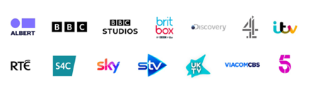
Climate Content Pledge
SKILLS FOR A SUSTAINABLE SCREEN INDUSTRY: Part 4 – Climate Storytelling
We will reach more of our audiences with content* that helps everyone understand and navigate the path to net zero & inspires them to make greener choices.
We will ensure that our efforts are informed by the science.
Signed at COP26 in 2021
We will develop processes that help us to consider climate themes when we are commissioning, developing and producing content.
We will recognise the importance of fair and balanced representations of visions for a sustainable future.
*For the purposes of this pledge, “content” is all programming with the exception of news
Notes:
In TV, many major broadcasters in the UK signed up to the Climate Content Pledge in 2021
Each agreed to get behind climate content, and develop and publish company-specific commitments
The pledge and additional commitments are reviewed each year as a group to check progress against plans

Slide 22
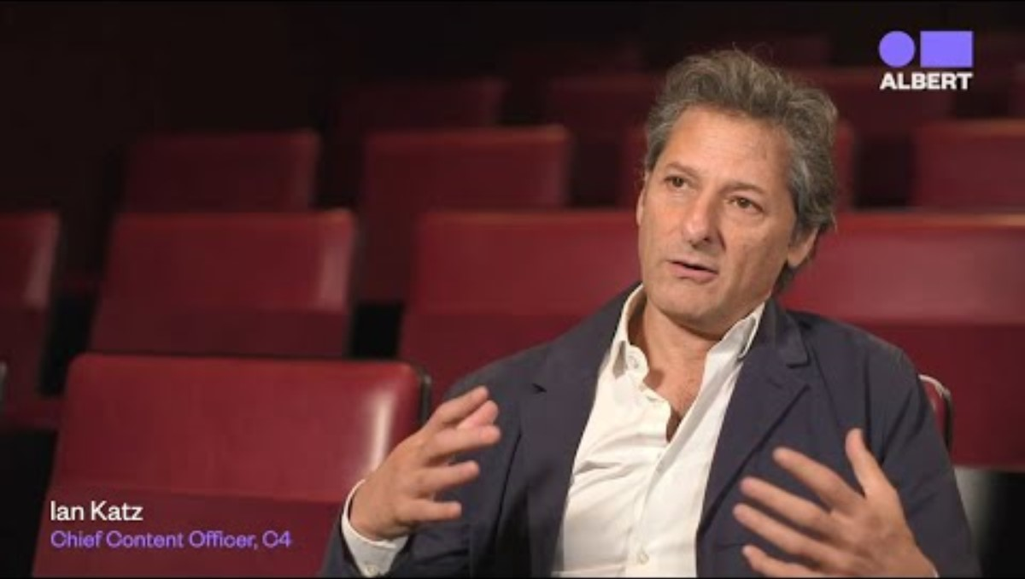


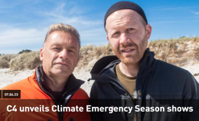




SKILLS FOR A SUSTAINABLE SCREEN INDUSTRY: Part 4 – Climate Storytelling
How has it been implemented?
“We are increasingly embedding our commitment ... into every stage of the TV & Film production process.”
Meghan Lyvers, Exec Director of Original Scripted UK & Ireland
“From continuing to normalise sustainable behaviours across our output from soaps to more explicit green commissions, ITV is dedicated to shaping and reflecting culture for good.”
Dame Carolyn McCall, CEO
“...The all-encompassing topic of climate change provides a huge creative opportunity”
Tim Davie, Director General
Notes:
In TV, many major broadcasters in the UK signed up to the Climate Content Pledge in 2021
Each agreed to get behind climate content, and develop and publish company-specific commitments
The pledge and additional commitments are reviewed each year as a group to check progress against plans

Slide 23
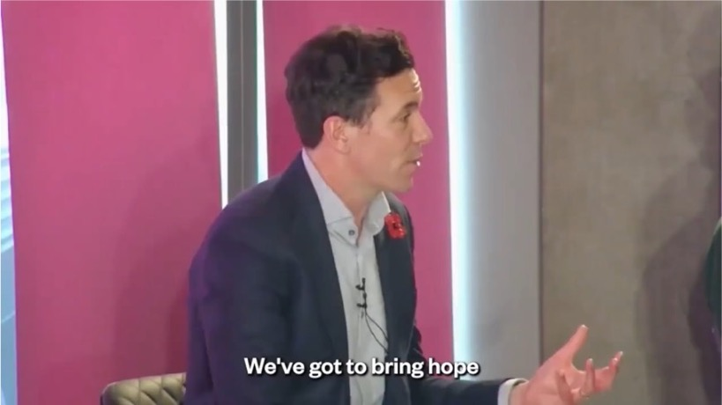
SKILLS FOR A SUSTAINABLE SCREEN INDUSTRY: Part 4 – Climate Storytelling
How the Pledge has been adopted
Notes:
https://www.youtube.com/watch?v=WIVVcXw58Mo

Slide 24
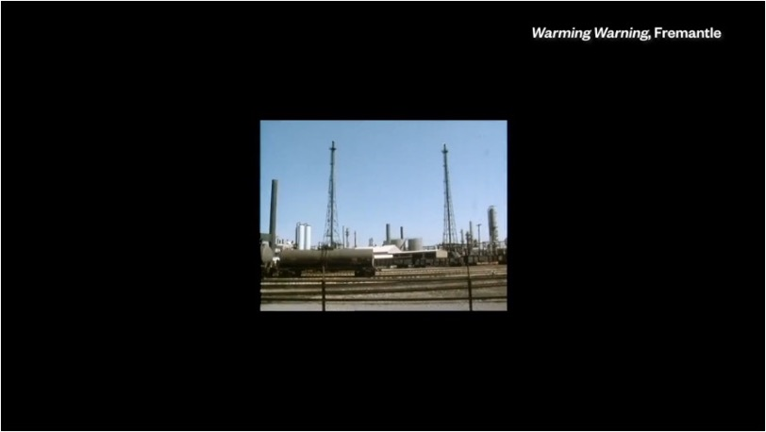
SKILLS FOR A SUSTAINABLE SCREEN INDUSTRY: Part 4 – Climate Storytelling
2024 Climate Content Showreel

Slide 25
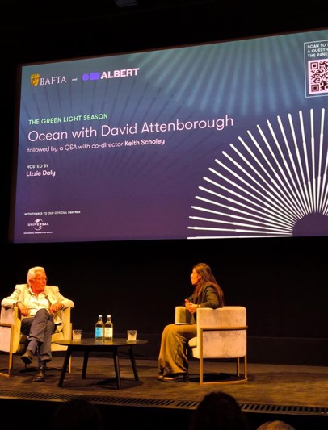
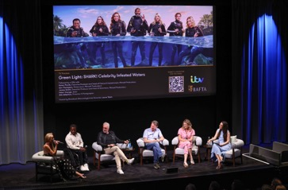
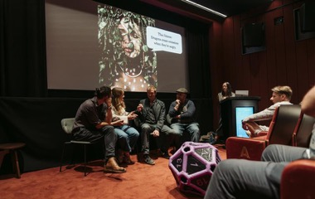
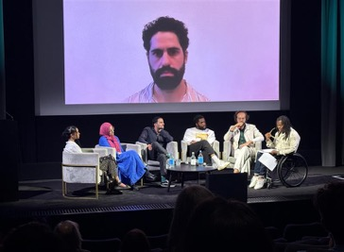
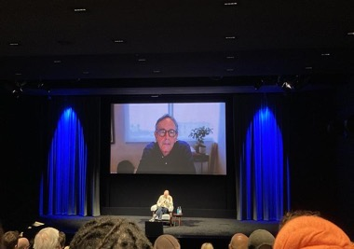
SKILLS FOR A SUSTAINABLE SCREEN INDUSTRY: Part 4 – Climate Storytelling
Green Light Season at BAFTA's HQ
SHARK!
Sustainable game design
Jurassic World: Rebirth
climate refugee stories
Notes:
This past summer, BAFTA ran a Green Light season for its members at its HQ on Piccadilly, screening loads of films and television featuring climate content and Q&A sessions with their creators
Left - screening of Ocean with David Attenborough, followed by Q&A with co-director Keith Scholey
Top middle - screening of SHARK! Celebrity Infested Waters, followed by Q&A with the executive producers Karen Plumb, Iain Thompson and James Smith and cast members Ade Adepitan and Helen George
Bottom middle - Panel of case studies showcasing climate refugee stories followed by Q&A
Top right - Assemble for Change: An Interactive Adventure in Sustainable Game Design with Jennifer Estaris
Bottom right - screening of Jurassic World Rebirth, followed by a virtual Q&A with producer Patrick Crowley

Slide 26
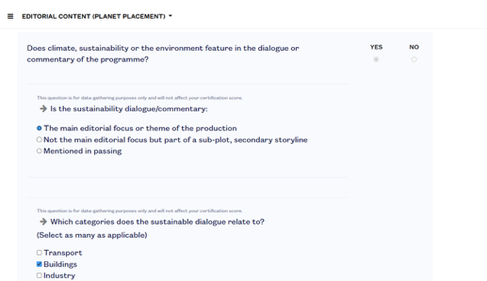
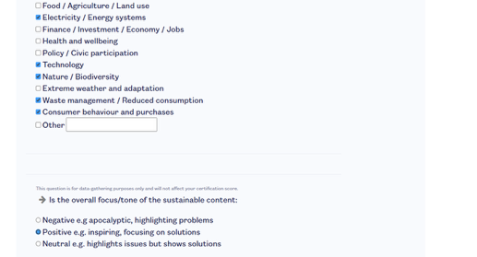
SKILLS FOR A SUSTAINABLE SCREEN INDUSTRY: Part 4 – Climate Storytelling
Is it working?
What does the albert toolkit show us?
The BAFTA albert toolkit gathers data on climate storytelling in TV and film through a mandated UK questionnaire for broadcasters.
This gives us a comprehensive overview of how climate content is being integrated across genres, informing training and industry strategies to improve climate representation on screen.
Notes:
The BAFTA albert toolkit gathers data on climate storytelling in TV and film through a mandated UK questionnaire for broadcasters
While including climate content itself isn’t required, the survey provides a comprehensive view of its presence. It tracks whether it’s visual or verbal, the themes it addresses, and the tone in which it’s presented
The data the toolkit collects provides a comprehensive overview of how climate content is being integrated across genres, informing training and industry strategies to improve climate representation on screen
[This is now replacing the Subtitles to Save the World report from previous years - albert-subtitle-report-2021.pdf (wearealbert.org)]

Slide 27
SKILLS FOR A SUSTAINABLE SCREEN INDUSTRY: Part 4 – Climate Storytelling
Does climate, sustainability or the environment feature in the dialogue or commentary of the programme?
By Genre
Overall
Notes:
Question one: does climate, sustainability or the environment feature in the dialogue or commentary of the programme?
Visibility and verbal mentions: it tracks whether climate change is featured visually (i.e through imagery, settings, props) or verbally (i.e. through dialogue or narration). This helps us understand how on-the-nose or subtle the messaging is.
What do you notice in the data? What sort of opportunities/challenges can you imagine certain genres/formats might have?
[Only Childrens, Continuing Drama, Learning and News genres show more climate content in the dialogue or commentary than not]

Slide 28
SKILLS FOR A SUSTAINABLE SCREEN INDUSTRY: Part 4 – Climate Storytelling
Is the sustainability in dialogue/commentary?
By Genre
Overall
Notes:
Question two: Is the sustainability in dialogue/commentary (as opposed to just background dressing such as wind turbines or recycling bins)?
Narrative role: The data shows us how the climate is mentioned: whether this is in passing, as a secondary storyline or a central focus. This reveals the depth of engagement with the topic and its integration into storytelling
What do you notice in the data? What sort of opportunities/challenges can you imagine certain genres/formats might have?
[Factual shows have the most references overall – but Factual Entertainment, Entertainment and Drama are hot on their heels]

Slide 29
SKILLS FOR A SUSTAINABLE SCREEN INDUSTRY: Part 4 – Climate Storytelling
Is the overall focus/tone of the sustainable content...
By Genre
Overall
Notes:
Question three: is the overall focus/tone of the sustainable content:
-Negative e.g. apocalyptic, highlighting problems
-Neutral e.g. highlights issues but shows solutions
-Positive e.g. inspiring, focusing on solutions
Tone of representation: It assesses whether the overall focus is negative, neutral, or positive. This is key to understanding how climate change is framed; if it is represented as a crisis, a challenge or an opportunity
What do you notice in the data? What sort of opportunities/challenges can you imagine certain genres/formats might have?
[Factual shows have the most climate content, and focus most on inspiring solutions-based content]

Slide 30
SKILLS FOR A SUSTAINABLE SCREEN INDUSTRY: Part 4 – Climate Storytelling
Climate Themes Snapshot 2024
Notes:
Themes covered (or missing): The toolkit identifies which climate-related themes are being addressed. This could be anything from waste management, climate justice to energy and biodiversity. It also highlights the themes that are underrepresented. This helps to spot gaps and areas for creative exploration, rather than repeating the same stories
Genre analysis: By seeing which genres most frequently feature climate content, we can identify where climate storytelling is thriving (as well as when it’s missing). This insight allows us to target underused genres and develop original, entertaining content that brings climate narratives to new audiences in unexpected ways
Have a look at the categories the climate themes relate do – what sort of thing do you think could come up in each of themes? Think about character actions, the setting, story themes etc.
[Ideas to get you started:
-Transport -> switching to electric vehicles, using public transport, cycling
-Food etc -> vegan characters, themes of overfishing
-Nature/biodiversity -> animal representation, nature as a safe space, politics of access to green spaces, endangered species
-Health and wellbeing -> short and long term consequences of pollution, politics of access to green spaces, expense of quality food
-Consumer behaviour and purchases -> fast fashion, supporting local businesses
-Extreme weather and adaptation -> danger of flooding, heat waves, lower crop yields, cities like Jakarta, New York and Venice sinking a bit more every year]
A key part of BAFTA albert’s remit is to support content makers to tell more – and better – climate stories. The footprinting process includes questions about climate references, with a drop-down menu to enable production teams to indicate topics featured, as well as a free text box to give more detail
This information is not used for certification, as editorial decisions rightly rest with the production team and their commissioning body

Slide 31
SKILLS FOR A SUSTAINABLE SCREEN INDUSTRY: Part 4 – Climate Storytelling
3
Tone of voice for positive impact
1
2
3
Make it do-able and show change is possible
Normalise action
not inaction
Focus on the big things that make the most difference
Awareness of climate change is at an all time high. We now need to help audiences see that we can tackle climate change - it’s challenging but doable.
When we hear no-one is doing the right thing for the planet, we assume little can be done. We need to show that action is underway and most people care deeply about fixing our only home.
If we only talk about whether people are making sustainable choices in their own lives, we lose sight of the big changes that are needed. We need to pan out to look at the big picture.
4
6
4
5
6
Connect the planet’s health with our own health
Evoke our responsibility to young people and the future
Keep it down to earth
Human health goes hand in hand with the planet’s health. Reminding people of this connection boosts understanding, concern and support for policy change.
It’s hard to argue against protecting the planet for our young people, our children and grandchildren. It’s a compelling way to help audiences to connect to climate.
Down to earth, straightforward messages work. Complex language and messages can undermine our cause.
Taken from On Road Media’s Climate Stories that Work research
Notes:
[Source: On Road Media – now HEARD – Climate Stories that Work https://onroadmedia.org.uk/work/climate-stories-that-work/]

Slide 32

SKILLS FOR A SUSTAINABLE SCREEN INDUSTRY: Part 4 – Climate Storytelling
01
Storytelling power
02
Influencing behaviour
03
Storytelling in action
04
Assessment 4
05
Module conclusion
Notes:
[agenda slide]

Slide 33
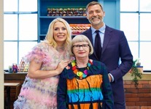
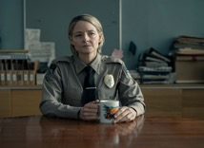

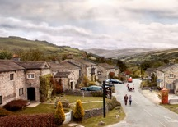
Implicit to Explicit
SKILLS FOR A SUSTAINABLE SCREEN INDUSTRY: Part 4 – Climate Storytelling
Climate
Climate
Climate
Climate
Placement
Themes
Stories
Mentions
Climate change is subtly woven into the setting or set design of a story but might not be directly addressed or mentioned.
Climate-related themes drive a story arc or episode in a meaningful way, but the show itself isn’t about climate change.
Films and programmes that are primarily about climate change.
Characters mention climate change in passing, normalizing talk of the climate crisis in daily life.
Emmerdale
Sewing Bee
True Detective: Night Country
Families Like Ours
Notes:
There are lots of way to include climate content in stories
Climate placement: Sewing Bee – Zero waste dress (BBC) - Contestants are challenged to make a dress from dead stock fabric to make is “zero-waste”
Climate themes: True Detective: Night Country (HBO) - Detective Drama against the backdrop of an indigenous community which is being poisoning and threatened by eviction from a fossil fuel company.
Climate stories: Families Like Ours (2025) (BBC/Netflix) - Danish drama set as the Danish govt closes down the country for good as the cost of protecting it against sea level rise has bankrupt the country. Survival, murder and love stories play out during the mass evacuation. (https://www.independent.co.uk/arts-entertainment/tv/features/families-like-ours-danish-bbc-netflix-climate-b2764967.html)
Climate mentions: Emmerdale (ITV) - Emmerdale has included multiple storylines on climate and solutions over the years including a big climate related storm tragedy that hit the village, the installation of an air-source heat pump, a community allotment, electric cars and characters interviewing for jobs at windfarms.

Slide 34

SKILLS FOR A SUSTAINABLE SCREEN INDUSTRY: Part 4 – Climate Storytelling
Sports Broadcasting:
Formula E
Sustainability Meets Entertainment
World's first net-zero sport championship, placing sustainability at the core of a high-adrenaline sport
The all-electric round up demonstrates the future of clean entertainment on a global stage
Built-in Climate Messaging
Proves that purpose-driven storytelling can be exciting, redefining audience expectations for climate conscious content
Formula-E partners with clean teach brands and climate advocacy groups to amplify sustainability messaging
Back to
case studies
Forward to
next section

Slide 35
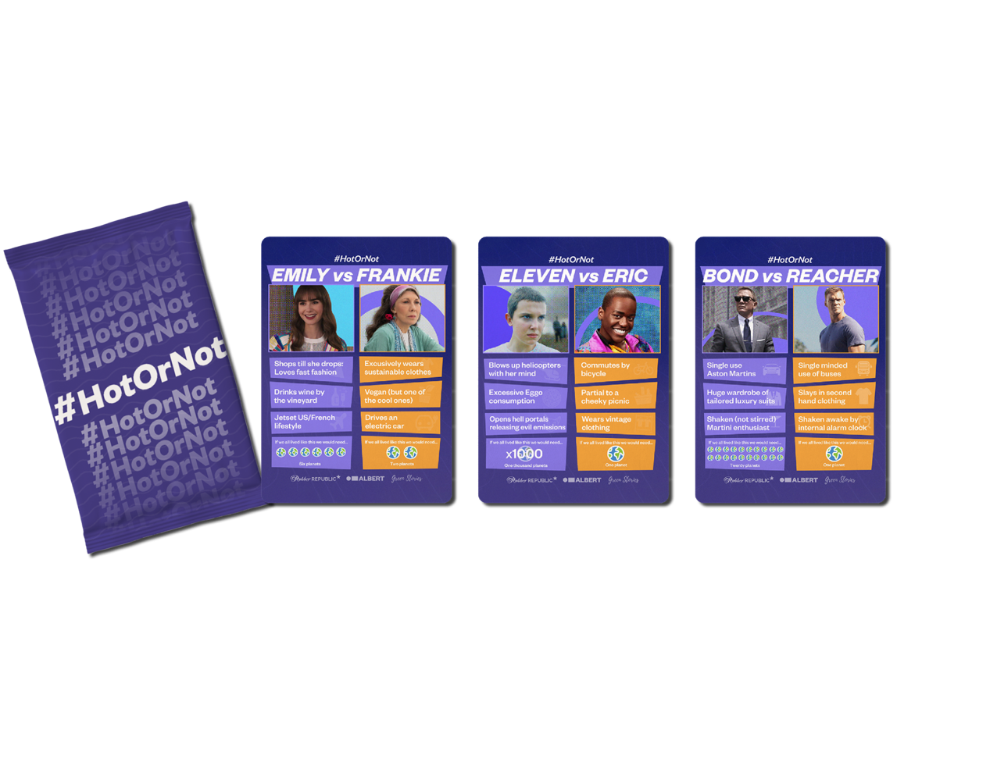
#HotOrNot Climate Characters
SKILLS FOR A SUSTAINABLE SCREEN INDUSTRY: Part 4 – Climate Storytelling
Notes:
This is from a campaign albert ran with Rubber Republic to highlight how characters can reinforce certain behaviours

Slide 36

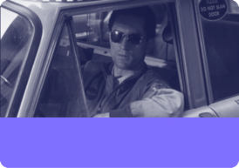
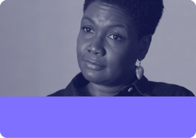
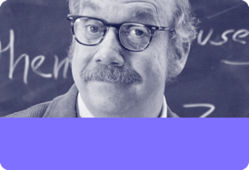

Climate and character
SKILLS FOR A SUSTAINABLE SCREEN INDUSTRY: Part 4 – Climate Storytelling
Group Exercise
Taxi driver
Therapist
How might climate change affect the portrayal of these characters’ jobs?
Teacher
Chef
Notes:
Group Exercise: Let’s think about our characters and how climate issues may affect their everyday world and behaviour, without changing the story
Examples to get people going/to add to their ideas:
Taxi driver = type of vehicle they drive, passing discussion of climate with customers, more customers sharing rides
Teacher = changes to curriculum, questions from pupils, student climate strikes, staff room discussions, campus-based travel policy, climate anxiety in students
Therapist = more clients with climate anxiety, upgrading their skills to understand climate & mental health, client concerns prompt exploration of own behaviour
Chef = including meat-free menu options, discussing vegetarian or vegan food, taking on a vegan sous chef, customer requesting information about food sourcing or food waste

Slide 37

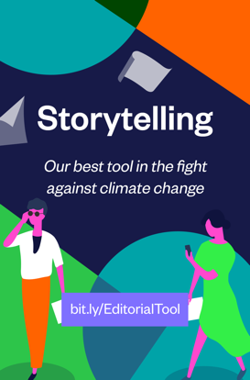
SKILLS FOR A SUSTAINABLE SCREEN INDUSTRY: Part 4 – Climate Storytelling
albert guides & tools

Slide 38

SKILLS FOR A SUSTAINABLE SCREEN INDUSTRY: Part 4 – Climate Storytelling
01
Storytelling power
02
Influencing behaviour
03
Storytelling in action
04
Assessment 4
05
Module conclusion
Notes:
[agenda slide]

Slide 39
SKILLS FOR A SUSTAINABLE SCREEN INDUSTRY: Part 4 – Climate Storytelling
Assessment 4:
Telling a Climate Story
Creative Storyboard / Elevator Pitch / Ideas
Based on your understanding of the science behind climate change, how the screen industries lead to behaviour and societal change, discuss solutions and/or create ideas/a storyboard/an elevator pitch for a short, TV show or film that could help connect audiences with sustainability stories – particularly positive ones.
This will evidence your understanding to: “Identify strategies that could engage audiences with environmental sustainability”
Notes:
Climate change is happening now, and it will affect your ability to produce Film and TV content in the future.
As a student, and as an individual wanting to work in the Screen Arts Industries, it is important to work towards being sustainable. Every positive action will help reduce the impacts of climate change. Every person matters.

Slide 40
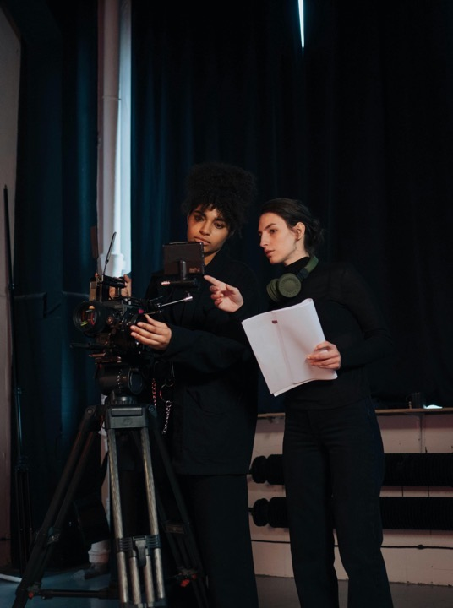
SKILLS FOR A SUSTAINABLE SCREEN INDUSTRY: Part 4 – Climate Storytelling
01
Storytelling power
02
Influencing behaviour
03
Storytelling in action
04
Assessment 4
05
Module conclusion
Notes:
[agenda slide]

Slide 41
SKILLS FOR A SUSTAINABLE SCREEN INDUSTRY: Part 4 – Climate Storytelling
The Next Generation
You are the next generation of the screen industries
Through the you tell and how you tell them,
you can make a difference both behind and in front of the camera.
The baton is being passed to you.
Are you up for the challenge?

Slide 42
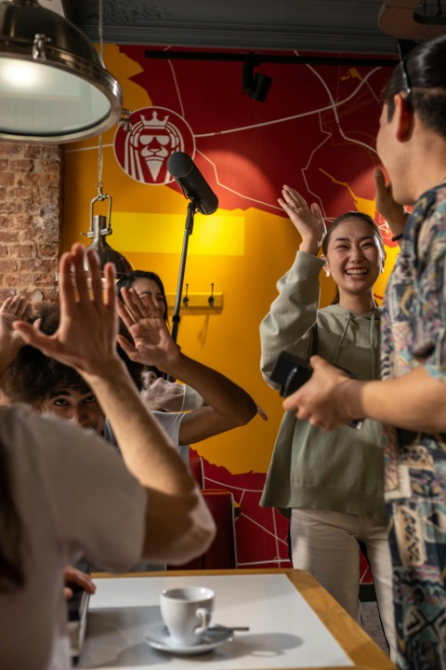
SKILLS FOR A SUSTAINABLE SCREEN INDUSTRY: Part 4 – Climate Storytelling
What have you learnt?
By completing this module you have:
Evidenced a general understanding of the science of climate change and its impacts.
Evidenced a commitment to creating a greener industry in a future role you would like to hold within the industry
Calculated a production’s carbon footprint using the albert footprint calculator
Discussed solutions to reduce the environmental impact of a production
Identified strategies that could engage audiences with environmental sustainability

Slide 43
SKILLS FOR A SUSTAINABLE SCREEN INDUSTRY: Part 4 – Climate Storytelling
Congratulations
Want to learn even more about industry sustainability?
Ask your tutor for the further reading resources
Look up our full case studies
Read some of BAFTA albert’s research, reports or watch our webinars
Follow BAFTA albert’s social channels to stay up to date
Consider being a student case study for us
You have now completed BAFTA albert’s Skills for a Sustainable Screen Industry!
You will need to collate and submit your four assessments with your tutor. Once these have been evaluated and approved you will receive a certificate, albert Grad badge for your CV, and a letter of congratulations from the BAFTA albert team.
Join our community by following us across social media, shout about your achievements through the module, and keep in touch:
albert@bafta.org
wearealbert.org
@weareALBERT

