Slide 1

L4: Learning in the Digital Era
New L4 Online Learning module.
The foundations for success.
Support Tutorial 4. Assignment Task 2(b).

Slide 2
Reminders:
Standard Referencing format within the school is IEEE. To access the University’s IEEE Referencing click-here. For referencing images click-here then scroll down and click-here.
Location of Support slides (Moodle: Additional Resources tile).

Slide 3
Last week = Assignment 1: Task 2 (a).
  Create an Online e-portfolio with a page/section for each Assignment task answer.
Choose a platform to create your Online e-portfolio:
  E.g. a free Online Website builder such as Google Sites, Wix, Weebly, a free e-Portfolio builder or an Office 365 App. such as OneNote, or GitHub.
The e-portfolio should have a welcome/title page.
A page for each task answer. And
A menu with links to each task page at the top of each page.

Slide 4
Bg. Assignment 1 Task 2a tips.
If you are not sure how to create the e-portfolio or if you are struggling with the task, go to YouTube and search for:
  How to create an e-portfolio online using wix; or
  How to create an e-portfolio online using weebly; or
  How to create an e-portfolio online using google sites.
You will find 5 minutes tutorials to help you complete the task with ease.
If you are unable to embed any of the task answers in the e-portfolio, you can include links in the portfolio to allow the answer to be viewed in another application e.g., a link to the Video on YouTube or a link to the poster in your OneDrive.
Whichever technology you choose to create your task answers, you must ensure the tutors are able to easily view the e-portfolio and all the task answers for marking purposes.
For marking purposes, make sure the e-portfolio and task answers are NOT set to private.
For assessment purposes only include the Assignment task answers.

Slide 5
This week - Assignment 1 task 2.
Assignment 1, Task 2(b).
Creation of an E-Portfolio template and Video Presentation:
  Finish Online e-portfolio template with a page for each Assignment task answer.
  Produce a Video presentation showing your e-portfolio template (1-2 minutes).

Slide 6
Assignment 1: Task 2 (b).
  Produce a simple Video presentation, only 1-2 minutes, include some screenshots, some references and voice over slides throughout to demonstrate the e-portfolio.
  PowerPoint (or alternative) can be used to create the Video Presentation.
  Reference 4 sources.
  To receive marks for this task you must make sure your tutor is able to view the video presentation online. If using YouTube, set the video to public but unlisted.
    Bg. Optional: instead of many screenshots you could include a Video demonstration in the slide deck. A free screen recorder could be used to do this, such as OBS Studio.

Slide 7
Creating a Video presentation:
PowerPoint and YouTube can be used to create our Video presentation to answer Task 2(b).
Please note other technologies can be used if preferred (e.g. such as MS Sway or Adobe Spark).
Whichever method is chosen, make sure the tutors can easily view the video online.
Please make sure the video is streamed over the cloud and NOT available via download as video file sizes can be very large and PowerPoint slides do not include video timings.
The following step-by-step guide can be used to help you easily create a video presentation. Please also use online tutorials for further assistance if needed.
1. Create PowerPoint slides.
2. Voice over slides: Record yourself delivering the slides. Goto: Slide Show > Record Slideshow.
3. File: Export: Create a Video.
4. Upload to e.g. Youtube (* as public and unlisted), Vimeo or Other.
5. Include video / video url in your e-portfolio.
* IMPORTANT: To allow the markers to view the video online, set the video to public but unlisted.

Slide 8

E-portfolio
After creating your e-portfolio, you can include your answer to task 1 and Task 2b in the e-portfolio.
This Photo by Unknown Author is licensed under CC BY-SA-NC

Slide 9

The Key to Success
THE KEY TO SUCCESS FOR THIS MODULE IS TO MAKE WEEKLY PROGRESS.
Don’t leave it until last minute.

Slide 10
Next complete:
Finish your E-portfolio template.
Create your slides.
Voice over and export as Video.
Upload to YouTube/Vimeo.
Include your Task 1 & Task 2(b) answers in the e-portfolio.
Next:
Schedule in your diary /\.

Slide 11
Register.
Save / Download participant list from teams.

Slide 12

Questions.
Q&A.

Slide 13

If time: Student Social.
(Chat & Support each other)

Slide 14
The End.

Slide 15
Archive slides.

Slide 16

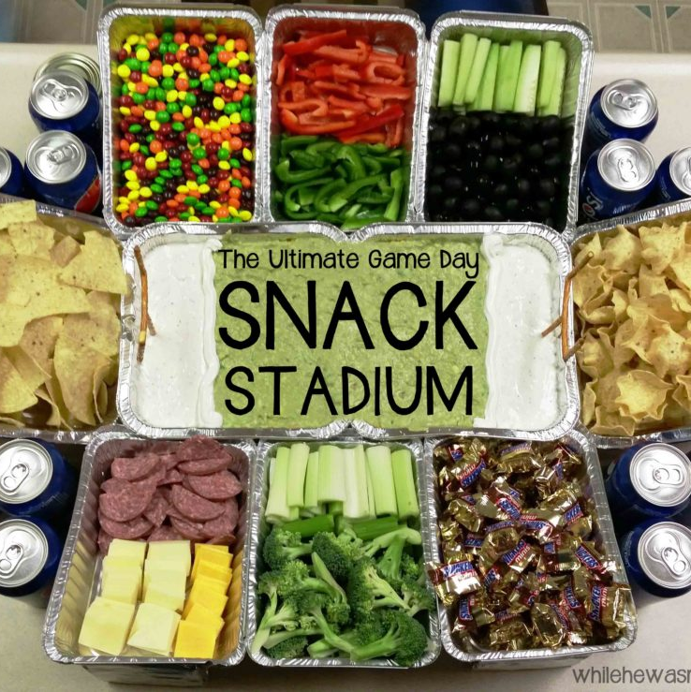

Don’t forget:
This Photo by Unknown Author is licensed under CC BY
This Photo by Unknown Author is licensed under CC BY-NC-ND
Fav. Drink & Snacks.
This Photo by Unknown Author is licensed under CC BY-SA

Slide 17
Tip:
Assignment 1 - Tasks 1 and 4.
The time to complete these tasks takes longer due to the Online learning content.
Tasks 2 and 3 do not include the Online learning content and will take less time.
If you are short on time. Focus on the Assignment task more so than the activities. If you have time, complete both.
Next:

