Slide 1

Working with Children in a Social Care Setting
Nasreen Akhtar-2132945​
Module code- LCSH4006 BIRM​
Module-Psychology in Health and Social Care​
Lecturer- Joanne Davies

Slide 2
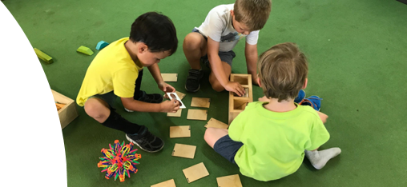
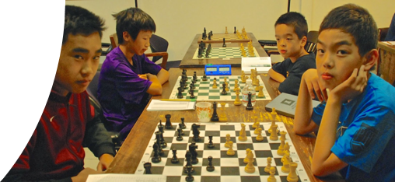
introduction
In this presentation I will be presenting two creche activities for children aged 7-11 who live with their mothers in a womans refuge Centre .These activities will hopefully help with the development of the children and keep them occupied while their mothers are in their 1 to 1 weekly support sessions.
I will link these activities to Piaget's theory of development.

Slide 3

Cognitive development for 7–11-year-olds
Older children have a sharp metacognition, a sense of their own inner world. These children become skilled at problem solving. Piaget referred to the cognitive development occurring between these ages as the concrete operations stage. Oswalt.A,(2010).

Slide 4

Activity 1
Chess

Slide 5
How my theory relates to activity 1
Chess makes kids smart it's a game of logic. According to Piaget, children start to develop at the age of 7 in the form of first step in abstract thinking. In chess you evaluate different ideas, recognize patterns and decide on the best moves.

Slide 6
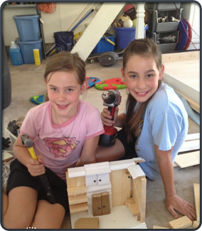
Activity 2
Building Models

Slide 7

How my theory relates to Activity 2
When children are exposed to situations that provide opportunities for learning in the real world, they continue to expand their knowledge of objects and become more familiar with the specific properties of these objects. • Piaget's concrete operational stage of development
Brennan,(2004).p.10

Slide 8
conclusion
In my presentation I found two suitable activities for 7–11-year Olds. I researched Piaget's theories to recognize how these activities would help in the development of children of these ages .I also researched activities for 7–11-year-olds and realized that my two chosen activities would be a good way to help these children for their performance in tests and exams as well.

Slide 9
References
Oswalt, A. (2010). Cognitive development: Piaget’s concrete operations. Available at: http://www.mentalhelp.net/poc/view_doc.php?type=doc&id=37677&cn= 1272
DeHart, G., Sroufe, A., & Cooper, R. (2004). Child Development: Its Nature and Course (5th edn). New York: McGraw-Hill.
Brennan, C. (ed.) (2004). The Power of Play: A Play Curriculum in Action. Dublin: IPPA
MLA 9th Edition (Modern Language Assoc.)
Ann Marie Halpenny, and Jan Pettersen. Introducing Piaget : A Guide for Practitioners and Students in Early Years Education. Routledge, 2013.
APA 7th Edition (American Psychological Assoc.)
Ann Marie Halpenny, & Jan Pettersen. (2013). Introducing Piaget : A Guide for Practitioners and Students in Early Years Education. Routledge.

