Slide 1
Employability and Career Development
(LCLM4005) – June 2026
Session 9: Career Development

Slide 2
Week | Topic of focus
1 | Introduction to the module and Personal Development Plans
2 | Self-Awareness
3 | Exploring Employment Opportunities
4 | Recruitment and Selection Process
5 | CV and Cover Letter Writing
6 | Job Interview Preparation
7 | Present Task 1 in class (Mock Interviews)
8 | Employment Legislation
9 | Career Development
10 | Alternative Pathways to Consider upon Graduation + Revision
 | Submit Task 2 via Moodle (Portfolio of Written Tasks)

Slide 3
Session Aims
Understand how to create a career development plan
Identify ways of developing a career.
Consider the importance of CPD in your career

Slide 4
Creating a career development plan

Slide 5
What is career development?
?

Slide 6



Career Development Planning
Career planning will help shape (and reshape) your personal brand.
Can you name each famous figure and identify their personal brand?

Slide 7
Ways of developing a career

Slide 8
Career Development Process
1. Discover yourself
2. Explore options
3. Make choices
4. Take Action
wk1: Personal Development Plans → self-assessment quiz, SMART goals
wk2: Self-Awareness → SWOT, Johari Window, personality tests, learning styles
wk3: Career Planning → individual vs. organisational, future of workplaces, creating a PDP
wk4: Recruitment and Selection Process → legislation, workplace policies
wk5: CV and Cover Letter Writing → stylistics and formatting, business writing
wk6: Job Interview Practice → promoting your personal brand, professional alignment
wk7: Interview Assessment → post-interview reflective practice
wk8: Employment Legislation → applying regulations to practice in the workplace

Slide 9
Career development process
SWOT analysis
Feedback from others
Johari Window
Personality tests
Learning Styles
1. Discover yourself

Slide 10
Career development process
Decide on one career for life?
Be flexible
(with a plan B in place)?
Look for opportunities
Focus on the next step(s)
Expect and plan for uncertainty
2. Explore options

Slide 11
Career development process
Cognitive approach
Intuitive Approach
3. Make choices

Slide 12

Discuss: How do you overcome self-doubt?
Fixed mindset
Growth mindset
3. Make choices

Slide 13
Career development process
Volunteering
Apply for jobs
Work experience
Networking
Further studies
Apprenticeships
4. Take Action

Slide 14
Developing Employability skills
https://www.pwc.co.uk/careers/early-careers/employability-hub.html
Visit the (Price Water Coopers (PWC) website and explore its Employability Hub.
Identify how the Hub encourages employees to develop their employability skills.
You may also discover ways of developing your own employability skills via this Hub.
Take Action
4. Take Action

Slide 15
The importance of CPD

Slide 16
What is CPD?
Watch the upcoming recording and consider these points:
What are the benefits of engaging in CPD?
What is the process to follow?
1317) Continuing Professional Development (CPD) - YouTube
02:10

Slide 17

Notes:
https://youtu.be/HnhmW0PZieg

Slide 18
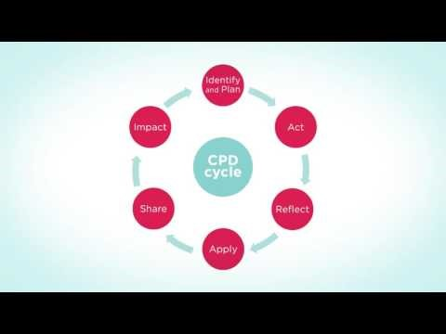

Slide 19
Further Research
https://www.cipd.org/uk/learning/cpd/about/
https://www.york.ac.uk/admin/hr/learning-and-development/career-development/professional-careers/understand-yourself/

Slide 20

Recap
We have understood how to create a career development plan
We have identified ways of developing a career.
We have considered the importance of CPD in a career
You will now complete a Knowledge Check Quiz

Slide 21
Task 1 (400 words): select and compare two adverts. Identify the key skills and knowledge required for your selected profession. Highlight the common skills and knowledge areas across these two adverts. Select one of those shared skills and explain why this skill is important for your profession.
Task 2 (800 words): conduct a reflective self-assessment to identify your personal strengths and areas for further development. Use a self-assessment tool in the form of a SWOT analysis. Provide examples of your readiness for employability and personal advancement (including academic achievements; work experience; extracurricular activities; feedback from peers and mentors).
Task 3 (300 words): set employment goals based on the weaknesses identified in your self-assessment. Identify these goals (both short-term and long-term), then explain why they are important to you and how they align with your career aspirations. Create a personal development plan which outlines specific actions you will take to address your weaknesses. State realistic timelines, resources needed and how progress shall be measured.

Slide 22
Reference List
Neugebauer, J. and Evans-Brain, J. (2022) Employability: Making the Most of Your Career Development. Croydon: SAGE.
Morgan, P. (2024) The Business Student’s Guide To Study And Employability. London: Sage Publications Ltd
Torrington, D. and Hall, L. (1998) Human Resource Management. London: Prentice Hall Europe.

