Slide 1

Social inclusion and Welfare

Slide 2
Today’s session
Making relevant links between welfare and criminal behaviour

Slide 3
Big news in the budget last week
2 child benefit cap to be scrapped as of April 2026
However, their effects up to then will likely be felt for years to come

Slide 4
Are there links between being on welfare and crime/victimisation
As we have established, welfare reforms have led to many impacts such as
Sanctions
Benefit Caps- amount provided
Child Caps
Reduction in support funding

Slide 5

How do these link to crime
The introduction of the Welfare Reform Act 2012- Research on the impact of the 2012 Act, which introduced significant cuts, found that areas more exposed to the reforms experienced increased levels of crime, particularly violent crime.
The effects were primarily concentrated in already deprived neighbourhoods, suggesting the cuts reinforced existing inequality
The research also found that there were more ‘new’ offenders rather than repeat offenders

Slide 6
Cont…
It could also be argued that ‘survival crime’ is more prevalent since the Act
Survival crime is defined as crime that is committed out of necessity to meet basic needs
A mother stealing formula
Prostitution/sex work to keep a roof over the family's head
Drug dealing to pay for daily essentials
Forcing children to commit petty crimes e.g. shoplifting

Slide 7
Future impact of committing crime in desperation
Employment challenges- A criminal record can create significant barriers to employment, even after a sentence is served, due to employer background checks this can be uncovered and reduce the likelihood of gaining employment
Financial strain- Individuals may face financial hardship from losses, legal fees, and the inability to earn a steady income.
Insurance issues- People with convictions may face difficulty obtaining certain types of insurance or be subject to higher premiums
Housing and benefits- A criminal record can affect eligibility for housing, and some individuals may be denied public benefits
Social isolation A person may withdraw from friends and family, making it difficult to maintain good relationships.
Social alienation- It can be hard to re-integrate into society, and individuals may feel they don't belong in social settings.
Relationship strain- Strain can be placed on existing family relationships and make it difficult to form new, healthy connections.

Slide 8
Example
Depending on the nature of the crime
-Offender could be sentenced to custodial sentence
-The offender would then likely lose their home
-Likely lose their employment (if they have one)
-Detachment from family/friends
Could lead to mental health issues
Upon release the offender would likely find it difficult to find new employment
Will have to sign on to benefits which can often take weeks
More likely to reoffend as a ‘survival crime’
The cycle continues

Slide 9
Causes of social exclusion among offenders
Many offenders have already experienced a lifetime of social exclusion before entering the justice system
Poor educational backgrounds
High rates of unemployment
Substance misuse problems
Poor mental and physical health
Childhood experiences like being in care or experiencing family member convictions
Ace’s

Slide 10
What are ACEs
Adverse Childhood Experiences are stressful or traumatic events that can happen to a person before the age of 18
They range from child verbal, mental, physical and sexual abuse, to being exposed to alcoholism, drug use and domestic violence at home
These experiences can have a profound and lasting impact on a person's physical and mental health, as well as their life opportunities, well into adulthood
In Parc Prison alone, 8 in 10 inmates have experienced at least 1 ACE
46% said they had experienced 4 or more

Slide 11
What counts as an ACE
Abuse
Physical Abuse: Being pushed, grabbed, slapped, hit, or injured by an adult in the household.
Sexual Abuse: Experiencing unwanted sexual contact or sexual activity with an adult or older person.
Emotional Abuse: Being sworn at, insulted, put down, humiliated, or threatened by a household adult in a way that causes fear of physical harm.
Neglect
Physical Neglect: Lacking basic necessities like enough food, clean clothes, or necessary medical care.
Emotional Neglect: Feeling that no one in the family loved you, looked out for each other, felt close, or provided support.
Household Dysfunction
Mother Treated Violently: Witnessing a mother or stepmother being physically harmed or threatened with a weapon by a partner.
Substance Use in the Household: Living with a problem drinker, an alcoholic, or someone who used street drugs.
Mental Illness in the Household: Living with a household member who was depressed, mentally ill, or attempted suicide.
Incarcerated Household Member: Having a household member who went to jail or prison.
Parental Separation or Divorce: Experiencing the separation or divorce of parents.

Slide 12
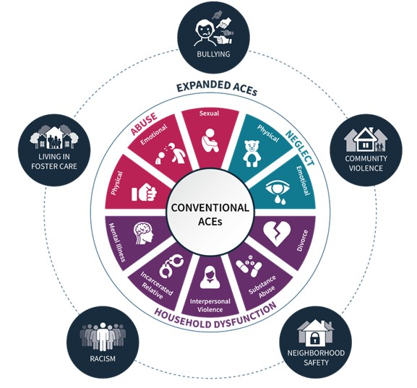
Expanded list
While the original 10 remain the standard for the ACE score, researchers and practitioners have identified a wider range of adversities that can also trigger toxic stress and trauma. These expanded lists can include-
Experiencing community violence
Living in an unsafe neighbourhood
Discrimination or racism
Bullying
Homelessness or residential instability
Bereavement
Poverty or financial hardship

Slide 13
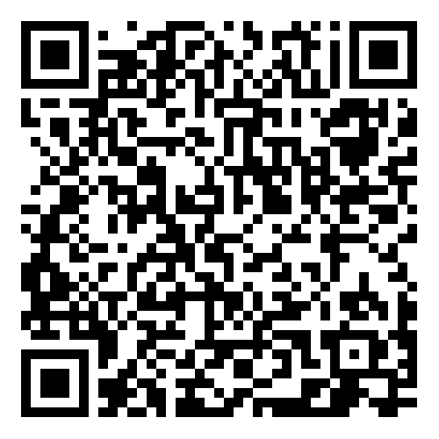
Ace test- Voluntary test you do not need to take part!

Slide 14

Debrief and recap

