Slide 1

Are Digitals Skills Important For Study And Work
  Lecturer Neale Haddon
  Yasmeen 2233492
  Amy 2221378
  Module code LCHS4002
Digital skills & Research Method

Slide 2
Introduction
The aim of this assignment is to gather enough information to produce a poll. This PowerPoint presentation is based on a Quantitative research project proposal. We will be conducting a survey with ethical consideration by discussing with students about their abilities and their confidence on using digital skills online. We are also going to research further into how we can provide students with extracurricular to gain the knowledge to become competent in their research skills and Microsoft skills.

Slide 3

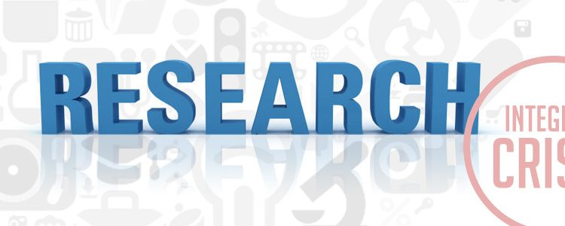
Rationale
There is a great deal of research that explores the set of skills or competencies that are important and how they should be operationalized for research and practice (Ba et al., 2002; Eshet-Alkalai and Amichai-Hamburger, 2004; Gilster, 1997; Van Deursen, 2010).
This Photo by Unknown author is licensed under CC BY-SA-NC.

Slide 4
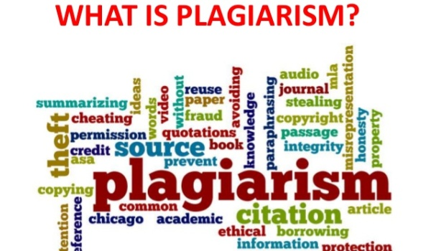
Ethical Consideration
An ethical consideration university students face is plagiarism.
Plagiarism is immoral since it amounts to theft. This is because you are stealing someone else's intellectual property when using their own words and ideas and claim them to be your own. Pupils who plagiarise have a high possibility of failing.
This Photo by Unknown author is licensed under CC BY-NC-ND.

Slide 5

The Proposed Method
"An important factor to consider when you need the results from your quantitative study to inform decision-making is to ensure that your study generates evidence of a sufficient quality, which may mean obtaining a high level of evidence"(Grey, Laura, Payne Katherine 2014 Chapter 6 pg 83-36)
This Photo by Unknown author is licensed under CC BY-NC-ND.

Slide 6
Hypothesis
We believe that the UWTSD students feel comfortable using their digital abilities. We have come to this conclusion by monitoring and examining fellow students during our own study time in university. I have found that they are confident enough to ask for assistance and are willing to stay overtime to become more competent is using MS. However, given the different ages gaps amongst UWTSD students, we have concluded the younger generation are more confident in using digital skills online.

Slide 7
Reference List
Walker (Ed.). (2014). An Introduction to health services research . SAGE Publications Ltd
Helsper, E.J. and Eynon, R. (2013) ‘Distinct skill pathways to digital engagement’, European journal of communication., 28(6), pp. 696–713.

