Slide 2
Welcome & introduction
Assessment process
Weekly schedule & expectations
What is People Management?

Slide 3
About me
Worked in Human Resources for 27 years
Personnel, HR, now People
Fellow of the CIPD (more on that shortly)
Specialist in Employment Relations and Employment Law
HR Consultant – keeps me up to date

Slide 4

Chartered Institute of Personnel and Development
https://www.cipd.org
Membership by qualification
Good source of information

Slide 5
Your assignment
Report of 2,000 words – due 24th November 2025
15 minute presentation – with questions. 1st or 8th December

Slide 6
The Case Study
Fictional company based in South Wales
You need to apply your knowledge and understanding to the case study
As always, use Harvard referencing
Credible, academic and relevant references

Slide 7
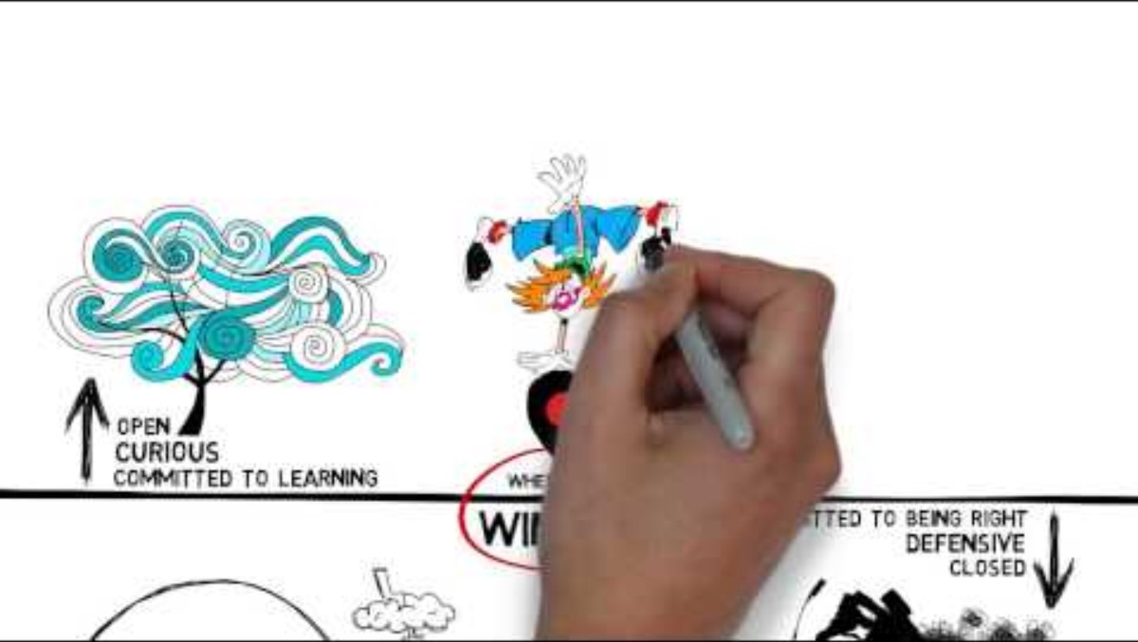
What is People Management?

Slide 8
Group Discussion – 30 minutes
How does this video help explain the role of leaders at work?
How do they influence behaviour at work?
What skills are needed?
What does this video tell us about the role of HR (or People Management) at work

Slide 9
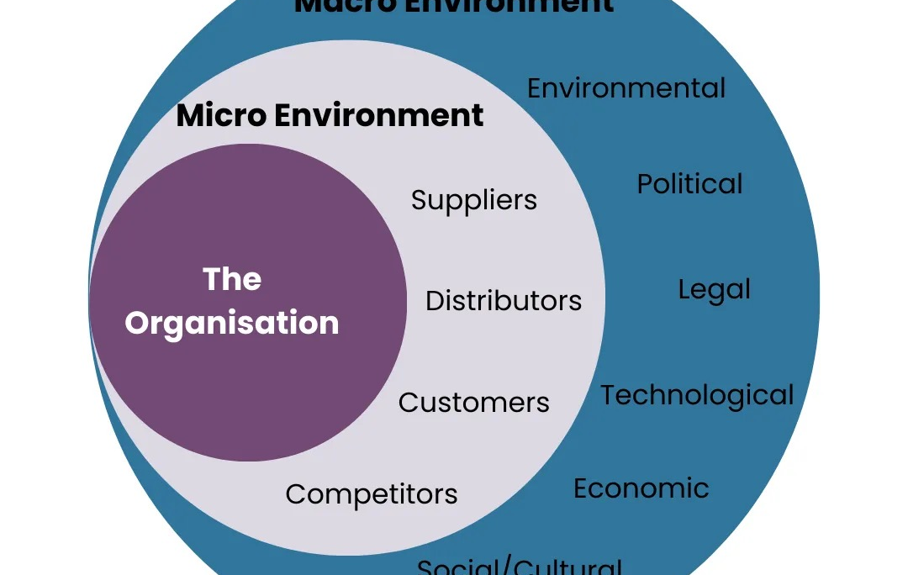
The business environment
Business environment operates at 2 levels – micro and macro
Macro – societal level and major uncontrollable external forces
Micro – specific to the organisation's internal and immediate environment

Slide 10
Why is it important to understand this?
Stay ahead of changes that may impact the business
Plan and prepare for change
Manage turbulent times
Regulatory requirements
Align with company goals and strategy
Gain a competitive advantage

Slide 11
Exercise
Read the case study in the assignment on Moodle
Prepare a PESTLE and SWOT based on the current business environment in the UK
Whilst the case study organisation is fictional, use PESTLE and SWOT to construct an analysis of the actual UK business environment, remembering to consider the company's location in south Wales.
Remember to reference your work.

Slide 12
PESTLE – in groups (base on case study)
Political
Economic
Social
Technological
Environmental
Legal

Slide 13
SWOT analysis – in groups
Carry out a SWOT analysis of the organisation in the case study
Remember to reference your SWOT analysis
Strengths, Weaknesses, Opportunities and Threats

Slide 14
Organisational goals and objectives
Mission statements & vision create a compelling view of the future, shape direction and help with decision-making
Swansea City AFC foundation vision:
  Improving our Communities through the power of "The Swans"
  And the mission:
  "To use Swansea City AFC s a force for positive change within our communities, creating the conditions needed for communities to flourish"

Slide 15
Values
Equality, Diversity and Inclusion
Community Support and Empowerment
Respect and dignity
Sustainability and Growth

Slide 16
Group work
Why are vision, mission, values and purpose important for an organisation?
Use examples from other organisations

Slide 17
Vision, values and mission
Vision: acts as a "north star"
Mission: explains why an organisation exists and what it does to achieve that
Values: drive decision-making, shapes culture, defines behaviour

Slide 18
Evidence base
Can positively influence performance where they are clear, well-developed and actively implemented
Managers play a critical role in role-modelling values
Impact of mission and vision mediated by actions of leaders and culture
Mixed empirical evidence (see Moodle for further reading)

Slide 19
Drucker (1973)
A business is not defined by its name, statues or articles of incorporation. It is defined by the business mission. Only a clear definition of the mission and purpose of the organisation makes possible clear and realistic business objectives

Slide 20
Competitive Advantage
Porter (1985)
The ability of a firm to create value in a way competitors cannot match
Cost leadership or differentiation
Barney (1991) developed this further: resource-based view, focusing on internal resources as a source of competitive advantage
HRM (or people management) serves as a powerful source of competitive advantage

Slide 21
And finally!
Regular wider reading – broadsheet newspapers
Moodle
Watch the news
HR Magazine
Institute for Employment Studies (IES)

