Slide 1
HPEN 4004
The Language(s) of Persuasion
advertising: the language that sells

Slide 2
Aims & Learning Outcomes
AIM(S)
To introduce students to an understanding of the mechanisms of persuasion employed by powerful interests, from ideological propagandists to fake news sites, conspiracy theorists and more
LEARNING OUTCOMES
Upon the completion of this module, the student should be able to demonstrate the ability to :
deploy critical literacy skills both in reading the work of others and in their own writing
recognise and critique techniques of emotional manipulation used in the language of exploitative ideologies or persons

Slide 3
The conventional approach:
- REASON-WHY ADVERTISING
Benefits vs features
Benefits are what clinch a sale;
Features are what help the buyer to rationalise their purchase to themselves;
‘Reason-why’ approaches attempt to stimulate demand and sales by providing a rationale that leads to purchase. (USP)
The premise of all ‘reason-why’ approaches is that consumers are essentially rational and tend to make informed choices based upon the information presented to them.
Do you see any problems with this?

Slide 4
Unique selling proposition (USP)
A USP identifies a specific benefit provided by the product that is not available from any other similar product. It is a reason for buying this product rather than any other. Focuses on brand.
For example:
‘Make sure it’s Cadbury’s. Because no other chocolate can possibly give you the proper, creamy, Cadbury taste.’
‘The revolutionary PG tips pyramid bag gives the tea leaves more room to move, for the most delicious PG tips tea yet.’

Slide 5
Exercise 2: Identifying USPs (i)
Watch the BURBERRY cashmere scarves ad and identify the unique selling proposition
    https://www.youtube.com/watch?v=Ro3Qe_hbrt8
What specific benefit does the USP promise the consumer?
How is the distinctiveness of the product and/or brand emphasised?
How important is the USP for the advert’s persuasive effect?

Slide 6
Exercise 2: Identifying USPs (ii)
Watch the IPHONE ad
  https://www.youtube.com/watch?v=Q6dsRpVyyWs
- identify the unique selling proposition
What specific benefit does the USP promise the consumer?
How is the distinctiveness of the product and/or brand emphasised?
How important is the USP for the advert’s persuasive effect?

Slide 7
Writing for your reader
Effective copywriting is not about writing what you want to write, but writing what your reader wants to read.
What is copy?
Copy is written matter or text prepared for printing, specifically the wording of an advertisement or the narrative of a newspaper article.
Copy is ‘goal-directed’ writing. It is written with the primary intention of producing a pre-determined effect, to make something happen. Copy aims to interest, convince, persuade, sell.

Slide 8
ENGAGING YOUR READER: TEXT
WRITING COPY
Copy must catch the reader’s attention & maintain their interest
Good copy should provide:
A clear reason for pausing to read in the first place.
Enough material of interest to keep the reader reading.
No reason for not reading on.
Knowing what your reader is like, and particularly what she wants more or less of, makes it much easier to write copy that relates to her interests and needs, desires, fears, and hopes.
Widespread profiling of readers How has this been developed though internet algorithms – are there any problems with this?

Slide 9
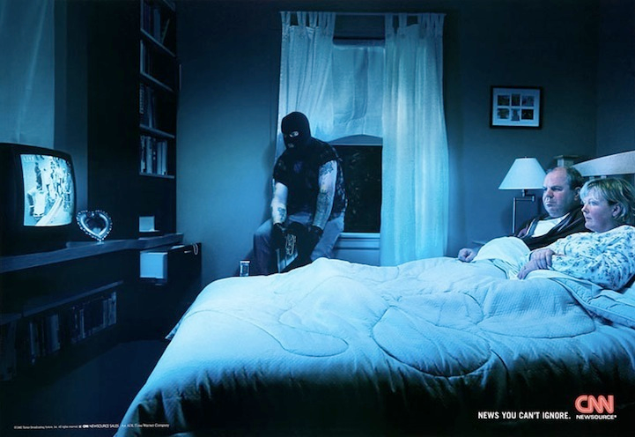
CNN – how does this ad work?

Slide 10
ATMOSPHERE ADVERTISING
‘Atmosphere’ approaches do not rely upon rational arguments in order to persuade consumers; instead, they appeal to their emotional impulses and non-rational responses.
An attempt is made to ‘tap into’ powerful irrational motivations such as sexual desire, patriotism, or social anxieties which importantly affect the behaviour of consumers.
How does this relate to online communication (esp. conspiracy theories/ grooming of various kinds)?

Slide 11
Atmosphere advertising: Emotional Selling Proposition (ESP)
An emotional selling proposition (ESP) is formulated by allying the product and/or brand image with positive attributes or implicit promises of desired outcomes.
eg
development of Stella Artois: ‘reassuringly expensive’
  https://www.youtube.com/watch?v=xuYVq8M7ybs
Widespread promotion of ‘brands’
Relation to ‘snobbery’ / elitism?

Slide 12
Exercise 3: Identifying ESPs (i)
Watch the IPHONE ad
  https://www.youtube.com/watch?v=r8mR33cp_Fk
try to identify the ESP
What ‘atmosphere’ does the advertisement attempt to create?
Which attributes or qualities are linked to the product/brand?
Does the advertisement attempt to manipulate the consumer’s emotions? How?

Slide 13
Exercise 3: Identifying ESPs (ii)
Look at BENETTON ads
  http://abduzeedo.com/awesome-and-controversial-ads-benetton
try to identify the ESP
What ‘atmosphere’ does the advertisement attempt to create?
Which attributes or qualities are linked to the product/brand?
Does the advertisement attempt to manipulate the consumer’s emotions? How?

Slide 14
Profiling markets : the arrival of the ‘literate consumer’
Consider changes in FASHION: Used to be spring, summer, autumn, winter – is this still the case? How do changes affect stocking and advertising choices for shops?
Significance of stories;
growth of additional activities
  eg The Scarecrow
  Watch "The Scarecrow," the companion film for Chipotle's new app-based game. Then download the free app at www.scarecrowgame.com and join the quest for wholesome, sustainable food. (?)

Slide 15
Consumer irritation at interruptive ads: Ad blockers & switch off
The rise of ad blockers…threatens the marketing mix, Ait Addi (Teads)
What this means is that advertisers will need to fight even harder for their ads to be seen. However, we can’t blame people for using ad blockers online. The answer is for brands and advertisers to respond with far better ads that are less intrusive and more relevant to consumers. We need to focus on creating experiences that are respectful of the end user and which engage, rather than enrage consumers.
Viewability should … be the key driver behind media buying. When 50% of online ads are not seen by users, that’s half of someone’s online advertising budget wasted. Currently the industry standard for a ‘viewed’ advertisement is 50% of the surface of two seconds. This simply isn’t good enough for luxury brands.
IMPLICATIONS?

Slide 16
Intelligent responses to literate consumers
Dove’s ‘Real Beauty Sketches’
Gelner says that more than ever before, brands have to realize they aren’t just competing with other brands, they are competing with things in culture that are deemed share-worthy at that moment in time. “Things that entertain us. Things that connect,” he says. “Dove’s ‘Real Beauty Sketches’ is clearly the one piece of work that embodies that. It tapped into a powerful, global insight about beauty and about how women are tougher on themselves than others. It hit a nerve. It was one of the most shared videos of all time.”
(see link on moodle)

Slide 17
TASK: Moving image literacy
(500 words)
Select a viral video clip and explain its appeal and effectiveness.
Consider the way it establishes, or builds on, a brand identity
How important is its Unique Selling Proposition (USP)?
What specific benefit does the USP promise the consumer?
How is the distinctiveness of the product and/or brand emphasised?
Does the advertisement rely solely upon its USP for its persuasive effect?
How significant is its reliance on an Emotional Selling Proposition (ESP)
What ‘atmosphere’ does the advertisement attempt to create?
Which attributes or qualities are linked to the product/brand?
How does the advertisement seek to create a relationship with the consumer ?

Slide 18
DEVELOPING EMOTIONAL BONDS
, by the late twentieth century …. the overriding aim was now to occupy the market or brand position from which consumers could be invited to make lifestyle choices about a range of products or services. It is much easier to challenge a proposition then it is to dislodge a competitor from its market position. In the case of Nike, its slogan during the 1990s – ‘just do it!’ – sounds like an authoritative call to action. However, it’s actual meaning was nebulous, and it also seemed to be speaking about the consumer rather than the project. This basis of such appeals is emotional rather than rational, yet the bond the created with consumers could be robust, often deep and enduring (p.4)

Slide 19
IDENTITY IN A consumer SOCIETY
…between 1969 and 1997 there was a change in the prevailing sociopolitical view within Britain. The technological optimism of the post war period had given wait to the notion, first espoused by Keynes in 1929, that continuing economic growth would result in a more measured society wherein citizens would be required to work no more than a few hours each day. This idea continued to gain traction, influencing thinkers in both mainstream and counter-culture, throughout the years of full employment enjoyed during the early post-war decades. During the recession of the 1970s attitudes to the leisure society hardened, and the return of economic growth during the 1980s was fuelled by policies geared instead to achieving a rise in household expenditure, under the auspices of increasing individual economic freedom. Rather than a leisure society, a consumer society emerged where in the accumulation of goods became an expression of self-identity. (p.5)

Slide 20
Ideology: individual choice as freedom
The political and economic elevation of the needs and economic freedoms of the individual over those of society, which occurred during the 1980s … The ideology driving the Conservative and Republican governments, led by Prime Minister Margaret Thatcher and President Ronald Reagan respectively, was perfectly aligned with the aims and objectivists of the persuasion industries. Increasingly, global, corporate brands looked to forge strong emotional bonds with their consumers instead of simply pushing products to them. To that end, a large amount of communication output was designed to give the illusion that a personal ‘one-to-one’ conversation was taking place. Like many government policies at the time, this more intimate approach to persuasion also gave the impression that the individual was at the centre of society and that his or her wants and needs were of paramount importance.

Slide 21
feeling replacing rational thinking in more areas of life
When brand communication campaigns were successful during the 1980s and 1990s – which was certainly not always – they reached far more deeply into society than those of previous decades. The inculcation of emotional appeals, based on feeling rather than on rational thinking resulted in more areas of everyday life becoming mediated by some form of commercial exchange as consumers themselves became embroiled in the ongoing, effervescent process of persuasion. (p.7)
  Steven McKevitt, The Persuasion Industries: The Making of Modern Britain, OUP Oxford, 2018

