Slide 1


SJIE5004
Celebrating language and
Culture – Belonging
To Wales.

Slide 2


Welcome
(Flikr,2008)
(Campaugusta,2016)

Slide 3
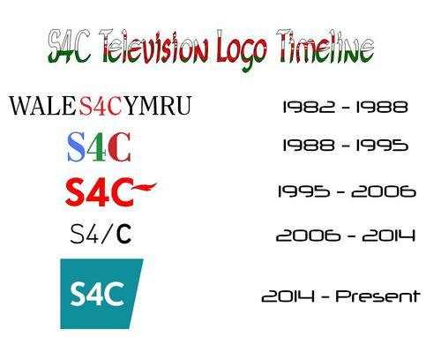

First television channel to be aimed specifically at a welsh speaking audience.
(Worldpress, 2018).
(S4C, 2014)
During the 1970s welsh language activists campaigned for a TV service in the language. A welsh language dedicated channel was seen by some as the best way to further promote the Welsh language and improve its programming.
When first established in 1982, the channel initially broadcast bilingual. (Welsh & English), until March 2010 when S4C began broadcasting entirely in the Welsh language.
(Worldpress, 2018).
(Worldpress, 2018).
Failure from the government to implement a welsh speaking television programme for welsh- speakers, made protestors refuse to buy TV licenses, some climbed television masts and illegally entered television studios.
(Walessince1945.2018).
(S4C, 2014).

Slide 4
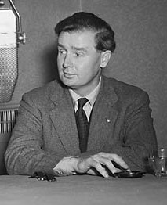
Gwynfor Evans
(1912-2005)
Welsh politician, who devoted his life to the peaceful cause of Welsh nationalism. Honorary president of plaid Cymru, the welsh nationalist political party.
(Wikipedia,2020).
(Evans,2001).
Gwynfor gained national attention for himself and his cause in 1980, when his threat of a hunger strike forced Prime Minister Margaret Thatcher’s government to follow through on a promise to establish a television station for Wales.
Gwynfor hunger strike was instrumental in bringing about the formation of S4C, and it began broadcasting in 1982
(Evans, 2011)
(Evans,2001)

Slide 5
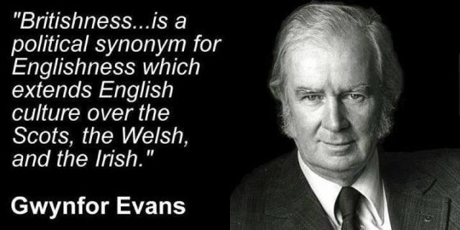
(Bellagwalia.org,2016)

Slide 6

Welsh Language Act 1993
“Equal validity” between the Welsh and English languages.
(Welshlanguageboard.org,2020.)
(Gov.wales,2016)
S4C is committed to supporting the use and development of the Welsh language to ensure the future of Welsh as a viable language. They have provided a wide range of content in the Welsh language that reflects Wales.
S4C has a duty to comply with standards in relation to the Welsh language. As a result, S4C has a duty which means that it should not treat the Welsh language less favourably than the English language in Wales.
(Gov.wales,2016)
(Gov.wales,2016)

Slide 7





Sport
What S4C can provide
to the welsh population.
Music
(S4C, 2014)
Cyw
Factual
Stwnsh
(S4C, 2014)
(S4C, 2014)
Drama
News
(S4C, 2014
(S4C, 2014)
Entertainment & Events

Slide 8
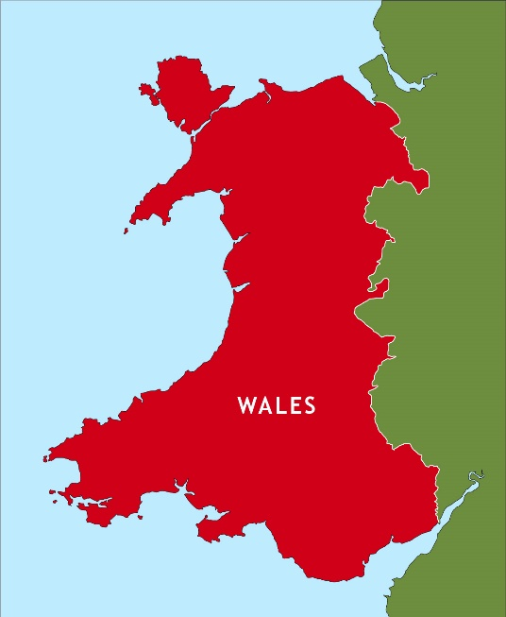
How has S4C benefited Wales?
Creating future benefits to Wales in regards to the digital sector – securing the Welsh language's place on the new digital platforms of the future in order to keep the language relevant to new generations.
“Giving the Welsh a platform on TV and online was S4C’s aim”.
(S4C,2014)
(S4C,2014)
Maintained the profile of Wales and the Welsh language – by targeting more co-production schemes and partnership agreements with international companies, creating additional economic impact.
Education and skills – partnering with educational establishments in order to ensure content is targeted specifically for use within the national curriculum, and securing investment in skills in Welsh television's production sector.
(S4C,2014)
(S4C,2014)

Slide 9

Conclusion
(Flikr,2008)
What did we find out?
How has this impacted on the education of language in Wales.
Casgliad

Slide 10

Diolch am wrando
(Diolch.Wales, 2020)
Thank you for listening

Slide 11
Reference List:
Bella Gwalia, (2016) Available at : https://bellagwalia.org, Accessed on [31/10/2020].
Cardiff Education Services, (2018) Available at: https://cardiffeducationservices.co.uk, Accessed on [29/10/2020].
Davies, J. (2014) The Welsh Language a History, University of Wales press.
Davies, J. (2007) A History of Wales, Penguin.
Davies, W. (1981) Wales in the Early Middle Ages,1st ED, Leicester.
Diolch.Wales. (2020) Available at : https://www.diolch.wales, Accessed on [31/10/2020].
Evans, G. (2011) The Fight For Welsh Freedom, 1st Ed, Y Lolfa.
Evans, G. (2001) For The Sake of Wales, The Memories of Gwynfor Evans, 1st Ed, Welsh Academic Press.
Flikr, (2008) Available at: www.flikr.com, Accessed on [ 27/10/2020].
Jenkins, H, G. (2007), Concise History of Wales, Cambridge.
Morgan, G. (2008) A Brief History Of Wales, 1St Ed, Ceredigion, Y Lolfa Cyf.
Morgan, P. (2005) The Tempus History Of Wales, Tempus.
Roberts, E. (2017) Highlights from Welsh History Opening Some Windows on our Past, Y Lolfa.
S4C history, (2014) Available at: https://s4c-history.tumblr.com, Accessed on [29/10/2020].
S4C Cymru, (2020) Available at: https://www.s4c.cymru, Accessed on [28/10/2020].
Welsh Assembly government, WAG, (2016) Available at: https://law.gov.wales/culture/welsh-language/welsh-language-act-1993, Accessed on [30/10/2020].
Welsh language Board, (2020) Available at: https://www.welsh-language-board.org.uk, Accessed on [31/10/2020].
Wikipedia, (2020) Available at: https://en.wikipedia.org/wiki/Gwynfor_Evans, Accessed on [30/10/2020].
Worldpress, (2018) Available at : https://walessince1945.wordpress.com, Accessed on [1/11/2020].

