Slide 1







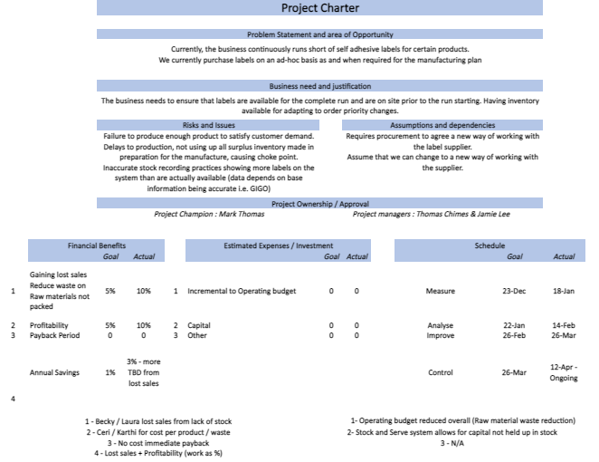
SIX PANEL DMAIC Project Review
Energizer label supply optimisation and management
Notes:
Highlights several progressive potential defects and charts it along the supply chain (Methods -> Materials & Machines -> Manpower)

Slide 2


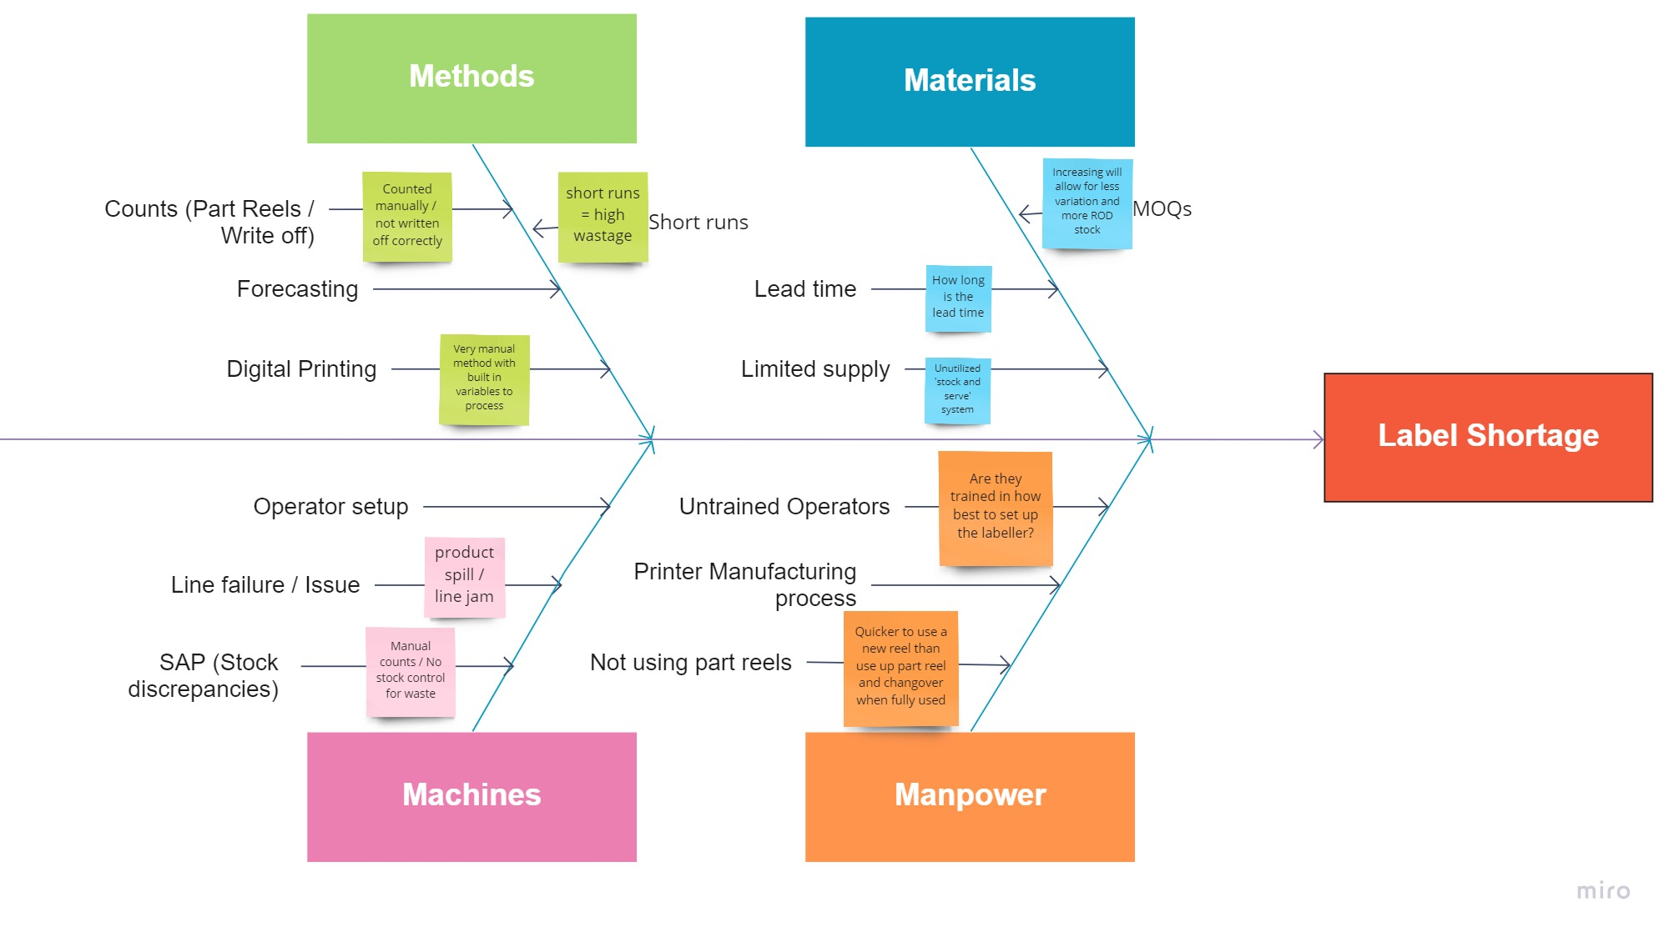
Energizer label supply optimisation and management
SIX PANEL DMAIC Project Review
Notes:
Highlights several progressive potential defects and charts it along the supply chain (Methods -> Materials & Machines -> Manpower)

Slide 3

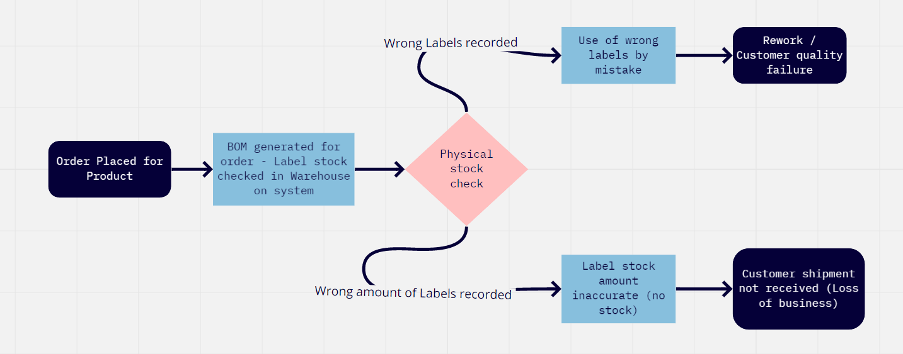
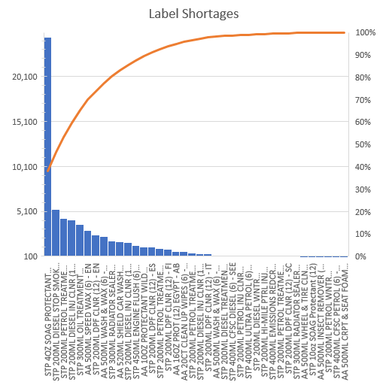
Energizer label supply optimisation and management
SIX PANEL DMAIC Project Review
When looking at which type of labels experience the most impact from shortages, we can identify the critical label stock levels immediately, for the maximum effect. However, the correlation could be mis represented. This is due to directly relating to SKUs that have low order frequencies experiencing the greatest shortages.

Slide 4

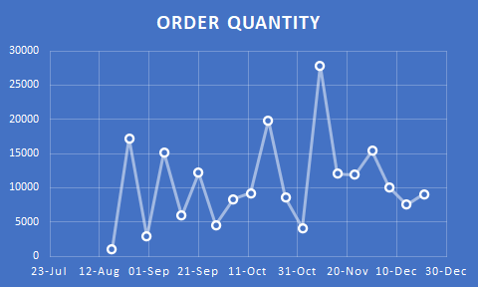
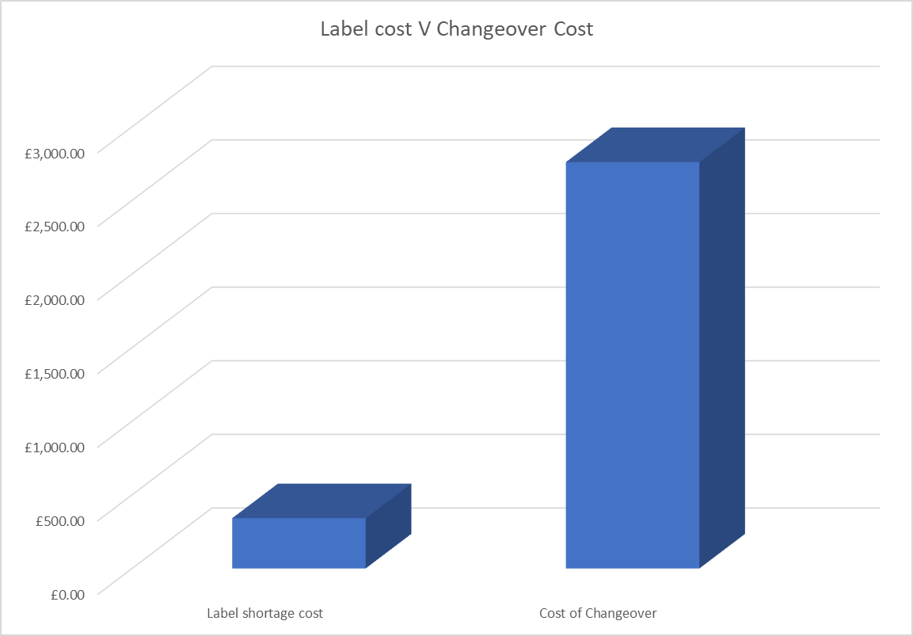
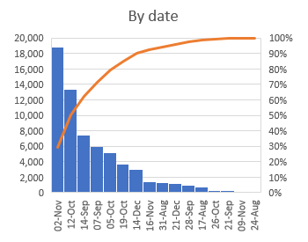
Energizer label supply optimisation and management
SIX PANEL DMAIC Project Review
The graphs display the order frequencies and volumes (on the right) and the date of label shortages (on the left).
The data shows that the orders are sporadic and in doing so creates pockets of shortages between ordering, at the certain dates that correspond to pocket areas of ordering.
The cost (in £’s) the labels we are short on orders. The data displays that the label prices are relatively small in comparison to the cost of missing shipments / orders and the wastage associated with that (shown as ’cost of changeover’)
Notes:
Note the peaks and troughs in conjunction with the pareto chart below allows for an accurate picture at when the defects tend to occur that lead to missed shipments *And notes the direct loss of shipment therefore payment and customer relationship.

Slide 5
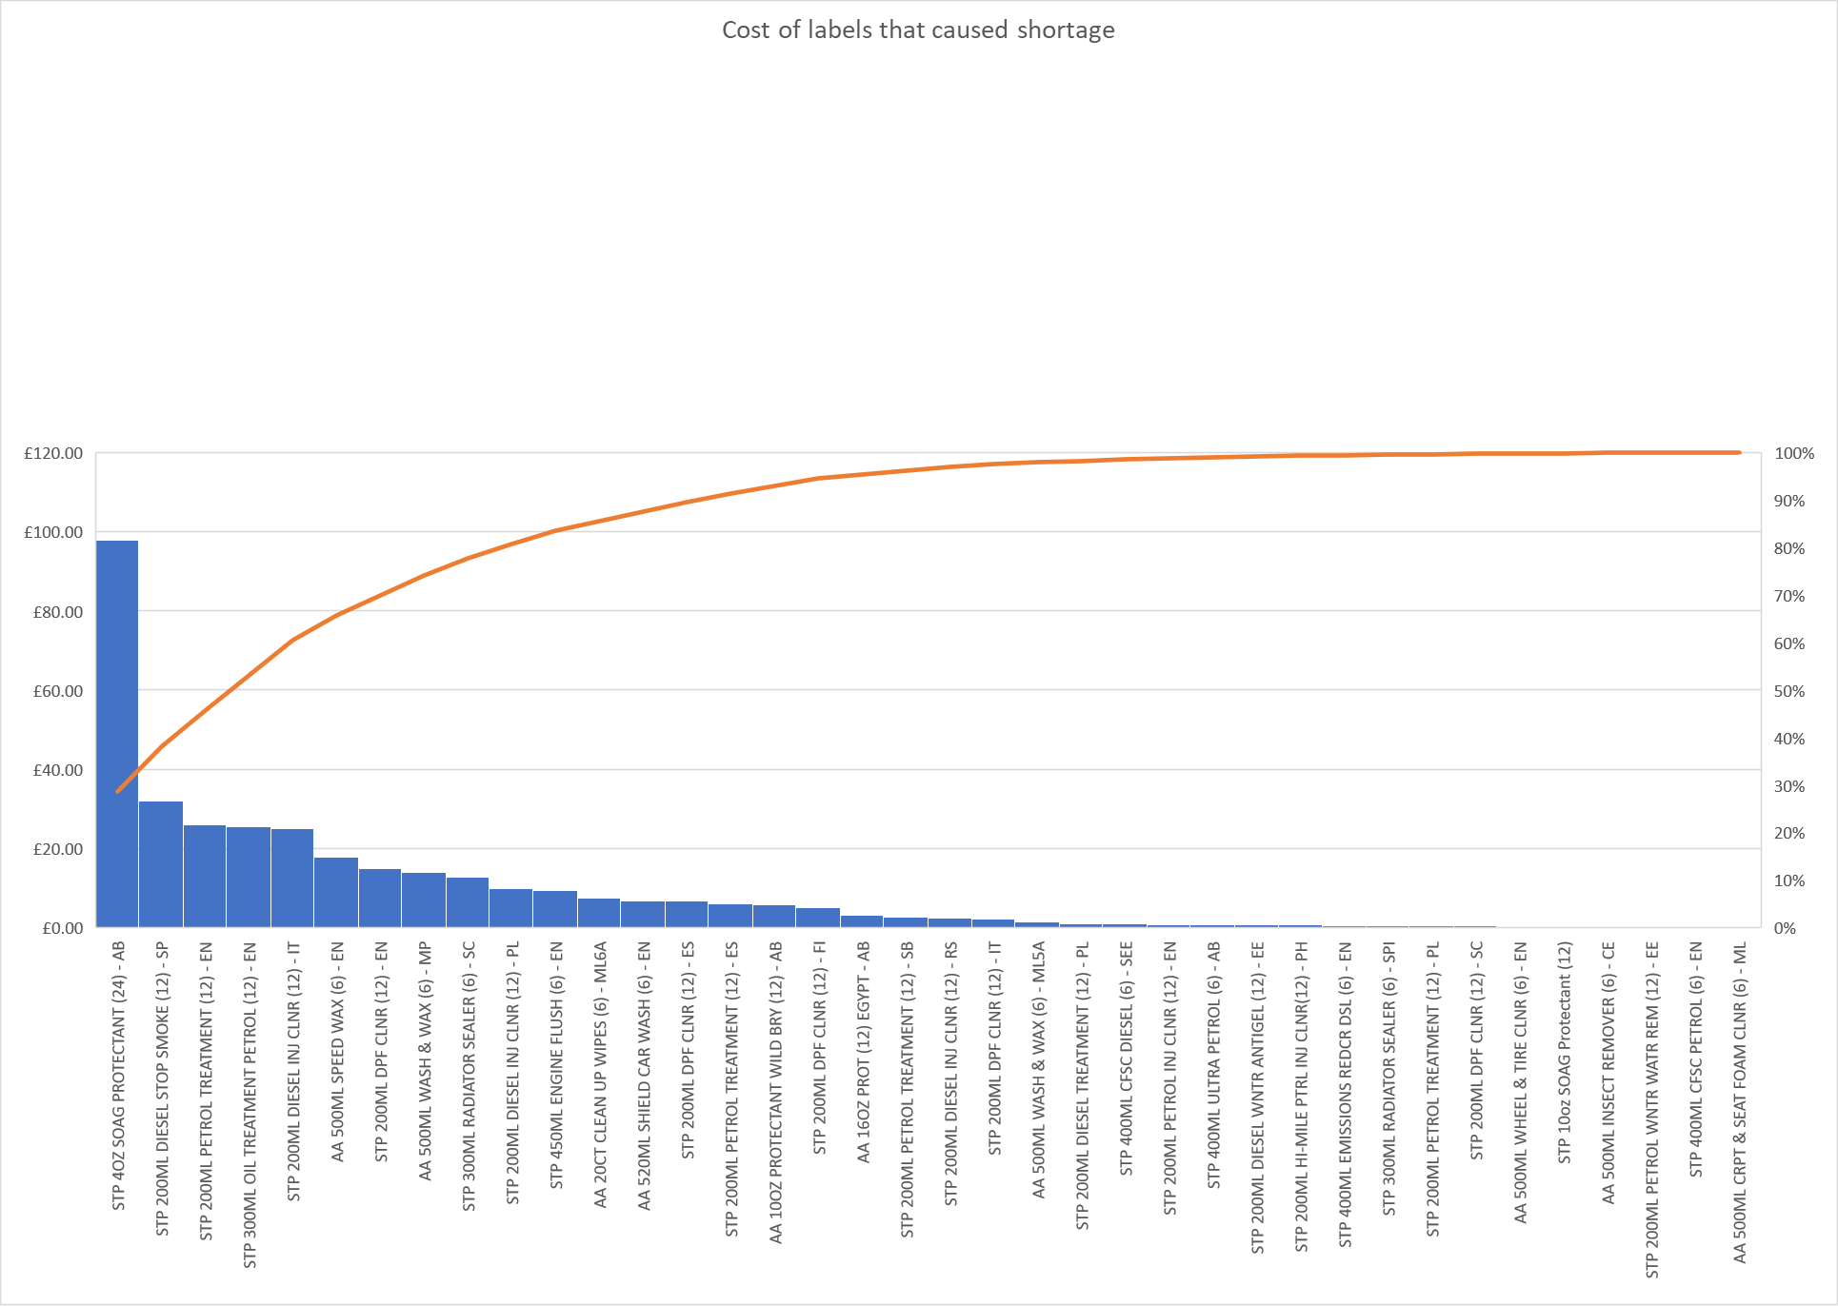
Energizer label supply optimisation and management
SIX PANEL DMAIC Project Review
The cost (in £’s) by product the labels we were short on orders for.
This shows that the label prices are relatively small, the cost for most labels missing to enable us to complete orders was less than £10
Notes:
Note the peaks and troughs in conjunction with the pareto chart below allows for an accurate picture at when the defects tend to occur that lead to missed shipments *And notes the direct loss of shipment therefore payment and customer relationship.

Slide 6
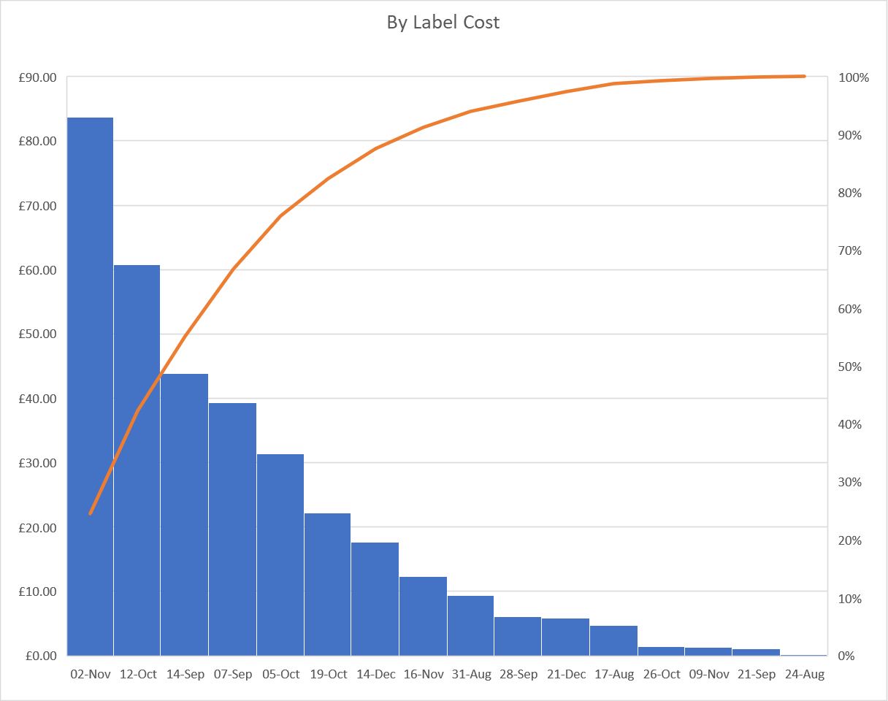
Energizer label supply optimisation and management
SIX PANEL DMAIC Project Review
The cost (in £’s) the labels on each day that we were short on orders for.
This shows that the cost per day was mainly less than £30, the highest being £85
Cost of changeover to another product is around £60 per changeover, this immediately shows that other than 2 products, it was more costly to switch than to have ordered more labels in
Notes:
Note the peaks and troughs in conjunction with the pareto chart below allows for an accurate picture at when the defects tend to occur that lead to missed shipments *And notes the direct loss of shipment therefore payment and customer relationship.

Slide 7

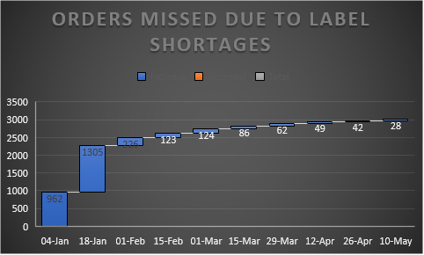
Energizer label supply optimisation and management
SIX PANEL DMAIC Project Review
The chart to the left shows how the improvements to ordering have increased the availability, in addition to offsetting missed orders due to shortages.
To the right is the newly revised ordering process that has seen a more consistent frequency and quantity of labels on site.
Notes:
Note – Primarily surrounding the start and mid month period, reading as the highest points of defects listed. Highlights a potential area of interest surrounding forecasting. I.e. is the forecasting done too late for the start of each months orders, only catering for a small period of time before again running short.

Slide 8


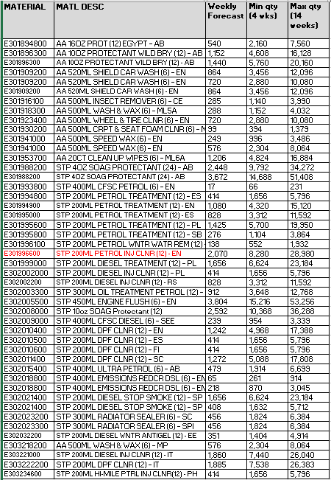
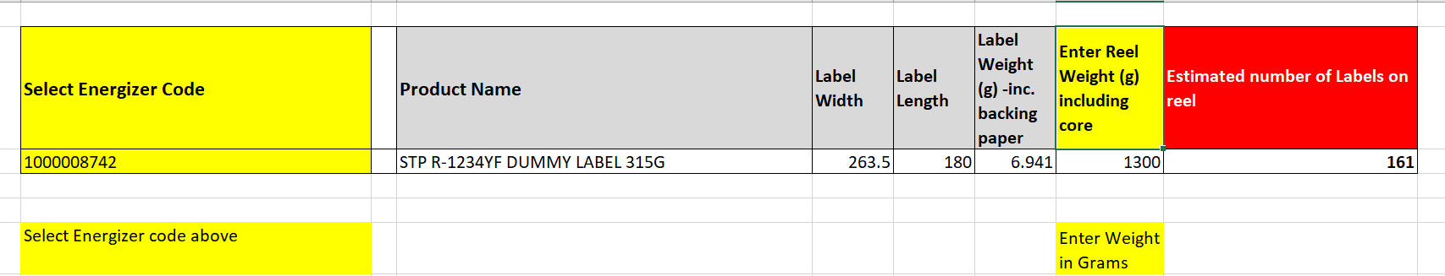
Energizer label supply optimisation and management
SIX PANEL DMAIC Project Review
CONTROL
By introducing a revised min – max stock control system label shortages seem to have reduced. The capital now additionally in inventory is offset by the amount of orders able to be produced. To better manage the stock control, we’ve introduced a label calculator (as above). This uses base data from our label supplier for all label variants, using this information we are able to accurately (to within 5 labels) capture part reel quantities and better manage and control stock.
As shown on the right, we’ve increased the capital spend in label inventory. This has a direct cost saving through larger order quantities. With of course the bonus of not having to miss shipments from not having labels to hand. The production can plan for bigger runs, which reduce wastage of the blended product that cannot be packaged.
Notes:
This Pareto helps lead to the root of what product experiences this defect the most.

Slide 9

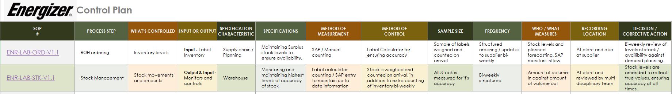
Energizer label supply optimisation and management
SIX PANEL DMAIC Project Review
CONTROL
Agreement with supplier for a min / max stock holding put in place
Minimum of 4 weeks’ worth of stocks to be held between ENR and CCL
Maximum of 14 weeks’ worth of stocks to be held between ENR & CCL
ENR to send stock list to CCL each week detailing qty of label stock held on site at ENR
CCL to determine when / how much to produce to stay within the Minimum / Maximum quantities
Control Plan created and SOP hyperlinks inserted with a clear picture of the procedures to follow, and the planned results and benefits of this.
Notes:
This Pareto helps lead to the root of what product experiences this defect the most.

