Slide 1

Component 1
Student name: Harriet Erhere Akpojotor
Student ID: 2020979
Module name: Community Care and Development
Module code: BMHP6022
Lecturer name: Jolly Nwankwo

Slide 2
Introduction
Peckham and Godel (2023) define a community as a group of individuals who share common characteristics, interests, or geographic locations and are interconnected by social relationships, influencing their health and well-being collectively.
Community development, as per Peckham and Godel (2023) , is a collaborative and participatory process that empowers individuals within a community to enhance their well-being, address social determinants of health, and collectively work towards creating positive and sustainable changes.

Slide 3
Background
The London Borough of Barking and Dagenham is characterized by a diverse population, including a substantial representation of Black, Asian, and Minority Ethnic (BAME) communities, accounting for around 61% of the residents (Director of Public Health 2023).
With a median age of 32, the borough has a notably youthful population. However, it faces economic challenges, as approximately 29% of children live in poverty (Director of Public Health 2023).
In terms of employment, the borough experiences a mix of job types, with a concentration in service industries (Director of Public Health 2023).
Despite ongoing regeneration efforts, Barking and Dagenham encounters health disparities, with higher rates of chronic diseases and lower life expectancy compared to the London average (Director of Public Health 2023).
Addressing these disparities requires a nuanced understanding of the borough's demographics, emphasizing the need for targeted health interventions and equitable access to healthcare resources.

Slide 4
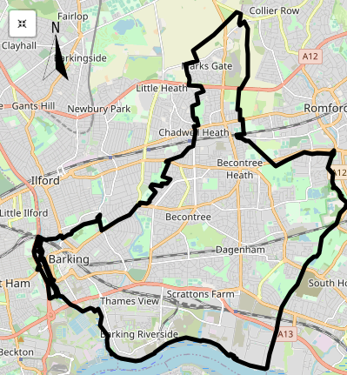
Health Summary
(NHS North East London no date)
The health of people in Barking and Dagenham is varied compared with the England average. Barking and Dagenham is one of the 20% most deprived districts/unitary authorities in England and about 22.5% (12,810) children live in low income families. Life expectancy for both men and women is lower than the England average.

Slide 5
Stakeholders involved in the program
Addressing health disparities in the London Borough of Barking and Dagenham involves collaboration among various key stakeholders.
Local government entities, including the Barking and Dagenham Borough Council and Public Health Department, play a pivotal role in policy formulation and resource allocation for health initiatives (Director of Public Health 2021).
Healthcare providers such as NHS trusts and local clinics are essential for delivering healthcare services and implementing preventive programs (Director of Public Health 2023).
Community organizations and leaders, representing diverse ethnic and socio-economic groups, are crucial for fostering community engagement and tailoring interventions to meet specific needs (Director of Public Health 2021).
Educational institutions contribute to health literacy and awareness. Additionally, businesses and employers influence the socio-economic determinants of health through employment opportunities (Director of Public Health 2023).
Inclusion of residents and advocacy groups ensures that community voices are heard and that initiatives align with the community's values.
A collaborative approach, involving these stakeholders, is essential for creating comprehensive, culturally sensitive, and effective strategies to mitigate health disparities in Barking and Dagenham.

Slide 6
Use of digital media and technologies for community development
Social media platforms, including Facebook, Twitter, and Instagram, serve as dynamic tools for communication, allowing community members to share resources, initiatives, and updates (Malikhao 2020). Online forums and community websites create virtual spaces for dialogue, collaboration, and the exchange of ideas.
Digital technologies enable the dissemination of health information, educational resources, and awareness campaigns, promoting health literacy and empowering residents (Malikhao 2020).
Mobile applications and telehealth services facilitate access to healthcare resources, particularly relevant in addressing health disparities (Malikhao 2020).
By leveraging these digital tools, community development efforts in Barking and Dagenham can enhance inclusivity, bridge communication gaps, and foster a sense of shared identity and purpose among its diverse population.

Slide 7
legislation and policy impact the support and growth of a community
In the London Borough of Barking and Dagenham, several legislations and policies significantly impact community support and growth. Housing policies, such as affordable housing initiatives and urban regeneration projects, aim to improve living conditions and provide sustainable housing solutions (Director of Public Health 2023).
Education policies focus on enhancing educational opportunities, including access to quality schools and resources, thereby contributing to community development (Director of Public Health 2023).
Social welfare policies, guided by national frameworks, address poverty and inequality by offering support programs and services to vulnerable populations (Director of Public Health 2023).
Health policies, including NHS guidelines and local health initiatives, play a vital role in promoting public health, preventive care, and overall well-being (Director of Public Health 2023).
Policies promoting social inclusion and diversity foster community cohesion and resilience. Local governance policies, driven by borough councils, influence resource allocation and community engagement strategies (Director of Public Health 2023).
A comprehensive understanding and alignment of these legislations and policies with the unique needs of Barking and Dagenham are critical for fostering a supportive, equitable, and thriving community.

Slide 8
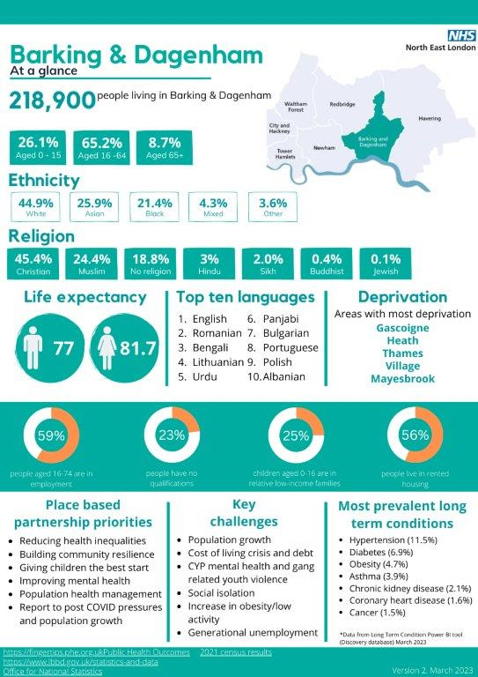
(NHS North East London no date)

Slide 9
Barriers/obstacles to community development
One significant challenge is a pervasive lack of trust stemming from past instances of unfulfilled promises and misuse of community programs, eroding faith in participatory initiatives (Gholipour et al. 2023). Low public awareness and a misunderstanding of the importance of health programs contribute to limited community engagement, as individuals may prioritize personal commitments over societal interests.
Cultural barriers, particularly the reluctance of certain demographic groups to actively participate, hinder the effectiveness of community initiatives (Gholipour et al. 2023).
Cumbersome bureaucratic structures in implementing government-sponsored programs create delays and demoralize stakeholders (Gholipour et al. 2023).
Inadequate financial resources and understaffing within the community health scene impede the successful rollout of programs, limiting their impact and reach (Gholipour et al. 2023).
Addressing these barriers requires targeted efforts to rebuild trust, enhance awareness, and create inclusive, culturally sensitive programs that resonate with the diverse population of Barking and Dagenham.

Slide 10
Recommendations
Systematically screening patients for health-related social needs
Community health clinics should partner with stakeholders to align local services with patient needs
Make Mental Health First Aid Training more accessible and affordable for businesses
Strengthen and deepen the collaboration between the Barking and Dagenham local council and its partners to address drug and alcohol misuse

Slide 11
Conclusion
A comprehensive community health clinic strategy is imperative to address the social determinants of health and bridge the health inequality gap among vulnerable working-age individuals.
Even in situations where quality healthcare services are available, social determinants of health may hinder individuals from reaching their health objectives
This community development initiative should be heavily supported by relevant legislation and policy to ensure sustainability.

Slide 12
Reference.
Director of Public Health, (2021). Equality challenges in barking and Dagenham [online]. London: Director of Public Health. [Viewed 22 November 2023]. Available from: https://www.lbbd.gov.uk/sites/default/files/2022-09/LBBD%20Equality%20Challenges%20in%20Barking%20and%20Dagenham%20Report%202021%20summary.pdf
Director of Public Health, (2023). Joint health and wellbeing strategy 2023 to 2028 [online]. London: London Borough of Barking and Dagenham Council. [Viewed 22 November 2023]. Available from: https://www.lbbd.gov.uk/sites/default/files/2023-06/LBBD%20JHWS%202023-28.pdf
Gholipour, K., Shokri, A., Yarahmadi, A. A., Tabrizi, J. S., Iezadi, S., Naghibi, D. and Bidarpoor, F., (2023). Barriers to community participation in primary health care of district health: a qualitative study. BMC Primary Care [online]. 24(1). [Viewed 23 November 2023]. Available from: doi: 10.1186/s12875-023-02062-0
Malikhao, P., (2020). Health communication: approaches, strategies, and ways to sustainability on health or health for all. In: Handbook of communication for development and social change [online]. Singapore: Springer Singapore. pp. 1015–1037. [Viewed 23 November 2023]. Available from: doi: 10.1007/978-981-15-2014-3_137
NHS North East London, (no date). Barking and dagenham [online]. NHS. [Viewed 23 November 2023]. Available from: https://northeastlondon.icb.nhs.uk/your-area/barking-dagenham/
Peckham, S. and Godel, D. M., (2023). Community development and health [online]. Socialist Health Association. [Viewed 23 November 2023]. Available from: https://sochealth.co.uk/national-health-service/public-health-and-wellbeing/community-development-and-health/

