Slide 1
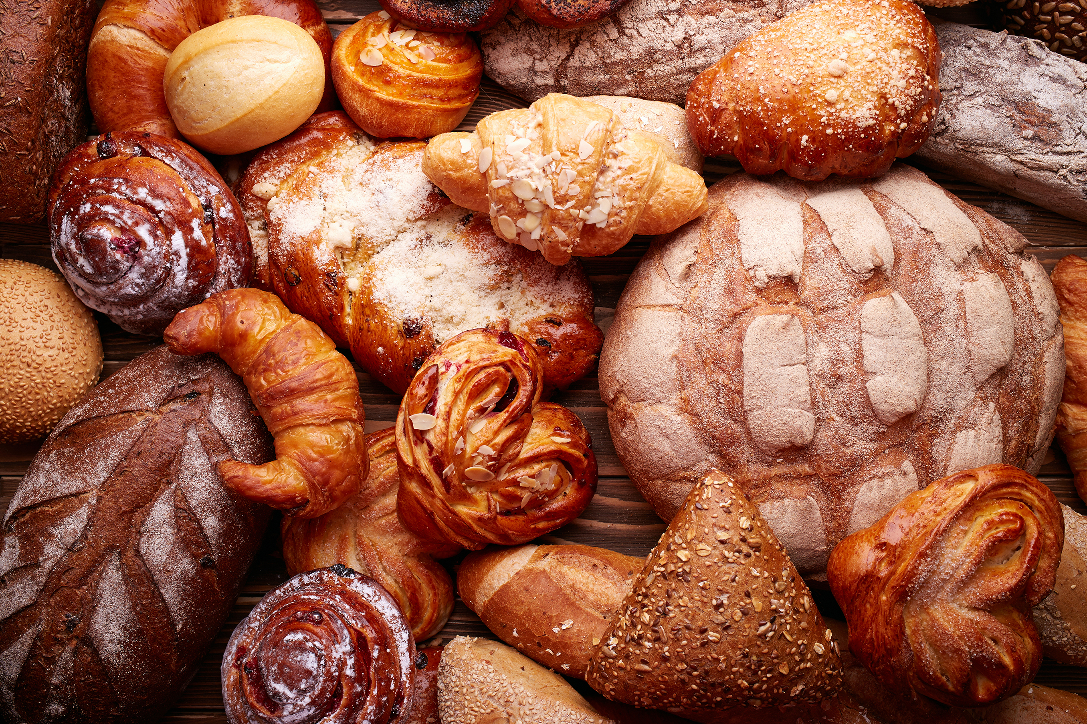
Basil’s Bakery
Problem Solving and Decision Making
Student name: Adriana Elena Mihai
Student number: 2537571
Lecturer: Zahida Khan
Module: LCLM4004
Notes:
Good morning. Today, I will be discussing Basil’s Bakery and investigating why its sales have not returned to their 2019 level. I will use two problem solving tools, PESTEL and a Fishbone Diagram, to organise the possible causes and identify what Basil should investigate before making any decisions.

Slide 2
What I’ll cover
01
02
03
04
05
The Business
The Problem
PESTEL
Fishbone
Key findings
Background on Basil’s Bakery and its products.
Sales remain around 25% below 2019 level.
External political, economic, social, technological, environmental and legal factors that may affect sales.
Possible root causes of the decline, organised into cause categories.
The main issues identified and what Basil should investigate before making decisions.
Notes:
First, I will introduce Basil’s Bakery and explain the background of the business. Then, I will discuss the main problem affecting its sales. After that, I will explain and apply PESTEL to explore external influences. Next, I will use a Fishbone Diagram to organise the possible causes. Finally, I will summarise the key findings and explain why further evidence is important.

Slide 3
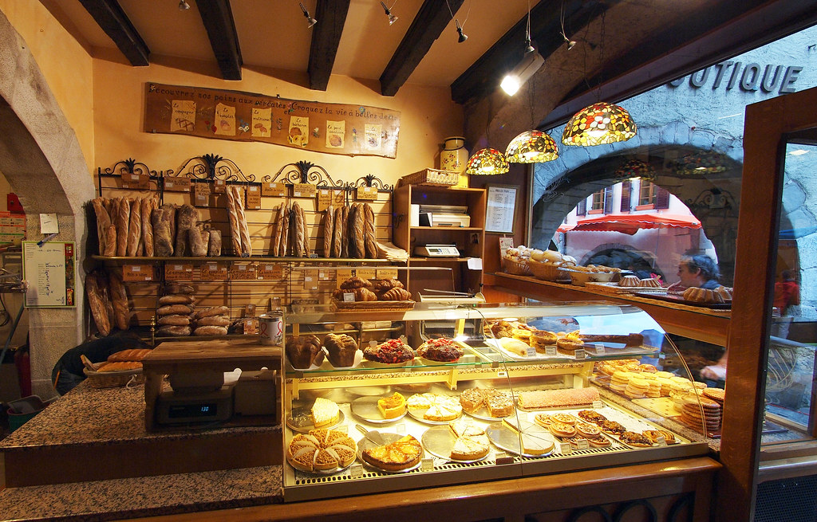
Basil’s Bakery: the context
Independent bakery
What it sells
What changed
Opened in Coventry in 2015.
Sales grew year on year before 2020
Bread, cakes and pastries made with high quality organic ingredients.
COVID reduced visits in 2020. Sales recovered partly, but did not return to 2019 levels.
=25%
Sales remained around 25% below the 2019 level during 2023-2025.
Source: Basil’s Bakery case study (LCLM4004, 2026).
Notes:
Basil’s Bakery is an independent bakery located in retail park in Coventry. It opened in 2015 and sells bread, cakes and pastries made with high quality organic ingredients. Before the COVID-19 pandemic, sales remained around 25% below the 2019 level. This shows that the problem has continued for several years, so it is important to understand the possible reasons behind it.

Slide 4
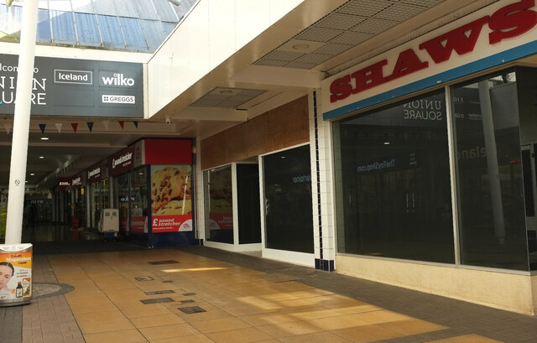
The main problem and what sits behind it
SALES STUCK BELOW 2019
External pressures
Customer experience
Cost pressures
Quiter retail park, vacant shops, some loyal customers losing jobs, and fewer office visits due to hybrid work.
Customers request delivery and pre orders. Busy periods create long waits; Basil cannot always answer the phone.
Rent, utilities, business rates and insurance are higher. Organic ingredient costs are unpredictable.
Control: Basil cannot control the wider economy or footfall, but can investigate internal processes and customer patterns
Sources: Basil’s Bakery case study (LCLM4004, 2026); Adair (2022).
Notes:
The main problem is that sales have remained below the 2019 level, and there are several possible explanations. Firstly, the retail park has become quitter, with some shops closing and some customers losing their jobs. Secondly, changes in working patterns mean that fewer office workers may visit the bakery regularly. There are also customer service challenges. Customers have asked about delivery and pre orders, but Basil needs to remain on site to bake and cannot always answer the phone during busy periods. Finally, the business is facing higher overheads and unpredictable organic ingredient costs. Basil cannot directly control the wider economy or the number of people visiting the retail park, but it can investigate its own processes, customer demand and sales information.

Slide 5

PESTEL: useful, but not a complete answer
What it does
Why it helps
Its limits
Scans six external areas: Political, Economic, Social, Technological, Environmental and Legal.
Gives Basil a structured way to consider forces beyond the bakery and identify questions to investigate.
It can be broad and subjective. It does not rank causes, measure their impact or prove that they caused falling sales.
For Basil, PESTEL helps explain the context but it cannot prove which factor caused the sales decline.
Sources: Brooks, Weatherston and Wilkinson (2011); Proctor (2019).
Notes:
PESTEL is a framework used to examine six areas of the external business environment: Political, Economic, Social, Technological, Environmental and Legal. One advantage is that it provides a structured way to identify external influences that might otherwise be overlooked. It can help Basil understand the wider environment in which the business operates. However, PESTEL also has limitations. It can become a simple checklist if the factors are listed without considering their importance. It can become a simple checklist if the factors are listed without considering their importance. It does not automatically show which factors have the greatest effect, and it cannot prove that a particular factor caused the decline in sales. Therefore, PESTEL isa useful for identifying issues to investigate, but its findings should be checked against evidence.

Slide 6
Applying PESTEL to Basil’s Bakery
P
Political
E
Economic
S
Social
No specific policy change is given in the case. Check whether local business support or rates relief applies.
Higher overheads and variable organic stock costs coincide with sales around 25% below 2019.
Hybrid work and job losses may reduce regular visits; customers still ask for delivery.
T
Technological
E
Environmental
L
Legal
Phone pre orders are hard to manage while baking. Test a simple online form or timed collection.
Organic crops are vulnerable to failure, making ingredient supply and prices less predictable.
If ordering/delivery changes, check food safety, allergen, consumer and data protection duties.
Political factor and proposed technology are questions to test, not established causes. Sources: Brooks et al. (2011); LCLM4004 (2026).
Notes:
Applying PESTEL helps us connect the framework to Basil’s situation.
Politically, business rate policies and local business support could be relevant, but the case does not identify a specific policy change as a cause. This would need further investigation. Economically, the case directly identifies higher costs for utilities, rent, business rates and insurance. Organic ingredient prices are also unpredictable, which creates additional pressure while sales remain below their 2019 level. Socially, some customers have lost jobs, and changes to office working patterns may mean fewer regular visits to the bakery. Technologically, Basil currently has difficulty managing phone pre orders while baking. A simple digital ordering process could be worth investigating, although it would need to be tested to see whether customers would use it. Environmentally, crop failures can affect the availability and price of organic ingredients. Legally, any changes to ordering or delivery would need to take account of food safety, allergen information and other relevant requirements. Overall, PESTEL identifies several areas worth investigating. However, these factors should not automatically be treated as proven causes of the sales decline.

Slide 7
Cause and Effect: organise causes, then test them
What it is
Benefits
Limitations
A cause and effect diagram groups possible causes of one clearly defined problem into categories.
It makes complex issues easier to discuss, exposes gaps in thinking and helps plan evidence gathering.
It can include assumptions, miss causes or oversimplify links. Each cause needs checking against evidence.
For Basil, the diagram should guide what to investigate next not be treated as evidence that every branch is true
Sources: Sproull (2018); Proctor (2019).
Notes:
The second tool is the Fishbone Diagram, also known as an Ishikawa or cause and effect diagram. It is used to organise possible causes of a clearly defined problem into categories. Itsa main advantage is that it helps break down a complicated problem into smaller areas that are easier to discuss and investigate. It can also highlight gaps in our understanding. However, the diagram has limitations because it only organises possible explanations; it does not prove them. It can also make every cause appear equally important, even when some may have much greater effect than others. For this reason, the possible causes need to be tested using evidence.

Slide 8
Fishbone analysis: possible causes of stagnant sales
ENVIROMENT
MATERIALS
PEOPLE
Quieter retail park
Vacant units; hybrid work
Organic crop failures
Unpredictable stock costs
Loyal customers lost jobs
Fewer routine visits
Sales remain below 2019
SALES -25% BELOW 2019
METHODS
MACHINES / TECH
MEASUREMENT
No delivery service
Phone pre orders unreliable
No data shown for lost orders, footfall, margins or best sellers
No ordering system described;
Basil must stay onsite baking
Important: these are plausible contributing factors from the case; their relative impact still needs to be measured.
Sources: Basil’s Bakery case study (LCLM4004, 2026); Sproull (2018).
Notes:
In this diagram, the main problem is that sales remain below the 2019 level. I have organised the possible causes into six categories. Environment includes the quitter retail park, vacant units and potentially lower footfall. Materials includes the vulnerability of organic crops to failure and the resulting uncertainty around ingredient availability and costs. People includes changes in customers working patterns and the loss of some loyal customers jobs. Methods includes long queues during busy periods and the difficulty of managing phone orders while baking. Machines and technology highlights that case does not describe an effective online ordering system, which may be an area to explore. Finally, Measurement is important because Basil needs reliable information about sales by product and day, customer footfall, waiting times, order requests and costs. These branches represent possible contributing factors based on the case, rather than confirmed causes. The next step would be to collect information and compare the factors to understand which ones most closely linked to the decline in sales.

Slide 9
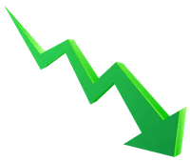
Key findings
1
The problem is multi causal
External footfall, customer routines and services bottlenecks may all contribute.
2
Costs are squeezing the business
Lower sales plus higher overheads and uncertain ingredient prices may squeeze margins.
3
Convenience is a visible friction point
A low cost pre order / collection trial could test demand before a delivery commitment.
4
Evidence is the next priority
Track footfall, missed orders, product sales, waste and margins before deciding.
Sources: Adair (2022); Sproull (2018); case analysis based on LCLM4004 (2026).
Notes:
There are four main findings from this analysis. First, the sales problem appears to have several possible causes rather than one single explanation. External changes, customer behaviour and internal service limitations may all be relevant. Second, higher overheads and unpredictable ingredient costs are putting pressure on the business. Third, customer requests for delivery and pre orders suggest that convenience is worth investigating. Finally, evidence is needed before Basil chooses a solution. Sales records, customer feedback, footfall information, waiting times and cost data could help the business identify its priorities. Overall, PESTEL helps explain the external context, while the Fishbone Diagram organises the possible causes that should be investigated further.

Slide 10
References
Adair, J. (2022) Decision Making and Problem Solving: Break Through the Barriers and Banish Uncertainty at Work. 5th edn.
Brooks, I., Weatherston, J. and Wilkinson, G. (2011) The International Business Environment: Challenges and Changes. 2nd edn.
Harlow: Pearson Education.
Proctor, T. (2019) Creative Problem Solving for Managers: Developing Skills for Decision Making and Innovation.5th edn.
Abingdon: Routledge.
Sproull, R. (2018) The Problem Solving, Problem Prevention, and Decision Making Guide: Organised and Systematic Roadmaps for Managers. Boca Raton, FL: CRC Press.
Solving Problems and Making Decisions (2007) 5th edn. Amsterdam: Pergamon Flexible Learning.
LCLM4004 (2026) Component 1 Assessment Specification: Basil’s Bakery case study. Module assessment brief.
Notes:
This slide contains the academic and supporting sources used to inform the presentation. These sources support the problem solving frameworks and the analysis of Basil’s Bakery.

Slide 11
Thank you
Notes:
Thank you for listening to my presentation. To conclude, Basil’s Bakery needs to understand the reasons behind its continued sales decline before deciding what changes to make. I am now happy to answer any questions.

