Slide 1

BMP6
Digital and Operational Policing
Workshop: Recap and Revise

Slide 2

EXAM DETAILS
Date: Monday 8th January 2024
Time: 09:00hrs start (2hrs)
Location: Waterfront, IQ Campus, University of Wales Trinity, Swansea SA1 8EW
Policing Prejoin Students Room: IQ301
Extra time

Slide 3

Revision Session
Monday 4th December 2023

Slide 4


Slide 5
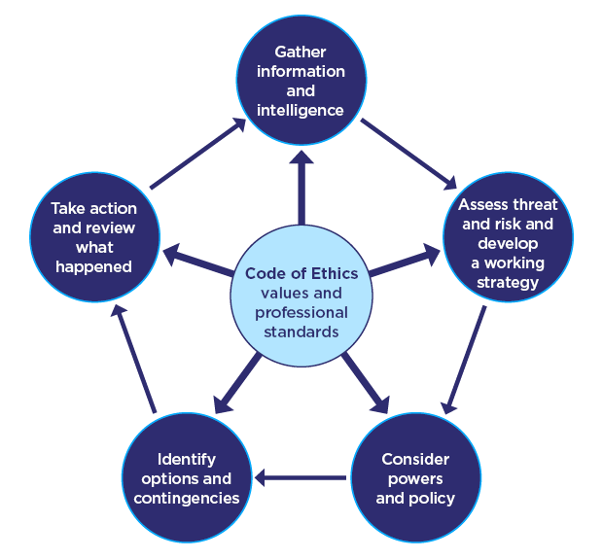

Slide 6
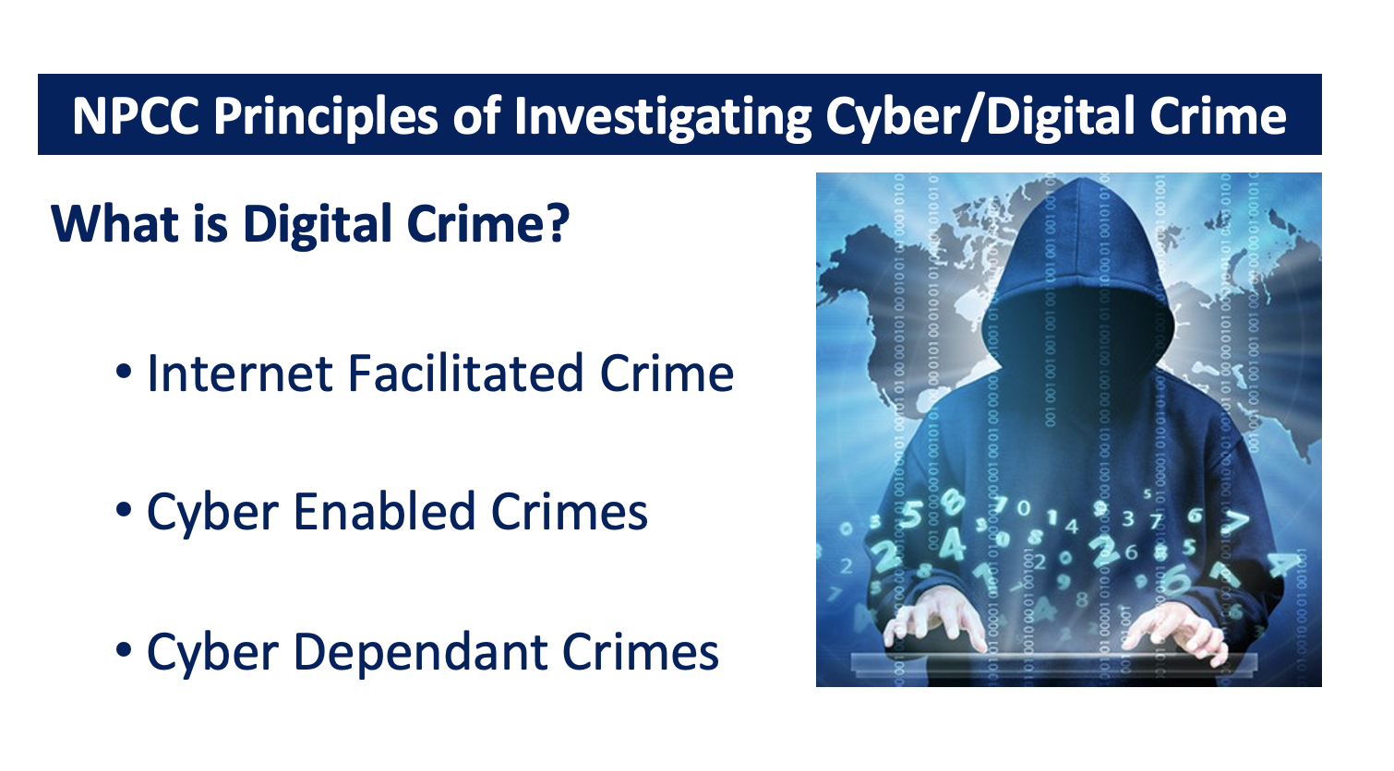
Task: Research each of these – what’s the difference?

Slide 7
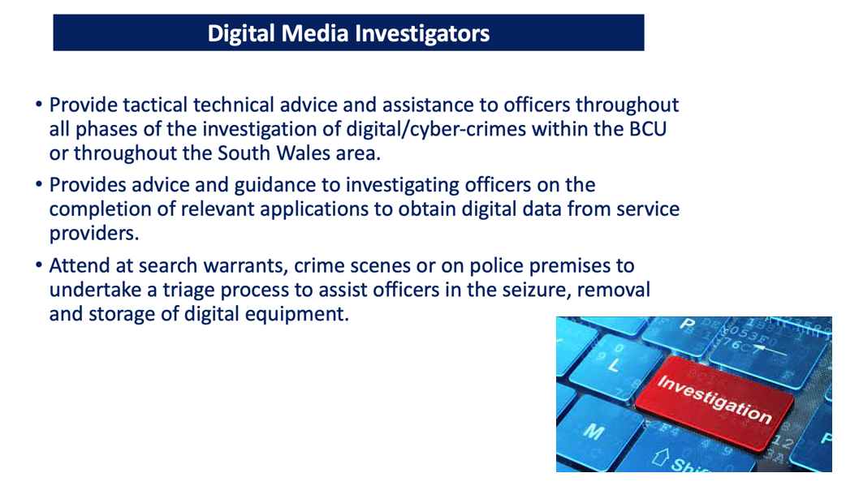

Slide 8
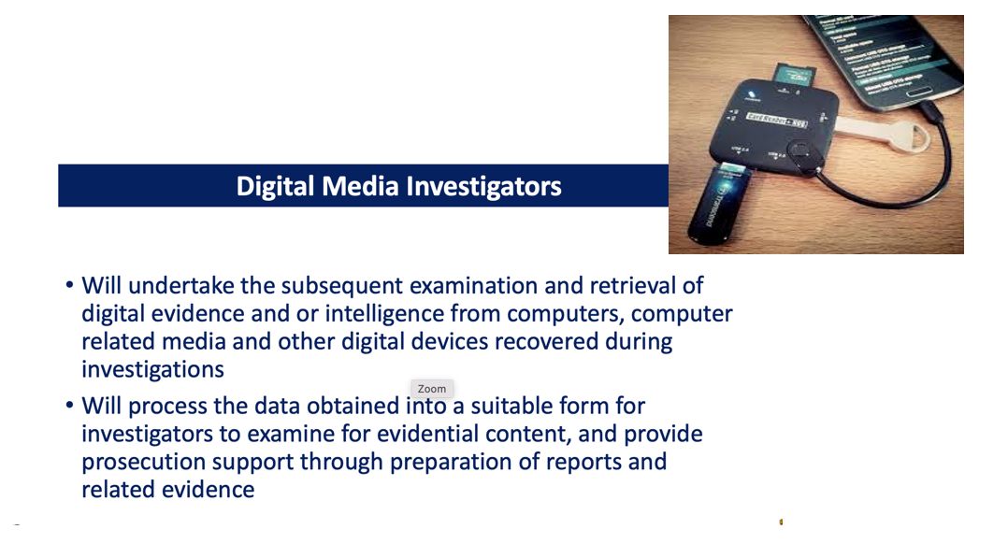

Slide 9
APC Approach - Arriving at the scene
APC
Assess
Protect
Communicate

Slide 10
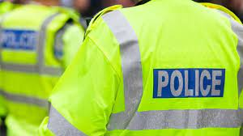

Methods of Investigation
There are two methods of criminal investigation:
Reactive
This starts with the discovery of a crime & seeks to bring offenders to justice by uncovering material that identifies suspects & provides sufficient evidence to enable a court to determine their guilt
Proactive
This usually starts with an intelligence analysis that a particular individual or group is involved in criminal enterprise

Slide 11
Definition of ‘Domestic Abuse’
Behaviour of person A towards another person B is domestic abuse if -
A & B are each aged 16 or over & are personally connected to each other, & the behavior is abusive
Behaviour is ‘abusive’ if it consists of any of the following – physical or sexual abuse, violent or threatening behavior; controlling or coercive behavior; economic abuse, psychological, emotional or other abuse;
And it does not matter whether the behavior consists of a single incident or a course of conduct
Notes:
Controlling behaviour is: a range of acts designed to make a person subordinate and/or dependent by isolating them from sources of support, exploiting their resources and capacities for personal gain, depriving them of the means needed for independence, resistance and escape and regulating their everyday behaviour.
Coercive behaviour is: an act or pattern of acts of assault, threats, humiliation and intimidation or other abuse that is used to harm, punish, or frighten their victim

Slide 12

DASH Model
Domestic Abuse, Stalking, Harassment
(including Honour-Based Abuse)
Risk identification, Assessment and Management

Slide 13
The DASH model seeks to……
Help front line practitioners & specialist staff identify high risk DA, stalking & harassment & HBV
Help staff to identify dangerous & serial perpetrators
Decide which cases should be referred to MARAC, & what other support might be required. A completed form becomes an active record
A common tool for agencies that are part of MARAC process & provides a shared understanding of risk in relation to DASH & HBA
Enable agencies to make defensible decisions based on the evidence from extensive research of cases, including domestic homicides & ‘near misses’ which underpins most models of RA

Slide 14
Risk Levels of DA
STANDARD
Current evidence does not indicate likelihood of causing serious harm
MEDIUM
There are identifiable indicators of risk of serious harm. Offender has potential to cause serious harm but unlikely unless there is a change of circumstances
HIGH
There are identifiable indicators of risk of serious harm, which could happen at anytime.

Slide 15

A PPN form must be submitted in every Domestic Abuse and Stalking and Harassment incident
The PPN is used to update partner agencies and share information they may be aware of in order for them to provide further assistance to the victims and other vulnerable persons

Slide 16

PPN
The PPN lists 29 questions which are used to identify, assess & manage risk in relation to DA
All 29 questions must be asked for every DASH incident
All decisions & actions must be reviewed, recorded & updated
The risk identification process remains dynamic & must be kept under review

Slide 17

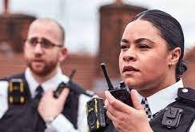
There are 18 Specific
HIGH RISK questions
However, there is the need to use professional judgement
- a person who engages in an activity with competence and skill and being able to make an informed decision based on a balanced viewpoint.
Notes:
Such situations may include:
• There are extreme levels of fear.
• Cultural barriers to disclosure such as in cases of ‘honour based violence’ and female genital mutilation.
• Extreme levels of control and/or isolation.
• Obsessive stalking behaviour.
• Where the perpetrator is abusing more than one partner.
• Fear of loss of financial support, or losing children, house etc.
• Remind the delegates that if they are not so experienced – and therefore not so confident with their professional judgement, they should speak to a supervisor or someone more experienced in this area - a specialist/domestic abuse officer, for example.
• Using the sum total of your knowledge, experience and skill, you have concerns about this person’s risks and the risk of serious harm is high. A question the delegates should ask themselves here would be “What do I feel that I cannot walk away from?”

Slide 18
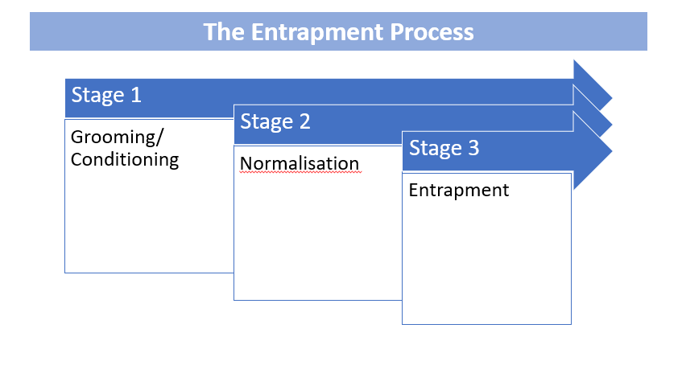

Slide 19
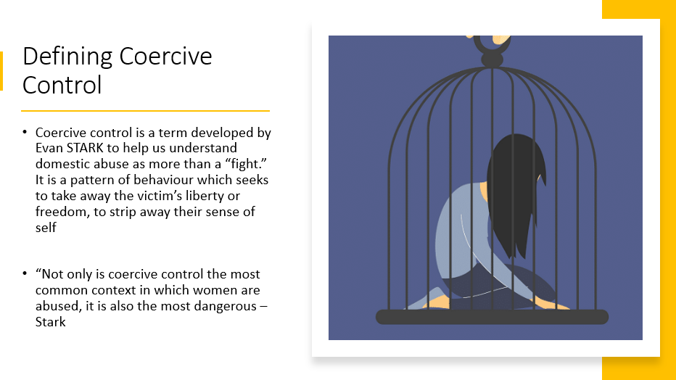

Slide 20
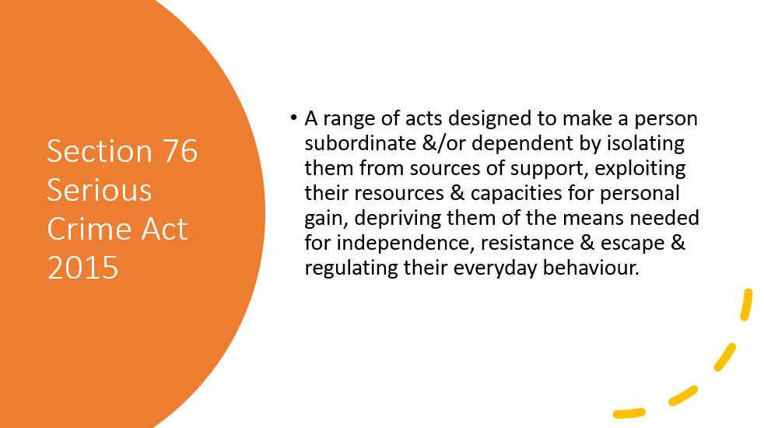

Slide 21
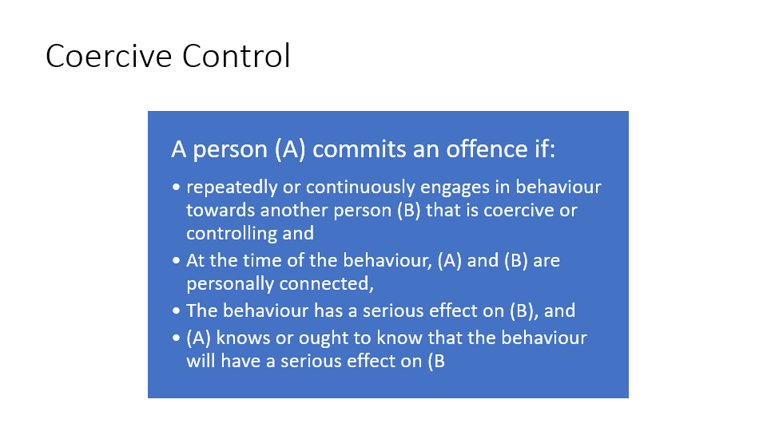

Slide 22
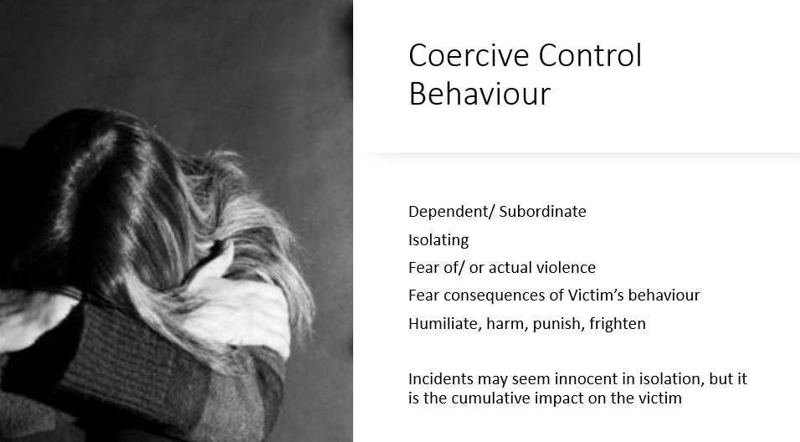

Slide 23
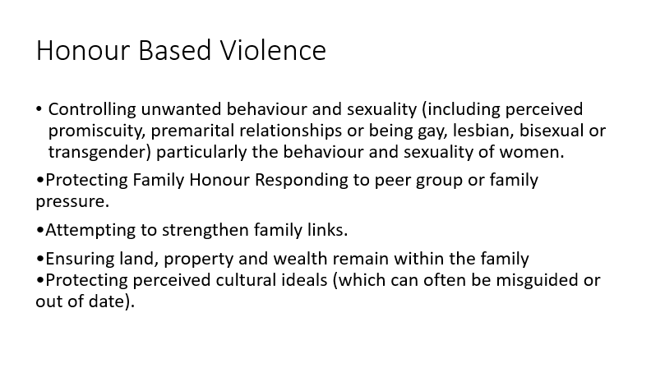

Slide 24
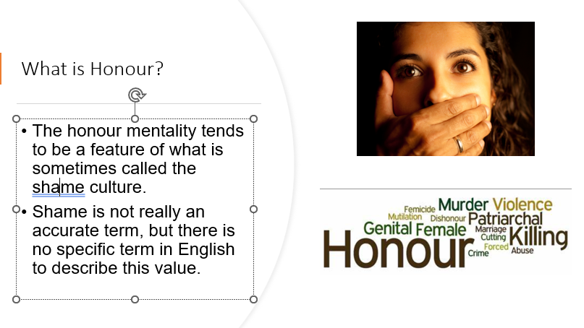

Slide 25
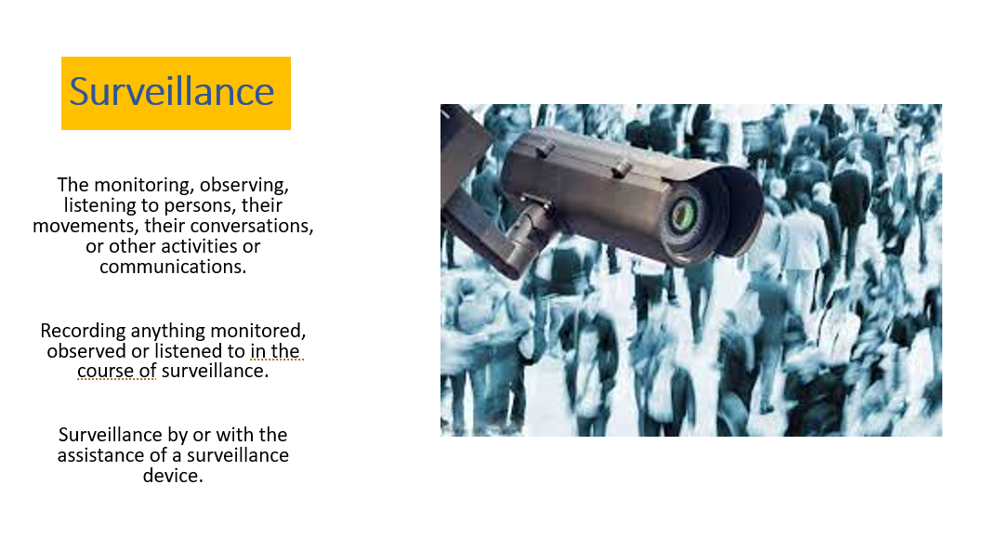

Slide 26
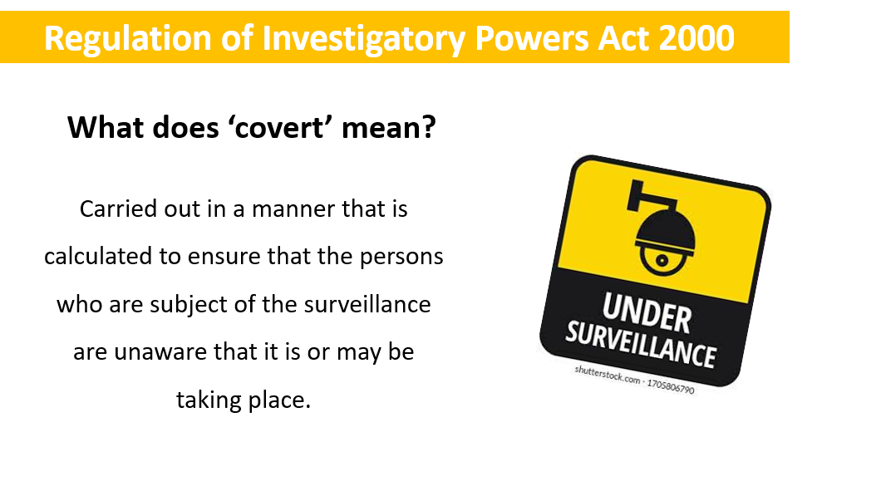

Slide 27
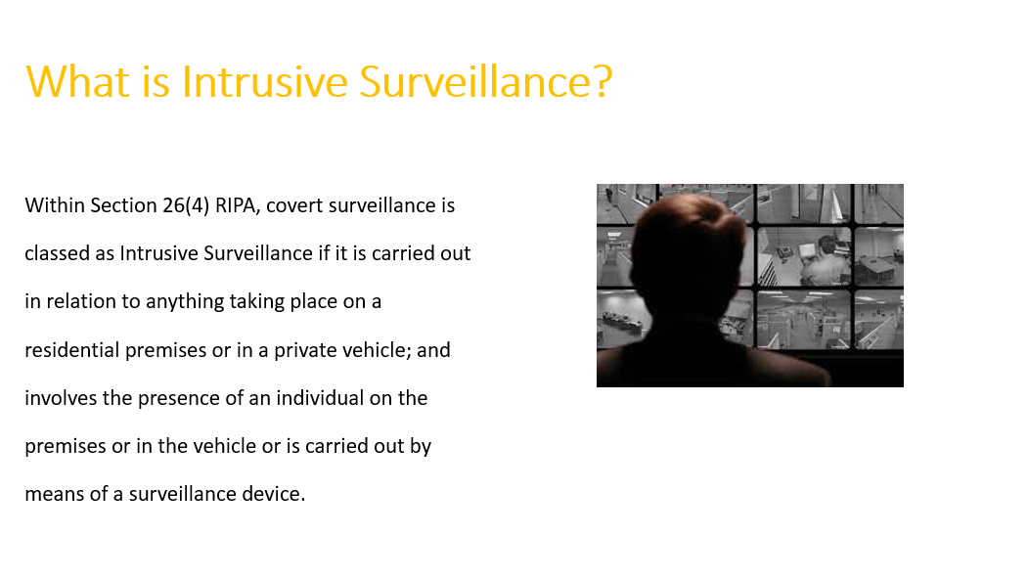

Slide 28
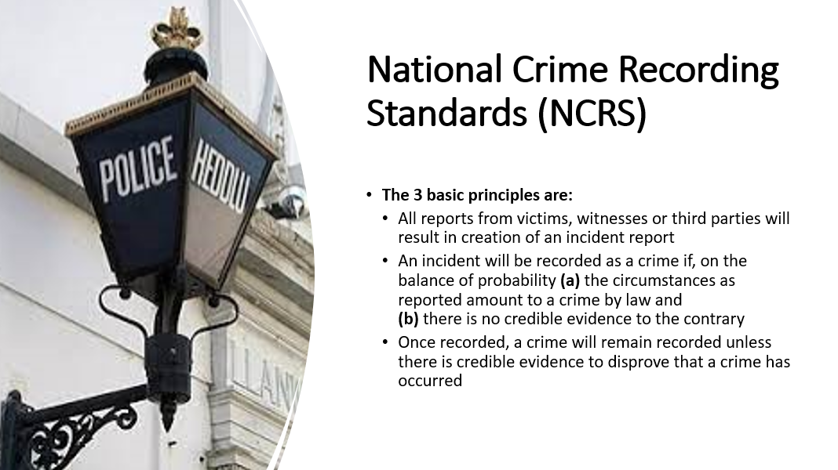

Slide 29
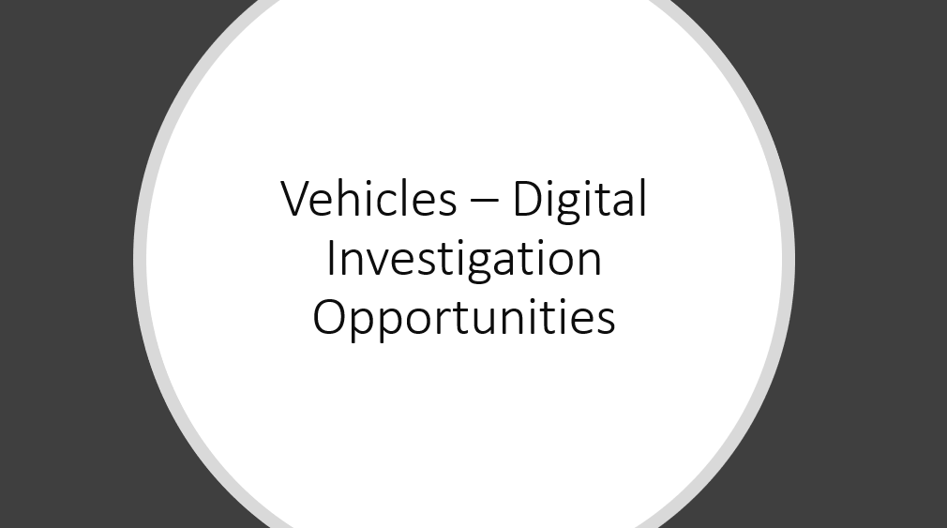
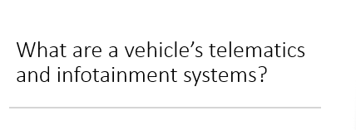

Slide 30
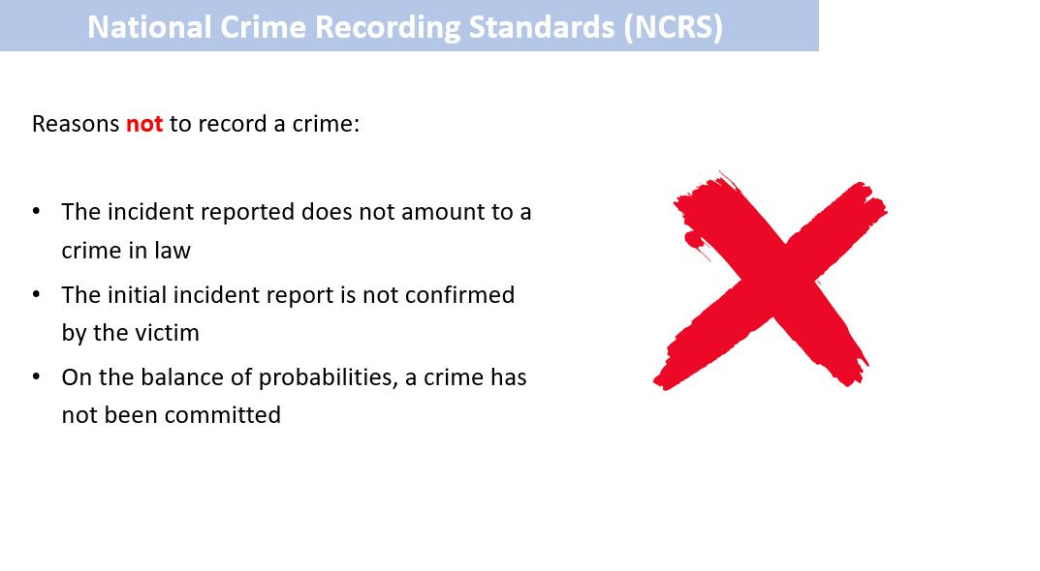

Slide 31
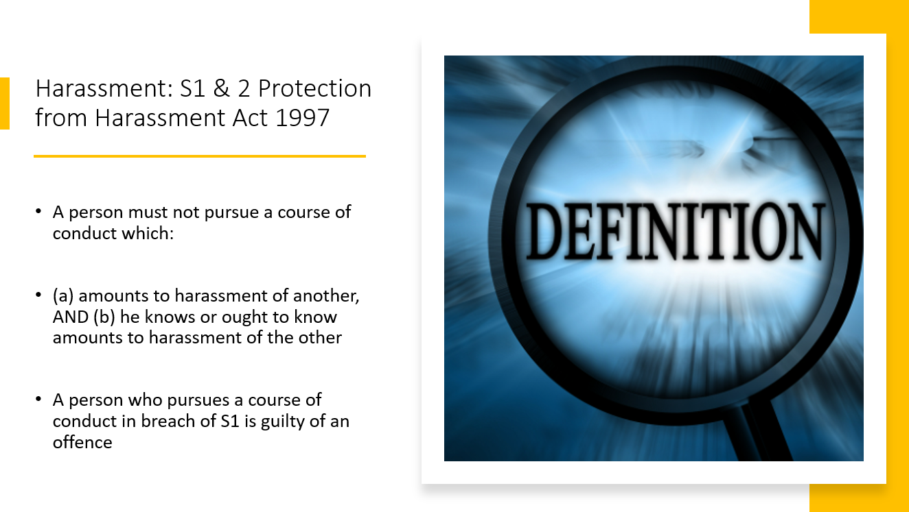

Slide 32
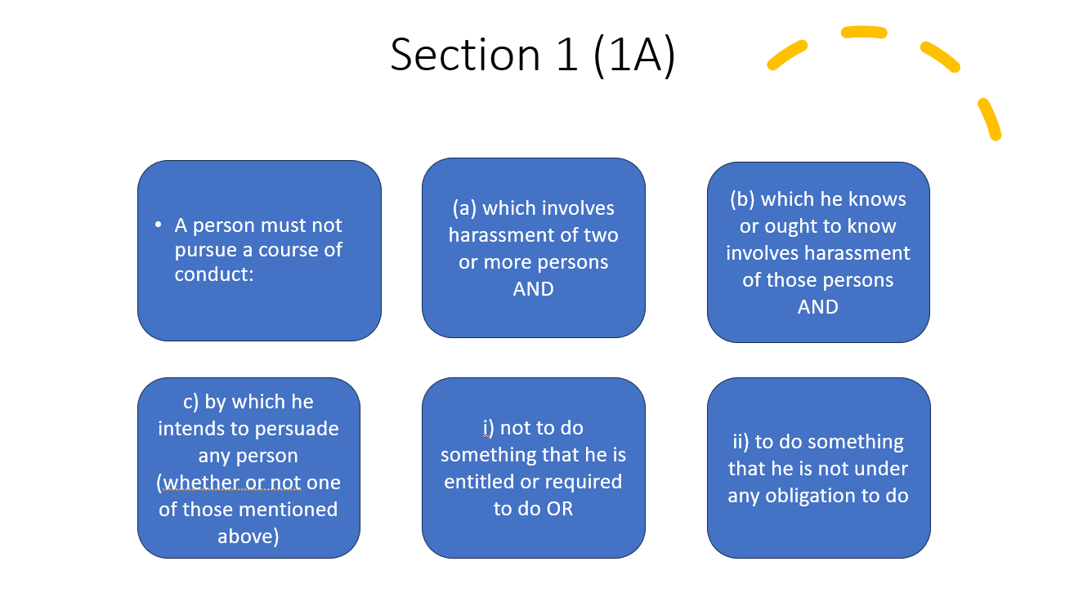

Slide 33
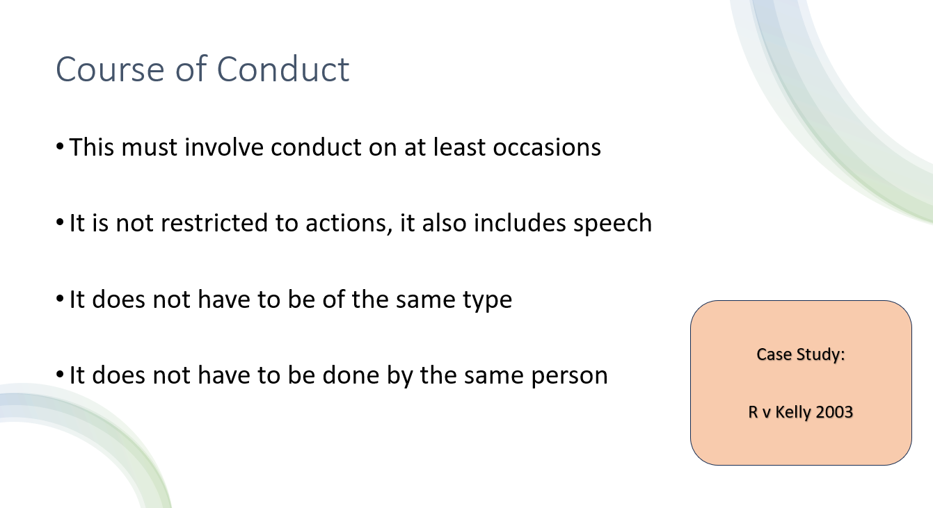

Slide 34
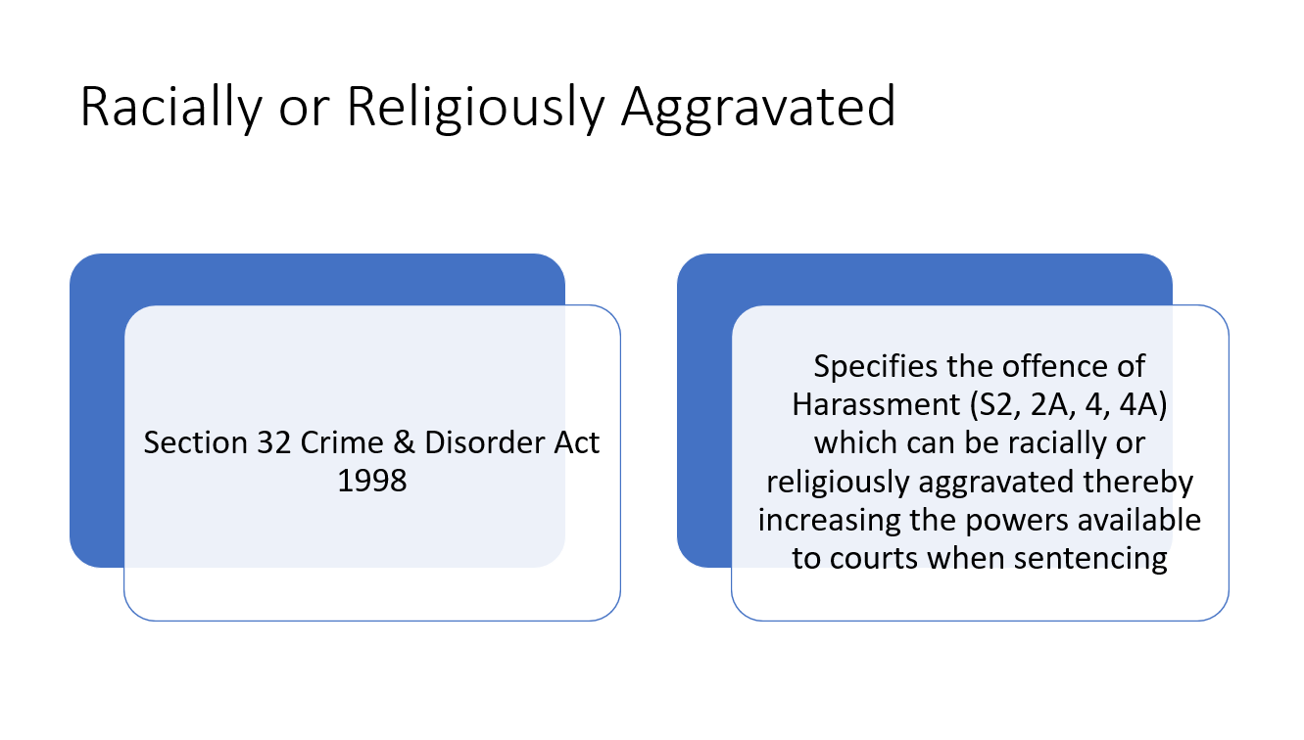

Slide 35
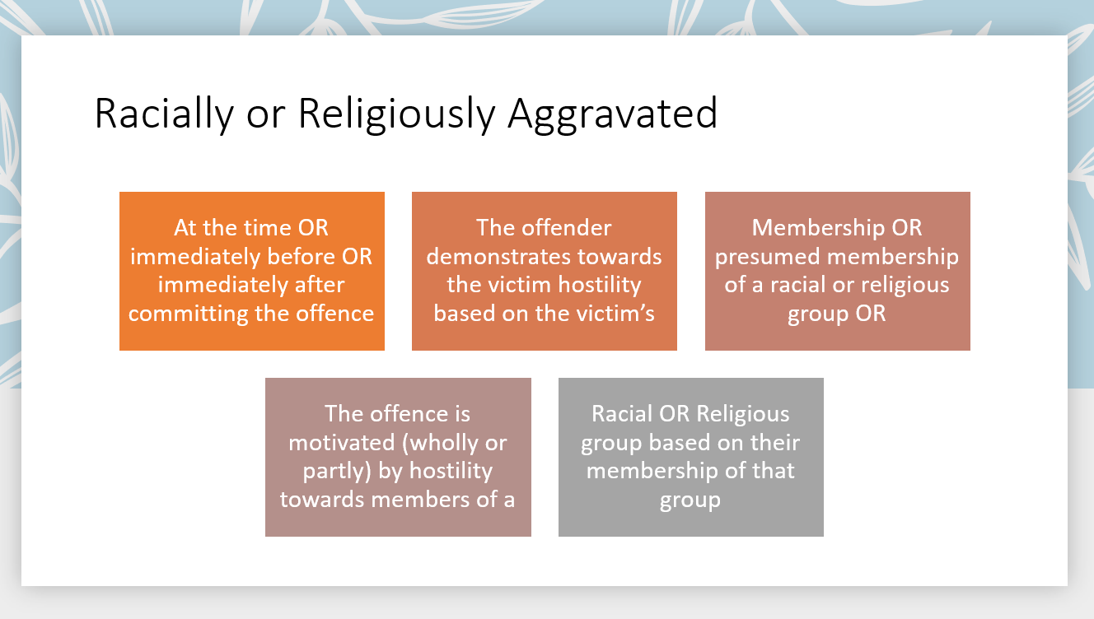

Slide 36
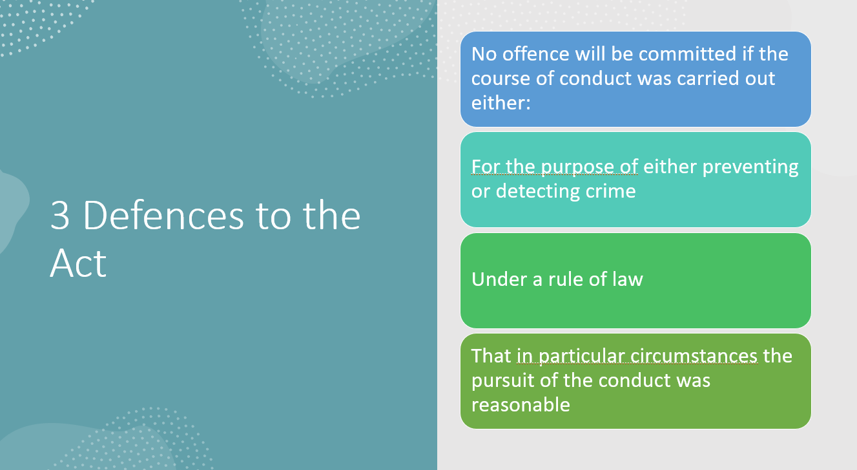

Slide 37
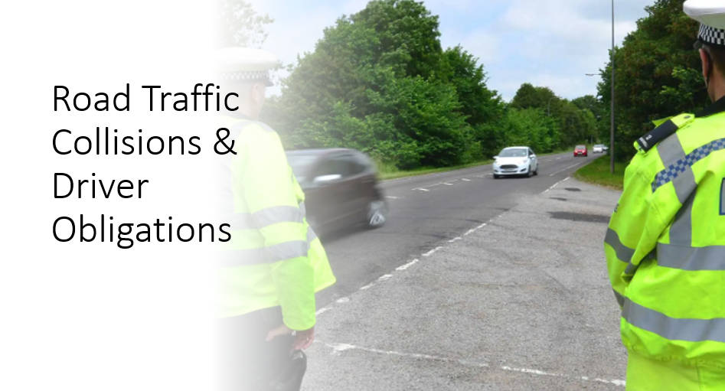

Slide 38
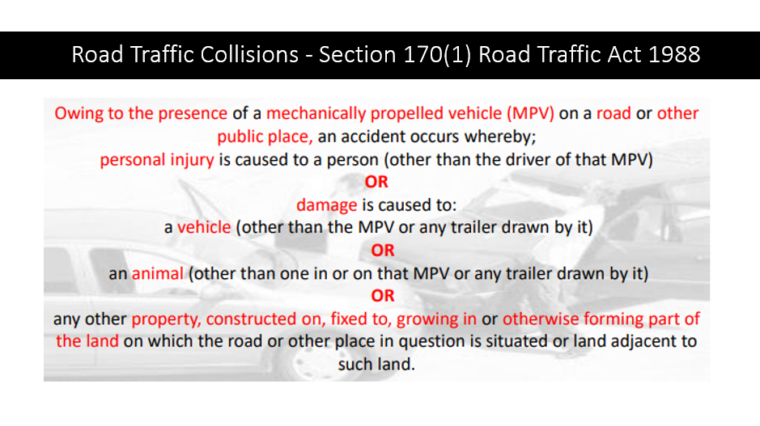

Slide 39
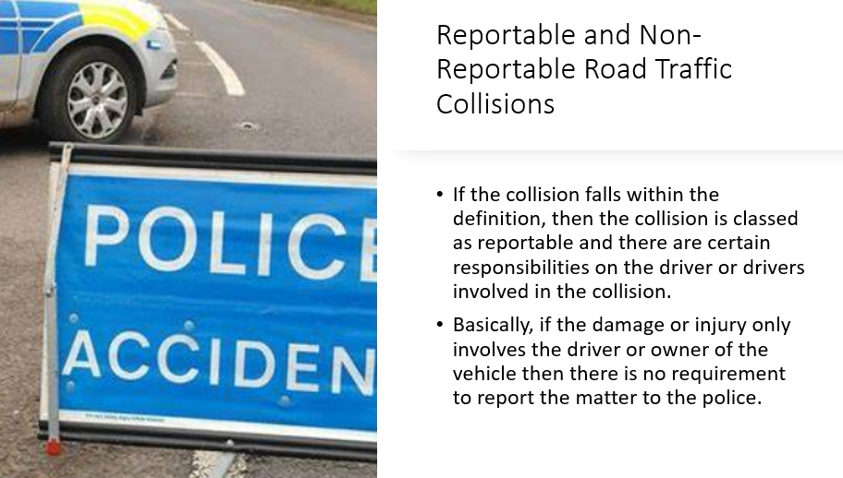

Slide 40
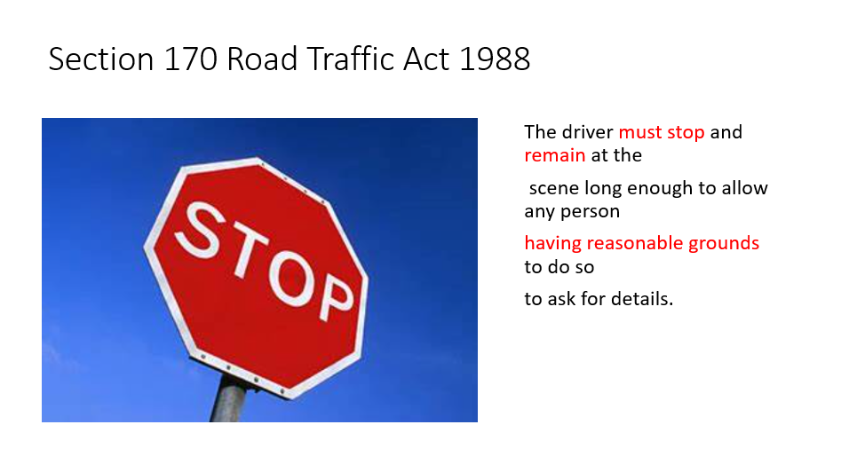

Slide 41
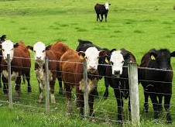
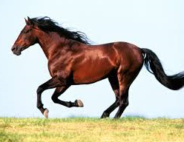
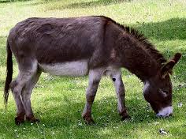
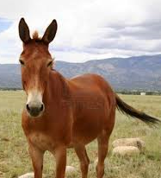
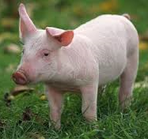
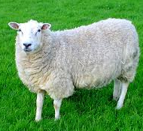
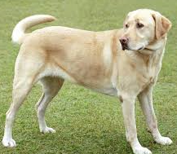
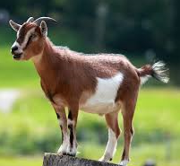
Damage is caused to an animal other than one in or on the MPV or trailer
Cattle
Horse
Ass
Mule
Pig
Sheep
Dog
Goat
Notes:
This is because animals are, in most cases, considered to be property.
The list of animals under Sec 170(8) does not include one of the most common ‘victims’ of road traffic collisions, cats.
This is because the animals listed are seen as of some financial/economic value.

Slide 42
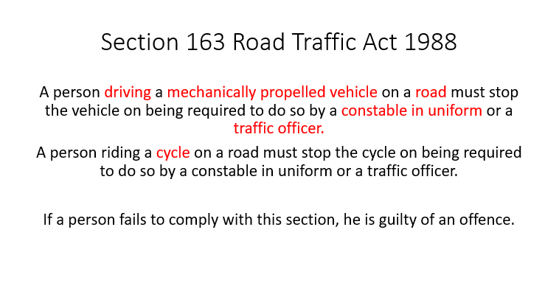

Slide 43
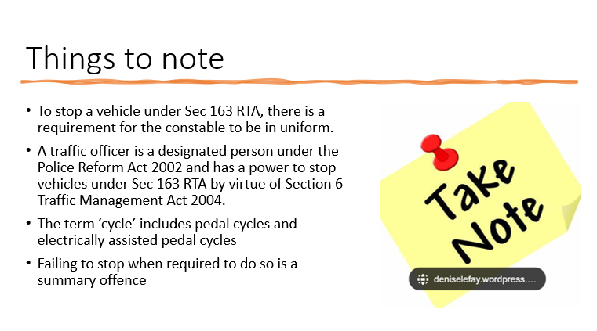

Slide 44

Upsetting Discussions Next

Slide 45
Consent – S74 SOA 2003
“ …a person consents if he/she agrees by choice, and has the freedom and capacity to make that choice”

Slide 46
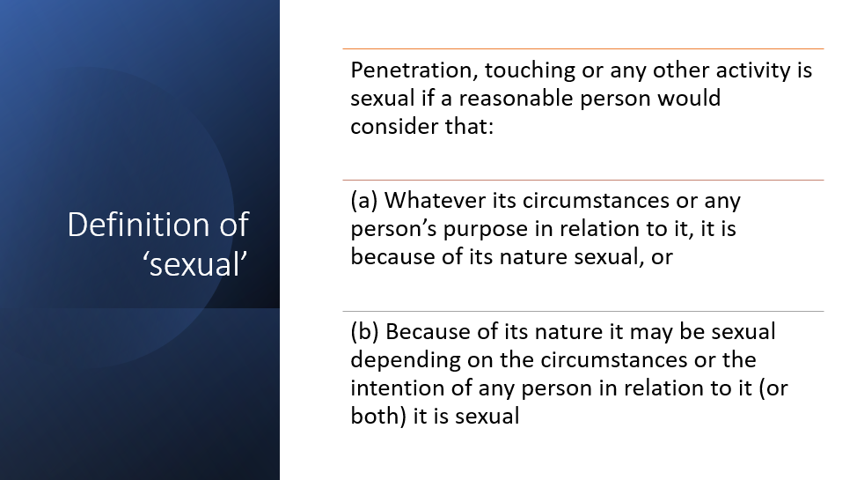

Slide 47
S1 Rape
S2 Sexual Assault by Penetration
S3 Sexual Assault by Touching
S4 Causing sexual activity without consent
Establishing the Absence of Consent
Dealing with offences of:-
There are two forms of statutory presumptions that can be utilised to assist with determining whether consent was absent or not:
Evidential Presumptions
Conclusive Presumptions
Notes:
Statutory Presumption – A presumption of a particular fact can be made without the aid of proof in some situations. The burden of proof can shift from one party to the opposing party in court trial.
Two statutory presumptions exist:
Evidential – can be argued by the defence
Conclusive – Conclusive fact

Slide 48


