Slide 1

Welcome
Founder of Hilton Hotel
Conrad Hilton
Entrepreneurial
characteristics and motivation
BA International Hotel Management
Entrepreneurship
M5XO1926
Lecturer: Dr David Jenkins
Created by: Stilyana Mincheva
1816276

Slide 2

Preamble
Entrepreneurial motivation is influence by the gap in services as well as a vision to bring positive changes in the world.
Conrad Hilton is a man who creates a new vision of running hotel business.
The failure of Hilton in the hospitality industry influenced him to take a second chance and achieve the desired targets.
Different segmentation of pricing helped him to understand the desire and the needs of the customers.
He implemented the different pricing tactics considering the background of the customers.
Incorporation of new features helped him in providing significant customer experiences in the global market.

Slide 3
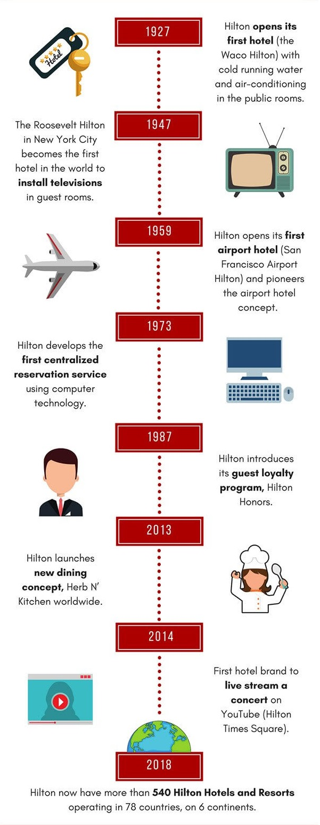
Start up
Conrad Hilton buys The Mobley Hotel in Cisco, Texas in 1919.
To eliminate future queues, he improved the hotel by equipping it with more rooms.
He sees an opportunity to earn more from the guests by offering them additional products and services for entertainment.
Conrad placed small windows in the lobby, where he sold various goods for everyday use (toothbrushes, toothpaste, razors, newspapers, magazines).

Slide 4
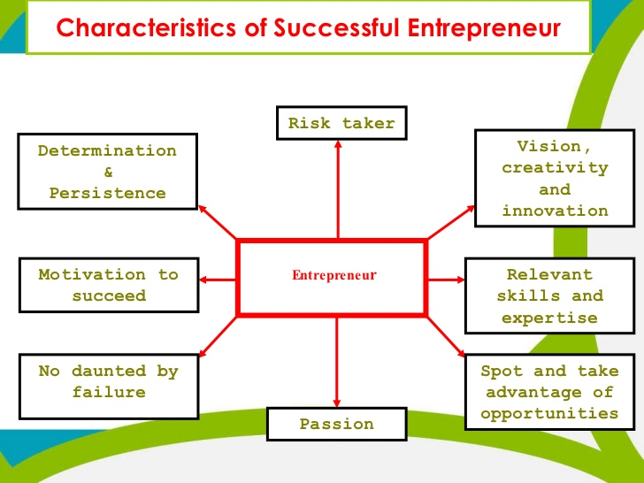

Slide 5
10 Rules For Success, from Conrad Hilton
Find
Discover your talent and be extremely good at it.
Be
Think big and grow as big as you can..
Live
Don't forget to laugh and live with enthusiasm.
Don’t let
Don't let things belong to you.
Assume
Take full responsibility in the world and work for every dollar.
Don’t worry about
Don’t worry about your problems.
Be
Be honest.
Look up
Watch people when you can, but don't bow your head. Look for mentors. Do not look down on your employees from a lower level with a descent.
Don’t cling
Always move forward to the future and do not cling to the past
Pray
Pray consistently and confidently.

Slide 6

Uniqueness
No one has ever placed small windows in a hotel lobby like those in Hilton Hotels.
No one has ever equipped their rooms with automatic doors, air conditioning, direct dial telephones and an alarm clock.
Hilton sees an opportunity in building its near airports and seaports, thus offering passengers special packages.
Create a unique reward system for guests called Hilton Honors.
Conrad Hilton applies the hotel rating system to this business.
He managed to combine hotels with restaurants and casinos.

Slide 7
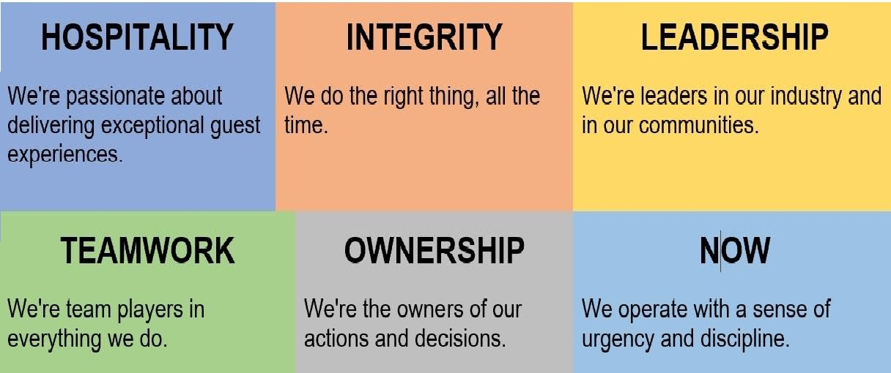
Implication

Slide 8
References
Anon, A Brief History of Hilton Hotels. Available at: https://www.torontosom.ca/blog/a-brief-history-of-hilton-hotels [Accessed June 18, 2020].
Anon, (2016). 10 Rules For Success, From The Man Who Founded Hilton Hotels. Yahoo! Finance. Available at: https://finance.yahoo.com/news/10-rules-success-man-founded-193923410.html?
The History of Hilton Hotels Corporation. [Internet]. 2020. Astrum People website. Available from: https://astrumpeople.com/conrad-hilton-biography-the-history-of-hilton-hotels-corporation/. [Accessed 18 Jun 2020].
yumpu.com.( 2020). THE LUXURY OF BEING YOURSELF - Hilton. [ONLINE] Available at: https://www.yumpu.com/en/document/read/37160005/the-luxury-of-being-yourself-hilton. [Accessed 18 June 2020].
Blackwell, E. (2011). How to Prepare a Business Plan: Create Your Strategy; Forecast Your Finances; Produce That Persuasive Plan. Kogan Page Publishers. London, UK.
blog.ehl.edu (2020) Hospitality: An industry of entrepreneurs Available at https://blog.ehl.edu/hospitality-an-industry-of-entrepreneurs [accessed on 27/05/2020]

Slide 9



