Slide 1
Chapter 6
Perception and communication

Slide 2
Perception
The process of perception is at the root of our understanding, behaviour and actions. Managers need to understand the importance of perception and communications in guiding behaviour and for effective personal and work relationships with others.

Slide 3
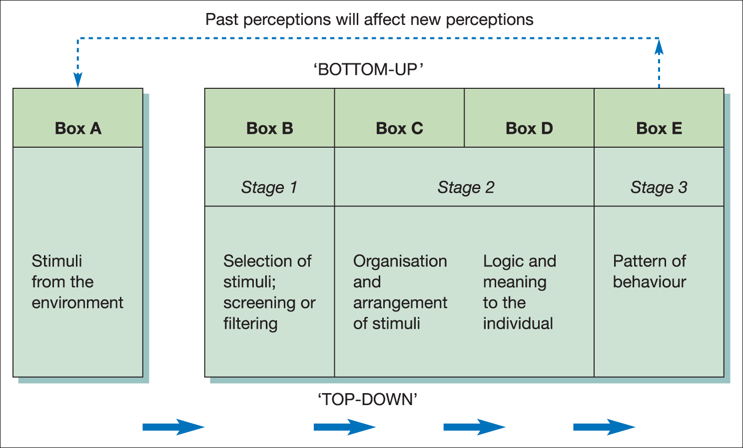
The perceptual process
Figure 6.1 Perceptions as information processing

Slide 4
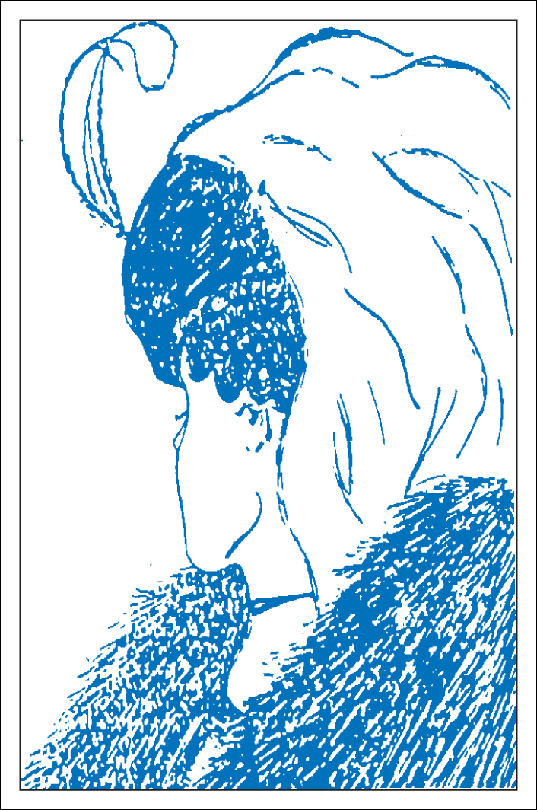
Perceived reality: what do you see?
Figure 6.2

Slide 5
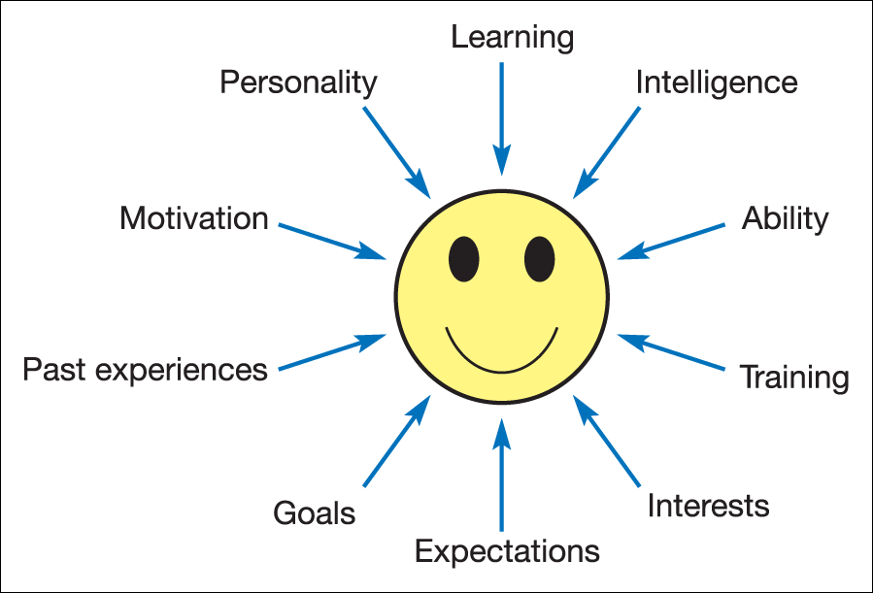
Factors affecting an individual’s perceptual set
Figure 6.3 Factors affecting an individual’s perceptual set

Slide 6
Cultural differences
The ways in which people interact are subject to cultural differences and these can be misconstrued.
The ways in which words are used and assumptions made about shared understanding are dependent on a person’s culture and upbringing.

Slide 7
The organisation and arrangement of stimuli
The Gestalt school claimed that:
  the process of perception is innately organised and patterned;
  the human brain acts like a dynamic, physical field in which interaction among elements is an intrinsic part.
They identified three important principles of perception:
  Figure and ground
  Grouping
  Closure

Slide 8
The Gestalt School: principles
Figure and ground
  Figures are seen against a background.
  What is significant (figure) and what less so (ground)?
Grouping
  A tendency to organise patterns and shapes instantly into meaningful grouping of patterns on the basis of their proximity or similarity.
  What assumptions might result about groups of individuals?
Closure
  The tendency to complete an incomplete picture, to mentally fill in the gaps and perceive a figure as a whole.
  What assumptions are being made about the environment?

Slide 9

The Gestalt School: figure and ground
Figure 6.5

Slide 10
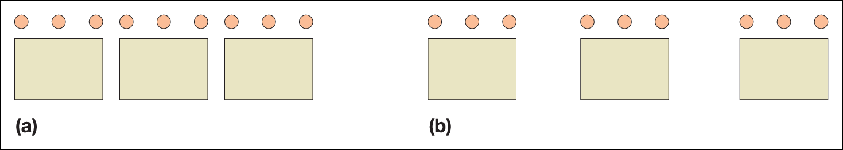
The Gestalt School: grouping
Figure 6.6

Slide 11

The Gestalt School: closure
Figure 6.7
Source: King, R. A. Introduction to Psychology, 6th edition, McGraw-Hill (1966). Figure 10.22, p.339. Reproduced with permission from the author, Professor Richard King.

Slide 12
Perceptual illusions
Our brains can be fooled.
People make assumptions about things that go beyond the pure sensations our brain receives.

Slide 13
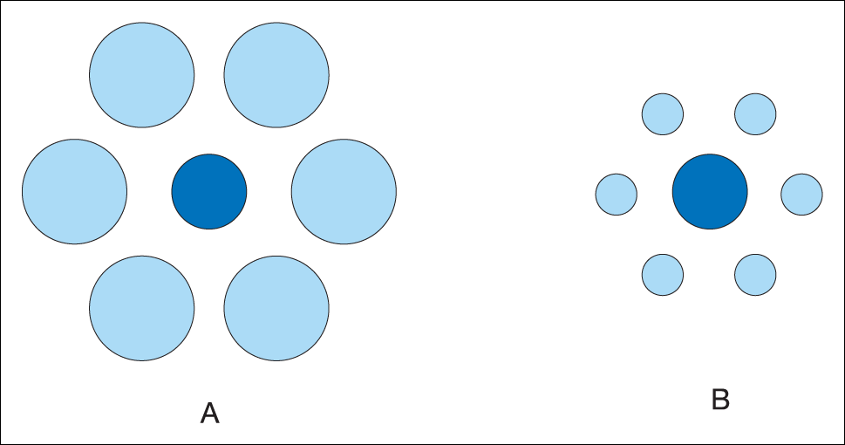
Perceptual illusion 1
Figure 6.9

Slide 14
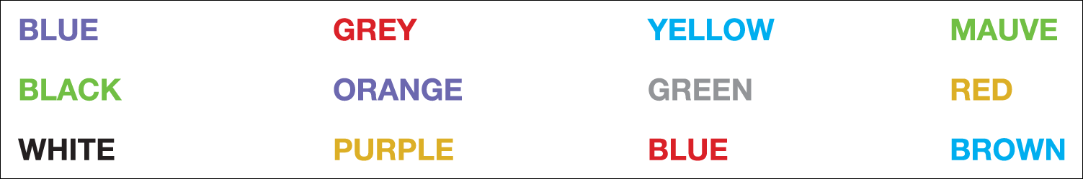
Perceptual illusion 2
Figure 6.10

Slide 15
Impression management
Verbal signals: what is said
Non-verbal signals including:
  Bodily contact
  Proximity
  Orientation
  Head movements
  Facial expressions
  Gestures
  Posture
  Direction of gaze
  Dress and appearance
  Non-verbal aspects of speech

Slide 16
Organisation and judgement
Our judgement of other people can be influenced by our previous experience, inferences and assumptions.
It can also be influenced by perception of stimuli such as:
  Role or status
  Occupation
  Ethnicity, gender and age
  Physical factors and appearance
  Non-verbal communication and body language

Slide 17
Perceiving other people
The process of perception and the selection of stimuli can influence a manager’s relationships with other staff. For example:
Grouping – the way in which a manager may think
of a group of staff.
Figure and ground – a manager may notice a new recruit and set that person apart from the rest because of particular characteristics such as appearance.
Closure – the degree to which unanimity is perceived.

Slide 18
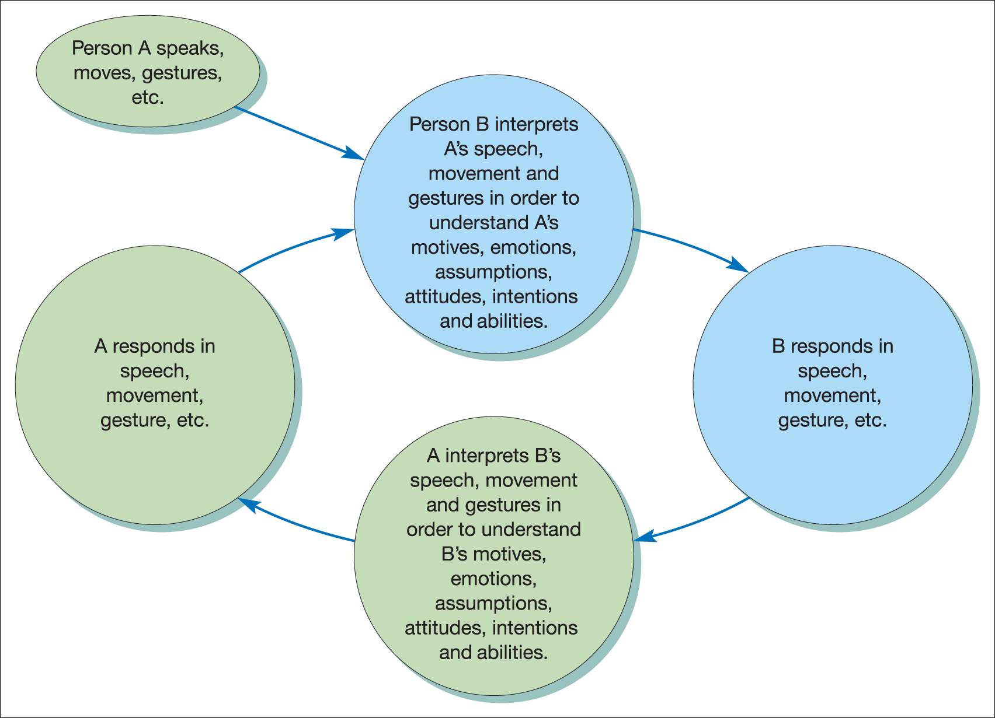
Cycle of perception and behaviour
Figure 6.12 Cycle of perception and behaviour
Source: From Guirdham, M. Interactive Behaviour at Work, third edition, Financial Times Prentice Hall (2002), p. 162. Reproduced with permission from Pearson Education Ltd.

Slide 19
The importance of language
Language:
labels and distinguishes our environment;
structures and guides our thinking patterns;
is part of the culture we experience and learn to take for granted;
influences our relationships with others and with the environment;
reflects our cultural background.

Slide 20
Non-verbal communication and body language
The message in face-to-face communication can be received from stimuli other than words.
Mehrabian considers that messages can be received
  7 per cent from words;
  38 per cent from tone of voice; and
  55 per cent from body language and facial expression.

Slide 21
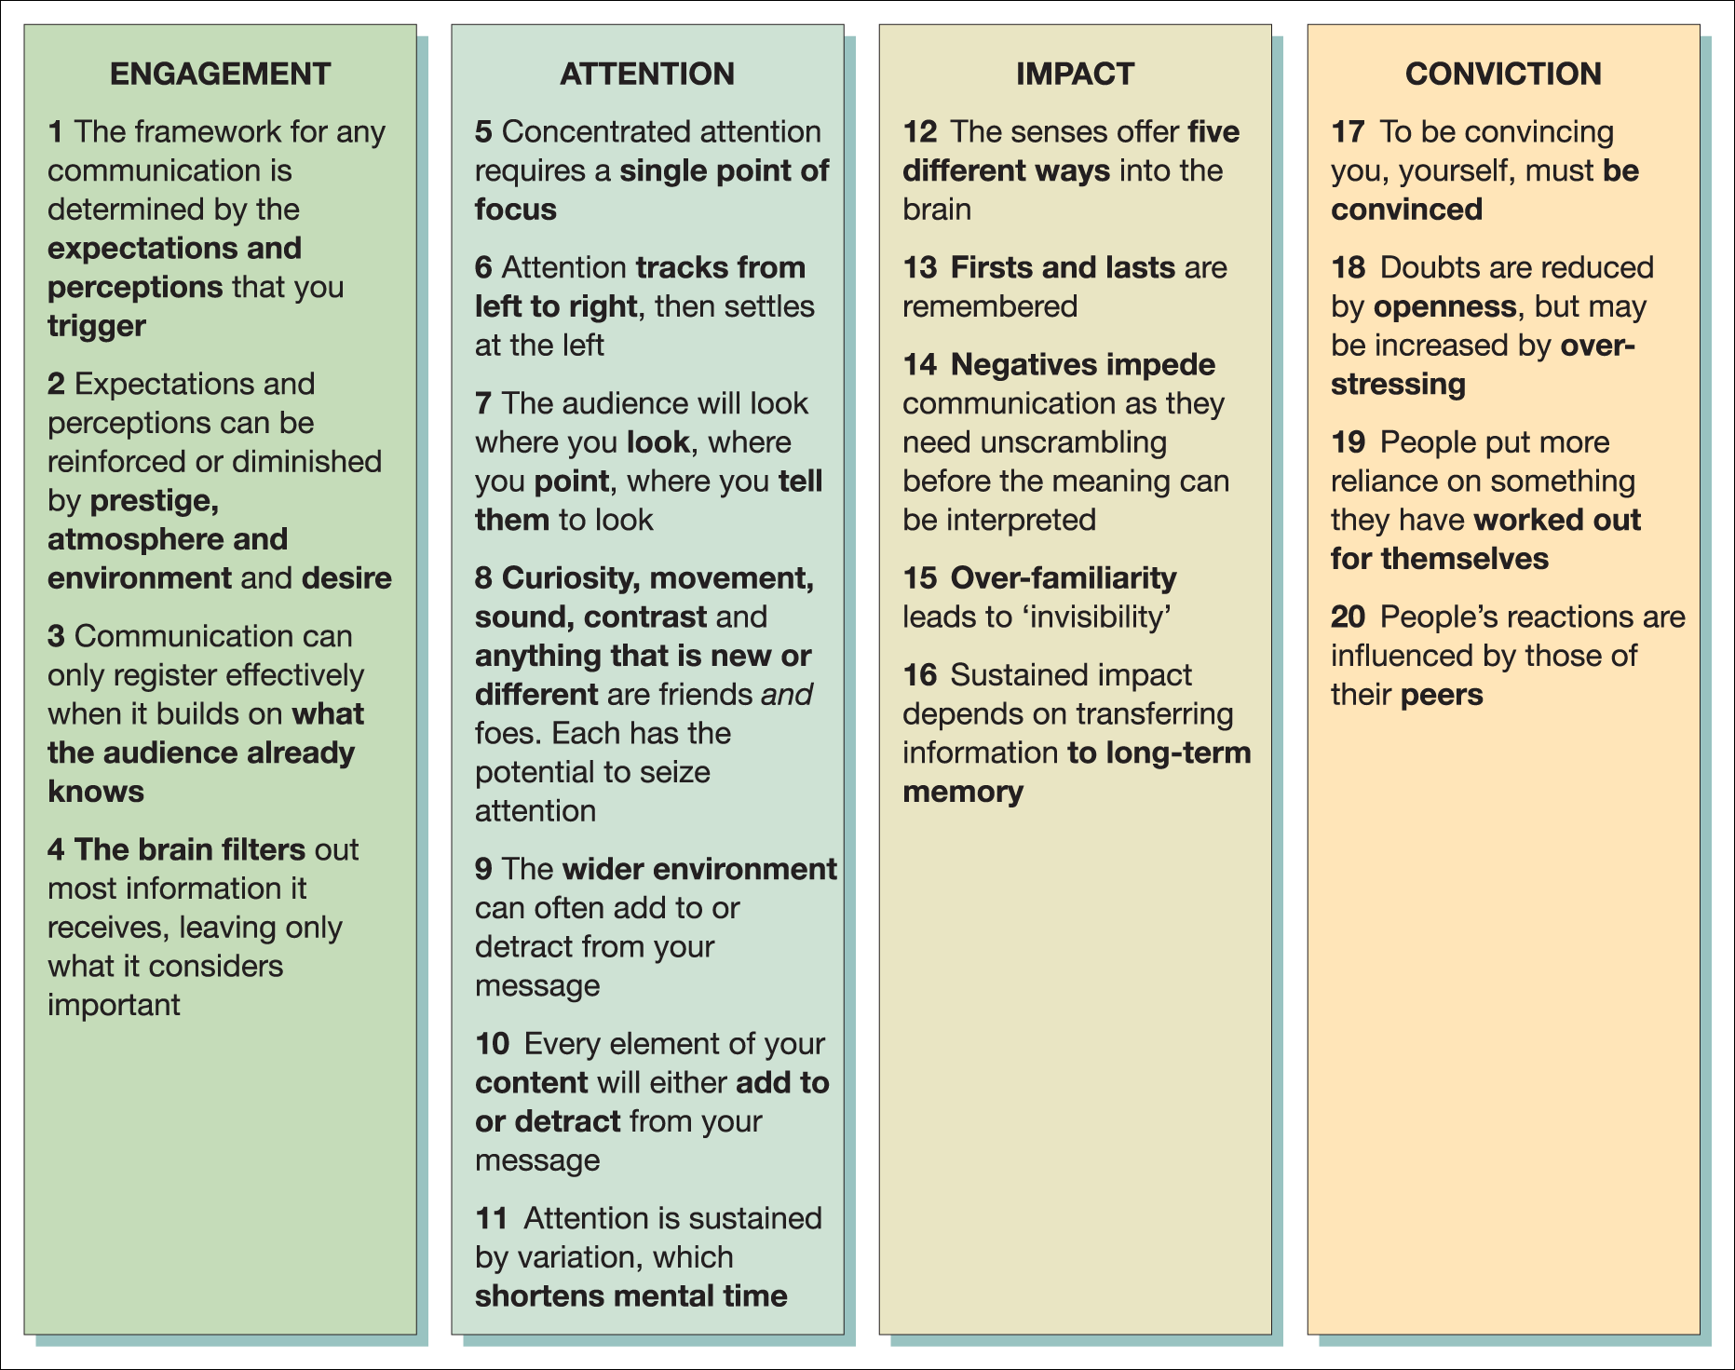
Interpersonal communications
Figure 6.14 Twenty rules of perception and communication
Source: Nick Fitzherbert, www.fitzherbert.co.uk. Reproduced with permission.

Slide 22
Neuro-linguistic programming
(NLP)
Approach developed by John Grinder and Richard Bandler in the 1970s which links three different disciplines:
Neurology – the nervous system and processes linking body and mind.
Linguistics – the study of words and how they are understood and communicated.
Programming – behaviours and strategies used by individuals.

Slide 23
NLP, awareness and change
Techniques
  Mirroring
  Positive thinking
  Anchors
Key skills which can be developed by NLP
  Sensory acuity
  Rapport building
  Improving sensory awareness

Slide 24
Transactional analysis: Berne
A popular way of explaining the dynamics of interpersonal communication.
It can be used by organisations as a training and development programme.
Has two underlying assumptions:
  All experienced events and feelings are stored and can be replayed.
  Personality is made up of three ego states, almost as if they are different people within us.

Slide 25
Transactional analysis: the three ego states
Adult
  Behaviour which concerns our thought processes and the processing of facts and information; rationality and reasonableness
Parent
  Behaviour which concerns the attitudes, feelings and behaviour incorporated from external sources, primarily our parents; sense of right and wrong
Child
  Behaviour that demonstrates the feelings we remember as a child; fun, play and emotion.

Slide 26
Preferred ego states
Analysing, dealing only with facts and distrusting own feelings
Continually advising and criticising others
Reliant on feelings, constantly clowning around or being consumed with anger
Adult
Parent
Child

Slide 27
Attribution theory
Behaviour is determined by a combination of perceived internal and external forces:
Internal forces
e.g. personal attributes such as ability, skills, amount of effort and fatigue
External forces
e.g. organisational rules and policies, the manner of superiors, the weather

Slide 28
Implications of attribution theory
‘Employees with an internal control orientation are more likely to believe that they can influence their level of performance through their own abilities, skills or efforts. Employees with an external control orientation are more likely to believe that their level of performance is determined by external factors beyond their influence’.

Slide 29
Perceptual distortions and errors
The accuracy of judgements made about other people are influenced by:
the nature of the relationship;
the amount of information available;
the nature and extent of the interaction.

Slide 30
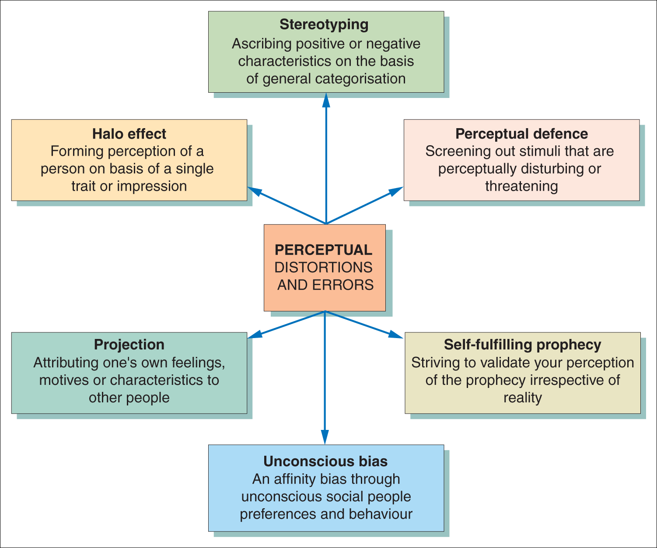
Causes of perceptual distortions and errors
Figure 6.15 Causes of perceptual distortions and errors

Slide 31
Stereotyping
The tendency to ascribe positive or negative characteristics to others on the basis of general categorisations and perceived similarities.
A means of simplifying the process of perception and making judgements of other people, instead of dealing with a range of complex and alternative stimuli.

Slide 32
Common stereotypes
Common stereotypes may be based on:
Nationality
Occupation
Age
Physical attributes
Education
Social
Politics

Slide 33
The halo/rusty halo effects
The halo effect
A process whereby a person’s perception is formed on the basis of a single favourable trait or impression.
It tends to shut out other relevant characteristics of a person.
The rusty halo effect
Judgements made about a person are formed from the perception of negative characteristics.

Slide 34
Perceptual defence
The tendency to avoid or screen out certain stimuli that are perceptually disturbing or threatening, and select information supportive of an existing point of view.

Slide 35
Projection
The tendency to attribute or project one’s feeling, motives or characteristics to other people.
These can be positive, but are often negative and reflect our own undesirable traits.

Slide 36
The self-fulfilling prophecy
The idea that the very act of making a prophecy can tend to make the result actually happen.
Managerial expectations of staff can therefore have an effect on the actual performance, either positive or negative.

Slide 37
Unconscious bias: Robertson
Assumptions we are ‘hard-wired’ to make
‘Preferred people preferences’
Affinity bias
Subtle, unconscious behaviours or ‘micro-behaviours’

Slide 38
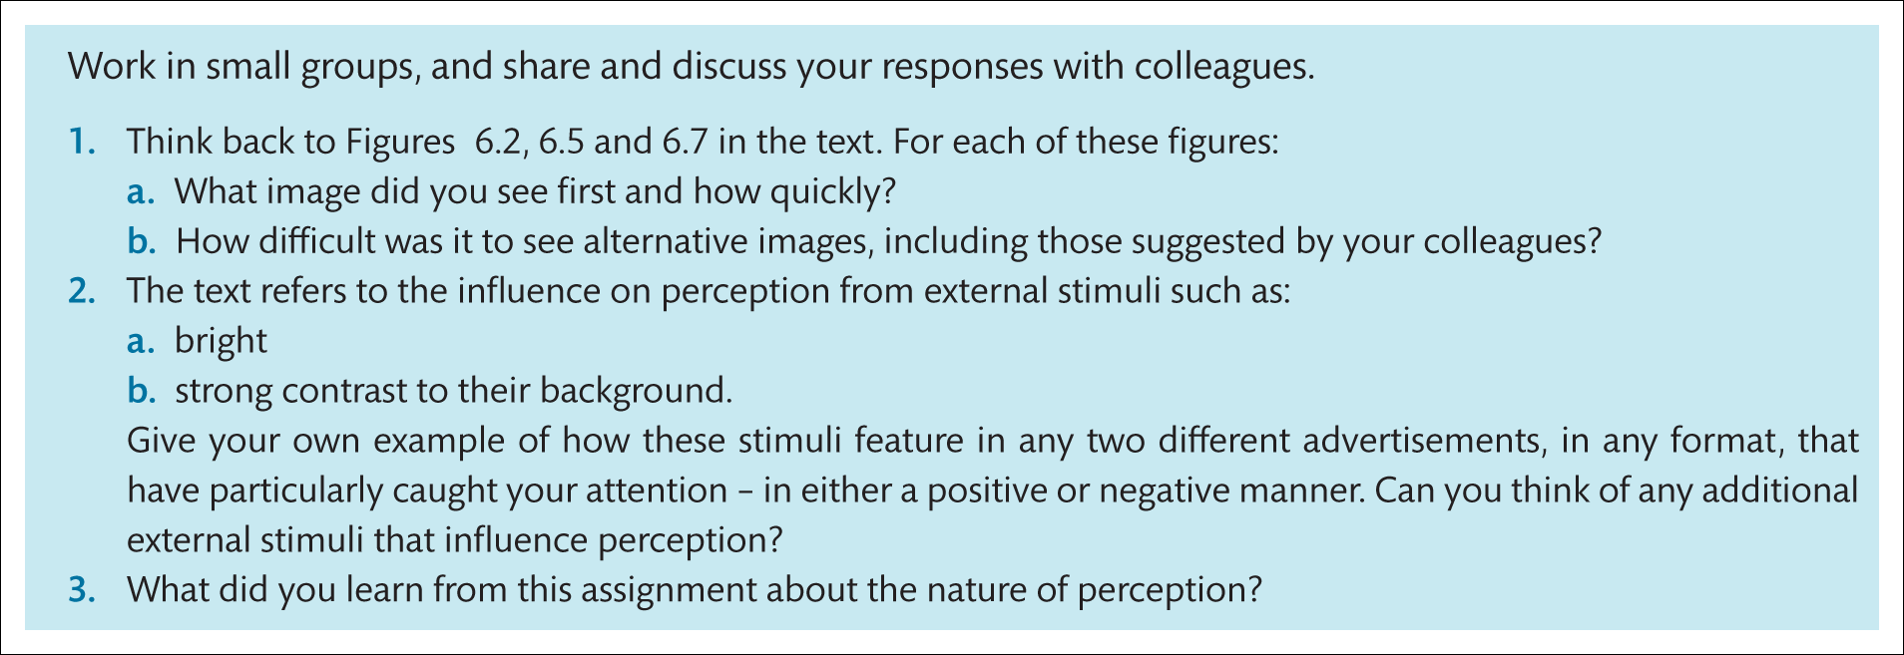
Assignment

