Slide 2
Protecting Data and
Ensuring Integrity
- An Art!!!
Network and Cybersecurity
Essentials (ACCA4024)
Applied Computing - WISA

Slide 3

During today’s lecture, we shall discuss the part of cryptography in Cybersecurity. You will understand how encryption techniques, access control techniques used to protect confidentiality.
In the later part of this session, you will also understand the different processes used to ensure integrity along with the need of digital signatures, digital certificates and database integrity enforcement.
Today’s Class
Cryptography
Access Control
Obscuring Data
Types of Data Integrity Controls
Digital Signatures
Certificates and
Database Integrity Enforcement

Slide 4








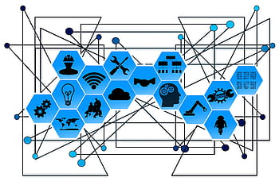
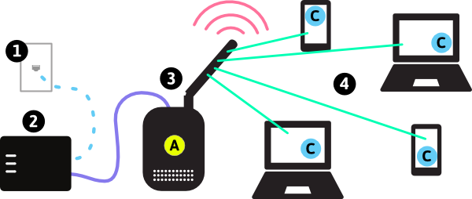
Understanding Threats, Vulnerabilities and Attacks
Denial-of-Service (DoS)
Sniffing, Spoofing,
Man-in-the-middle,
Zero-Day Attacks, Keyboard Logging, Grayware, SMiShing
Rogue Access Points,
RF Jamming, Bluejacking, Bluesnarfing,
Remote Code Executions, Cross-site scripting (XSS)
Etc…
SCANNING/ INFORMATION GATHERING
Spam, Spyware, Adware, Scareware, Phishing, Spear Phishing, Vishing, Pharming, Whaling, Plugins,
SEO Poisoning, Browser Hijacker
Attack
Social Engineering, Shoulder Surfing, Dumpster Diving, Piggybacking, Tailgating, Online, Email Trickery
Gain Access
installation of malware
Virus, Worms, Trojans, Logic Bomb, Ransomware, Backdoors, Rootkits etc
Weak points

Slide 5

How to protect the data in a Network/ Cyberspace?
Give your suggestions!!!
Don't allow unauthorized users
Secure the network/ cyberspace (Passwords/ MFA etc)
Cryptology is the science of making and breaking secret codes.
Cryptography is a way to store and transmit data so only the intended recipient can read or process it.
Modern cryptography uses computationally secure algorithms to make sure that cyber criminals cannot easily compromise protected information.
Each encryption method uses a specific algorithm, called a cipher, to encrypt and decrypt messages.
A cipher is a series of well-defined steps used to encrypt and decrypt messages.
There are several methods of creating ciphertext: two examples are : Transposition, Substitution

Slide 6
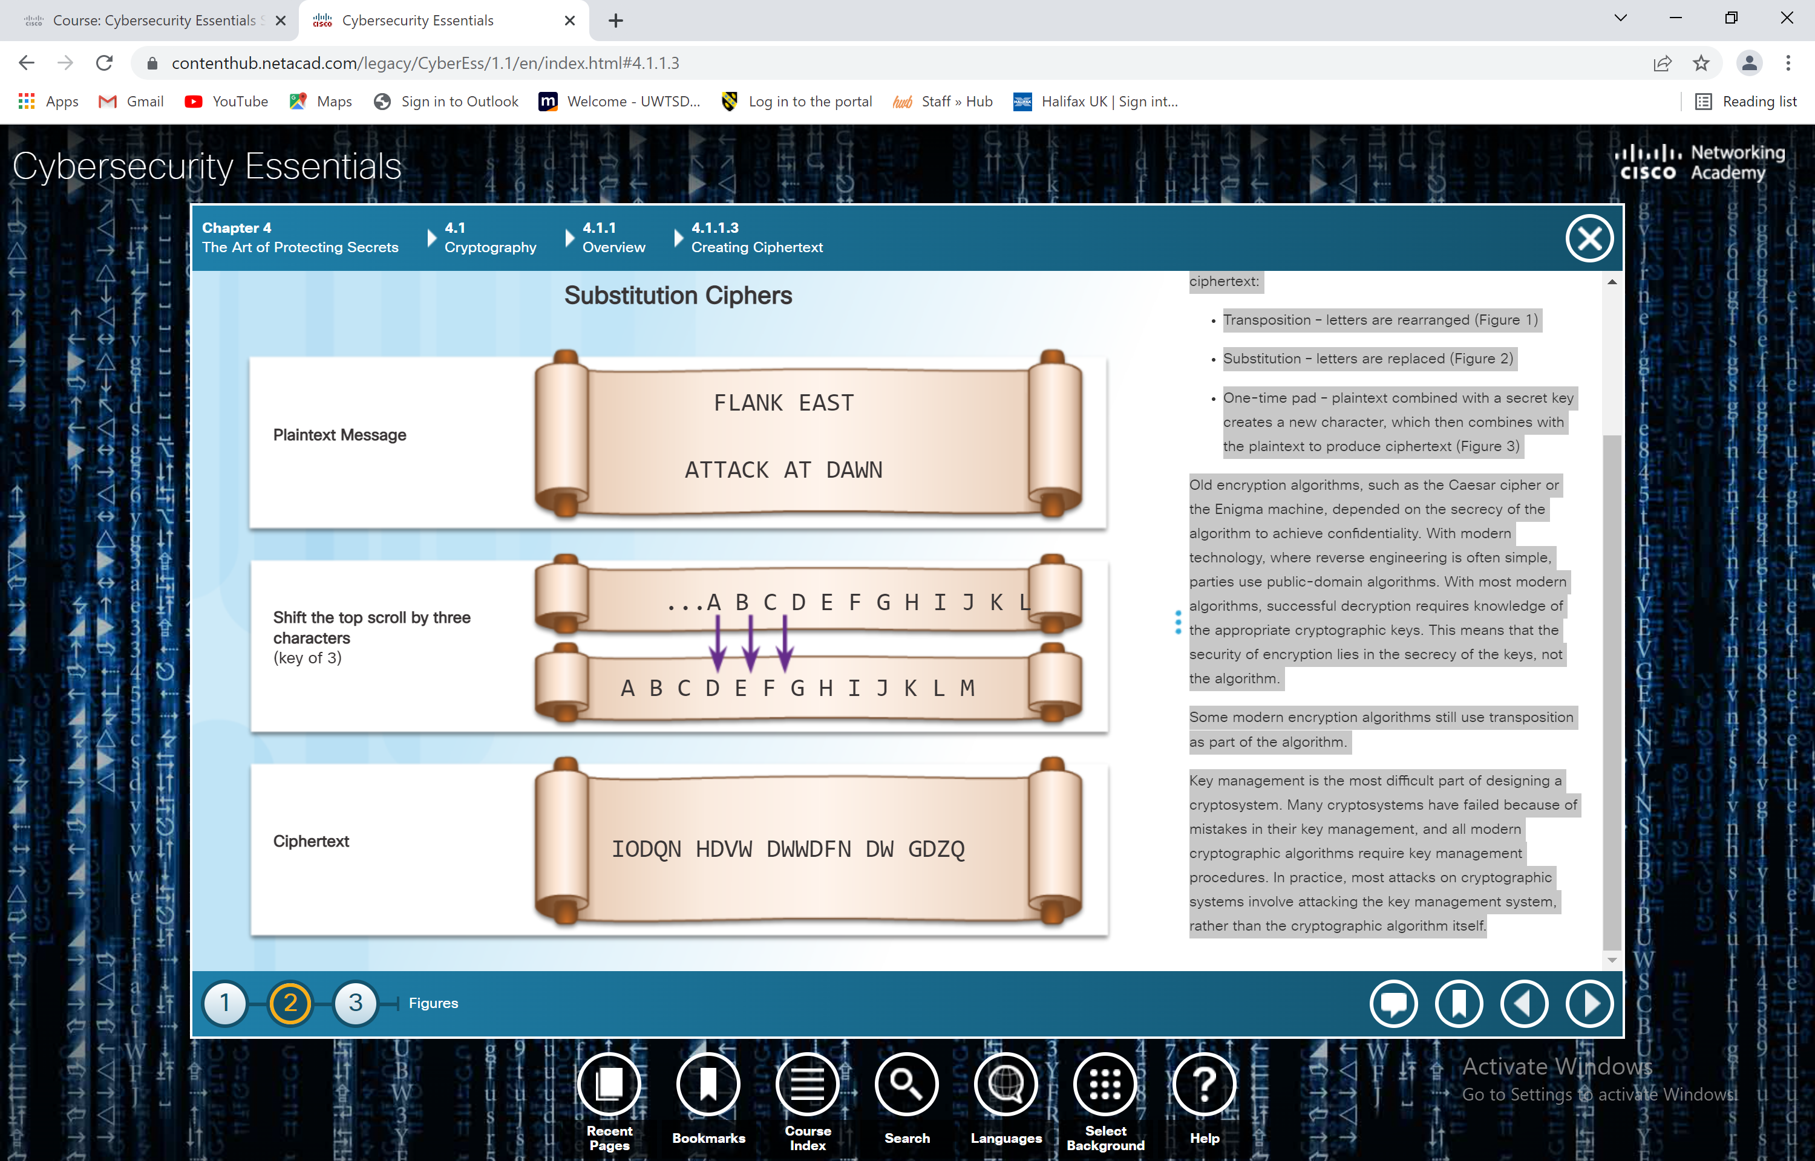
Substitution means replacing each letter (or symbol) with another letter or symbol
NB:A key is the secret rule or code that tells a computer how to scramble and unscramble information (Key –”Shift by 3”)

Slide 7
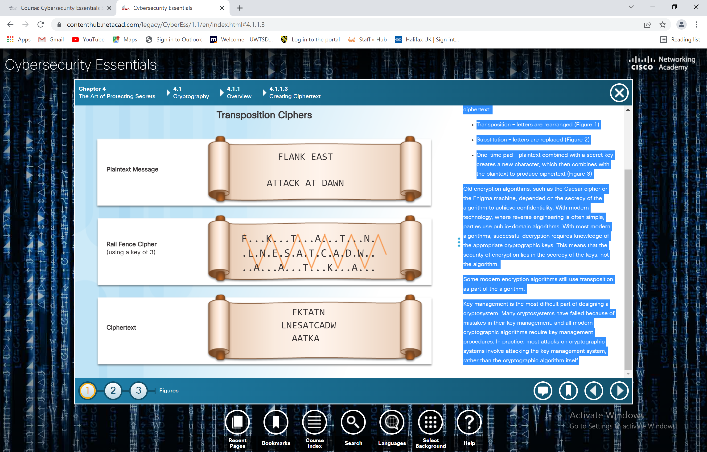
Transposition means rearranging the positions of letters without changing the letters themselves.

Slide 8
Cryptography
Two Types of Encryption: There are two classes of encryption algorithms
Symmetric algorithms
  These algorithms use the same pre-shared key, sometimes called a secret key pair, to encrypt and decrypt data.
  Both the sender and receiver know the pre-shared key before any encrypted communication begins.
Asymmetric algorithms
Asymmetrical encryption algorithms use one key to encrypt data and a different key to decrypt data.
One key is public and the other is private.
In a public-key encryption system, any person can encrypt a message using the public key of the receiver, and the receiver is the only one that can decrypt it using his private key.
Parties exchange secure messages without needing a pre-shared key.
Asymmetric algorithms are more complex.
These algorithms are resource intensive and slower to execute.
  NB: Cryptographic Key= long, complex string generated by a computer

Slide 9
Cryptography – Symmetrical Encryption Process
Symmetric algorithms use pre-shared key to encrypt and decrypt data, a method also known as private-key encryption.
Numerous encryption systems use symmetric encryption.
Some of the common encryption standards that use symmetric encryption include the following:
3DES (Triple DES):
Digital Encryption Standard (DES) is a symmetric block cipher with 64-bit block size that uses a 56-bit key.
Triple DES encrypts data three times and uses a different key for at least one of the three passes, giving it a cumulative key size of 112-168 bits.
IDEA:
The International Data Encryption Algorithm (IDEA) uses 64-bit blocks and 128-bit keys.
IDEA performs eight rounds of transformations on each of the 16 blocks that results from dividing each 64-bit block.
IDEA was the replacement for DES, and now PGP (Pretty Good Privacy) uses it.
AES:
The Advanced Encryption Standard (AES) has a fixed block size of 128-bits with a key size of 128, 192, or 256 bits.
The National Institute of Standards and Technology (NIST) approved the AES algorithm in December 2001.
Very secure and fast, Used in Wi-Fi, Banking , phones

Slide 10
Cryptography – Asymmetrical Encryption Process
Uses two different keys:
🔓 Public key – used to encrypt data
🔐 Private key – used to decrypt data
The keys are linked, but:You cannot easily work out the private key from the public key
RSA (Rivest_Shamir-Adleman)
Uses very large numbers (hundreds of digits long) to keep data secure
Browsers use RSA to establish a secure connection(HTTPS)
Used to verify identity (the website proves it is real)
Used for digital signatures (proving identity online)
Confirms who sent the message and that it has not been altered
Diffie-Hellman
Used to securely share a secret key over the internet
Used in protocols like HTTPS, SSH, VPNs

Slide 11
Cryptography – Symmetrical Vs Asymmetrical
It is important to understand the differences between symmetric and asymmetric encryption methods.
Symmetric encryption systems are more efficient and can handle more data. However, key management with symmetric encryption systems is more problematic and harder to manage.
Asymmetric cryptography is more efficient at protecting the confidentiality of small amounts of data, and its size and speed make it more secure for tasks such as electronic key exchange which is a small amount of data rather than encrypting large blocks of data.
Application
There are many applications for both symmetric and asymmetric algorithms.
The electronic payment industry uses 3DES.
Operating systems use DES to protect user files and system data with passwords. (older method)
Most encrypting file systems, such as NTFS, use AES.(most common today)

Slide 12
Cryptography – Symmetrical Vs Asymmetrical continue…..
Application
Three protocols use asymmetric key algorithms:
  Internet Key Exchange (IKE), which is a fundamental component of IPsec Virtual Private Networks (VPNs).
  Secure Socket Layer (SSL), which is a means of implementing cryptography into a web browser.
  Secure Shell (SSH), which is a protocol that provides a secure remote access connection to network devices.
Notes:
Internet Key Exchange (IKE) is a standard protocol used to set up a secure and authenticated communication channel between two parties via a virtual private network (VPN). The protocol ensures security for VPN negotiation, remote host and network access.

Slide 13
Access Control

Slide 14
Access Control
Physical Access Controls
  actual barriers deployed to prevent direct contact with systems.
  The goal is to prevent unauthorized users from gaining physical access to facilities, equipment, and other organizational assets.
  Physical access control determines who can enter (or exit), where they can enter (or exit), and when they can enter (or exit).
Logical Access Controls
  hardware and software solutions used to manage access to resources and systems.
  These technology-based solutions include tools and protocols that computer systems use for identification, authentication, authorization, and accountability.
Administrative Access Controls
  policies and procedures defined by organizations to implement and enforce all aspects of controlling unauthorized access.
  Administrative controls focus on personnel and business practices.

Slide 15
Access Control Strategies
  Discretionary access control (DAC)
  DAC grants or restricts object access determined by the object’s owner. As the name implies, controls are discretionary because an object owner with certain access permissions can pass on those permissions to another subject.
  Role-based access control (RBAC)
  is based on the role of the subject. Roles are job functions within an organization. Specific roles require permissions to perform certain operations. Users acquire permissions through their role. RBAC can work in combination with DAC or MAC by enforcing the policies of either one.
  Rule-based access control
  uses access control lists (ACLs) to help determine whether to grant access. A series of rules is contained in the ACL.The determination of whether to grant access depends on these rules. An example of such a rule is one that states that no employee may have access to the payroll file after hours or on weekends.

Slide 16
Access Control Identification -
Identification enforces the rules established by the authorization policy:
  A subject requests access to a system resource. Every time the subject requests access to a resource, the access controls determine whether to grant or deny access.
  Cybersecurity policies determine which identification controls should be used.
  The sensitivity of the information and information systems determine how stringent the controls.
  The increase in data breaches has forced many organizations to strengthen their identification controls.
  Authentication Methods
  What You Know
  Passwords, passphrases, or PINs are all examples of something that the user knows. Passwords are the most popular method used for authentication.
  What You Have
  Smart cards and security key fobs are both examples of something that users have in their possession.
  Who You Are
  A unique physical characteristic, such as a fingerprint, retina, or voice, that identifies a specific user is called biometrics.
  Multi-factor Authentication
  Multi-factor authentication uses at least two methods of verification. A security key fob is a good example. The two factors are something you know, such as a password, and something you have, such as a security key fob.

Slide 17
Access Control Authorization
Authorization controls what a user can and cannot do on the network after successful authentication:
  After a user proves his or her identity, the system checks to see what network resources the user can access and what the users can do with the resources.
  Authorization uses a set of attributes that describes the user’s access to the network.
  The system compares these attributes to the information contained within the authentication database, determines a set of restrictions for that user, and delivers it to the local router where the user is connected.
  Defining authorization rules is the first step in controlling access. An authorization policy establishes these rules.
  Accountability
  Accountability traces an action back to a person or process making the change to a system, collects this information, and reports the usage data:
  The organization can use this data for such purposes as auditing or billing.
  The collected data might include the log in time for a user, whether the user log in was a success or failure, or what network resources the user accessed.
  This allows an organization to trace actions, errors, and mistakes during an audit or investigation.
  Implementing accountability consists of technologies, policies, procedures, and education.
  Log files provide detailed information based on the parameters chosen.

Slide 18
Access Control – Types of Security Controls
Preventative Controls
Prevent means to keep something from happening. Preventative access controls stop unwanted or unauthorized activity from happening. E.g Assigning user specific privileges on a system is an example of a preventive control
Deterrent Controls
A deterrent is the opposite of a reward. A reward encourages individuals to do the right thing, while a deterrent discourages them from doing the wrong thing. Cybersecurity professionals and organizations use deterrents to limit or mitigate an action or behavior. Deterrents do not always stop these actions. Deterrents make potential cyber criminals think twice before committing a crime e.g fence, auditing, encryption, cameras , guards e.t.c
Detective Controls
Detection is the act or process of noticing or discovering something. Access control detections identify different types of unauthorized activity. Detection systems can be very simple, such as a motion detector or security guard. They can also be more complex, such as an intrusion detection system.
Corrective Controls
Corrective counteracts something that is undesirable. Organizations put corrective access controls in place after a system experiences a threat. Corrective controls restore the system back to a state of confidentiality, integrity, and availability. They can also restore systems to normal after unauthorized activity occurs. E.g Antivirus, alarms
Notes:
All detective systems have several things in common; they look for unusual or prohibited activity. They also provide methods to record or alert system operators of potential unauthorized access. Detective controls do not prevent anything from happening; they are more of an after-the-fact measure.

Slide 19
Access Control – Types of Security Controls
Recovery Controls
Recovery is a return to a normal state. Recovery access controls restore resources, functions, and capabilities after a violation of a security policy. Recovery controls can repair damage, in addition to stopping any further damage.
These controls have more advanced capabilities over corrective access controls. E.g Backup/restore operations, Fault tolerance drive systems, server clustering e.tc.
Compensative Controls
Compensate means to make up for something.
Compensative access controls provide options to other controls to bolster enforcement in support of a security policy.
A compensative control can also be a substitution used in place of a control that is not possible under the circumstances. E.g an organization may not be able to have a guard dog, so instead it deploys a motion detector with a spotlight and a barking sound.

Slide 20
Obscuring Data

Slide 21
Obscuring Data
Data Masking is a technology that secures data by replacing sensitive information with a non-sensitive version.
The non-sensitive version looks and acts like the original. This means that a business process can use non-sensitive data and there is no need to change the supporting applications or data storage facilities.
In the most common use case, masking limits the propagation of sensitive data within IT systems by distributing surrogate data sets for testing and analysis.
There are data masking techniques that can ensure that data remains meaningful but changed enough to protect it:
  Substitution
    replaces data with authentic looking values to apply anonymity to the data records.
  Shuffling
    derives a substitution set from the same column of data that a user wants to mask. This technique works well for financial information in a test database, for example.

Slide 22
Obscuring Data Steganography
Steganography conceals data (the message) in another file such as a graphic, audio, or other text file.
The advantage of steganography over cryptography is that the secret message does not attract any special attention. No one would ever know that a picture actually contained a secret message by viewing the file either electronically or in hardcopy.
    Data Obfuscation
Data obfuscation is the use and practice of data masking and steganography techniques in the cybersecurity and cyber intelligence profession:
  Obfuscation is the art of making the message confusing, ambiguous, or harder to understand.
  A system may purposely scramble messages to prevent unauthorized access to sensitive information.
  Software watermarking protects software from unauthorized access or modification.
  Software watermarking inserts a secret message into the program as proof of ownership.
  The secret message is the software watermark. If someone tries to remove the watermark, the result is nonfunctional code.

Slide 23
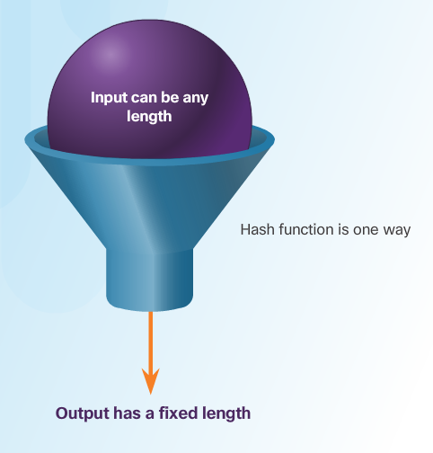
Data Integrity
Recall : Data integrity is the overall accuracy, completeness, and consistency of data
Hashing Algorithms
Hashing is a tool that ensures data integrity by taking binary data (the message) and producing a fixed-length representation called the hash value or message digest.
Hashing is a one-way mathematical function that is relatively easy to compute, but significantly harder to reverse. Grinding coffee beans is a good analogy of a one-way function. It is easy to grind coffee beans, but it is almost impossible to put all of the tiny pieces back together to rebuild the original beans.
  A cryptographic hash function has the following properties:
    The input can be any length.
    The output has a fixed length.
    The hash function is one way and is not reversible.
    Two different input values will always result in different hash values.
There are many modern hashing algorithms widely used today. Two of the most popular are MD5 and SHA.
Message Digest 5 (MD5) Algorithm - is a hash algorithm developed by Ron Rivest that produces a 128-bit hash value.
Secure Hash Algorithm (SHA) – was developed by the U.S. National Institute of Standards and Technology (NIST) and can be implemented in different strengths: SHA-224 (224 bit), SHA-256 (256 bit), SHA-384 (384 bit), SHA-512 (512 bit)

Slide 24
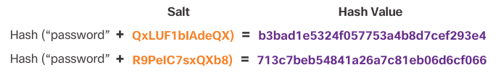
Data Integrity
Salting is used to make hashing more secure.
If two users have the same password, they will also have the same password hashes. A salt, which is a random string of characters, is an additional input to the password before hashing.
This creates a different hash result for the two passwords as shown in the figure. A database stores both the hash and the salt.

Slide 25
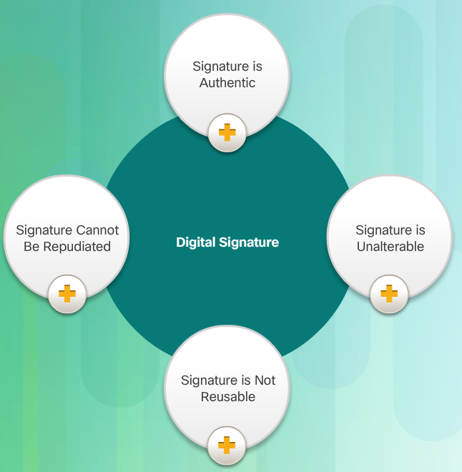
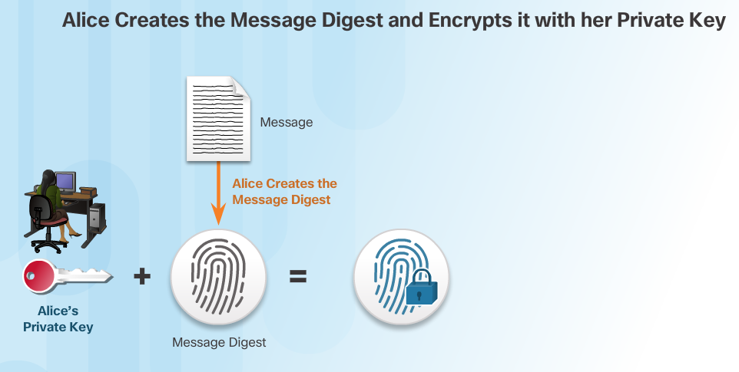
Digital Signatures
Digital signatures provide the same functionality as handwritten signatures for electronic documents.
A digital signature is used to determine if someone edits a document after the user signs it.
A digital signature is a mathematical method used to check the authenticity and integrity of a message, digital document, or software.
In many countries, digital signatures have the same legal importance as a manually signed document.
Asymmetric cryptography is the basis for digital signatures.
A public key algorithm like RSA generates two keys: one private and the other public. The keys are mathematically related.
Notes:
Non-repudiation -Assurance that the sender of information is provided with proof of delivery and the recipient is provided with proof of the sender's identity, so neither can later deny having processed the information.
Nonrepudiation is achieved through cryptography, like digital signatures,
In online transactions, digital signatures ensure that a party cannot later deny sending information or deny the authenticity of its signature.

Slide 26
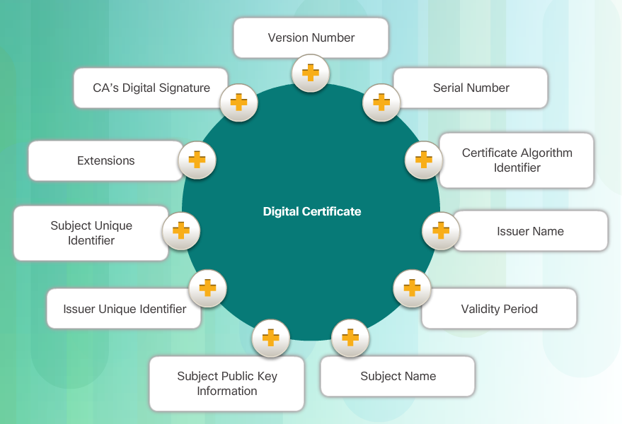
Digital Certificates
A digital certificate is equivalent to an electronic passport. Digital certificates enable users, hosts, and organizations to exchange information securely over the Internet.
A digital certificate authenticates and verifies that users sending a message are who they claim to be. Digital certificates can also provide confidentiality for the receiver with the means to encrypt a reply.
Digital certificate must follow a standard structure so that any entity can read and understand it regardless of the issuer.
TheX.509 is the standard for construction of digital certificates and the public key infrastructure (PKI) used to manage digital certificates.
PKI is the policies, roles, and procedures required to create, manage, distribute, use, store, and revoke digital certificates.

Slide 27
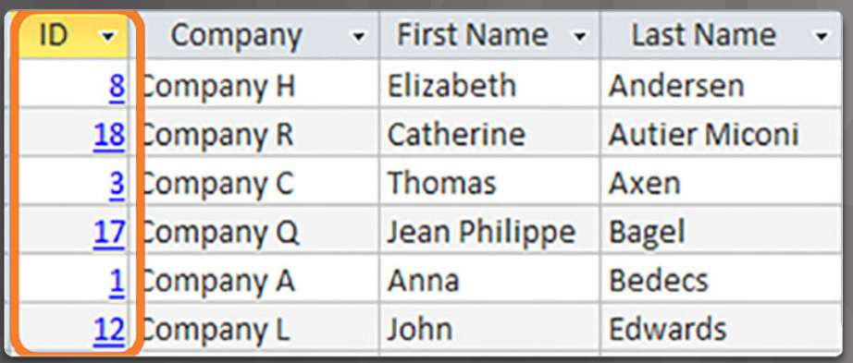
Database Integrity
Databases provide an efficient way to store, retrieve, and analyze data.
As data collection increases and data becomes more sensitive, it is important for cybersecurity professionals to protect the growing number of databases.
Data integrity refers to the accuracy, consistency, and reliability of data stored in a database.
The four database integrity rules or constraints are as follows:
Entity Integrity: All rows must have a unique identifier called a Primary Key.
Domain Integrity: All data stored in a column must follow the same format and definition.
Referential Integrity: Table relationships must remain consistent. Therefore, a user cannot delete a record which is related to another one.
User-defined Integrity: A set of rules defined by a user which does not belong to one of the other categories. For example, a customer places a new order. The user first checks to see if this is a new customer. If it is, the user adds the new customer to the customers table.

Slide 28
Database Validation Rules
A validation rule checks that data falls within the parameters defined by the database designer. A validation rule helps to ensure the completeness, accuracy and consistency of data. The criteria used in a validation rule include the following:
Size – checks the number of characters in a data item
Format – checks that the data conforms to a specified format
Consistency – checks for the consistency of codes in related data items
Range – checks that data lies within a minimum and maximum value
In order to maintain the integrity of the database filing system, users must follow certain rules.
Entity integrity is an integrity rule, which states that every table must have a primary key and that the column or columns chosen to be the primary key must be unique and not NULL. Entity integrity enables proper organization of data for that record.
Another important integrity check is referential integrity which deals with foreign keys. A foreign key in one table references a primary key in a second table. Referential integrity maintains the integrity of foreign keys.
Domain integrity ensures that all the data items in a column fall within a defined set of valid values. Limiting the value assigned to an instance of that column (an attribute) enforces domain integrity. Domain integrity enforcement can be as simple as choosing the correct data type, length and or format for a column.

Slide 29
END and Thank You?

