Slide 1

Student name: Cecilia-Maria Cojocaru
Student number: 1816288
Module: Food &Beverage Operations BMIH4002
Lectures: Tristan Hawkins
Title: Menu Engineering

Slide 2



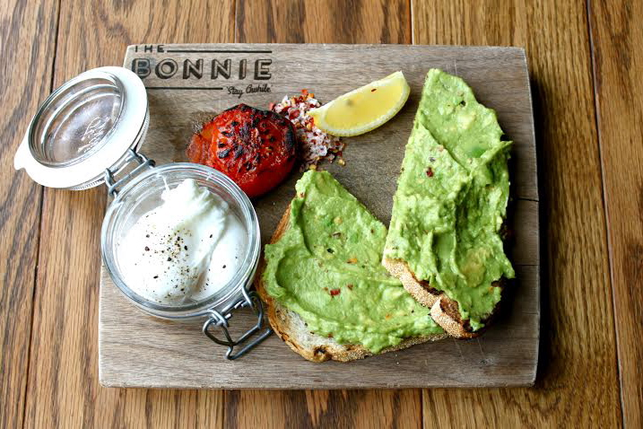
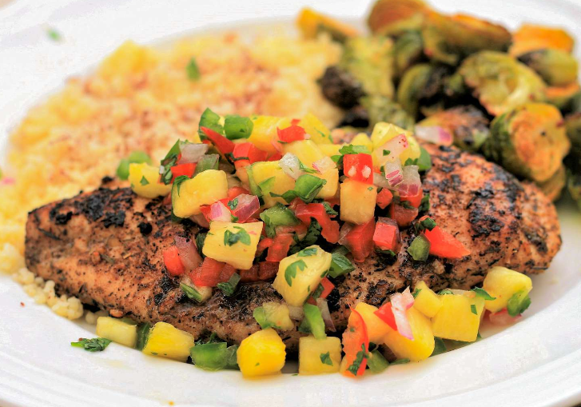
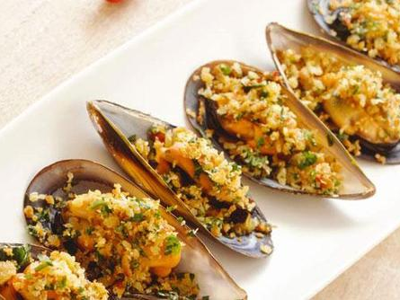


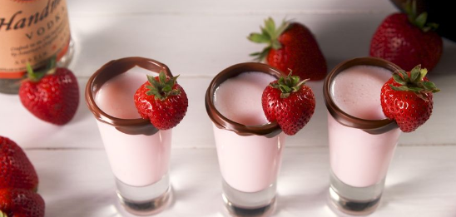
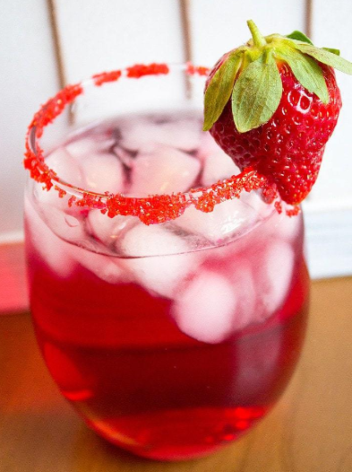
Starter
Soup £5.5
Served with homemade bread and butter
Crispy Whitbread £6.95
Served with roasted garlic Mayo and a bit of salad
Fresh Oysters £10
Kilpatrick (hot with cheese, bacon, and garlic) is one option for oysters.
Calamari £6.95
Deep-fried calamari served with roasted garlic mayonnaise and salad
Avocado on Toast £8.5
Sliced avocado, beetroot hummus, seeds, and chili served on toasted sourdough
Main Course
Dauphinoise Potatoes £4.5
Slices of tender potatoes with clotted cream, garlic sauce, and crisp cheese
Hashbrown Casserole £3.6
Chicken soup with sour cream, cheddar cheese
Manzo £17.5
Finely sliced, rolled, and stuffed with fresh herbs, garlic, and parmesan cheese, the best beef is prepared in a hearty red wine tomato sauce.
Mussels £15.95
Fresh mussels prepared in a red vine tomato sauceor a creamy white wine and fresh herb sauce
Grilled Chicken £14.9
Butterfly chicken breast with pineapple salsa, chill mayo, raw claw, and fries.
Deserts
Chocolate-covered-Strawberries £4.5
Strawberry-Donuts £3.99
Red-velvet cupcakes £20.5
Heart Sugar Cookies £2.50
Beverages
Sparkling Cranberry Sangria £4.5
Sweetheart cocktail £23.0
Strawberry Shortcake Daiquiri £5.50
Scarlett kiss £16.0
Chocolate Truffle Martini £11.5
Passion Cocktail £3.5
Chocolate-covered strawberry shooters £24
Lovebug cocktail £5.5
-
Wine
Merlot £19.25
Malbec £25.0
Raphael £27.9
Sides
Garlic bread £4.25
Garlic bread with tomato £5.25
Sauteed Mushrooms £5.0
Mixed Salad £7.4
French fries/chips £3.0
Note
Please give an order if the number of members is above 10
Get 15% discounts for couples

Slide 3

References
Brown, D.R. (2013) The restaurant manager's handbook: How to set up, operate, and manage a financially successful food service operation. 4th edn. Ocala, FL: Atlantic Publishing Group, Inc.
Walker, J.R. (2017) Introduction to hospitality. Boston: Pearson.
Witts, S. (2022) Restaurants welcome return of valentine's day..., The Caterer. The Caterer. Available at: https://www.thecaterer.com/news/restaurants-welcome-return-valentines-day-bookings (Accessed: February 9, 2023).
Davis, B. (2018) Food and beverage management. 6th edn. London etc.: Routledge.
Foskett, D. et al. (2021) The theory of hospitality and catering. 14th edn. London, England: Dynamic Learning.
Kate , L. (2023) 40+ romantic vegan valentine's day recipe, The Green Loot. Available at: https://thegreenloot.com/vegan-valentines-day-recipes/ (Accessed: February 9, 2023).
Lelieveld, M.H.L. and Motarjemi, Y. (2014) Food safety management: a practical guide for the food industry. Illustrated Amsterdam: Academic Press.
Cousins, J. et al. (2020) Food and beverage service. 9th edn. Abingdon: Hodder Education.
Overhiser, S. (2022) 15 fun valentine's day cocktails, A Couple Cooks. Available at: https://www.acouplecooks.com/valentines-day-cocktails-drinks (Accessed: February 9, 2023).
Porter, J. (2023) It's a labour of love for operators this..., The Caterer. The Caterer. Available at: https://www.thecaterer.com/products/its-labour-of-love-operators-valentines-day (Accessed: February 9, 2023).
Walker, J.R. (2017) Introduction to hospitality. Boston: Pearson.

