Slide 1

Oppression
ECAY4002: Giving Individuals a Voice: Empowerment, Agency and Anti-Oppressive Practice

Slide 2
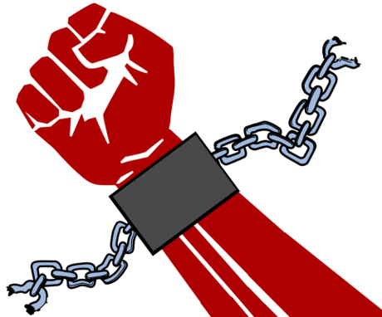
Key Terms
Identity
Oppression
Privilege

Slide 3
Oppression as Power
Oppression assumes a power relationship between the oppressor and the oppressed
Is this always the case?

Slide 4


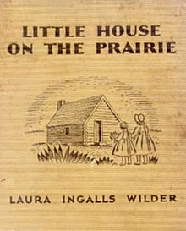
Oppressive Literature?

Slide 5



Oppressive Media?

Slide 6
Advocacy & Oppression
Advocacy is the representation of a need or an idea, either by a person or group on behalf of themselves, or by someone or an organisation on behalf of another person or group. Advocacy is allied to political action, since it usually involves seeking greater influence in decision-taking. However, it can involve other actions, such as helping people to integrate and participate in community life. Self-advocacy by disadvantaged groups, and advocacy on their behalf by others, can be vehicles through which injustices can become better recognised, people can become more involved, respected and included, and remedies found for oppression suffered.
Williams & Nzira, 2009

Slide 7
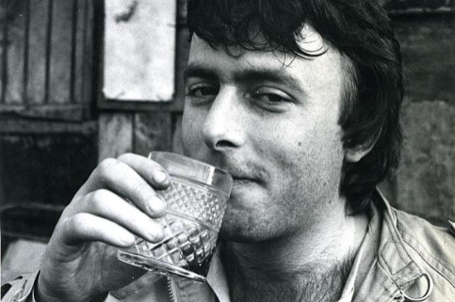
The rise of Identity Politics:
Christopher Hitchens,
Beware of identity politics… People began to stand up at meetings and orate about how they felt, not about what or how they thought, and about who they were rather than what (if anything) they had done or stood for. It became the replication in even less interesting form of the narcissism of small difference, because each identity group begat its subgroups and “specificities.” …From a way of being radical it very swiftly became a way of being reactionary.
Hitchens, 2005

Slide 8
Iris Marion Young: 5 Faces of Oppression (2004)
Exploitation
Marginalisation
Powerlessness
Cultural Imperialism
Violence
Paulo Freire also suggests a culture of silence as a form of oppression

Slide 9
Exploitation
Exploitation is the act of using people’s labours to produce profit while not compensating them fairly. Exploitation uses capitalism to oppress. The economic theory of capitalism states that people are free to exchange goods freely. Yet, whenever this has happens throughout history, it has created different classes of people: wealthy and poor

Slide 10
Marginalisation
Marginalization is the act of relegating or confining a group of people to a lower social standing or outer limit or edge of society. Most commonly, people are marginalized based upon race. One prominent example is the Aboriginal communities of Australia that were excluded from society and pushed farther and farther away from their homelands as cities grew

Slide 11
Powerlessness
Powerlessness links to Marx’s theory of socialism: some people “have” power while others “have-not”. The powerless are dominated by the ruling class and are situated to take orders and rarely have the right to give them. Some of the fundamental injustices associated with powerlessness are inhibition to develop one’s capacities, lack of decision making power, and exposure to disrespectful treatment because of the lowered status.

Slide 12
Cultural Imperialism
Cultural Imperialism involves taking the culture of the ruling class and establishing it as the norm. The groups that have power in society control how the people in that society interpret and communicate. Therefore, the beliefs of that society are the most widely disseminated and express the experience, values, goals and achievements of these groups.

Slide 13
Violence
Violence is probably the most obvious and visible form of oppression. Members of some groups live with the knowledge that they must fear random, unprovoked attacks on their persons or property. These attacks do not necessarily need a motive but are intended to damage, humiliate, or destroy the person.

Slide 14
Freire’s ‘Culture of Silence’
According to Freire, oppressed people become so powerless that they do not even talk about their oppression. If they reach this stage of oppression, it creates a culture wherein it is forbidden to even mention the injustices that are being committed. The oppressed are silenced. They have no voice and no will.

Slide 15
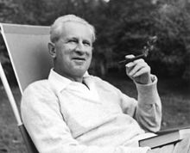
Anti Oppressive Practice
"Law and order are always and everywhere the law and order which protect the established hierarchy; it is nonsensical to invoke the absolute authority of this law and this order against those who suffer from it and struggle against it.“
-Herbert Marcuse
From Wiggershaus, 1994

Slide 16
Anti Oppressive Practice
It is an approach that seeks to reduce, undermine or eliminate discrimination and oppression and remove the barriers that prevent people from accessing services.
What are some of those barriers?

Slide 17
Anti Oppressive Practice
Requires the practitioner to critically examine the power imbalance inherent in an organisational structure with regards to the larger social and cultural context, aiming to create an environment free from oppression, racism and other forms of discrimination.

Slide 18
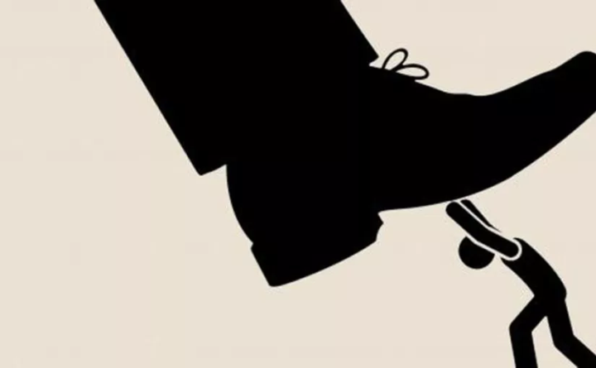
Anti Oppressive Practice
Anti-oppressive practice is an interdisciplinary approach primarily rooted within the practice of social work that focuses on ending socioeconomic oppression
HOWEVER…

Slide 19
Anti Oppressive Practice
There are other kinds of oppression, including:
Gender oppression
Racial oppression
Age oppression
Class oppression
Sexuality oppression

Slide 20
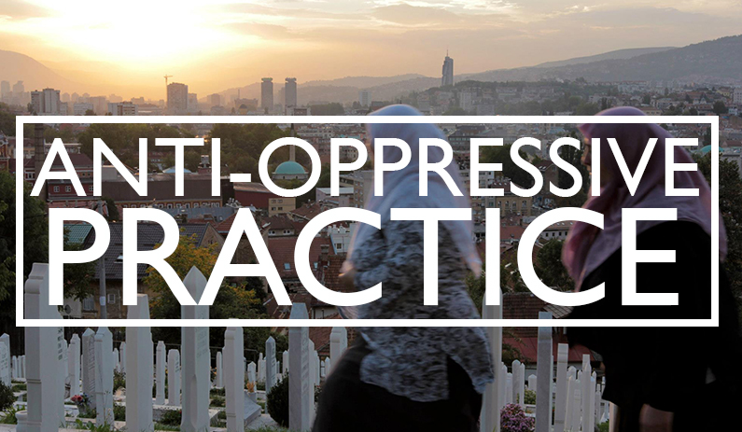
Examples of Principles
Inclusion
Communication
Empowerment
Equality
Respect
Commitment

Slide 21
References
Hitchens, C., 2005. Letters to a Young Contrarian. New York: Basic Books.
Nzira, V. & Williams, P., 2009. Useful Concepts in Anti Oppression. In: Anti-Oppressive Practice in Health and Social Care. New York: Sage Publications Ltd, pp. 21-40.
Thompson, N., 2016. Anti-Discriminatory Practice. 6th ed. London: Palgrave.
Wiggershaus, R., 1994. The Frankfurt School: Its Histories, Theories & Political Significance. Cambridge: MIT Press.
Young, I., 2004. Five Faces of Oppression. In: Oppression, Privilege and Resistance. Boston: McGraw Hill.

