Slide 1
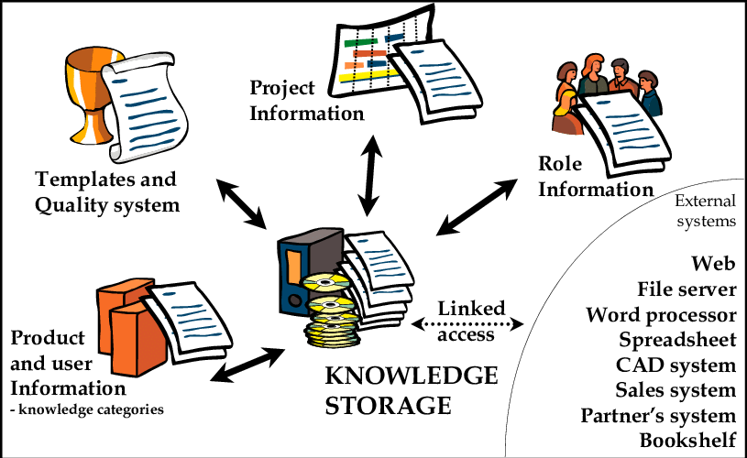
Amazon support by continuously raising the bar of the customer experience by using internet and technology to help staff and customers find, uncover and buy anything they like.
Amazon is the biggest internet-based company in the world. Selling everything from books to groceries to shiping container homes.
Our vision is to be earths most customer-centric company, to build a place where people can come to find and discover anything they might want to buy online.

Slide 2
Before you continue to Google Search (2021). Available at: https://www.google.com/search?q=Amazon+mission+vision+statment&rlz=1CAVUZL_enGB897&oq=Amazon+mission+vision+statment&aqs=chrome..69i57j0i13j0i8i13i30l5j0i390l2.13338j0j15&sourceid=chrome&ie=UTF-8 (Accessed: 21 May 2021).

