Slide 1

Student Name: Adji Makangila
Student ID: 2126238
Student name: Donna Shilunga
Student ID: 2129251
Lecture name: Joanne Davies
Module Title: Living with Care: The Older Person
Module Code: BMHP6009
Assignment title: Debate presentation and supporting paper

Slide 2
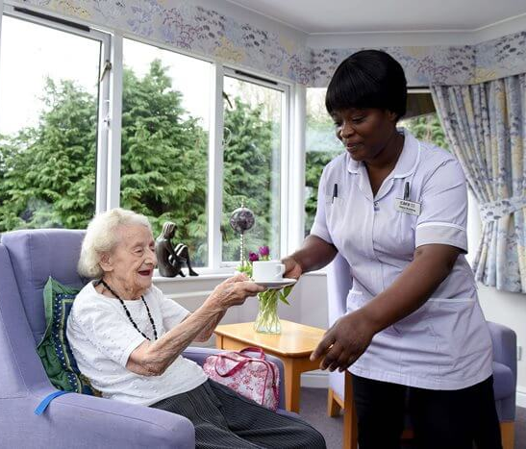

Introduction
In this debate we are going to discuss the advantages and disadvantages of living in domiciliary care when arguing for and against whether elderly people should be best cared for in their own homes.
In our debate, we will cover points such as:
The definitions of Residential care and Domiciliary care.
Funding options available for care in the UK
End-of-life care
Availability of care in UK
Theory of ageing
Conclusion
Recommendation
References

Slide 3

What is old age?
Old in the UK and internationally are defined depending on criteria that include, physical appearance, chronological age or inability to take care of oneself that can also be seen as participating in economic activity or being in retirement, which is usually at the age of 65 or plus (Sabharwal et al. 2015).

Slide 4


What is Domiciliary care and Residential care?
Domiciliary care is providing care services to individuals in their own homes. This type of care allows people to maintain their independence while receiving assistance with daily activities (Bolton and Wibberley, 2014).
Residential care refers to long-term care provided in a residential setting, such as a care home or nursing home, where individuals live on a full-time basis. This type of care offers accommodation, meals, personal care, and 24-hour support services (Carersuk, 2024).
Both provisions assist individuals with daily living activities, and the choice between them depends on the specific needs, preferences, and circumstances of the individual (Challis and Hughes, 2003)

Slide 5


Comparison
Aspect | Residential care | Domiciliary care
Location | Care home or nursing home | Individual's own home
Living Arrangement | Full-time, communal living | Independent in-home living, can have family and relative over night
Care Level | 24/7 comprehensive care | Varies, from a few hours to daily
Medical Supervision | Often included, especially in nursing homes | Limited, based on need
Social Interaction | Facilitated through group activities | Limited to caregivers and visitors
Independence | More structured environment | Greater independence and autonomy ( Kendall, 2000).

Slide 6


Risks of Abuse
Risks aspect | Residential care | Domiciliary care
Oversight and Supervision | More structured, but can suffer from overcrowding and understaffing | Less formal oversight, dependent on family and social services
Social Isolation | May experience isolation within the institution | can be more isolated at home without community interaction
Caregiver Dynamics | Staff-resident power imbalances, staff burnout (less staff more patients) | One-on-one care, potentially less supervision
Access to Resources | Limited personal control by residents | Greater access to personal resources by caregivers and a higher risk of financial abuse
Regulatory Environment | Subject to stricter regulations, but enforcement can vary (Fraga Dominguez et al. 2022) | Varies widely, especially with informal caregivers, unregulated carers can increase the risk of abuse due to a lack of professional oversight (Burnett et al. 2020)

Slide 7


Funding available
Domiciliary care and residential care in the UK are funded from different sources, depending on individual circumstances. For example, The National Health Service (NHS) may provide funding for domiciliary care if the individual's care needs are primarily health-related needing medical treatments, nursing care, or rehabilitation service (Thorlby and Arora, 2020).
Local authorities (councils) in the UK provide financial assistance for domiciliary care to those who are eligible based on a needs assessment. The level of funding provided depends on factors such as income, savings, and the level of care needed… also Individuals who are eligible for domiciliary care may receive a personal budget from the local authority, which allows them to arrange and pay for their care services. This often refers to a personal budget (Sumner and Smith, 2024; Homecare, 2024)
Those who are not eligible for financial assistance from the local authority, or the NHS must pay for domiciliary care services out of their pocket. Self-funding is often the case for individuals who have savings or assets above the threshold set by the local authority (AgeUK, 2022).

Slide 8

Funding Available
Means-tested benefits, such as Attendance Allowance or Personal Independence Payment help to cover the costs of domiciliary care and can be available for eligible people depending on circumstances. In some other cases, they are funded by charitable resources that provide financial assistance or grants to individuals who need domiciliary care but are unable to afford it (Curtis and Burns, 2015)
Both domiciliary and residential care providers are funded in the same way but the funding process for domiciliary care can be complex, and the eligibility criteria may vary depending on factors such as age, health condition, and location within the UK( Homecare, 2024).

Slide 9
Availability of care in the UK
In the UK care provisions range from domiciliary, Residential, respite, and nursing home. These provisions restrain different professions and specialists in dementia and, autism care environments.
Availability issues for Residential care
Capacity Issues, an ageing population has increased demand in the UK leading to waiting lists and capacity constraints in some areas(Zhou, Oyegoke and Sun, 2019).
Funding, adequate funding and resources are ongoing challenges, with pressures on both public and private sectors (Humphries et al. 2016).

Slide 10

Availability issues for domiciliary care service
Workforce Shortages: Recruitment and retention of skilled of care workers are significant issues, impacting the availability and quality of care. For example, ensuring that suitable and trusted members of staff are recruited to avoid the risks of harm and abuse that could affect elderly people in their homes. Also, provide staff rotations to minimise the risks of covered abuse from one regular staff. All this process takes time and needs prompt vetting checks (Rubery et al.2015).
Geographical Disparities: Access to domiciliary care can vary widely, with rural areas often facing more significant challenges in service provision. Elderly people in rural areas struggle to have enough carers for their services. This often costs a lot and causes problems of affordability (Milligan, 2016).
Reduce funding besides the increasing number of older adults (Hughes, 2023).

Slide 11
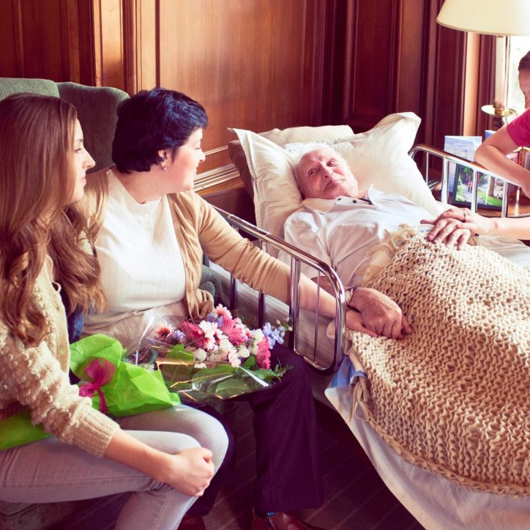
End of life care
Domiciliary advantage
Comfort home where Patients can stay in familiar surroundings, which can be emotionally comforting and less stressful.
Cost-Effectiveness: Home care can be less expensive than residential care, especially if intensive medical interventions are not required.
Family Involvement: Families can be more involved in the care process, which can be reassuring for both the patient and the family members ( Teno et al. 2004; Percival et al. 2014).
Disadvantage
Limited medical resources
Caregivers’ burden on family interference in the delivery of care causes physical and emotional exhaustion on carers (Hoare, Kelly and Barclay, 2019).

Slide 12


End of Life Care
The best setting for end-of-life care depends on the individual’s medical needs, personal preferences, family dynamics, and financial situation.
Residential care facilities offer comprehensive and specialised services but may lack the personal touch and comfort of home. On the other hand, domiciliary care provides a familiar environment and personalised attention but may lack immediate medical support and place a burden on family caregivers ( NHS, 2021)

Slide 13

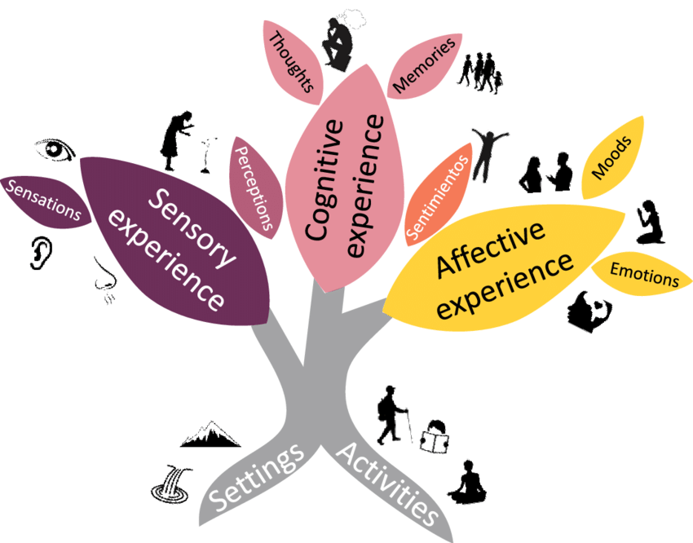
Theories of Ageing
In the UK the theory of ageing is not a framework enforcement. Still, it’s how the research departments in the UK view and analyse elderly people’s changes throughout their ageing periods by looking at factors such as.
Biological theory is when the body becomes less active and less responsive over time (Lipsky and King, 2015).
Psychosocial theory emphasises the role of psychological, social, and environmental factors in shaping the ageing process (Bowling and Iliffe, 2011).
Life course theory views ageing as a lifelong process influenced by cumulative experiences and events across the lifespan for example, it considers how factors such as socioeconomic status, education, and early life experiences shape health and well-being in later life (Bengtson et al. 2012; Fuller-Iglesias, Smith and Antonucci, 2009).
Disengagement theory, this theory, proposed by Cumming and Henry in 1961 consisted of saying that elderly people gradually withdraw from social roles and interactions, leading to a mutual disengagement between older adults and society (Zhang and Lin, 2022).

Slide 14

Legislations
In the UK, Domiciliary care and Residential care are governed by a combination of laws, regulations, and standards aimed at ensuring the safety, quality, and rights of individuals receiving care. For example,
Care Act 2014: This is a piece of legislation in England that sets out the legal framework for adult social care. It outlines the responsibilities of local authorities in assessing and meeting the care and support needs of individuals, including those receiving domiciliary care and residential care(Fernandez, Snell and Marczak, 2015).
Health and Social Care Act 2008 (Regulated Activities) Regulations 2014. s2 regulations are set to ensure the safety and well-being of individuals receiving care. They cover aspects such as person-centred care, dignity and respect, and protection from abuse (HSC Act, 2008).
Care Standards Act 2000: This legislation applies to care homes in England and Wales and sets out the regulatory framework for the registration and inspection of care homes by the Care Quality Commission (CQC) in England and the Care Inspectorate Wales (CIW) in Wales (Kerrison and Pollock, 2001).
National Minimum Standards for Domiciliary Care Agencies: These are standards set by the relevant regulatory bodies, such as the CQC in England and the Care Inspectorate in Scotland, to ensure the quality and safety of domiciliary care services (Venables et al. 2006).

Slide 15


Conclusion
Domiciliary care offers a more personalised and comfortable experience for end-of-life patients by allowing patients to remain in their familiar home environment. It fosters greater family involvement and tailored care, enhancing emotional well-being. Also, domiciliary care can be more cost-effective compared to residential provision. Despite potential limitations in immediate medical resources, the personalised attention and emotional comfort provided at home often compensate for the benefits of residential care for many individuals, making domiciliary care a preferred choice for those prioritising familiarity, individualised care, and family presence (Percival et al. 2014; Glendinning, Schunk and McLaughlin, 1997). However, on the other hand,
Residential care provides comprehensive, professional support, ensuring immediate medical attention and specialised services. It alleviates the caregiving burden on families and offers social interaction and structured activities, enhancing the overall quality of life for end-of-life patients in a secure, well-equipped environment (Burge and Street, 2010).

Slide 16

Recommendations
To improve domiciliary care, it is crucial to enhance access to comprehensive medical resources and support services.
Implementing regular home visits by multidisciplinary healthcare teams, including doctors, nurses, and social workers, can ensure holistic care.
Providing advanced training for home caregivers can elevate the quality of care.
Encouraging community involvement and establishing support networks for caregivers can alleviate their burden and improve overall care outcomes.
increasing financial support and subsidies for home care services can make them more accessible.
Provide adequate housing for those in need of extra support and be able to use equipment freely when there is enough space.
Issues accounted for might be a shortage of housing to accommodate everyone in need and this might be a problem using certain equipment in domiciliary care due to the space provided and certain people might need to go to residential care depending on the level of their health condition and assessment made by social workers.
(Elkan et al. 2001; Teno et al. 2015)

Slide 17
References
© 2024 HOMECARE. Available at: https://www.homecare.co.uk/advice/local-authority-funding-for-home-care#: (Accessed on 17 June 2024).
AGEUK.(2022). Available at: https://www.ageuk.org.uk/search/?q=What+is+self+funding (Accessed on: 16 June 2024).
Bengtson, V.L., Elder Jr, G.H. and Putney, N.M. (2012). The life course perspective on ageing: Linked lives, timing, and history. Adult lives: A life course perspective, pp.9-17. https://doi.org/10.1113/JP270579
Bolton, S.C. and Wibberley, G. (2014). Domiciliary care: the formal and informal labour process. Sociology, 48(4), pp.682-697. https://doi.org/10.1177/0038038513500098.
Bowling, A. and Iliffe, S. (2011). Psychological approach to successful ageing predicts future quality of life in older adults. Health and quality of life outcomes, 9, pp.1-10. DOI https://doi.org/10.1186/1477-7525-9-13.
Burnett, J., Suchting, R., Green, C. E., Cannell, M. B., & Dyer, C. B. (2020). Socioecological indicators of senior financial exploitation: an application of data science to 8,800 substantiated mistreatment cases. Journal of Elder Abuse & Neglect, 32(2), 105–120. https://doi.org/10.1080/08946566.2020.1737615
Burge, S. and Street, D. (2010). Advantage and choice: Social relationships and staff assistance in assisted living. Journals of Gerontology Series B: Psychological Sciences and Social Sciences, 65(3), pp.358-369. https://doi.org/10.1093/geronb/gbp118
Care Standards Act (2000) c.14: available at: https://www.legislation.gov.uk/ukpga/2000/14/contents (Assessed on: 22 June 2024).
Carersuk. (2024) available at: https://www.carersuk.org/help-and-advice/practical-support/arranging-care-and-support-for-someone/residential-care/#:~:text=What%20is%20residential%20care%3F,the%20toilet%20and%20taking%20medication. (accessed on: 16 June 2024).

Slide 18
Challis, D. and Hughes, J. (2003). Residential and nursing home care—issues of balance and quality of care. International journal of geriatric psychiatry, 18(3), pp.201-204. https://doi.org/10.1002/gps.813.
Elkan, R., Egger, M., Kendrick, D., Dewey, M., Hewitt, M., Robinson, J., Blair, M., Williams, D. and Brummell, K. (2001). Effectiveness of home-based support for older people: a systematic review and meta-analysis Commentary: When, where, and why do preventive home visits work?. Bmj, 323(7315), p.719. https://doi.org/10.1136/bmj.323.7315.719
Curtis, L.A. and Burns, A. (2015). Unit costs of health and social care 2015. Personal Social Services Research Unit. https://doi.org/3.
Fernandez, J.L., Snell, T. and Marczak, J. (2015) An assessment of the impact of the Care Act 2014 eligibility regulations. Available at: https://d1wqtxts1xzle7.cloudfront.net/111838271/__lse.ac.uk_storage_LIBRARY_Secondary (Assessed on: 18 June 2024).
Fraga Dominguez, S., Ozguler, B., Storey, J.E. and Rogers, M. (2022). Elder abuse vulnerability and risk factors: Is financial abuse different from other subtypes?. Journal of Applied Gerontology, 41(4), pp.928-939. https://doi.org/10.1177/07334648211036402.
Fuller-Iglesias, H., Smith, J. and Antonucci, T.C. (2009). Theories of aging from a life-course and life-span perspective. Annual review of gerontology and geriatrics, p.1. Available at: https://books.google.co.uk/books?hl=en&lr=&id=z7ZMcSP-VL( accessed on : 20 June 2024).
Glendinning, Schunk and McLaughlin. (1997). Paying for long-term domiciliary care: A comparative perspective. Ageing & Society, 17(2), pp.123-140. https://doi.org/10.1017/S0144686X96006356
Hoare, S., Kelly, M.P. and Barclay, S. (2019). Home care and end-of-life hospital admissions: a retrospective interview study in English primary and secondary care. British Journal of General Practice, 69(685), pp.e561-e569. DOI: https://doi.org/10.3399/bjgp19X704561.
Hughes, S. (2023). Domiciliary care, self and older age (Doctoral dissertation, Anglia Ruskin Research Online (ARRO)). Available at: https://aru.figshare.com/articles/thesis/Domiciliary_care_self_and_older_age/23760969 (Accessed on: 15 June 2024).
Humphries, R., Thorlby, R., Holder, H., Hall, P. and Charles, A. (2016). Social care for older people. The Kings Fund: Home truths. London. Available at : https://www.britishcouncil.nl/sites/default/files/social_care_older_people_kings_fund_sep_2016.pdf ( Accessed on: 16 June 2024).

Slide 19
Kendall, J. ( 2000). The third sector and social care for older people in England: Towards an explanation of its contrasting contributions in residential care, domiciliary care and daycare (No. 8). Centre for Civil Society (London School of Economics and Political Science). Available at: https://eprints.lse.ac.uk/29040/ (Accessed on: 16 June 2024).
Kerrison, S.H. and Pollock, A.M. (2001). Caring for older people in the private sector in England. BMJ, 323(7312), pp.566-569. https://doi.org/10.1136/bmj.323.7312.566
Lipsky, M.S. and King, M. (2015). Biological theories of aging. Disease-a-month, 61(11), pp.460-466. https://doi.org/10.1016/j.disamonth.2015.09.005.
Milligan, C. (2016). There's no place like home: Place and care in an ageing society. Routledge. https://doi.org/10.4324/9781315551128.
NHS. ( 2021). Available at: https://www.nhs.uk/conditions/end-of-life-care/where-you-can-have-care/care-at-home/( Accessed on: 19 June 2024).
Percival, J., Lasseter, G., Purdy, S. and Wye, L.(2014). “Earthly Angels”? A qualitative study of the domiciliary care worker role in meeting the needs of families caring for those dying at home. Palliative & Supportive Care, 12(6), pp.445-453. doi:10.1017/S147895151300076X.
Rubery, J., Grimshaw, D., Hebson, G. and Ugarte, S.M. (2015). “It's all about time”: time as contested terrain in the management and experience of domiciliary care work in England. Human Resource Management, 54(5), pp.753-772. https://doi.org/10.1002/hrm.21685.
Sabharwal, S., Wilson, H., Reilly, P. and Gupte, C.M. (2015). Heterogeneity of the definition of elderly age in current orthopaedic research. Springerplus, 4, pp.1-7. https://doi.org/10.1186/s40064-015-1307-x.
Sumner, G. and Smith, R. (2024). Planning local authority services for the elderly. Taylor & Francis. Available at: https://books.google.co.uk/books?hl=en&lr=&id=rp_8EAAAQBAJ&oi=fnd&pg=PA1936&dq=How+is+the+local+authority+funds (accessed on: 15 June 2024).

Slide 20
Teno, J.M., Clarridge, B.R., Casey, V., Welch, L.C., Wetle, T., Shield, R. and Mor, V. (2004). Family perspectives on end-of-life care at the last place of care. Jama, 291(1), pp.88-93. doi:10.1001/jama.291.1.88.
The Health and Social Care Act 2008 (Regulated Activities) Regulations 2014: Available at: https://www.legislation.gov.uk/ukdsi/2014/9780111117613/contents (Assessed on 20 June 2024).
Thorley, R. and Arora, S.(2020). The English health care system. International profiles of health care systems, p.59. Available a https://www.researchgate.net/profile/Roosa-Tikkanen/publication/347011106_International_Profiles_of_Health_Care_S (Aceeseede on: 18 June 2024).
Venables, D., Reilly, S., Challis, D., Hughes, J. and Abendstern, M. (2006). Standards of care in-home care services: A comparison of generic and specialist services for older people with dementia. Aging and Mental Health, 10(2), pp.187-194. https://doi.org/10.1080/13607860500310518.
Zhang, X. and Lin, H. (2022). Disengagement theory. In Encyclopedia of gerontology and population aging (pp. 1471-1476). Cham: Springer International Publishing. https://doi.org/10.1007/978-3-030-22009-9_645
Zhou, W., Oyegoke, A.S. and Sun, M. (2019). Causes of delays during housing adaptation for healthy aging in the UK. International Journal of Environmental Research and Public Health, 16(2), p.192. https://doi.org/10.3390/ijerph16020192.

Slide 21
Image References
https://www.careuk.com/help-advice/what-s-the-difference-between-a-care-home-and-a-nursing-home (Accessed on: 18 June 2024).
https://www.tlccare.co.uk/care-services/our-approach-to-residential-care/ (Accessed on: 18 June 2024).
https://money.com/this-is-the-age-when-you-become-old-according-to-four-different-generations/ (Accessed on: 18 June 2024).
https://www.theliveincarecompany.co.uk/care-guides/a-guide-to-domiciliary-care/ (Accessed on: 18 June 2024).
https://www.tvlicensing.co.uk/easy-read/if-you-live-in-residential-care-ea14 (Accessed on: 18 June 2024).
https://greenwichsafeguardingadults.org.uk/home/who-is-an-adult-at-risk/ (Accessed on: 18 June 2024).
https://spacecoastdaily.com/2020/06/what-are-the-warning-signs-of-elder-abuse/ (Accessed on: 18 June 2024).
https://www.nursenextdoor.com.au/blog/the-5-stages-of-palliative-care/ (Accessed 0n: 18 June 2024).
https://www.verywellhealth.com/what-is-palliative-care-1132354 (Accessed on: 18 June 2024).

