Slide 1
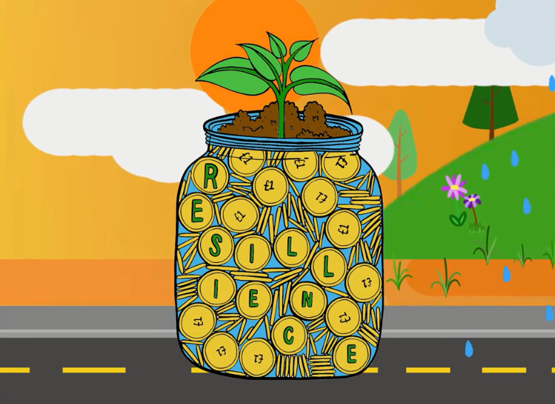
Notes:
Next steps:
Natural Resources Wales, working with others, hope to:
Develop better measures to enable us to assess level of risk, and contribution to well-being
Develop its approach to assessing resilience at different scales, using mapping tools and ways of assessing ‘value’
Continue to improve their understanding of the links between natural resources, ecosystem resilience, and well-being
Work with other bodies to refine the use of a Risk Register as a support tool for integrated planning.
While this is still work in progress, Wales now has the opportunity to use the new legislative Framework of the Well-being of Future Generations (Wales) Act and associated emerging research, to improve its approach to the management of natural resources.

Slide 2
Further Reading/Darllen Pellach:
A summary of the state of natural resources report: an assessment of the sustainable management natural resources. Available online at: www.naturalresources.wales/sonarr
Crynodeb o Adroddiad ar Sefyllfa Adnoddau Naturiol: asesiad o reolaeth gynaliadwy o’n adnoddau naturiol. Ar gael ar-lein yn: http://www.naturalresources.wales/sonarr?lang=cy
http://gov.wales/docs/desh/publications/170821-natural-resources-policy-en.PDF
http://www.legislation.gov.uk/anaw/2016/3/pdfs/anaw_20160003_en.pdf
http://www.legislation.gov.uk/anaw/2016/3/pdfs/anaw_20160003_we.pdf
Notes:
http://www.legislation.gov.uk/anaw/2016/3/pdfs/anaw_20160003_we.pdf

