Slide 1

The separation and exclusion of children with additional learning needs in the nursery setting.
Written and presented by
Sophie Morgan.

Slide 2
Why did I choose this?
ALN- A brief overview
What could this research do?
Throughout my studies and placement I saw a substantial amount of children with additional learning needs, mainly autism. In Wales, autism affects 1 in 100 people. Autism was first used in a modern sense in 1943 and it would therefore be expected that care and understanding standards would be at a substantial level in 2019. However, this is not the case. The National Assembly Government reported that there are currently 105,000 children recognised as having SEN. Within my setting I began to see differences in treatment of children with additional learning needs in certain activities and the staff's understanding of how to deal with these changes.
ALN means additional learning needs. The term ALN has replaced SEN- and the ALN Reform will be introduced in September 2020. Now the name has changed, it now means that SENCO's will now be ALNCO's- meaning additional learning needs coordinators. This was approved in January 2018 and the reform has some major changes to schools and nurseries across Wales. SNAP Cymru will be introducing Individual Development Plans, extending the support age to 25 and support will begin before birth and will require education and care settings to extend support for those who need it. The Welsh Government have invested £2.1 million pounds into this reform.
From my setting, I realised the effect of my research could lead to a positive outcome for the nursery, such as gaining more understanding. It became apparent to me that not only did staff have minimal knowledge on ALN, parents were also unaware of many ALN conditions and how to deal with them. This included parents with children that were on the autistic spectrum as an example. My research could also broaden my own knowledge of ALN and research methods. Through my research, I was trying to understand the barriers preventing or limiting staff and parental understanding of ALN. Research has to be completed for a reason and with a target, which was my goal.

Slide 3



My setting
Babies
Toddlers
Pre-school
Take babies from 6 weeks to one and a half years old.
Staff ration 1-2
Individual books and observations
Sleep and feeding
Develop fine motor skills
One year 11 months children are accepted for toddlers.
Based at top of the nursery with four playrooms.
More complex tasks such as painting and building.
Staff ratio of 1-3
Progress into preschool at three years until age four.
Well-developed gross motor skills from outdoor activities.
Encouraged independent learning.
Staff ratio 1-8
More involvement with parents.

Slide 4
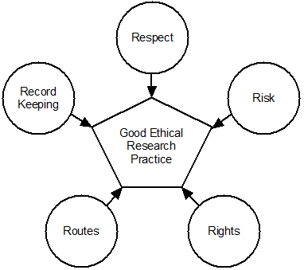
Ethics- Moral principles that govern a person's behaviour or the conducting of an activity.
When working with children, safety and safeguarding is always a key focus point. When looking at the ethics of my study, I considered whether it would harm, upset or jeopardise any individual during my study. When I conduct my interviews, I will ensure they are all anonymous. Therefore, no one can be penalised from the information they provide me with.
When gathering my research and data, I will store it in a diary that I will carry with me and leave in a locked locker when I have finished my daily observations, any interviews I conducted or focus groups I had created. I will ask permission from staff to gather information and use consent forms to keep record of their agreements. After every day that I have gathered data I will review it after work and ensure I note it clearly and use dated notes so I can keep accuracy and make any links to patterns that may exist, such as certain children being excluded if others are present as not every child attends the same days as their peers.
These are some of the principles I considered when planning my research. I will keep a daily diary, so my notes are accurate and ensure the staff are comfortable when I interview them. I want to ensure my research is done respectfully by doing this. Throughout I considered risks such as causing offense and privacy as well as breaching confidentiality. I investigated different routes I could take to gain information other than interviews, hence why I also used focus groups, allowing fairness and broader understanding.

Slide 5
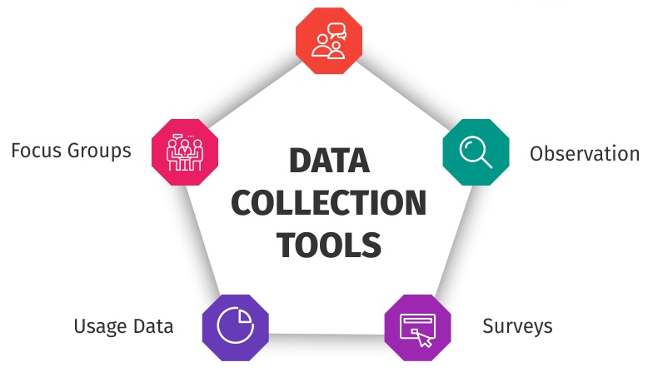
Research tools.
interviews
I used three different types of research tools/methods. These being:
Observations
Focus groups
Interviews
Observations.
When I conduct my observations, I will take detailed notes of staff's approaches to negative behaviour as well as how other children deal with it, as well as staff's, misunderstandings and punishments. This method is simple, easy and can be conducted constantly as I will always be in the environment. Also, my observations will make it easier to frame my hypothesis, give good accuracy as it was first-hand and mean I didn't disturb staff or children so it will be natural
Interviews
All staff will be interviewed for accuracy and fairness. It will give me information on my topic from all departments thus being more detailed and give me a bigger insight. Body language can also be taken into consideration and I can record that to make possible assumptions. Interviews are easy to conduct and make recording data easier. My interviews will allow more validity and depth to my research data and I can gain a bigger picture of the setting and record things I may not have seen in focus groups or observations.
Focus groups
I will use four focus groups whilst conducting my search spread over the 10 days of my placement. To ensure accuracy and to keep the focus of my hypothesis I will ask staff for records and suggestions of children that are considered to have an additional learning need and mix them with a variety of children to gain the information. Focus groups will help me observe with more detail and can allow me to ask questions, give tasks to help me with specific findings.

Slide 6

Interviews
Considerations
I would use private interviews of every individual member of staff so I could get honest and accurate answers. One type of question I would use would be a situational question. I would give a scenario and note how they would deal with it. From this I would be able to see how children with ALN are excluded and what training staff have to deal with certain situations. An example may be:
"A child with delayed speech and unsocial behaviour has pushed another child over after they attempted to join them in building with Lego blocks, how would you approach this?"
To help accuracy I would record the staff being interviewed through a divise such as a phone and when taking the interview use key words in taking my notes. I would also have premade positive and negative tables to separate the information. I would use semi-structured interviews to build a rapport, be more ethical and can gain broader knowledge. I may use a question such as:
"Do you think you have enough training?"….."Why do you think that?"
Even through private and confidential interviews some staff may feel obliged to only say positive things due to loyalty towards their employer, building a rapport should help the interviewee with this. Semi-structured interviews also take longer and can be harder to take notes on due to more detailed information being given rather than simple yes or no answers. As well as this, semi-structured interviews are a theoretical approach so often low in reliability and can also have researcher bias.
Additional help
To help improve my interview skills and review what I have in place I would do some research on different interview techniques. As well as this, I would also have a discussion with the manager to get a basic idea of the personalities of the staff I wikll be interviewing, scuh as seeing if any staff are shy or uncomfortable being interviewed.

Slide 7

Observations
Time samples
Running records.
I will use three different types of observations to ensure they are accurate and gather as much information as possible. My first will be anecdotal observations. This will allow me to observe the children's behaviour and then see how the staff react. If I have knowledge of how the children behaved, it can give me a better understanding of the staff's reactions to certain situations and how other children react to their peers. This type of observation is recorded by facts, and often includes the main three themes of when, why and where. All of this will be relevant in the nursery setting due to routines and different envrionments the children and staff will be working with. Anecdotal obnservations also take body language, facial expressions and reactions to certain situations into consideration and I believe this is an ideal method to use when working with children that may have delayed speech or limited body movement such as babies. This type of observation includes up to seven children which works well with child numbers in private nurseries.
Time samples are a form of observation that are recorded around certain times of the day, an example could be around nap time. When I note my observations, I will have to record the time it occured and see if there are any patterns or repetative behaviours. From time samples I may be able to see if the staff change their reactions at certain times of the day and if children exclude those with additional learning needs at specific times, such as after an hour or so of playing. Time samples will add context to my notes which will mean they are easier to review and make points on. It is important to remember that children with additional learning needs often require more attention and help and it is an interest of mine to see how the time of the day may affect this, such as towards the end of the day.
This type of observation is directly focussed on children's behaviour, is recorded in present tense and is kept in detail. Whilst using this I will be noting down exactly what the child says, the actions they tke and what the child is doing. It is important to remember what children say can sometimes mean multiple things or imply different things so observing what they are doing will help accuracy. For example, a child may say "You can't play with me" but this may not be in a malicious way but because they wish to play alone or are only playing the female peers. It is unfair to always assume if a child is excluded it is due to their additonal learning need. Thus this method will improve my accuracy massively.

Slide 8

Focus groups.
Although I will be using interviews with single members of staff which will also be confidential, I will use focus groups for staff and for children.
What is a focus group?
This is a form of qualitative research and usually includes around 6-12 people. This form of research began in market research but has now expanded to all fields of research topics such as crime, religion and childcare. Using a focus group will allow me to work closely with children and help me observe behaviour in more detail in a relaxed environment. Focus groups are useful in childcare research because I can investigate why children or staff have certain approaches and opinions to a topic and how this affects the environment around them.
Advantages and disadvantages
This will save me time in researching the children and will allow the children to feel relaxed in comparison to if I interviewed them individually. I will receive the most accurate information as it will be happening in an environment children are comfortable in and I can take notes and observations as they are happening. It may be difficult to note accurately and staff may influence the children so behaviour will not be accurate.
What I will do
When using a focus group I will set up an outdoor activity, such as playing in the sandpit or using the parachute and ball. I will observe how children react to children with additional learning needs taking part and how they include them. If their behaviour changes towards these children, I will ask the children why and see if there are any patterns, such as if only boys exclude them. I will also observe staff behaviour throughout this and see if any changes occur whilst conducting this activity.

Slide 9
References
Adobe Stock. (2020). Small baby cartoon minimalism character illustration isolated image - Buy this stock illustration and explore similar illustrations at Adobe Stock. [online] Available at: https://stock.adobe.com/ee/images/small-baby-cartoon-minimalism-character-illustration-isolated-image/218039735 [Accessed 16 Jan. 2020].
Bhat, A. (2016). How to use data collection tools for market research | QuestionPro. [online] QuestionPro. Available at: https://www.questionpro.com/blog/data-collection-tools/ [Accessed 16 Jan. 2020].
Chauhan, M. (2018). Direct And Inverse Variation - Lessons - Tes Teach. [online] Tes Teach with Blendspace. Available at: https://www.tes.com/lessons/crd9BtfJDJUsIQ/direct-and-inverse-variation [Accessed 17 Jan. 2020].
Crayon Bits, L. (2020). A new platform for user research and collaboration | UserBit. [online] UserBit. Available at: https://userbitapp.com/solutions/research-repository [Accessed 17 Jan. 2020].
Ethics.coventry.ac.uk. (2020). Introduction to Research Ethics. [online] Available at: https://ethics.coventry.ac.uk/about/Introduction-to-Research-Ethics.aspx [Accessed 16 Jan. 2020].
Freepik. (2010). Freepik | Discover the best free Preschool graphic resources, 34,467 results. [online] Available at: https://www.freepik.com/free-photos-vectors/preschool [Accessed 17 Jan. 2020].
School Website Design & Mobile Apps Blog by Webanywhere. (2020). Different types of observation methods in early years | Webanywhere. [online] Available at: https://www.webanywhere.co.uk/blog/2019/05/different-types-observation-methods-early-years/ [Accessed 18 Jan. 2020].
Sheehan, L. (2017). Focus Group Opportunity in the Chicagoland Area. [online] The Simon Foundation for Continence. Available at: https://simonfoundation.org/focus-group-chicago-incontinence/ [Accessed 18 Jan. 2020].
Shutterstock.com. (2003). Cartoon Toddler Images, Stock Photos & Vectors | Shutterstock. [online] Available at: https://www.shutterstock.com/search/cartoon+toddler [Accessed 17 Jan. 2020].
Thompson, K. (2016). Interviews in Social Research: Advantages and Disadvantages. [online] ReviseSociology. Available at: https://revisesociology.com/2016/01/23/interviews-in-social-research-advantages-and-disadvantages/ [Accessed 17 Jan. 2020].

