Slide 1

Contemporary technologies

Slide 2

Digital Age
Nowadays, or commonly referred to as the ‘digital era or age’(Selwyn and Facer, 2014; Redshaw, 2019), people are immersed within a vast array of digital technologies.
Covid 19 Pandemic accelerated digitalisation (José et al., 2021).
Society has become increasingly dependant on digital technology.

Slide 3
Digital Divide
The pandemic brought a tide of ‘new normality’, which highlighted three main inequalities (Digital Divide):
Access
Competencies
Educational Outcomes
Sub-categories:
Socioeconomic position
Age
Sex/Gender

Slide 4
Digital Divide
Access to to digital technology has been rigorously examined (gender, age, ethnicity, education and socioeconomic position)
On a global scale:
45% of women engage with the internet and digital platforms compared to 51% of males (250 million difference) (OCED, 2018).
51% British households earning under £10,000 had insufficient access.
99% British households earning £40,000+ has access (Local Government Association, 2021).

Slide 5

Wales Digital Literacy: Digital 2030 Strategy
To address the inequalities the WG and Post-16 sector developed the 2030 digital strategy:
Equip everyone with the right skills for a changing world
Support young people to make the most of their potential
Drive sustainable growth and combat climate change
Promote good health and wellbeing for everyone.

Slide 6
Digital Inclusion within HSC
According to the NHS (2022), the incorporation of digitalization can be crucial to achieving:
physical and mental wellbeing
prevention
self care
shared care and shared decision making
long term condition management
appropriate use of urgent and emergency care
https://digital.nhs.uk/about-nhs-digital/corporate-information-and-documents/digital-inclusion/digital-inclusion-in-health-and-social-care

Slide 7

Contemporary technology within HSC
Personal health records (PHR) were traditionally paper based:
Electronic Personal Health Records: (ePHR):
Empowerment
Increase accessibility
Promote digital literacy
(Nuffield Trust, 2007)

Slide 8
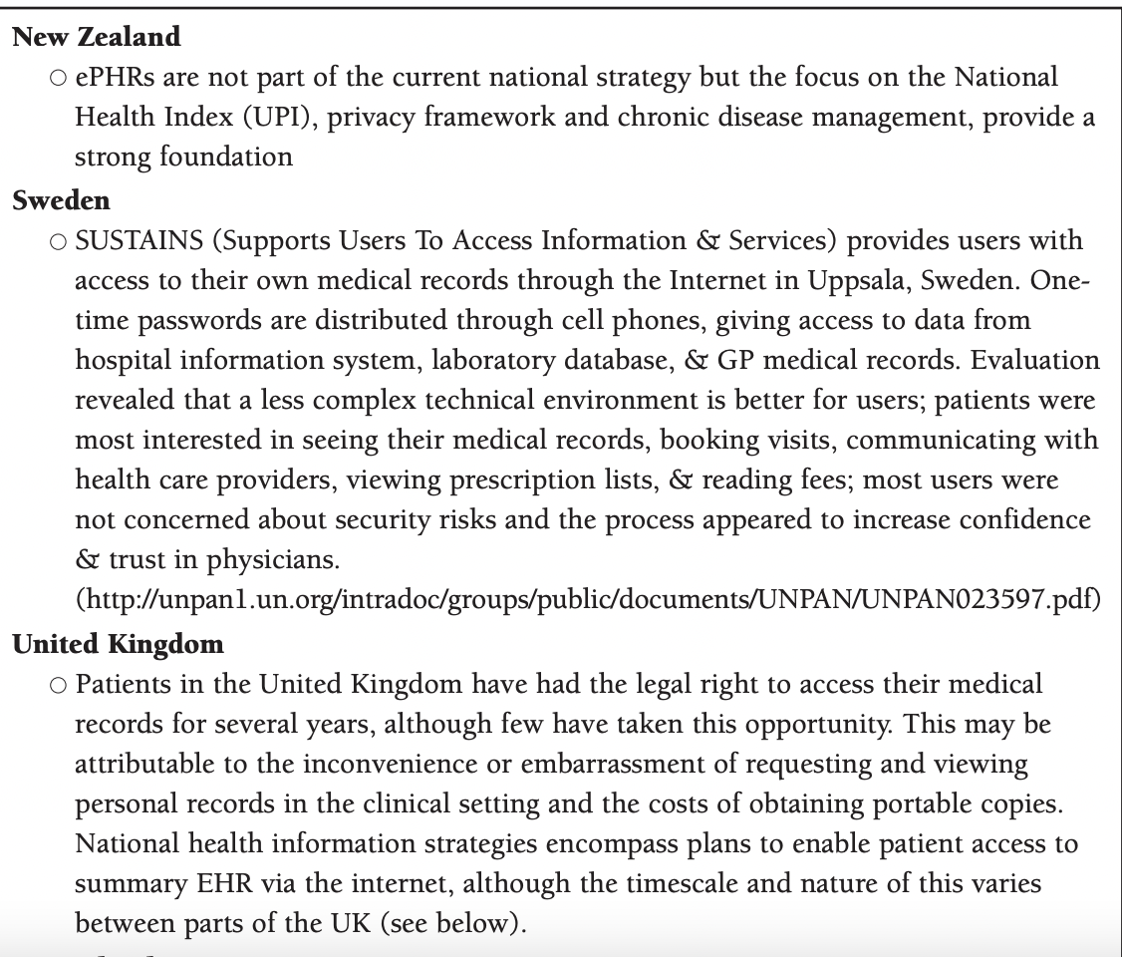

Slide 9
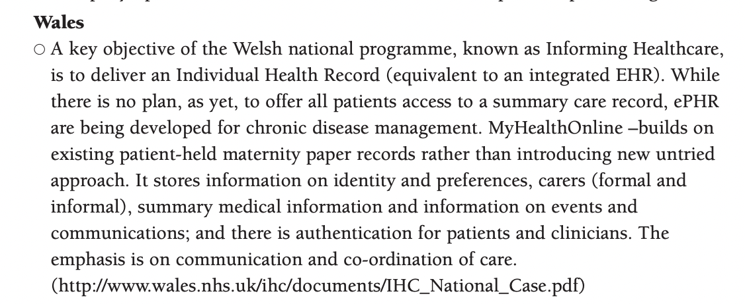

Slide 10

Testimony of EPHR

Slide 11


Slide 12

Telehealth and Telemedicine
Telehealth or Telehealth can be considered as providing healthcare remotely using digital technology (Olla and Tan, 2009).
Transferring medical data
Consultations
Monitoring diagnosis
Treatment and Education

Slide 13

Telehealth and Telemedicine
The Covid-19 pandemic accelerated the development and adoption of digital technologies to delivery health services widely and efficiently.
Streamline/ Triage
Free space for acute conditions within hospitals
Prevent infection transmissions
NHS:
NHS App
NHS login
e-prescription services.

Slide 14
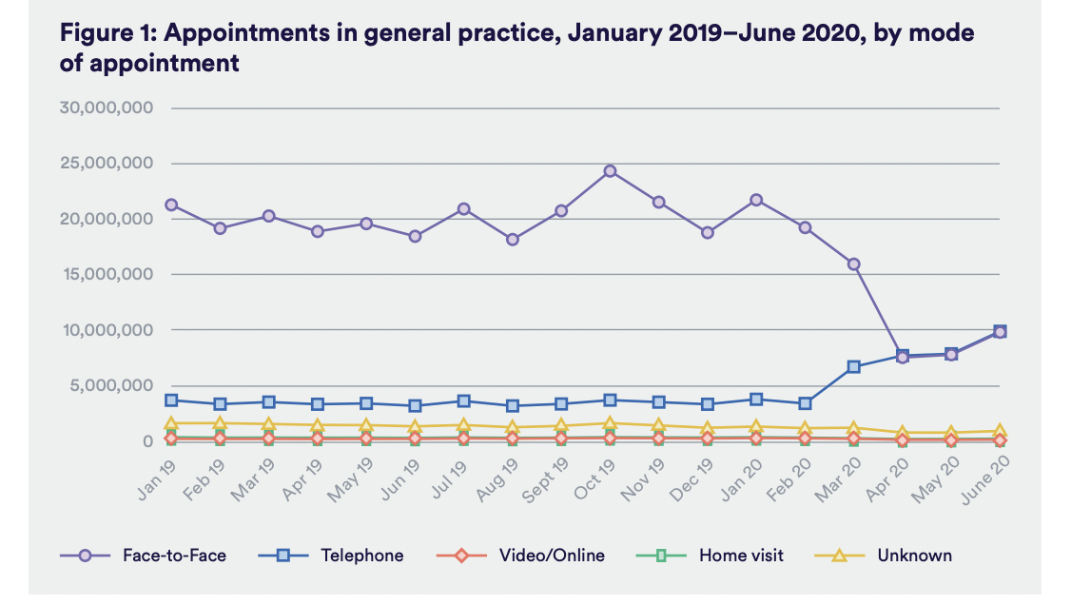
(Hitchings, 2020)
Notes:
https://www.nuffieldtrust.org.uk/sites/default/files/2020-08/the-impact-of-covid-19-on-the-use-of-digital-technology-in-the-nhs-web-2.pdf

Slide 15

Immersive Technology
AR - Augmented Reality: technology to superimpose digital elements (such as sounds, images, and text) to the world we see using a tablet, or a smartphone camera.
Virtual Reality is an immersive, three-dimensional, computer-generated environment which can be explored and interacted with by a person.
Mixed Reality is the merging of real and virtual worlds to produce new environments where both physical and digital objects co-exist and interact in real time.

Slide 16




Health Apps

Slide 17
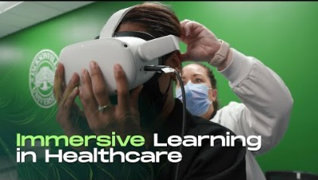
Immersive technology application

Slide 18

Artificial Intelligence and Dementia

Slide 19

Social Media
Hewson (2013, p.14 ), “outlines a person’s online activities, including their use of social networking platforms” (p. 14); A digital footprint is therefore created whenever we use networked technology.
Notes:
LinkedIn

Slide 20

Building an online reputation
Recruiters spend hours researching their networks, seeking out candidates and analysing profiles
If you were in the market for a new job right now and they landed on your profile, or read your recent updates, would they be impressed?

Slide 21

Why is an online presence important?
Return on Investment (ROI):
Building your reputation to gain gainful employment can be considered as
Return of Reputation (ROR):
Building your reputation and establishing new connections can lead yield opportunities.
(Phillips and Ellinas, 2014)
Notes:
Return on Investment: The more time you spend crafting an online reputation, the more likelihood of gaining traction.
Return of Reputation: Establishing meaningful connections can yield opportunities for collaboration.

Slide 22
Building an online reputation
Phillips and Ellinas (2014) advocates that people need to apply the ‘three Cs’ when attempting to develop their online reputation.
Clarity (Focus on key messages you want to share)
Consistency ( Apply consistent imagery and information)
Care (Be honest and authentic)

Slide 23

Blogs + Vlogs Road Map
Turning ideas into tangible SMART Goals
Specific: Narrow down vague goals to increase brand awareness (increase traffic to your blog)
Measurable: Numerical visits or replies
Achievable: Realistic goals within time restraints/ outreach.
Relevant: What will be useful for your brand? (Growing audience)
Time-bound. Time frames will help you to make an action plan

Slide 24

Blog Structure
A blog will have 4 elements:
Title/ Headline
Introduction
Main Body
Conclusion
Notes:
https://www.blogtyrant.com/blog-post-style/
Blogs are unconventional method of developing student’s academic writing skills.
Create an overall theme: and focus directly on that theme.
Incorpation of imagery and charts are useful to support written content as blogs are typically short.
Blogexamples: https://www.buzzlogic.com/blogging/examples-successful-blogs/
Research one.

Slide 25

Blog Examples
How to structure the perfect blog:
https://www.blogtyrant.com/blog-post-style/
Blog examples:
https://www.championingsocialcare.org.uk/blog/

Slide 26

Vlogging
Since the development of digital platforms like YouTube, vlogging (Video Blog) as been an accessible and creating method of providing informative information in creating ways.
Personal insight to your life
Insight to practice
Platform to share experiences
Platform to raise awareness

Slide 27


Podcasts
What is a podcast?
A podcast is an audio programme, just like Talk Radio, but you subscribe to it on your smartphone and listen to it whenever you like.
Purpose:
To entertain its audience.
Listeners might want to hear updates and breakdowns of current events
Podcasts Types:
Conversational ( Informal and topics are organically generated)
Narrative nonfiction (Long-form story telling)
Scripted fiction (Fictional entertainment such as TV and movies; episodic nature)
Repurposed content (repacking existing content)

Slide 28

How to start a Podcast
https://www.smartpassiveincome.com/guide/how-to-start-a-podcast-tutorial-pat-flynn/

Slide 29
Activity
In groups, students will need to think of a current topic within the HSC sector and choose a suitable platform to inform a specific target audience.
Students can choose the following platforms:
Blog (Provide a template approx. 500-words)
Vlog (provide a template approx. 5 mins)
Podcast (Provide a script approx. 10 mins)

Slide 30
References
National Health Service (2022)Why digital inclusion matters to health and social care. Available at: https://digital.nhs.uk/about-nhs-digital/corporate-information-and-documents/digital-inclusion/digital-inclusion-in-health-and-social-care
Welsh Government (2019) Digital 30: A strategic framework
for post-16 digital learning in Wales. [Online] Available at: https://gov.wales/sites/default/files/publications/2019-06/digital-2030-a-strategic-framework-for-post-16-digital-learning-in-wales.pdf
PHILLIPS, S. and ELLINAS, S., 2014. Chapter 06: Building your reputation online. London: Kogan Page Ltd.
Pagliari, C. Detmer, D. and Singleton, P. (2007) ELECTRONIC PERSONAL HEALTH RECORDS. London: Nuffield Trust.
Olla, P. and Tan, J. (2009) Mobile Health Solutions for Biomedical Applications. London: Information Science Reference
Hitchings, R. (2020) The impact of Covid-19 on the use of digital technology in the NHS. London: Nuffield Trust.
Spencer J and Oung C (2020) ‘How has lockdown affected general practice and where do we go from here?’. Nuffield Trust blog, www.nuffieldtrust.org.uk/news-item/how-has-lockdown-affectedgeneral-practice-and-where-do-we-go-from-here. Accessed 11th July.

