Slide 1
MSc in Cybersecurity and Digital Forensics
Cybersecurity and Digital Forensics
Quantum Tech Forensic Investigation
"Suspected theft and attempted external sale of the AI chip design patent.”
Cybersecurity and Digital Forensics (ACCA7031)
Student Name: Md Obaydul Haque
Student ID: 2435442
University of Wales Trinity Saint David
ACCA7031 • Cybersecurity and Digital Forensics
Notes:
[Sources]
- Structure aligned to user-provided presentation template.
[/Sources]

Slide 2
Case Background and Investigation Objectives
Investigation objectives
Quantum Tech reported the alleged abuse of sensitive information on patents.
In this case, an insider may have exfiltrated QT-AI-2025 and is attempting to sell it outside the company.
Primary individuals assessed:
  Emma - senior engineer and primary insider suspect
  Joe - suspected intermediary
  Norman - suspected buyer
  Vanessa / NexGen Circuits - relevant external contact
Acquire and preserve evidence
Document sources, maintain continuity and avoid unsupported assumptions.
Verify integrity
Use extraction status and hash verification to support repeatability.
Analyze communications and files
Review WhatsApp/Genie, contacts, calls, email, documents and source artifacts.
Correlate findings
Build a defensible timeline and assess suspect roles proportionately.
Quantum Tech Digital Forensic Investigation
2

Slide 3
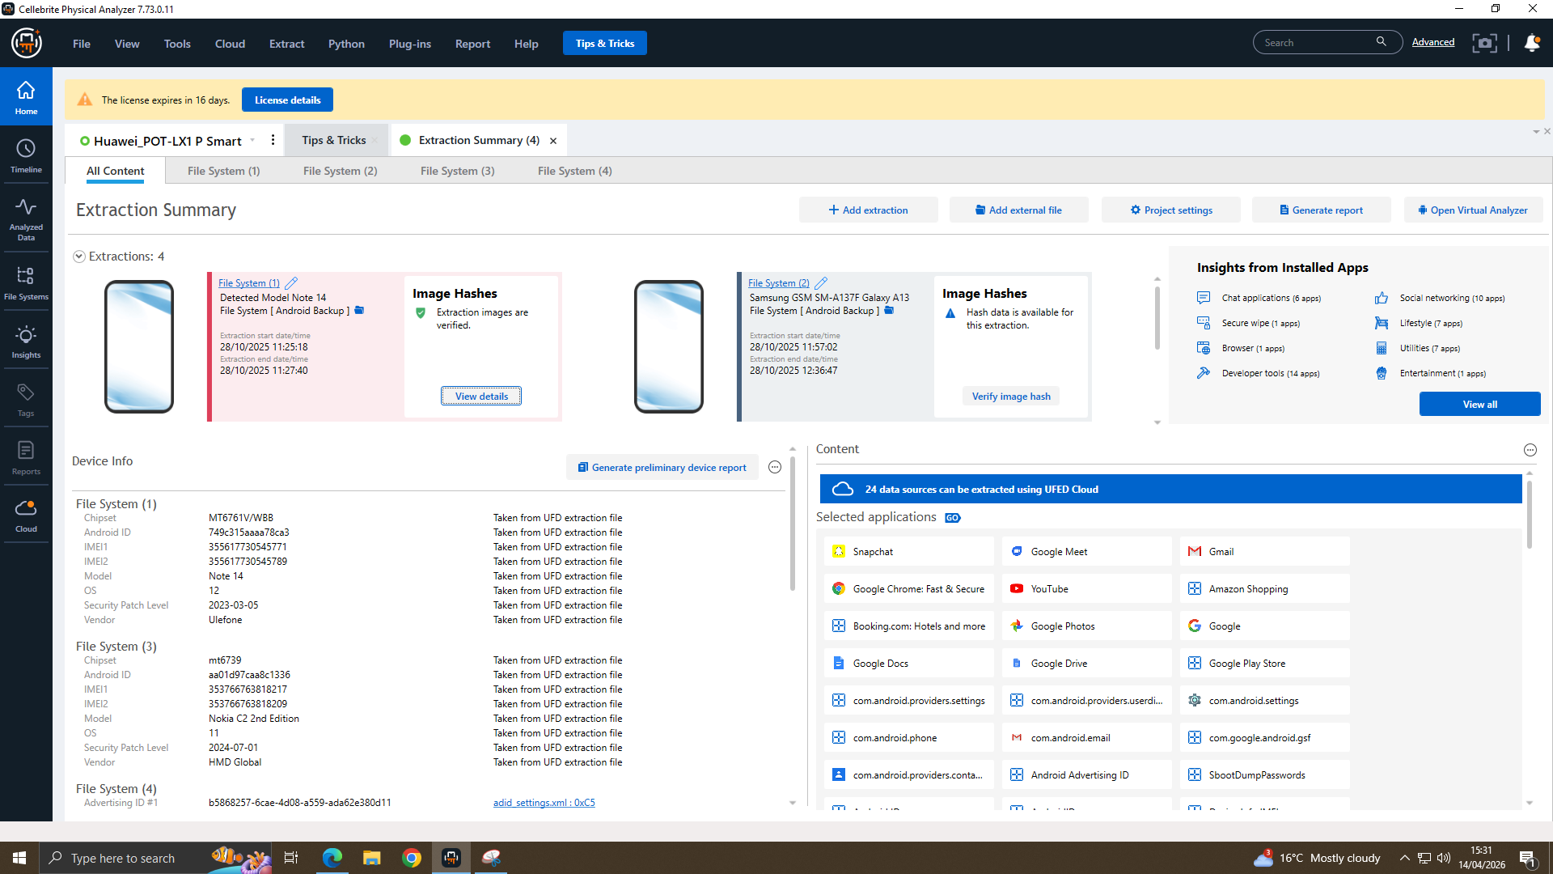
Evidence Sources Examined
Sources and Tool
Digital evidence set
Forensic tool used
Cellebrite Physical Analyzer 7.73.0.11
E1
Huawei Smart
Emma
E2
Samsung phone
Joe
E3
Nokia phone
Norman
E4
Samsung G950U
Source evidence
Quantum Tech Digital Forensic Investigation
3

Slide 4
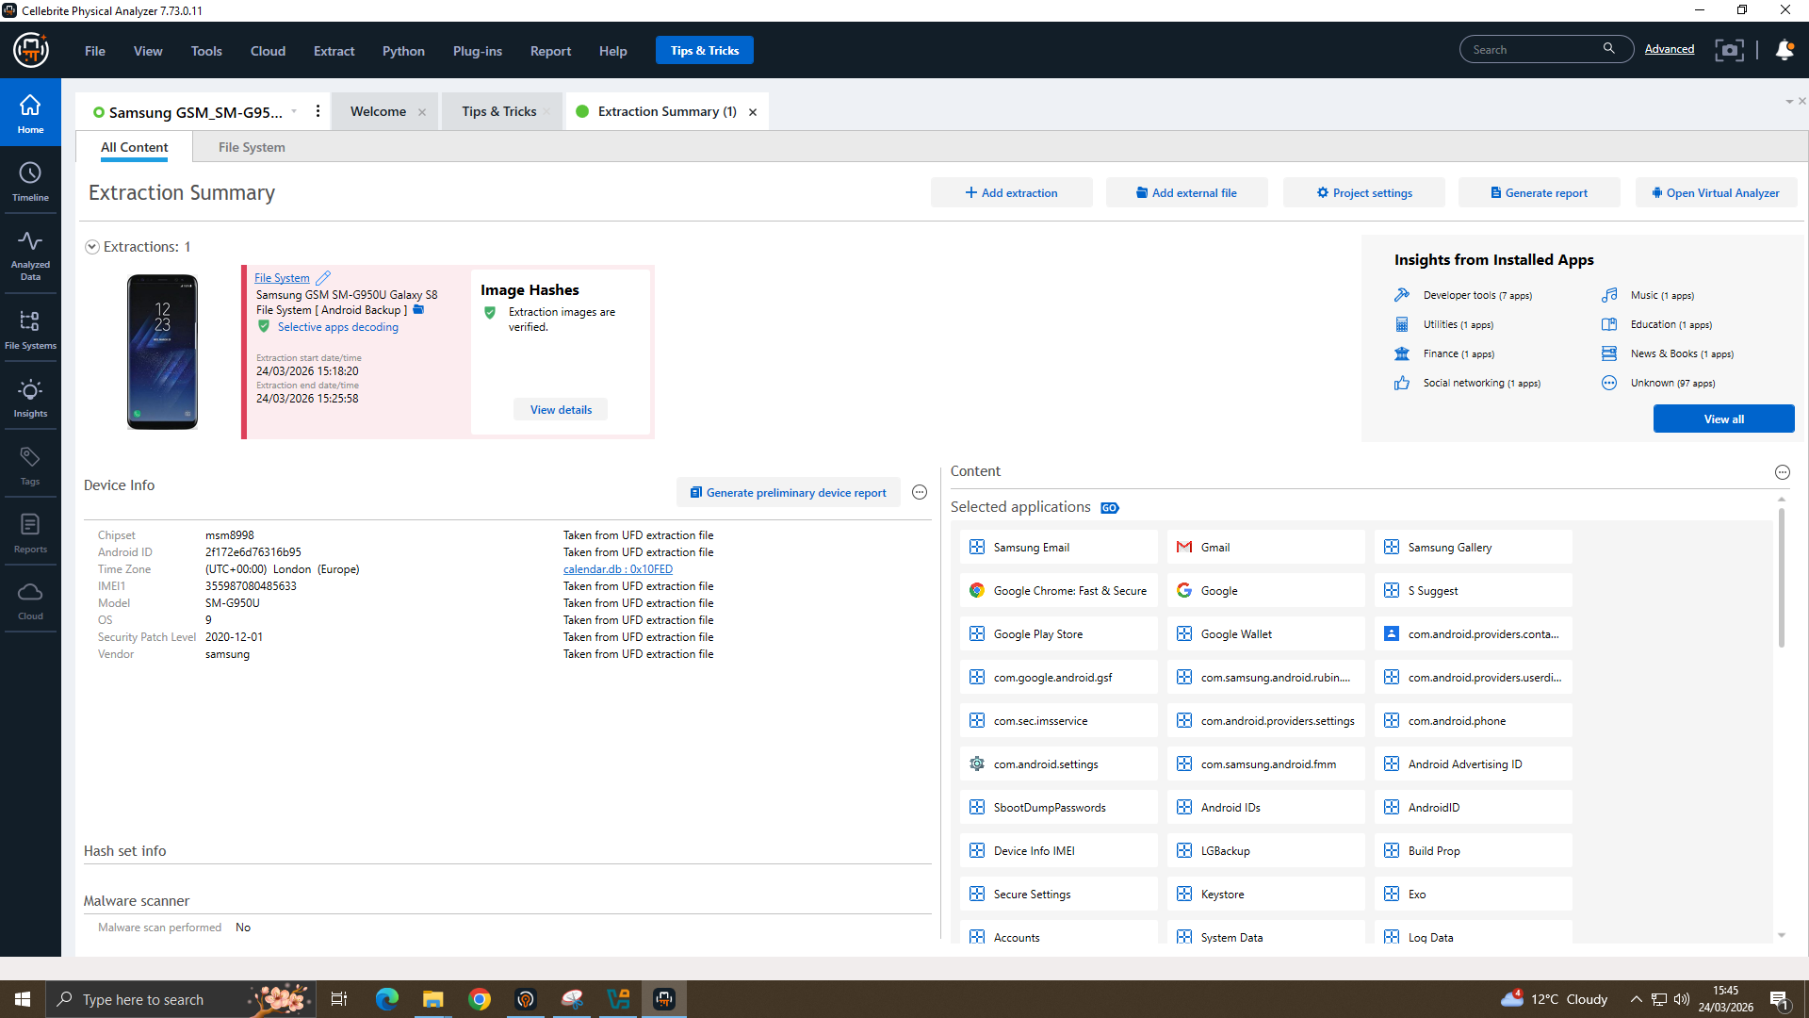
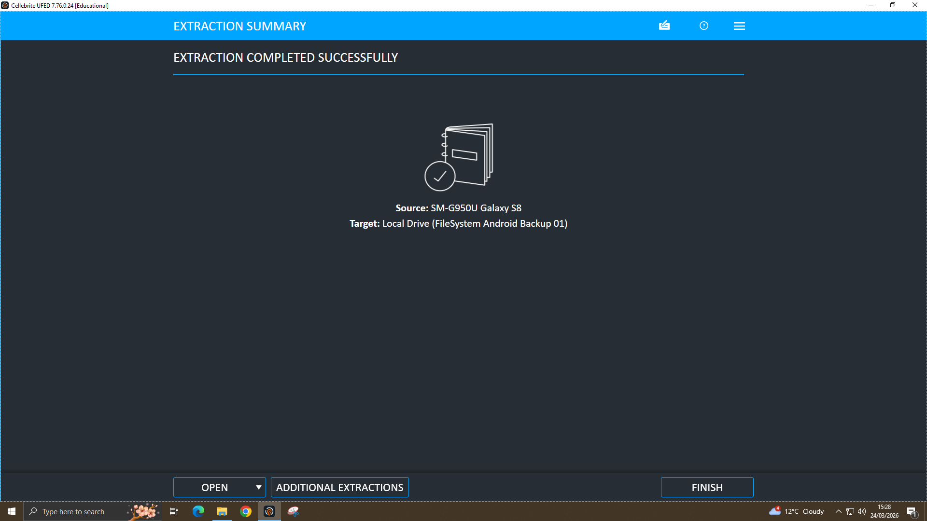
Methodology and Integrity Verification
Forensic Process
Integrity evidence
A forensic-first preservation workflow was played out.
The evidence was imported into Cellebrite for formal review, and extraction status checked along with metadata & hash values before analytical steps.
Chat, contacts calls and emails documents were crested pairs timeline and filesystem artifacts observations kept separate from impressions.
Hash verification provides repeatability and proof of integrity.
Extraction completed shows the source was processed before analysis.
The extraction is linked to a device/source by source metadata.
Quantum Tech Digital Forensic Investigation
4

Slide 5
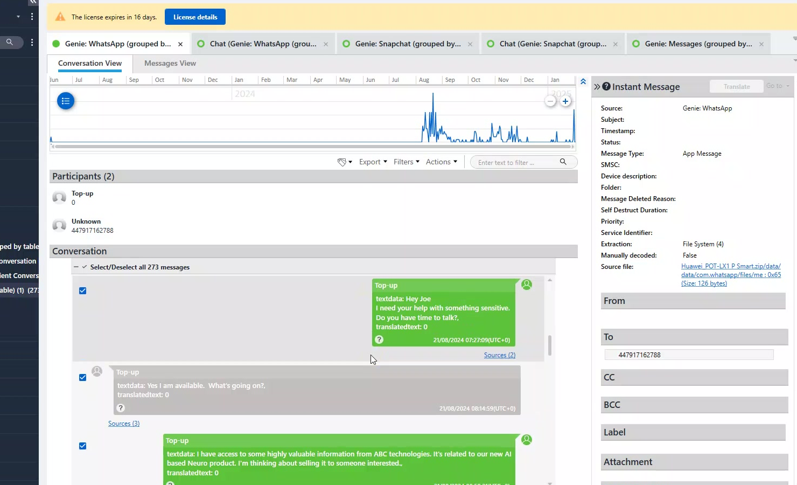
Key Evidence: Initial Sensitive Contact
Communication Evidence
Why it matters
Had direct contact with Joe in a sensitive matter.
Contains language about internal access to high level company information for a future buyer.
It offers the best justification for deeming Joe as an intermediary and Emma is a main insider suspect.
This artifact increases in potency when linked to other contemporaneous messages, document examination and timeline evidence.
Huawei WhatsApp/Genie artifact (Top-up conversation) strongest communication evidence.
Quantum Tech Digital Forensic Investigation
5

Slide 6
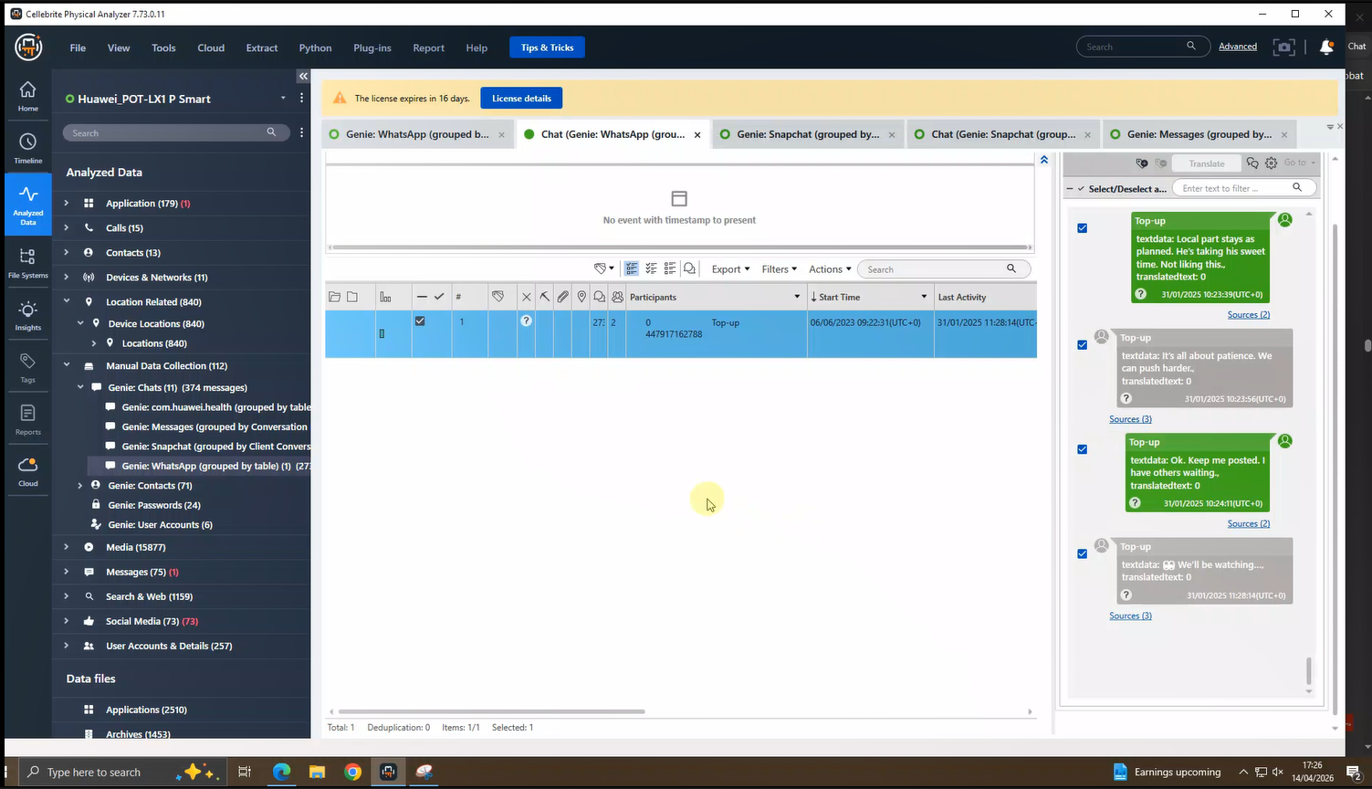
Key Evidence: Ongoing Coordination
Communication Evidence
Analytical significance
"Local part stays as planned"
"We can push harder"
"I have others waiting"
Quantum Tech Digital Forensic Investigation
6

Slide 7
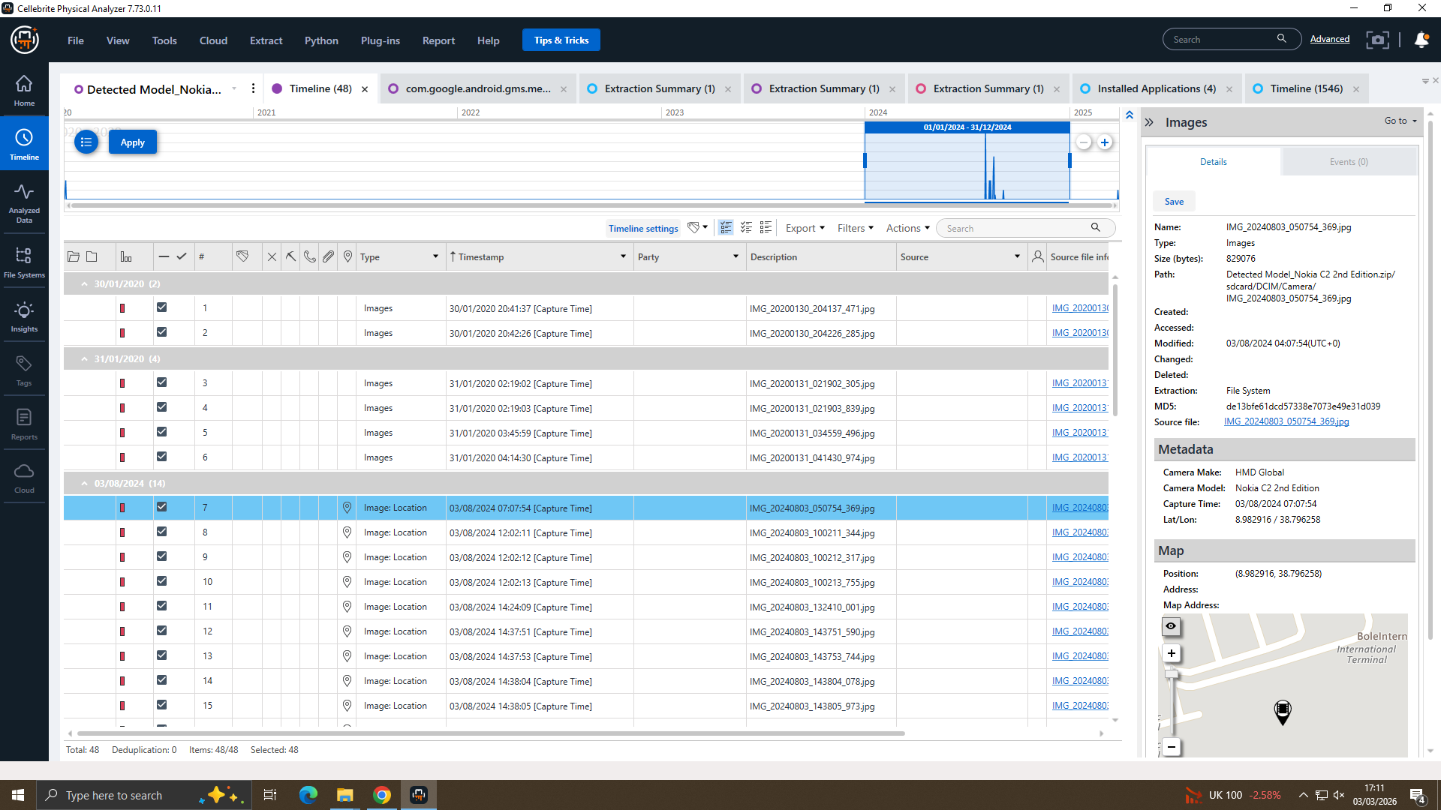
Timeline Reconstruction and Correlation
Timeline highlights
31/01/2025 10:23
Top-up messages begin
31/01/2025 10:24
Pressure / onward-party language
Case period
Document/source artefacts reviewed
24/03/2026
Extraction and hash verification documented
Quantum Tech Digital Forensic Investigation
7

Slide 8
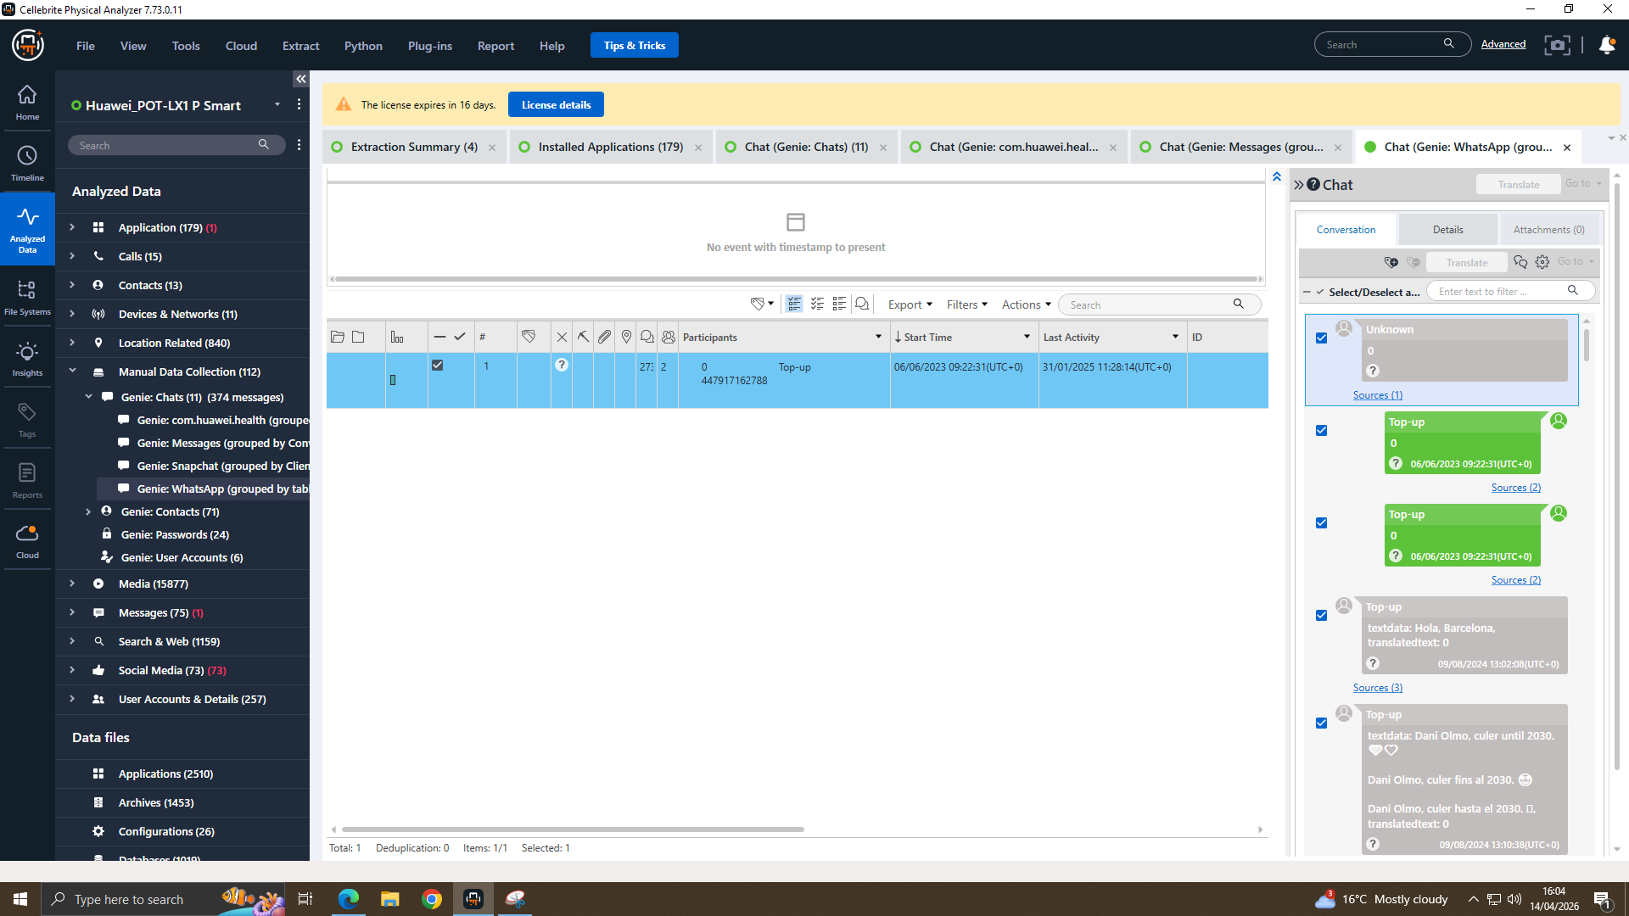
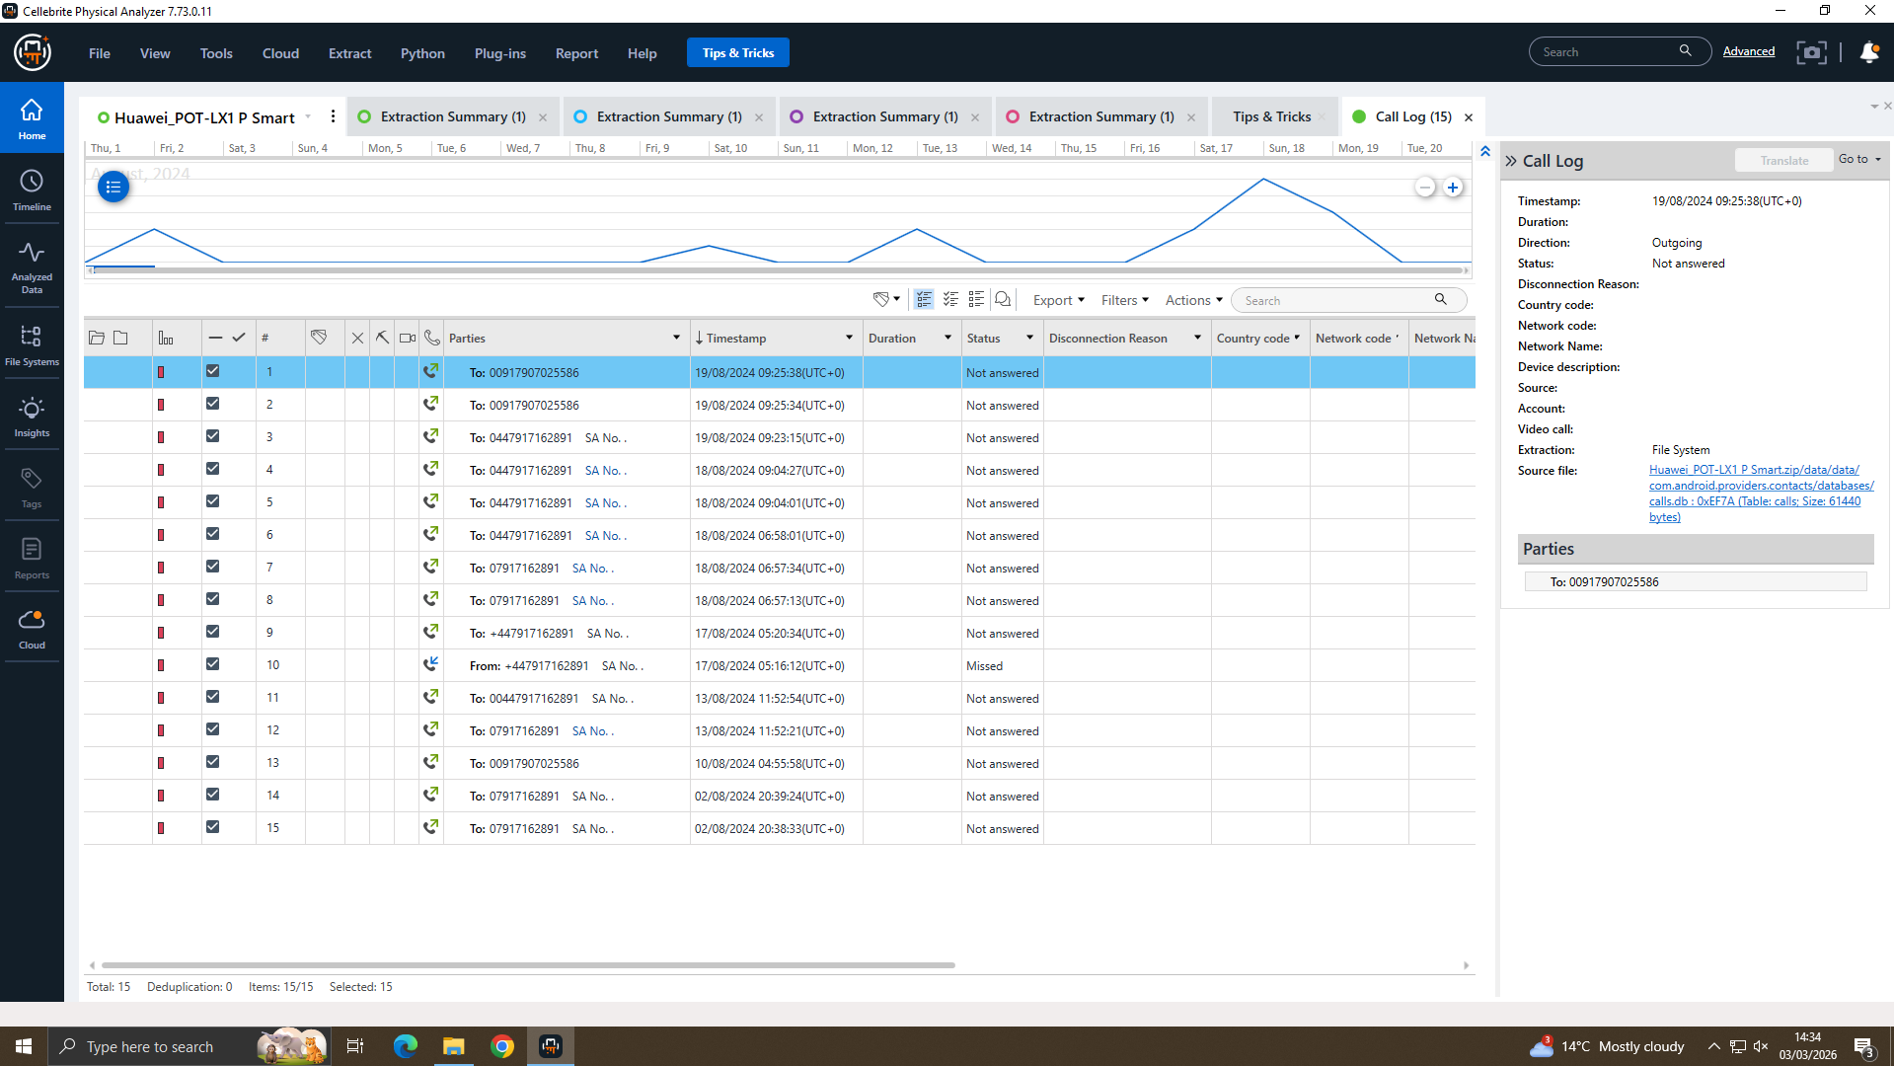
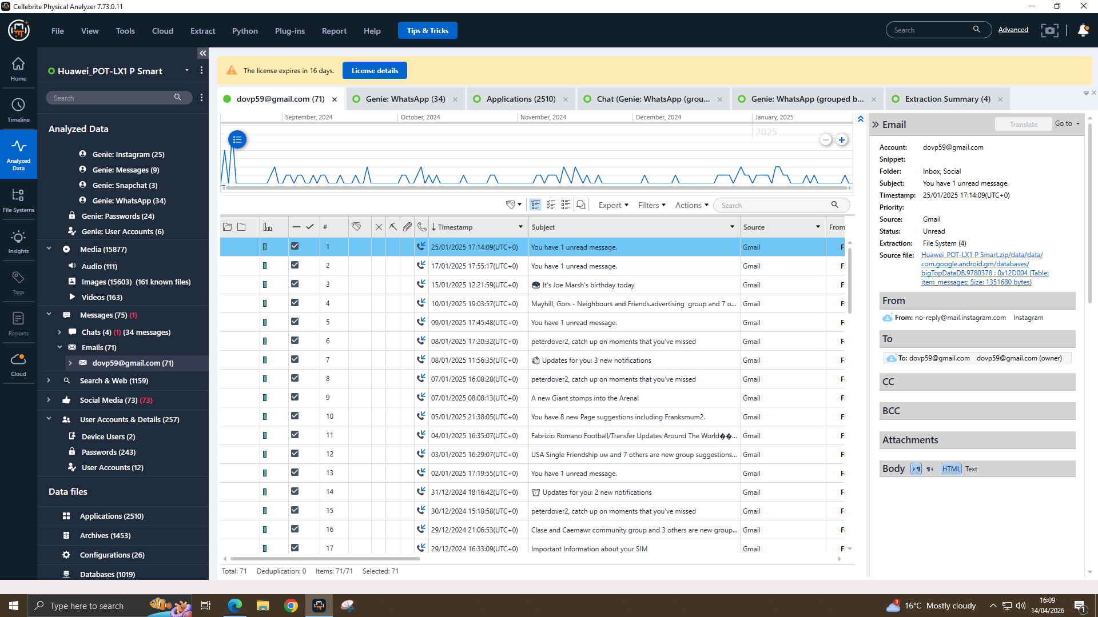
Supporting Communication Artifacts
Contacts, Calls and Email
Contact context
Call-log context
Email context
Enables attribution by connecting the thread to Joe Marsh and relevant communication context.
Good to correlate contact pattern against messaging and file activity windows that may be odd/suspicious.
If patent, payment, NexGen or transfer content is visible directly support channel only.
Quantum Tech Digital Forensic Investigation
8

Slide 9
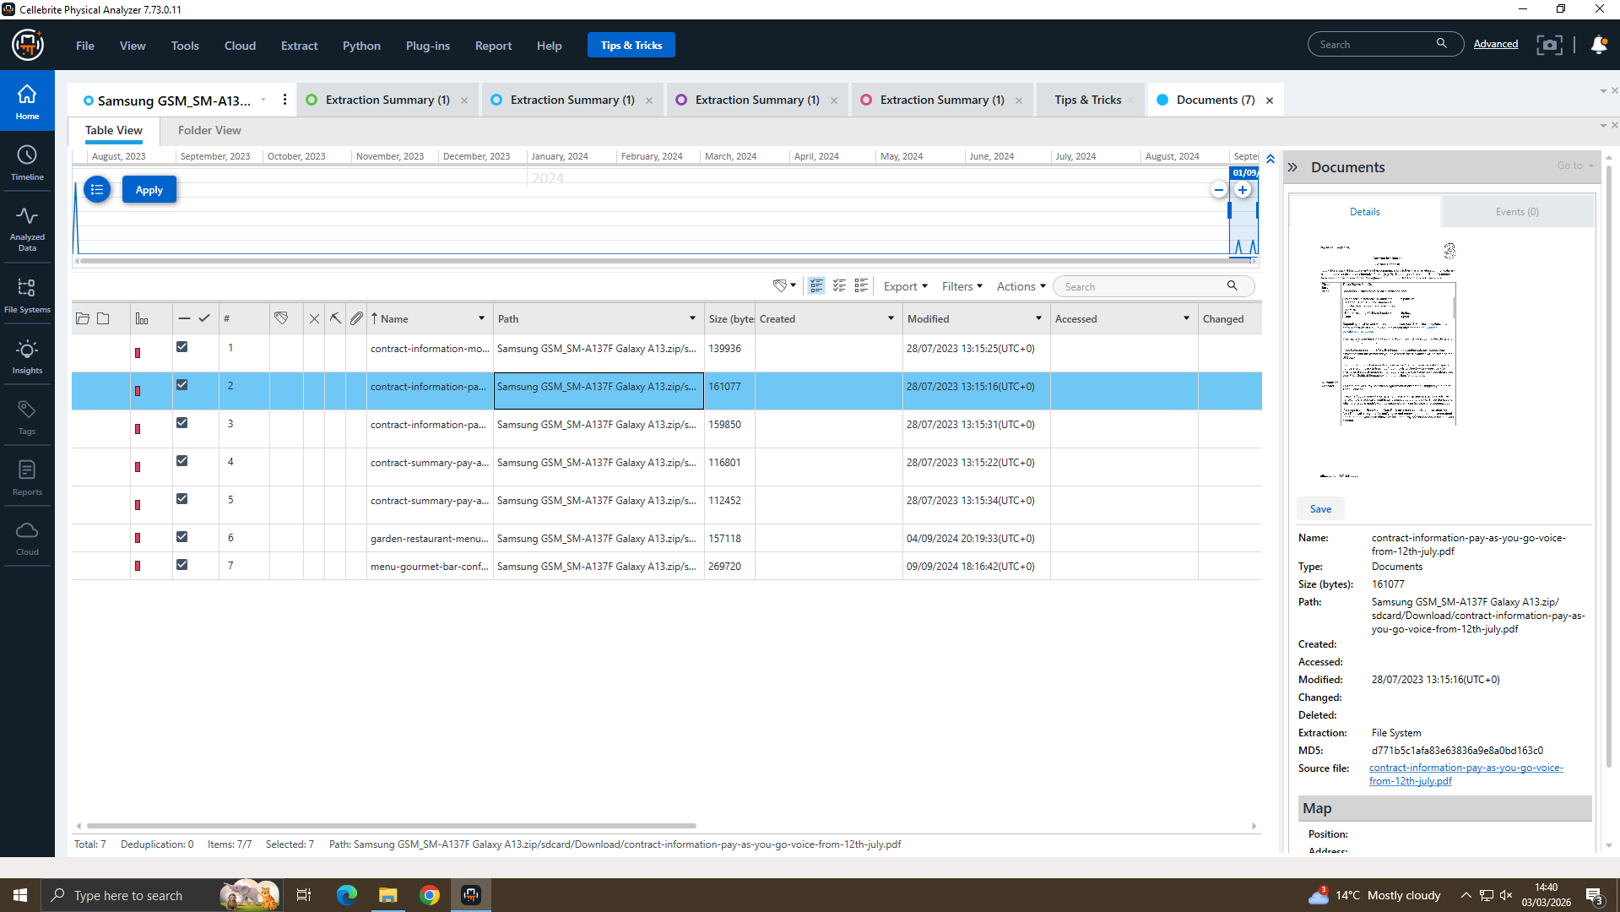
File and Source Analysis
Document Evidence
Key points
The availability of file analysis was critical to the case, given allegations involving confidential patent material.
We can see from both the document and source artifacts that evidence concerning files was reviewed in Cellebrite.
Still, the sources are not a definitive indication that such an entire file transfer or sale took place.
So, the conclusion must remain balanced.
Quantum Tech Digital Forensic Investigation
9

Slide 10
Suspect Role Assessment
Evaluation
Role assessment matrix
Most probative artifacts
Person | Likely Role | Support Level
Emma | Primary insider suspect | Supported
Joe | Intermediary / bridge | Partially supported
Norman | Suspected buyer | Requires corroboration
Vanessa | Relevant external contact | Requires corroboration
Direct Joe in the spectroscopy of a top-up conversation
Subsequent messages regarding Top-ups showing both planning and pressure
Contact context linking Joe Marsh
An integrity artifacts for a defensible workflow
Check Document/source views that displays file artifacts
Interpretation: The reviewed communication artifacts to which Emma and Joe are most strongly associated. Norman and Vanessa are still considered people of interest, but there remains a gap in evidence directly linking them to the transfer or negotiation.
Quantum Tech Digital Forensic Investigation
10

Slide 11
Key Findings and Limitations
Balanced Evaluation
Key findings
Key limitations
Cellebrite examination and discussion integrity artifacts provide a defaceable forensic workflow.
The Huawei Top-up conversation is the most incriminating evidence for unusual communication.
The artifacts support attempts at coordinating with Emma and Joe.
Supporting contacts, calls and email also help to provide context for the communication pattern.
Document/source views evidenced review of relevant file artifacts.
QT-AI-2025 transfer event is not complete evident such that definitive file name/path.
The work of communication artifacts found in the selected material have no direct link between Norman and Vanessa.
Exaggerated interpretation of contextual artifacts as evidence of sale or receipt
Conclusion, and the right to delay but if you can verify through direct file-transfer or receipt evidence of a real-time connection then that is within proportional.
Quantum Tech Digital Forensic Investigation
11

Slide 12
Recommendations
Recommendations
Prevent removable media with enforced DLP on patent/design repositories.
Keep an eye on downloads, exports, online sharing and screenshots of sensitive IP.
Tighten insider-threat screenings for new employees and high-risk users.
Alert triggers when critical IP is accessed unusually or during non-business hours.
Conduct training for staff regarding confidentiality, IP handling and reporting of suspicious-contact-related concerns.
Retention of key logs: Quickly relies on VPN, endpoint, cloud and repositories · Email
Quantum Tech Digital Forensic Investigation
12

Slide 13
Conclusion
Conclusion
The strongest artifacts lend credence to an insider seen engaging in some proprietary Quantum Tech information having been engaged for externalization. Emma is the most supported suspect, while Joe has partial support as intermediary. Nevertheless, the additionally selected artifacts fail to substantiate an actual transfer of QT-AI-2025 materials having been completed or received and sold.
Thank you
Thank you for your time and attention.
I would be happy to answer any questions.
Quantum Tech Digital Forensic Investigation
13

