Slide 1

BMBM6016
Strategic Marketing
The final stage of the Audit (SWOT)

Slide 2

Review
The SOSTAC marketing planning model
Situation Analysis – Marketing Audit
External Audit
  MACRO ENVIRONMENT AUDIT
    PESTEL Analysis
  MICRO ENVIRONMENT AUDIT
    Porter’s Five Forces
    Competitor Analysis
    Customer Analysis
  INTERNAL AUDIT
    VRIO
    Porter’s Value Chain
    McKinsey’s 7 S’s
    Financial performance

Slide 3
Today’s Lecture
Continuing with the Situation Analysis / Audit
FINAL STAGE OF THE AUDIT:
  SWOT / TOWS

Slide 4


Slide 5

The Final Stage of the Marketing Audit
A SWOT analysis is the final stage of the marketing audit.
A summary of all the key findings of your audit used to highlight both internal and external (macro and micro) factors affecting the business.
No new factors should be introduced in the SWOT

Slide 6
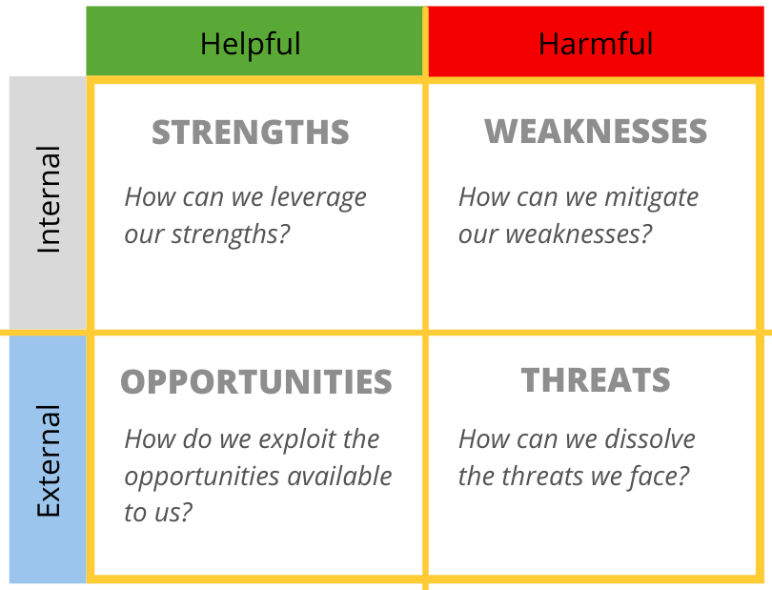
SWOT Analysis
Strengths and Weaknesses are drawn from your Internal Audit analysis
Opportunities and Threats are drawn from your External Audit analysis (MACRO, MICRO).

Slide 7
Conducting Your SWOT Analysis
Start by looking at the internal factors first.
Strengths can be identified by asking what advantages the organisation has. i.e. a brand name, patent or a workforce with a particular skillset.
Weaknesses identify areas your organisation needs to improve.
When identifying strengths and weaknesses, it’s important to compare your organisation to its competitors. Some of your proposed strengths could be a necessity in your organisation’s market and therefore not actually a strength.

Slide 8
Conducting Your SWOT Analysis
Once you’ve identified the internal factors, you need to move onto the external opportunities and threats.
These are the factors you analysed in your external audit.
You must identify the opportunities and threats to your company that result from your macro and micro environmental analysis.

Slide 9
SWOT Analysis
The SWOT provides focus on which to develop your marketing objectives and strategy
SWOT is really useful but on its own doesn’t generate actionable ideas for improvements.
That’s where a TOWS comes in.

Slide 10

SWOT Analysis of Tesla!

Slide 11
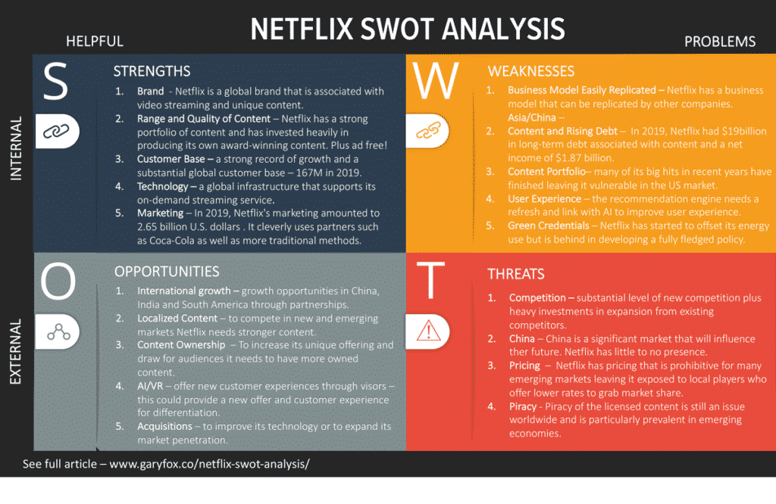
Example SWOT Analysis - Netflix
Netflix SWOT Analysis: Will The Tech Giant Survive Or Thrive? (garyfox.co)

Slide 12
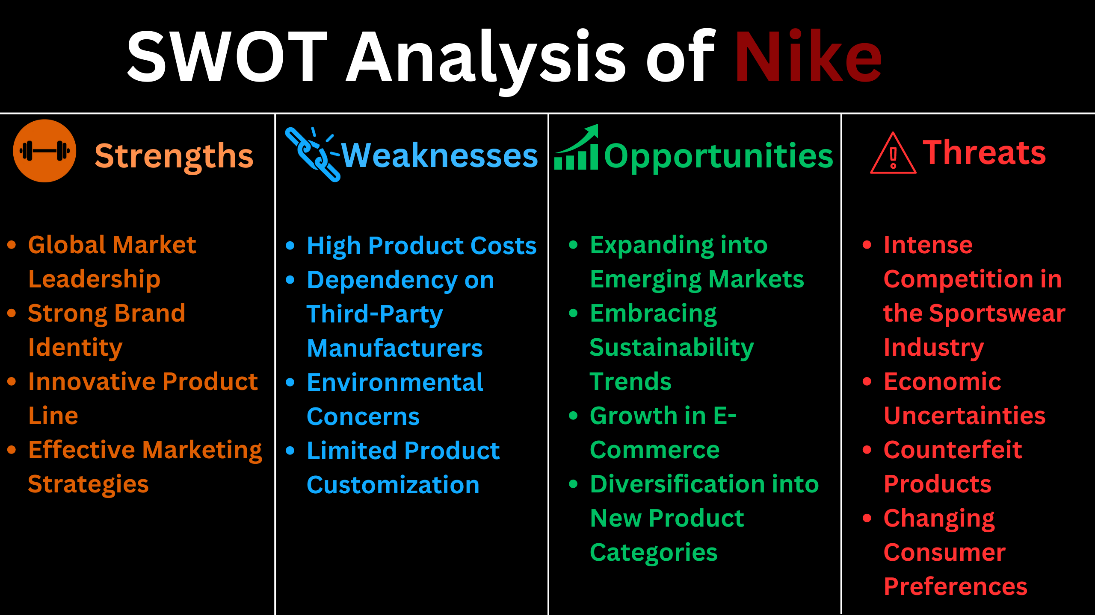

Slide 13

Going Beyond a SWOT Analysis

Slide 14
TOWS Analysis
A TOWS analysis takes a SWOT analysis one step further to help you identify strategic actions you can take from your findings.
The TOWS acronym uses the same elements as SWOT, but in reverse order. It combines internal and external forces to come up with productive ideas of how to best use the information.
The main purpose of a TOWS is to reduce threats, take advantage of opportunities, exploit strengths, and remove weaknesses.

Slide 15
What is the difference between TOWS and SWOT?
Although TOWS uses the same elements as a SWOT analysis, it is more of an action tool rather than an analysis one. TOWS is best used as an addition to the analytical SWOT tool to help you decide what to do with your findings.
Why is it important?
TOWS helps bridge the gap between research and forward thinking strategic directions.
It can very quickly define key focal points for actions.
It covers all bases by taking into account positive and negative influences.

Slide 16
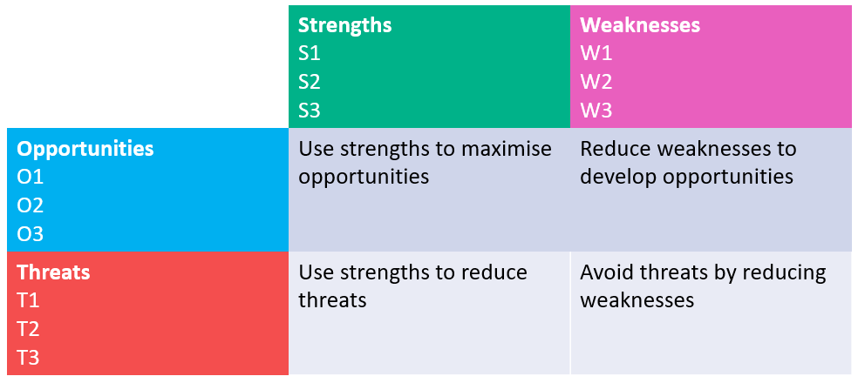
How does TOWS Analysis Work?
Your SWOT analysis will give you a list of Strengths, Weaknesses, Opportunities, and Threats. Number these as S1, S2, W1, W2, and so on. This will make it easier to identify them later.

Slide 17
Measure the elements against each other to consider potential strategies
Strengths & Opportunities: Use strengths to maximise opportunities
Strengths & Threats: Use strengths to reduce threats
Weaknesses & Opportunities: Reduce weaknesses to develop opportunities
Weaknesses & Threats: Avoid threats by reducing weaknesses

Slide 18
How to Use TOWS
TOWS can expand your SWOT analysis to discover some really useful potential strategies for the future.
See examples on the next slides

Slide 19
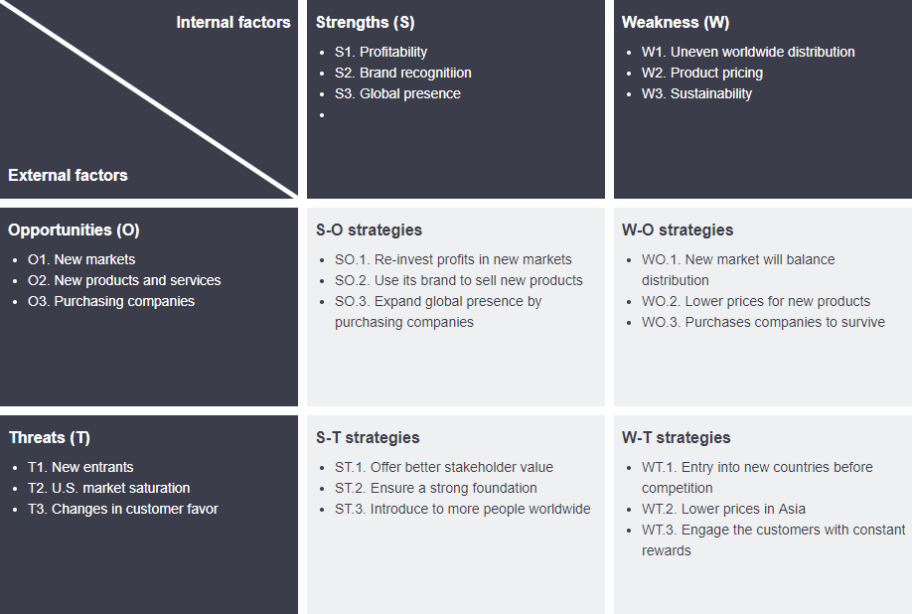

Slide 20
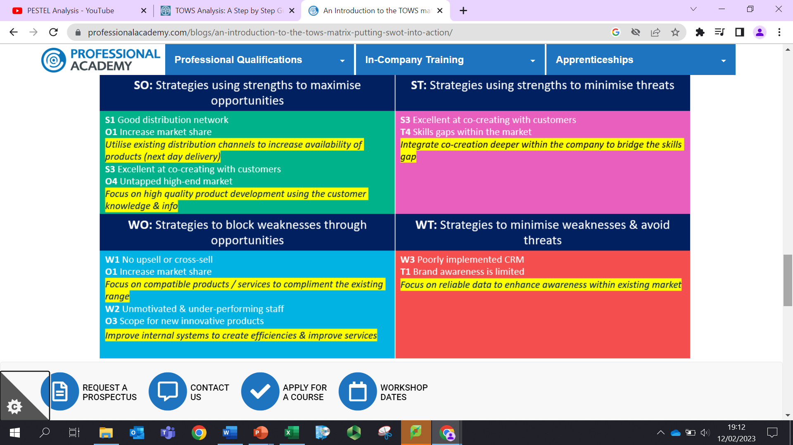

Slide 21
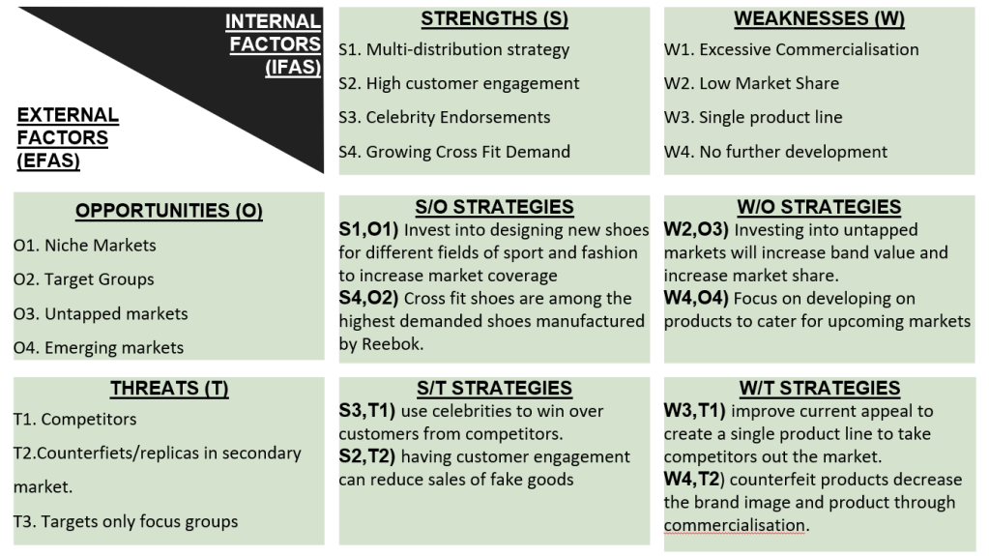
Example TOWS - Reebok

Slide 22
Assignment Recap
How many words?
What format should be used?
Hand in date?
How many References?
What 2 Frameworks must be included?
How many Frameworks/Models should be included in total?
What is the purpose of the Audit?

