Slide 1
LCMB7024
Marketing Management
Week 1: Session 1: Customer Buying Behaviour
Notes:
Note should be added to aid better use,

Slide 2
Content of the Sessions
Customer Buying Behaviour
Customer Buyer Behaviour Model
Factors Influencing Customer Buying Behaviour
  Culture Factors
  Social Factors
  Personal Factors
  Psychological Factors
Types of buying behaviour
Decision-Making Process of Buying Behaviour

Slide 3
Customer Buying Behaviour
Consumer behaviour is about how individuals, groups, and organisations select, buy, use, and dispose of goods, services, ideas, or experiences to satisfy their needs and wants.
It is influenced by cultural, social, personal, and psychological factors such as motivation, perception, emotions, and memory, shaping the consumer decision-making process (Kotler et al., 2025).

Slide 4
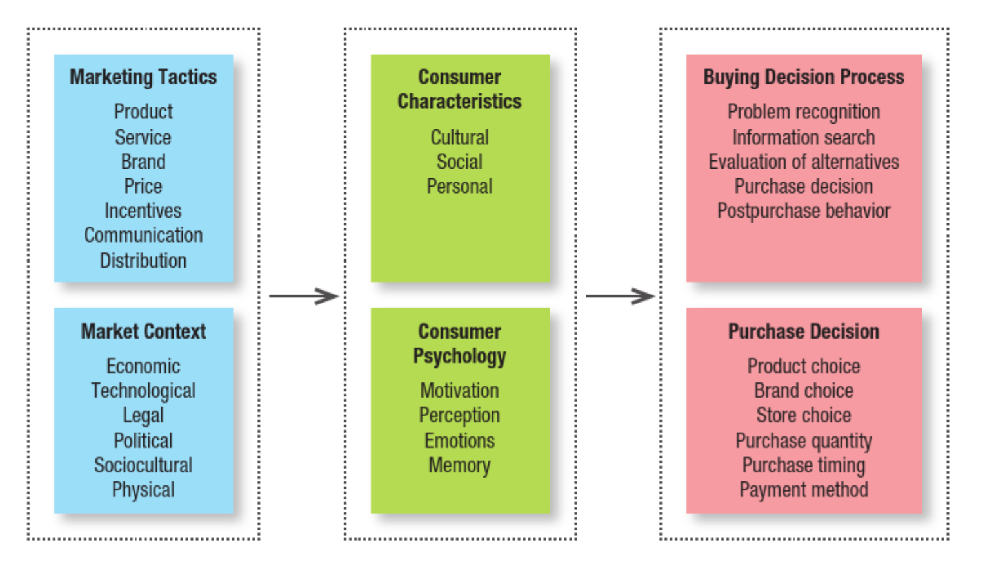
Customer Buying Behaviour Model
(Kotler et al., 2025, p. 80)

Slide 5
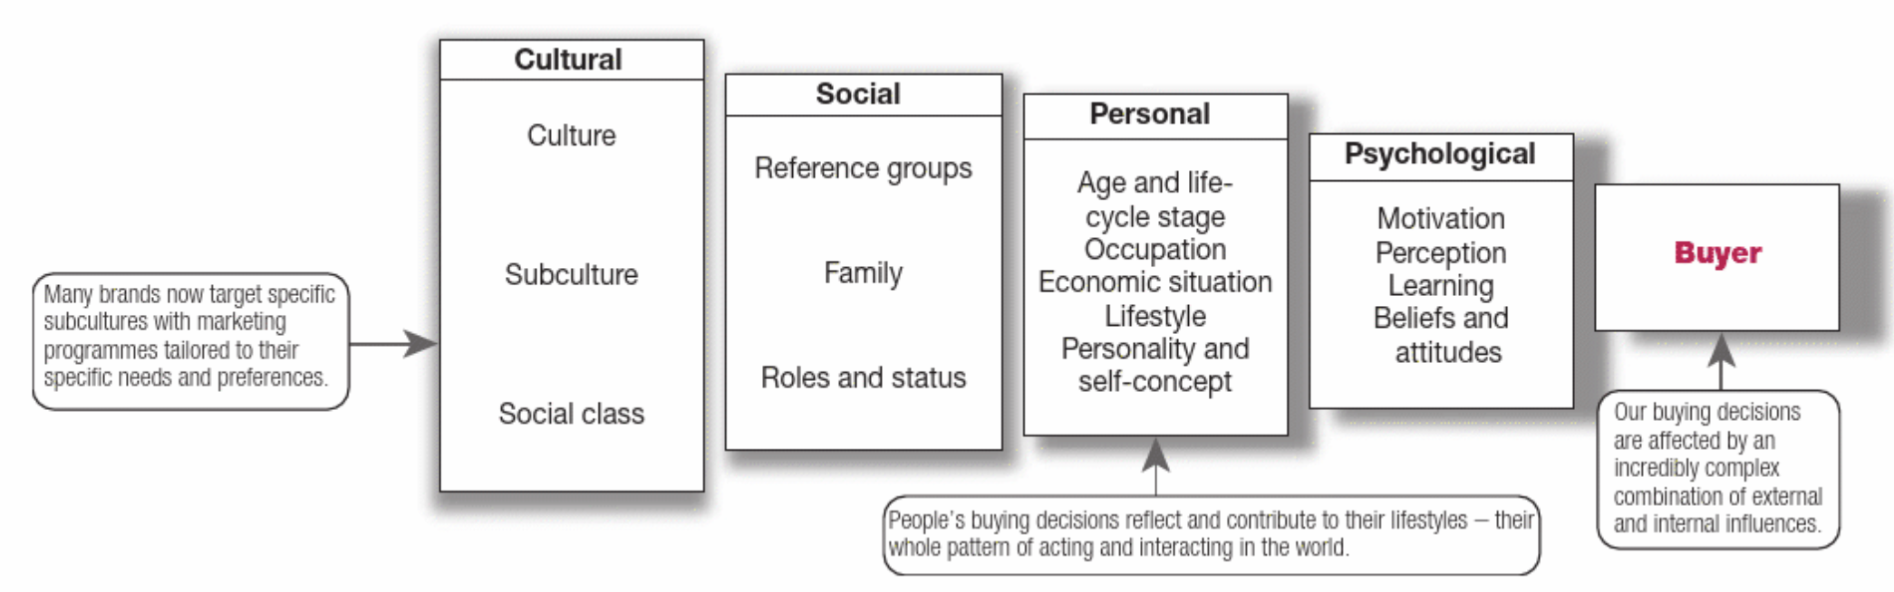
Factors Influencing
Customer Buying Behaviour
(Kotler et al., 2025, p. 163)

Slide 6
Culture Factors
Culture consists of fundamental values, beliefs, desires, and behaviours that individuals acquire from family and key societal institutions.
Subcultures are groups within a society that share distinct value systems shaped by common experiences and circumstances.
Social class refers to stable and structured societal divisions where people share similar values, interests, and behaviours.

Slide 7
Social Factors
Groups and social groups exert a substantial influence on consumer behaviour by shaping attitudes, preferences, and purchasing decisions. Key forms of social influence include:
  Membership and Aspirational groups
  Reference Group
  Word-of-mouth influence
  Opinion leaders
  Buzz marketing such as brand ambassadors.
Notes:
Groups influence consumer behaviour:
Membership groups: Directly influence individuals as they belong to them.
Reference groups: Act as comparison points, influencing attitudes and behavior even if the person is not a member.
Aspirational groups: Groups individuals aspire to join (e.g., a young footballer wanting to be like Lionel Messi).
Marketers target reference groups to influence consumer choices by exposing them to new lifestyles, attitudes, and social pressures.
Word-of-mouth influence plays a crucial role in purchasing decisions:
Recommendations from family, friends, and other consumers are more trusted than advertisements.
A study found only 49% trust advertising, while 72% trust family/friends and online reviews.
Marketers aim to create positive brand conversations instead of leaving word-of-mouth influence to chance.
Opinion leaders within reference groups exert strong social influence:
They are knowledgeable and respected, influencing others’ choices.
Known as "influentials" or "leading adopters".
Marketers identify and engage them to promote products.
Buzz marketing involves creating or enlisting opinion leaders as brand ambassadors to spread product awareness (e.g., Mercedes-Benz’s ‘Take the Wheel’ influencer campaign).
Groups influence consumer behaviour:
Studies show that children significantly affect family choices on holidays, cars, and mobile phones - In the UK, children under 16 are expected to exceed 13 million by 2026. Children aged 7 to 15 spend around €8,885 in pocket money per year, contributing €6.5 billion to the UK economy. Parents spend approximately €255,000 to raise a child to the age of 21 (including clothing, food, and education). In the US, 50 million children influence an estimated €1 trillion in annual spending. Studies show that children significantly affect family choices on holidays, cars, and mobile phones. Businesses, such as Pizza Hut in the UK, offer free meals for children to attract families, and holiday resorts provide child-focused amenities like kids' clubs and sports activities.

Slide 8
Social Factors
Individuals are part of multiple groups, such as family, clubs, organisations, and online communities. Within each group, their position is determined by both their role and status.
People often select products that align with these roles and their social status.

Slide 9
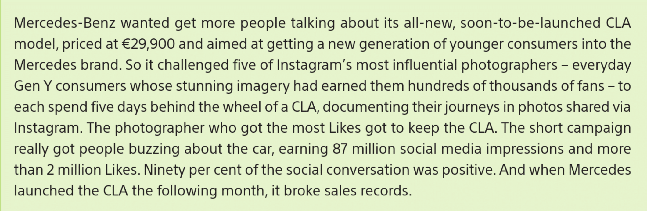
Read and Discuss
(Kotler et al., 2021)
Notes:
How might social proof and reference groups have influenced consumers’ attitudes toward the Mercedes-Benz CLA?
In what ways did the campaign appeal to Gen Y consumers’ self-concept or lifestyle aspirations?

Slide 10


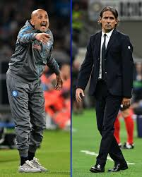
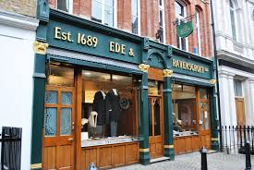

Personal Factors
Notes:
Age and life-cycle stage
Occupation
Economic situation
Personality and self-concept

Slide 11

Psychological Factors
A person’s buying choices are further influenced by four major psychological factors: Motivation, Perception, Learning and Beliefs, and Attitudes.

Slide 12
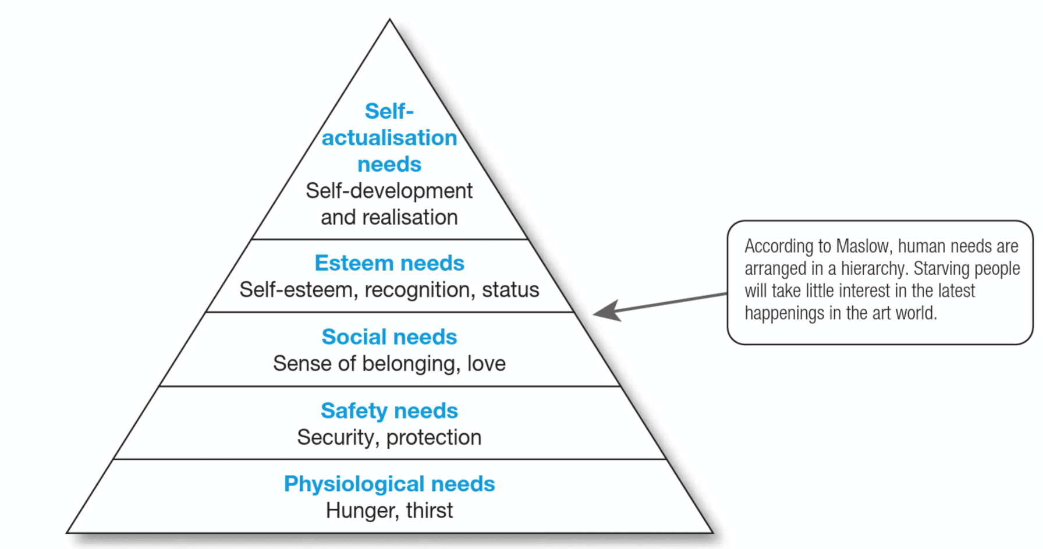
Motivation
Maslow’s Hierarchy of Needs
(Kotler et al., 2025, p 174)

Slide 13
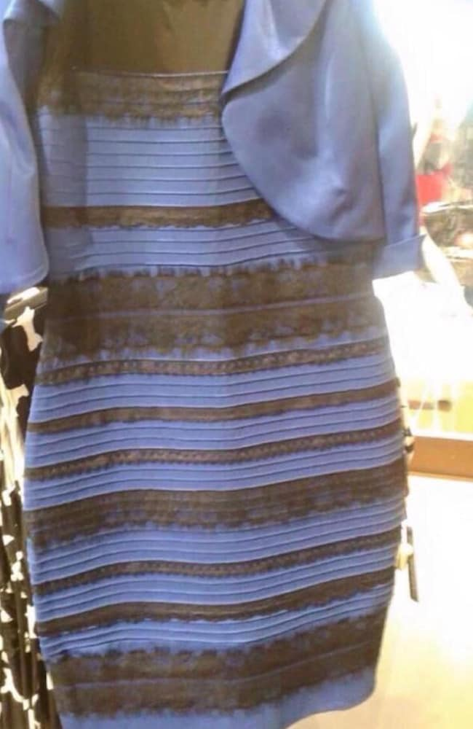
Perception: What Colour is this Dress?
To learn more about why the dress is perceived differently by different people, please read the following article: Why did we see the dress differently?
Notes:
Who sees the dress as gold and white?
Who sees the dress as blue and black?

Slide 14
Perception
The way individuals choose, organise, and interpret information shapes their understanding of the world.
Different people may perceive the same stimulus in unique ways due to three key perceptual processes: selective attention, selective distortion, and selective retention.
Notes:
1. Selective Attention
Definition:
People are exposed to a huge amount of information every day, but they only pay attention to a small portion of it. Selective attention is the process by which individuals focus on certain stimuli that are most relevant or interesting to them and ignore others.
Example:
You're scrolling through Instagram, and you skip past most ads—but suddenly, you stop at one for a sustainable fashion brand you love. Even though there were multiple ads, your brain chose to notice the one that aligned with your interests.
2. Selective Distortion
Definition:
People tend to interpret information in a way that fits their existing beliefs, values, or emotions. This is called selective distortion. It can lead to misinterpretation of messages or resistance to information that contradicts what they believe.
Example:
Two people watch the same advertisement for a fast-food chain. One thinks, “That’s convenient and delicious,” while another who strongly values healthy eating might say, “That’s unhealthy and misleading.” The same message, but perceived differently.
3. Selective Retention
Definition:
People tend to remember information that supports their beliefs or interests and forget what doesn’t. This is selective retention—it helps people make sense of the world, but it also means they may not remember everything accurately.
Example:
After attending a sustainability seminar, someone who already supports eco-friendly practices might remember all the stats about pollution reduction, but forget or ignore the parts that mentioned the challenges of implementing green policies.

Slide 15
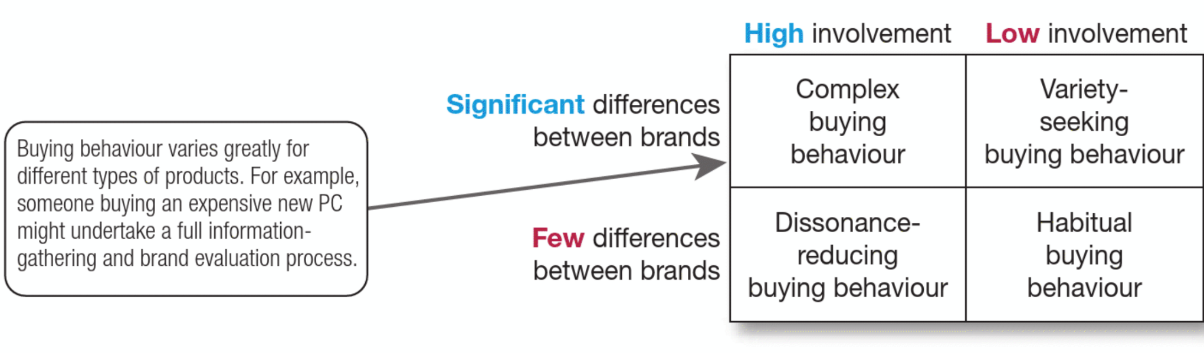
Types of Buying Behaviour
(Kotler et al., 2025, p 181)
Notes:
High-involvement purchase occurs when a consumer buys a product or service that is expensive or carries the risk of significant emotional consequences if the wrong choice is made.
Low-involvement products are consumable items that require minimal effort and consideration before purchase, as they have little impact on the buyer's lifestyle and represent a minor investment. These products are often bought out of habit, requiring little decision-making.

Slide 16
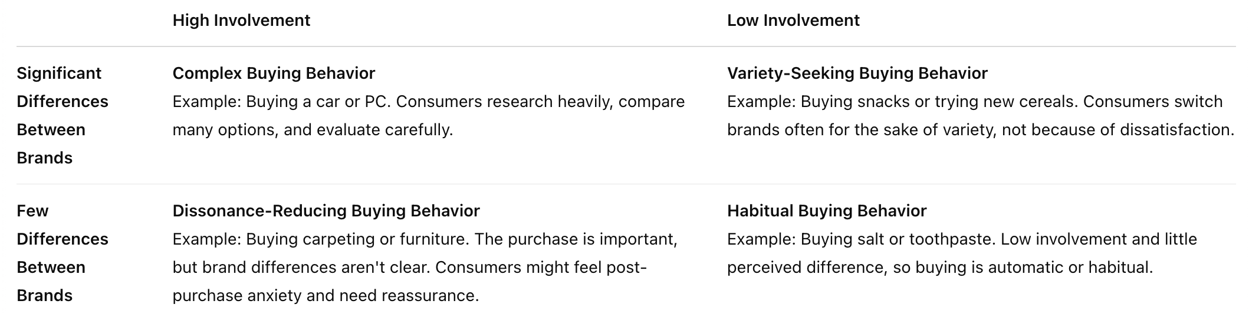
Buying Behaviour - Example

Slide 17

Decision-Making Process
The figure shows that the buying process starts long before the actual purchase and continues long after. In fact, it might result in a decision not to buy. Therefore, marketers must focus on the entire buying process, not just the purchase decision.
(Kotler et al., 2025, p 178)

Slide 18
Summary
Customer Buying Behaviour: The process of how individuals and groups select, buy, use, and dispose of products/services, influenced by cultural, social, personal, and psychological factors.
Key Influences: Culture (values, beliefs, subcultures), social factors (family, groups, networks), personal factors (age, lifestyle, personality), and psychological factors (motivation, perception, learning, beliefs, attitudes).
Types of Buying Behaviour: High-involvement (expensive, significant impact) vs. low-involvement (routine, low-cost, minimal effort).
Decision-Making Process: Involves need recognition, information search, evaluation of alternatives, purchase decision, and post-purchase behaviour.

Slide 19
Group Activity
(1 of 3)
One way consumers can evaluate alternatives is to identify important attributes and assess how purchase alternatives perform on those attributes.
Consider the purchase of a tablet. Each attribute, such as screen size, is given a weight to reflect its level of importance to that consumer. Then the consumer evaluates each alternative on each attribute.
For example, in the following table, price (weighted at 0.5) is the most important attribute for this consumer. The consumer believes that Brand C performs best on price, rating it 7 (higher ratings indicate higher performance). Brand B is perceived as performing the worst on this attribute (rating of 3). Screen size and available apps are the consumer’s next most important attributes. Operating system is least important.
Notes:
This activity is to practice the decision-making process.

Slide 20
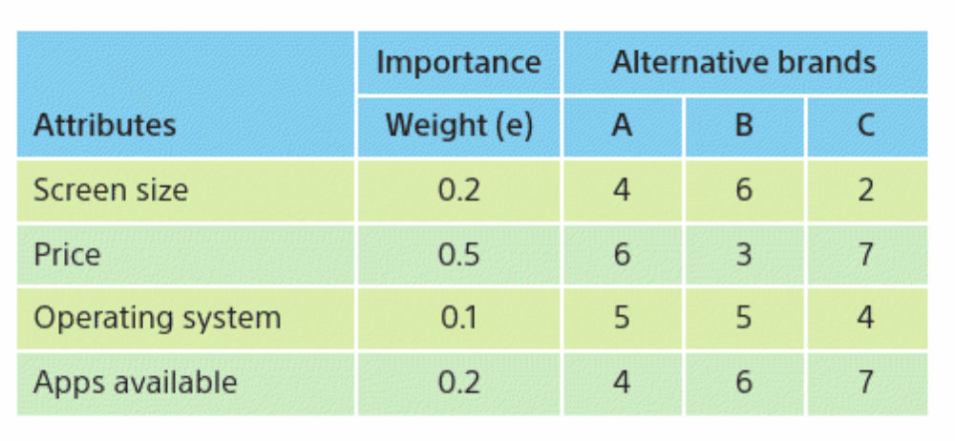
Group Activity
(2 of 3)

Slide 21
Group Activity
(3 of 3)
A score can be calculated for each brand by multiplying the importance weight for each attribute by the brand’s score on that attribute. These weighted scores are then summed to determine the score for that brand.
For example, Score for brand A = (0.2 × 4) + (0.5 × 6) + (0.1 × 5) + (0.2 × 4) = 0.8 + 3.0 + 0.5 + 0.8 = 5.1. This consumer will select the brand with the highest score.
Calculate the scores for brands B and C. Which brand would this consumer likely choose?
Which brand is this consumer least likely to purchase?
Discuss two ways the marketer of this brand can enhance consumer attitudes toward purchasing its brand.
Notes:
This activity requires between 45 minutes to 1 hour.

Slide 22
References
Hague, P. (2019) The Business Models Handbook: Templates, Theory and Case Studies. London, United Kingdom; New York, Ny, Kogan Page Limited.
Kotler, P., Armstrong, G., Harris, L. and Piercy, N. (2025) Principles of marketing. Nineteenth edition. Harlow, England: Pearson.
Kotler, P., Keller, K. and Chernev, A. (2021) Marketing management. 16th ed.

